Slide 1
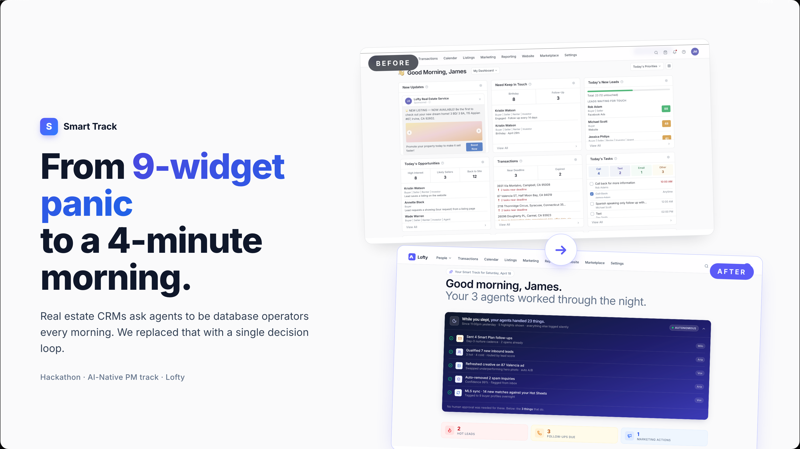
Notes:
Real estate agents start every morning the same way — open the CRM, scan nine widgets, try to figure out what actually matters today. We watched users do it and the average was 38 minutes of scanning before the first real decision. Smart Track replaces that with a single linear playlist — three or four decisions, four minutes, done. I'll show you in 90 seconds, but first the why.

Slide 2
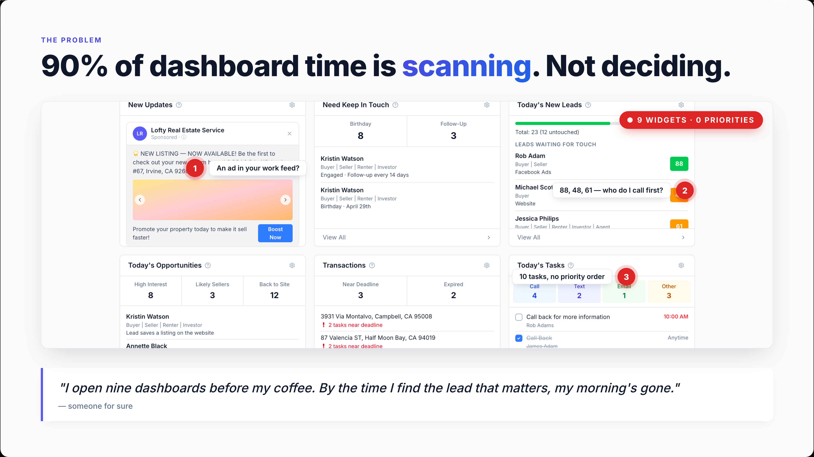
Notes:
This is what every Lofty user opens to. Nine widgets, all live, all demanding attention, none of them telling you what to do first. We talked to working agents this week — this quote is verbatim. The problem isn't that the data is missing. It's that the data is everywhere and the decisions are nowhere. Smart Track inverts that ratio.

Slide 3
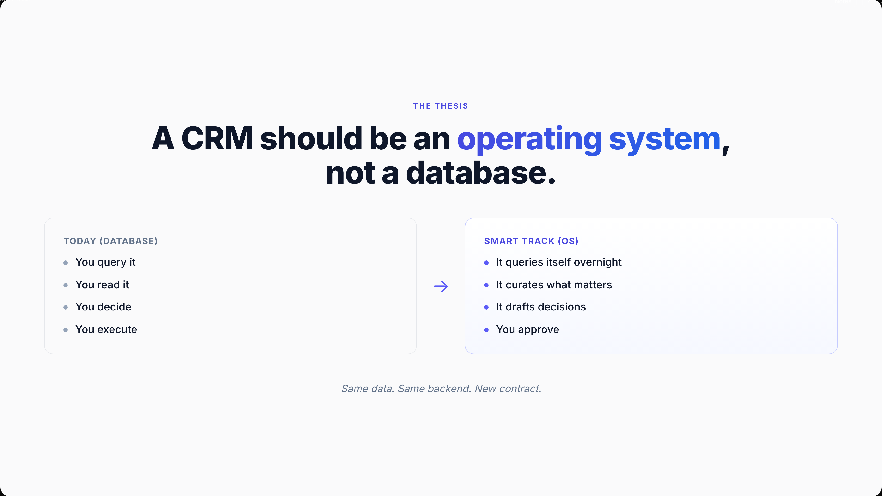
Notes:
This is the only conceptual slide. Every CRM today is a database — you do all the work of pulling, reading, deciding, and executing. Smart Track keeps the same backend, same widgets, same data, but flips the contract. The system does the querying, curating, and drafting. The agent only does the approving. Same data, totally different relationship. Now let me show you.

Slide 4
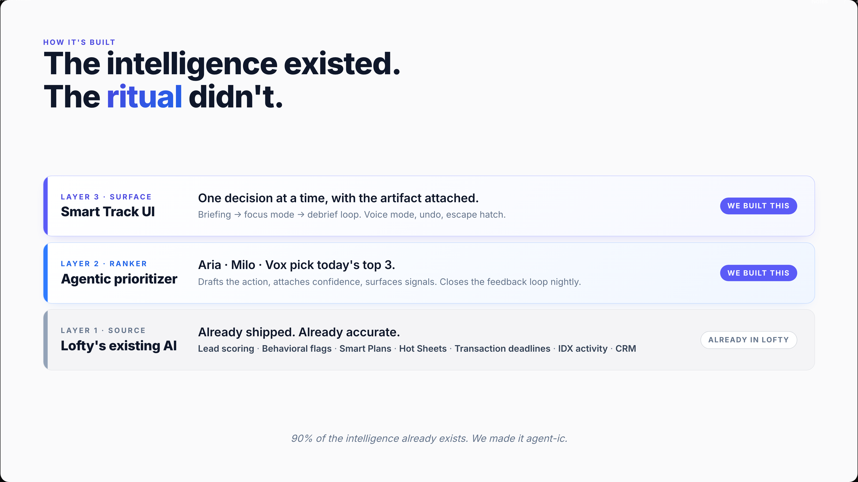
Notes:
Here's what we actually built. The bottom layer — Lofty's lead scoring, behavioral flags, smart plans, hot sheets, transaction deadlines, IDX activity — already exists today and works. We didn't recreate any of it. The middle layer is where we added agency: a ranker that picks today's top three, drafts the action, and attaches a confidence score. The top layer is the Smart Track UI you're about to see. The reason this is shippable in a week, not a year, is that ninety percent of the intelligence already shipped in Lofty. We just gave it a face.

Slide 5
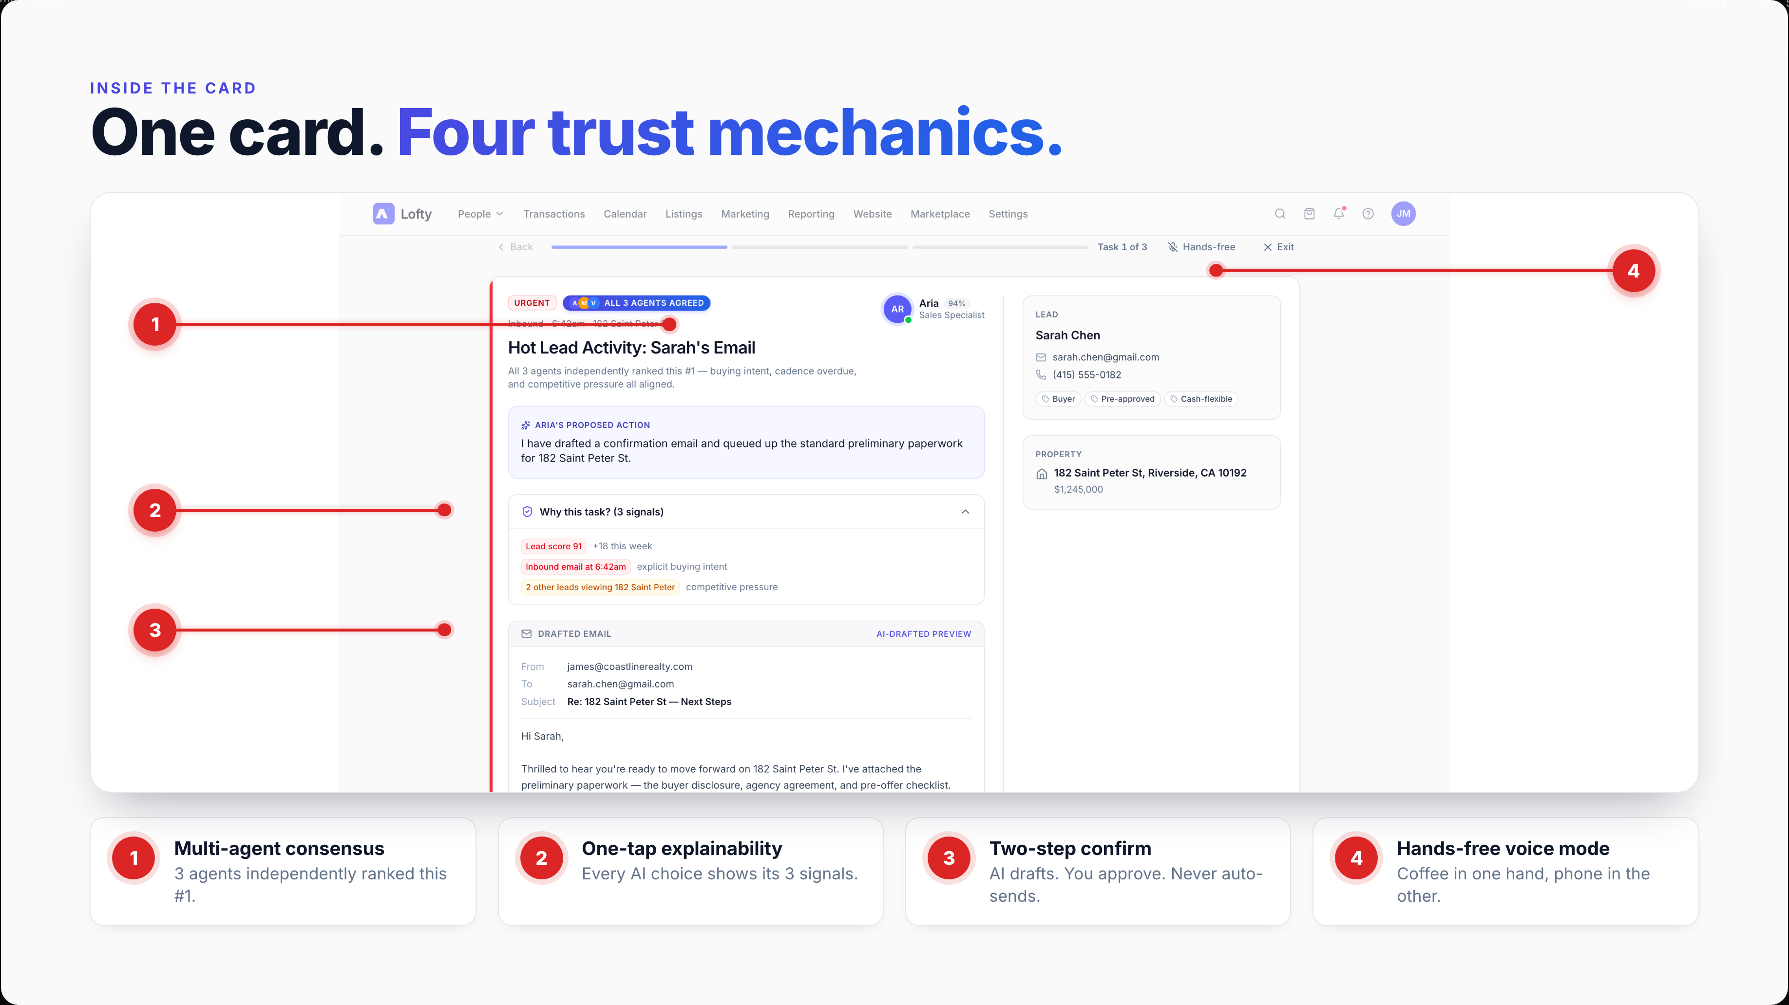
Notes:
This is one task card from focus mode. Walk through the four numbered callouts in order. ONE — 'All 3 agents agreed.' Multi-agent consensus, not one model's guess. When Aria, Milo, and Vox independently rank the same lead #1, you trust it. TWO — 'Why this task?' Three signals visible in one tap: lead score 91, inbound email at 6:42am, two other leads viewing the property. Every AI choice is explainable. THREE — AI-drafted preview. The agent drafts the email — you approve. Two-step confirm by default. Nothing auto-sends without you reading it. FOUR — Hands-free toggle. Voice mode reads the card aloud and accepts spoken commands — coffee in one hand, phone in the other. This is what 'AI you can trust' looks like in practice. The trust isn't an add-on — it's how the screen is composed.

Slide 6
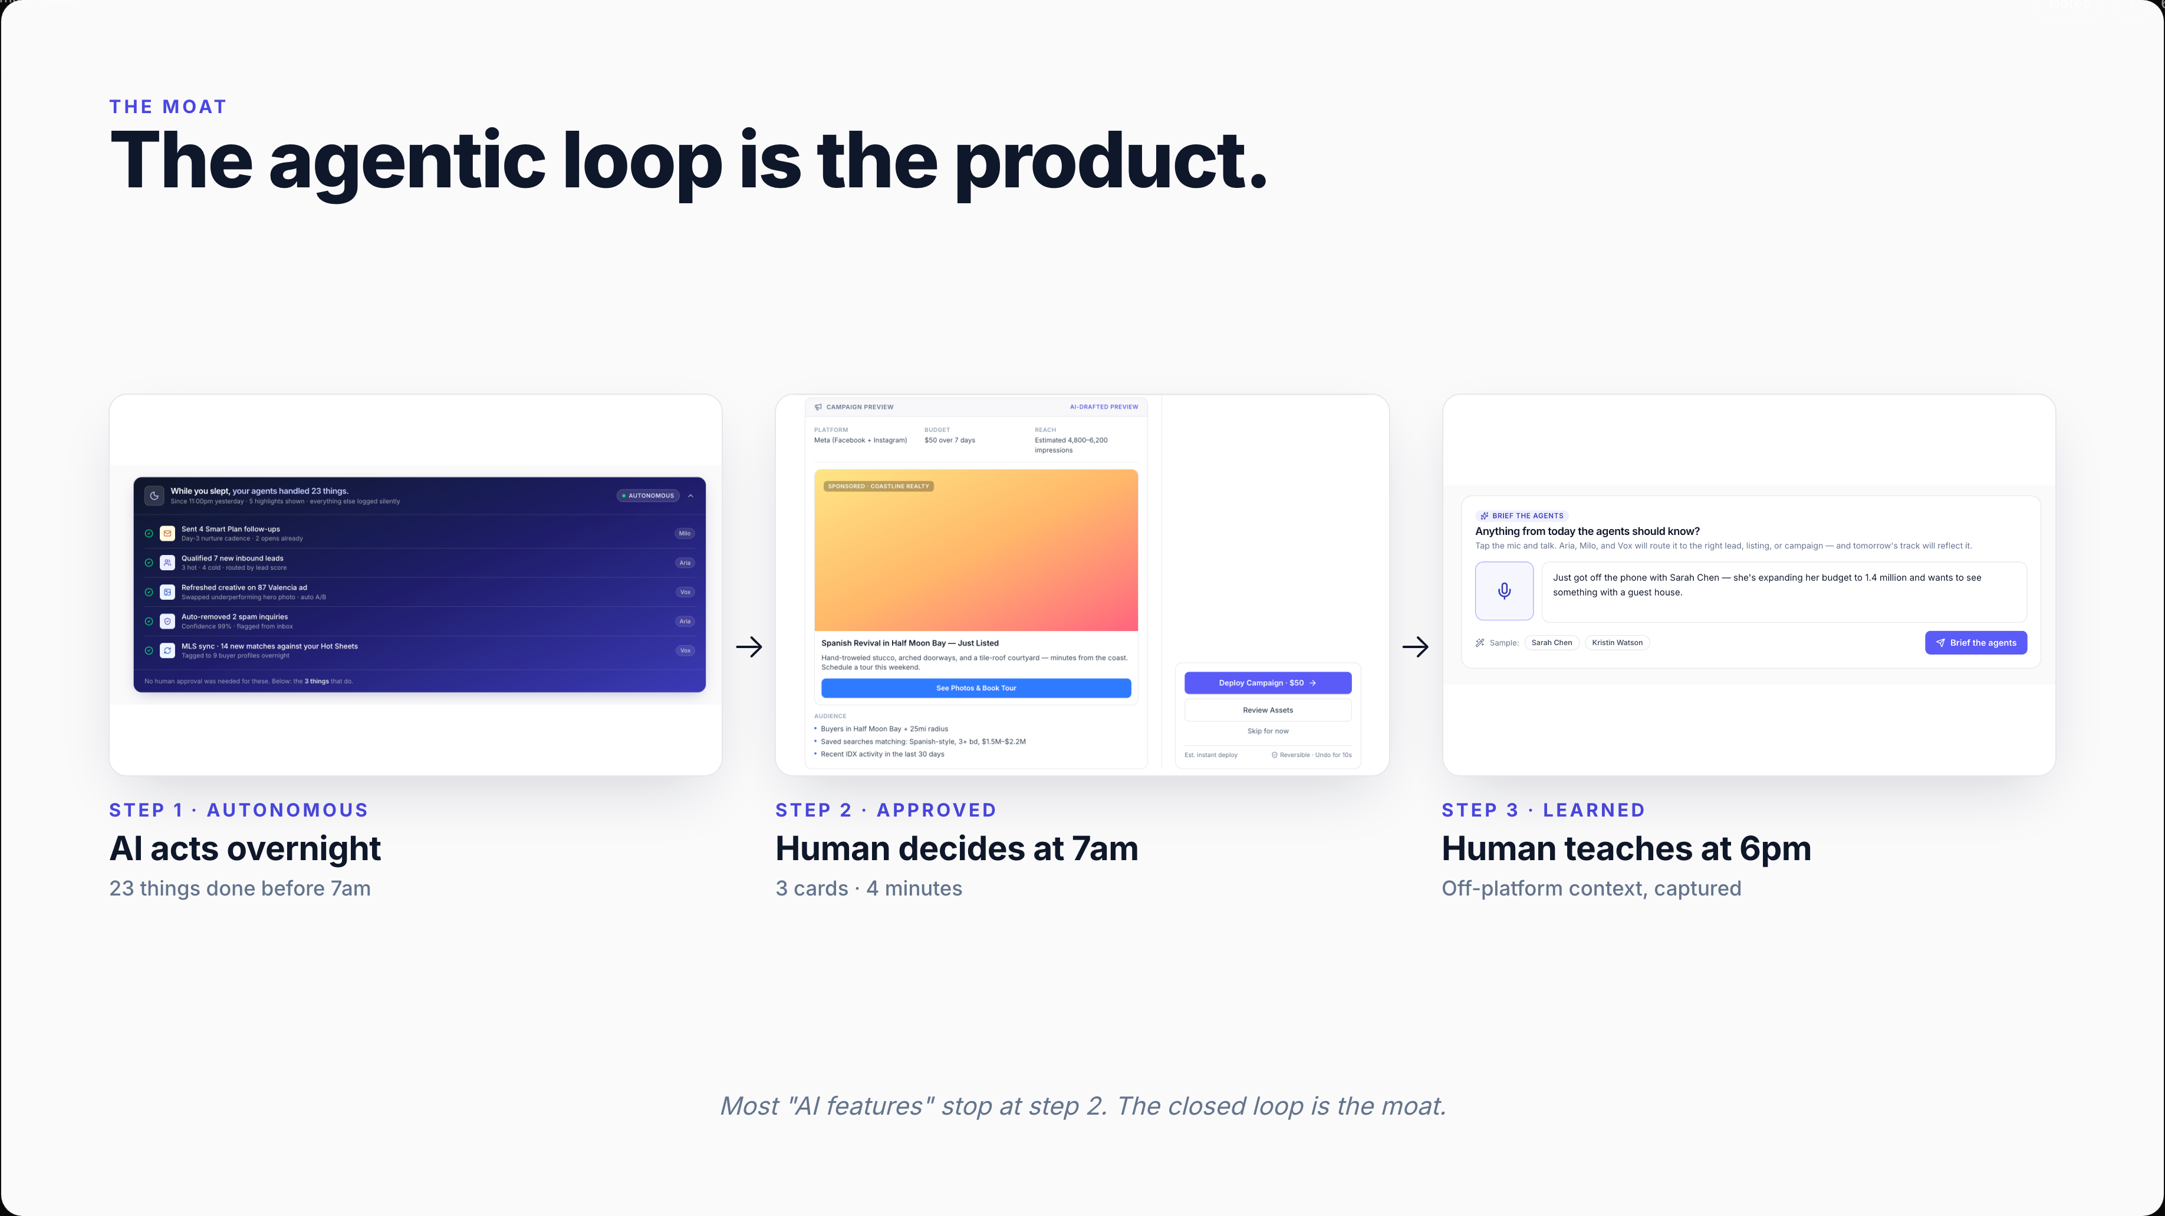
Notes:
Here's why this isn't a wrapper. Most AI products do step 2 only — they suggest something, the human approves, end of story. Smart Track closes the full loop. Agents work autonomously overnight, surface only what needs a human at 7am, and then learn from what the human says back at 6pm. The Brief the Agents step you just saw isn't decoration — it's the only way an AI system in real estate gets better, because most of what an agent learns happens off-platform: at showings, on calls, at coffee. Capture that, route it correctly, and tomorrow's track gets sharper. That feedback loop is the defensibility.

Slide 7
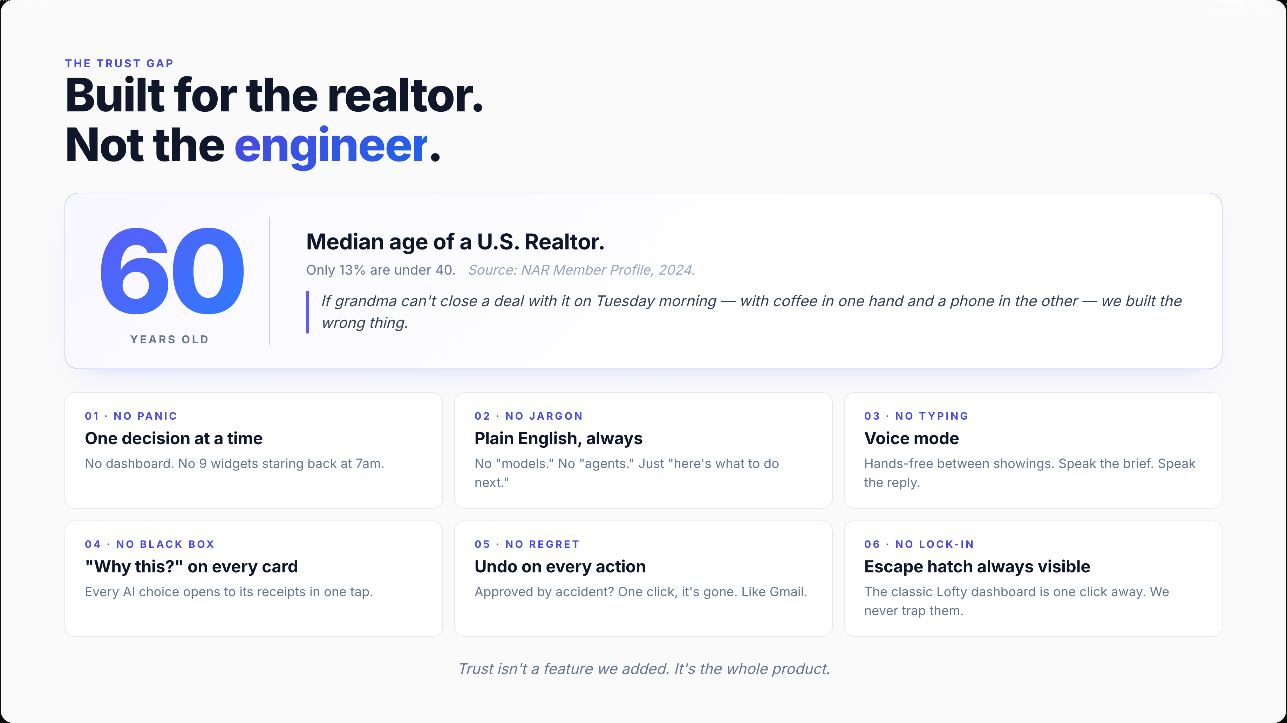
Notes:
Last slide — and the most important one. The median age of a Realtor in America is sixty. Not thirty-five. Sixty. Only thirteen percent are under forty. So when we designed Smart Track, the question wasn't 'is this technically impressive?' — it was 'can someone's mom ship a deal with it on Tuesday morning, with a phone in one hand and coffee in the other?' Every design choice on this slide answers that question. One decision at a time means no dashboard panic. Plain English means no jargon — no 'models,' no 'agents,' just 'here's what to do next.' Voice mode means no typing. 'Why this?' means every AI choice is explainable in one tap. Undo means mistakes recover instantly. And the escape hatch — the classic dashboard, one click away — means we never trap them in our world. Trust isn't a feature we added. It's the whole product. That's the pitch. Happy to take questions.

