Slide 1


SMART INDIA HACKATHON 2026
TITLE PAGE
Problem Statement ID – 26142
Problem Statement Title – Deep Learning Based Super Resolution Mapping (SRM) from Medium Resolution Satellite Imageries
Theme – Space Technology
PS Category – Software
Team ID – <to be filled>
Team Name – THE OUTLIERS

Slide 2
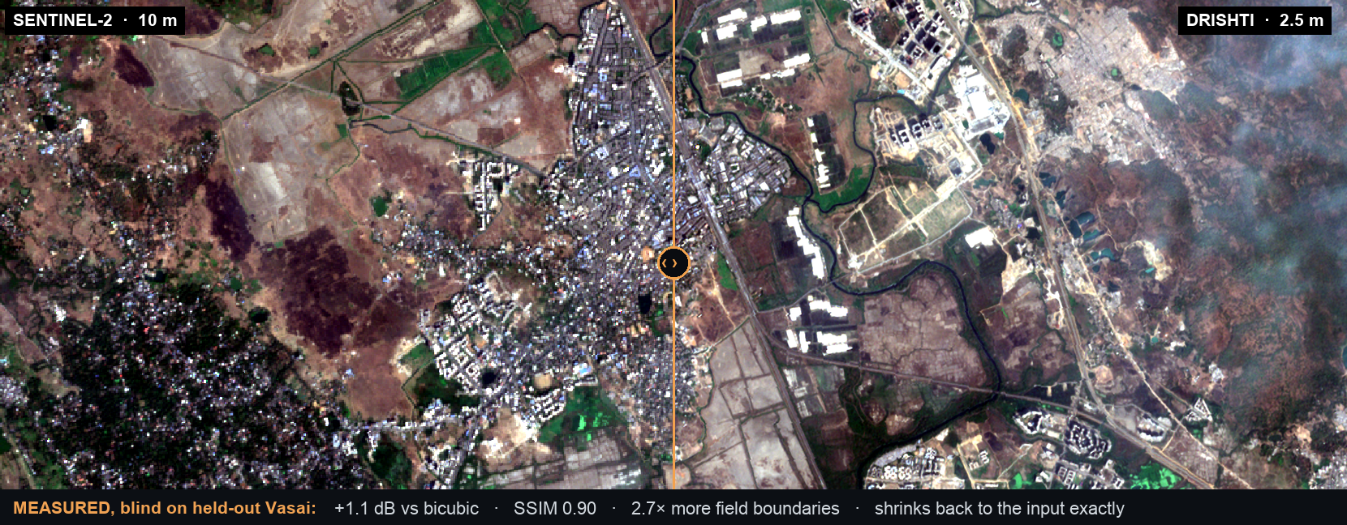


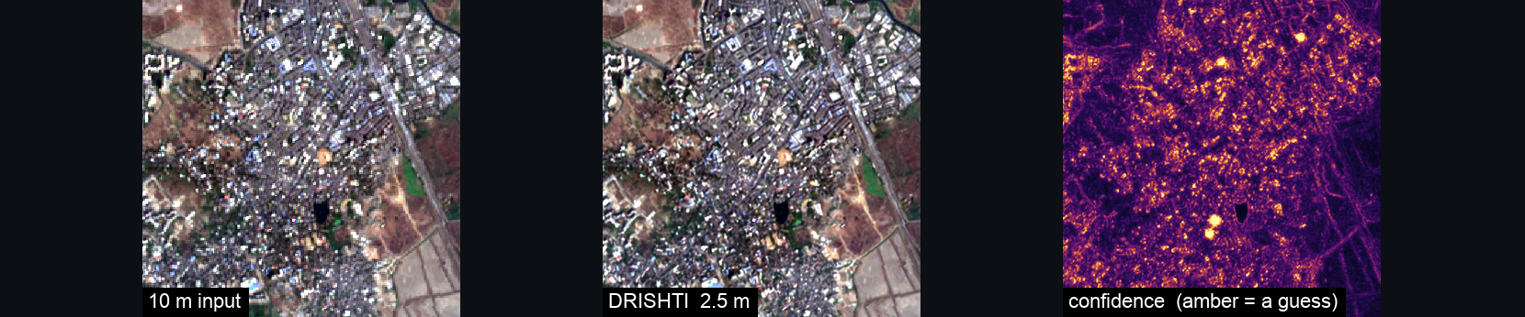



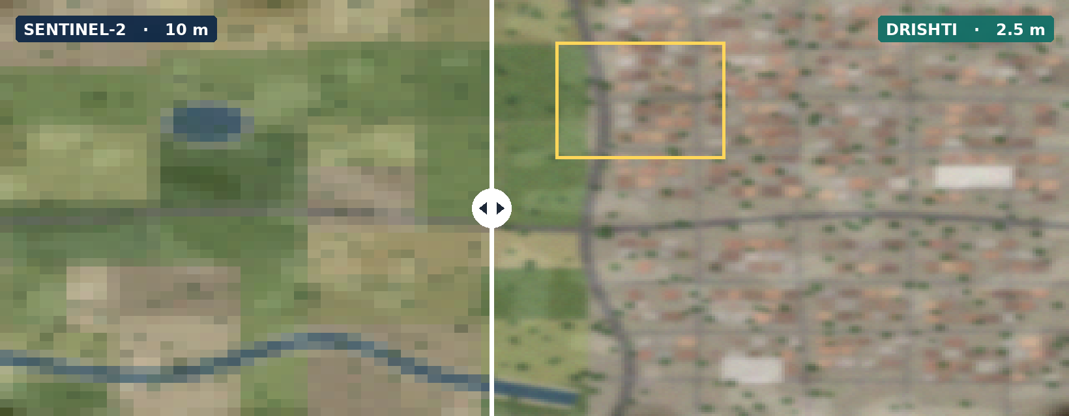
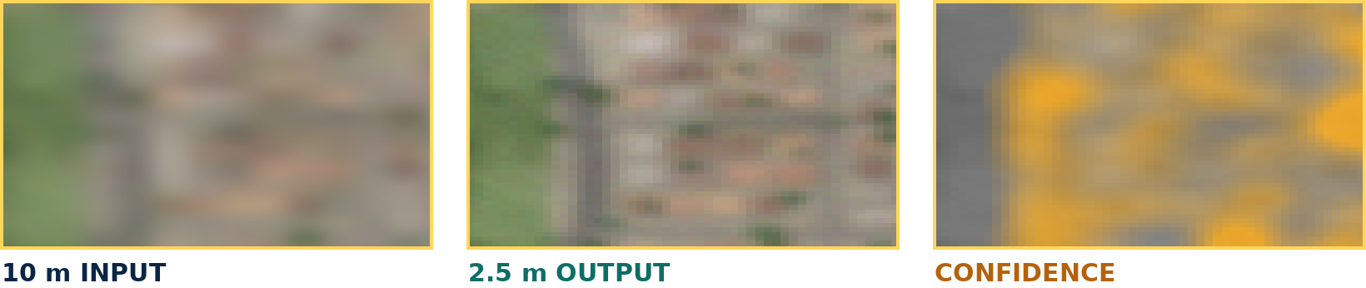
DRISHTI – Sentinel-2 at 2.5 m, Every Guess Flagged
THE OUTLIERS
INDIA-TUNED
trained on Indian ground
Others learn from US farms and European suburbs.
GUESSES FLAGGED
confidence map with every image
It may rearrange detail inside a pixel, never invent brightness.
STILL MEASURABLE
crop health still computable
Colour is preserved, so the output stays science.
drag the divider · same ground, 16x the pixels · amber = the model was guessing
GeoTIFF
Confidence
Report

Slide 3






















TECHNICAL APPROACH
THE OUTLIERS
HOW IT LEARNS · Wald's protocol
AOI
FETCH
MASK
PREP
TILE
PAIRS
user draws a box
newest clear pass
scene cloud < 5%
stack · normalise · reproject
128 x 128, 16 px overlap
real 10 m, degraded to 40 m
HYBRID SR NETWORK
NETWORK
CNN BRANCH
FUSE
rebuilds the 10 m
EDSR /RCAN · crisp, faithful edges
×4 · 35.7 dB
~35 dB
COMPARE
TILE
against the real 10 m
128²
SWIN BRANCH
SwinIR · reads the wider neighbourhood
512²
UPDATE
~35 dB
2.5 m
CONSTRAIN
nudge the weights
averages back exactly
fail → flag & fall back
BUILT WITH
Accuracy CHECK — every tile, before stitching
N passes → variance
Python
PyTorch
consistency
colour · SAM
confidence
all 3 must pass
where the passes disagree = a guess
Sentinel-2
QGIS
STITCH
GeoTIFF 2.5 m
CONFIDENCE MAP
feathered, no seams
opens in QGIS
amber = inferred
Web viewer
Docker

Slide 4














FEASIBILITY AND VIABILITY
THE OUTLIERS
₹0 INPUT DATA
NO LICENCE FEE
RUNS OFFLINE
INDIAN SERVERS
free imagery, forever
no tasking, no per-km² bill
a laptop GPU, no cloud
open data, our own machines
STAGE 1
STAGE 2
STAGE 3
STAGE 4
WORKING BASELINE
COMPARISON VIEWER
INDIA-TUNED MODEL
VALIDATED PRODUCT
an open pretrained model running on our own area
drag-slider view, so we can judge every result
trained on 12 Indian Sentinel-2 scenes
scored, packaged, runs offline
it invents detail
sensors do not line up
no 2.5 m truth for India
16x more pixels to store
force the output to average back to the real pixel
auto-align every image pair first
Wald's protocol; LISS-IV next
only process the area someone asks for
SO WHY NOT JUST USE SOMETHING ELSE?
GOOGLE EARTH
PAID SATELLITE
RAW SENTINEL-2
DRISHTI
a photo album
priced per km²
one house = one pixel
and it flags its guesses
SHARP
CURRENT
FREE
SHARP
CURRENT
FREE
SHARP
CURRENT
FREE
SHARP
CURRENT
FREE

Slide 5








IMPACT AND BENEFITS
THE OUTLIERS
DEFENCE
watch a border for destruction / impact analysis
sovereign, offline
WHAT COMES OUT
2.5 m image
FARMING
confidence map
see one farmer's field, not a whole village
fairer crop claims
SENTINEL-2
DRISHTI
free · every 5 days
but 10 m blurry
hybrid SR, 4x
+ confidence
accuracy report
DISASTER
which streets flooded, two days later
faster relief
CITY PLANNING
spot new construction as it goes up
enforcement on evidence

Slide 6


RESEARCH AND REFERENCES
THE OUTLIERS
WHAT ALREADY EXISTS
WHAT WE ADD, AND HOW WE PROVE IT
PROVEN SCIENCE
Trained on Indian ground
OpenSR (ESA)
12 Sentinel-2 scenes, one held out blind
10 m to 2.5 m, Europe-wide
opensr.eu
SEN2SR
Remote Sensing of Environment, 2025
sciencedirect.com
Bounded hallucination
Satlas SR
output must average back to the real pixel
Allen Institute for AI
github.com/allenai
DRISHTI
DATA WE CAN TRAIN ON
what nobody has
built yet
Still measurable
SEN2NAIP v2
India-tuned · hallucination-bounded · operational
crop and water indices survive the 4x
Nature Scientific Data, 2024
huggingface.co
Bhoonidhi (ISRO)
LISS-IV 5.8 m, Cartosat 2.5 m
Scored, not claimed
bhoonidhi.nrsc.gov.in
opensr-test · SAM 2.6° · boundary F1 0.81
Copernicus Data Space
free Sentinel-2, every 5 days
dataspace.copernicus.eu

