Slide 1

Decision Tree

Slide 2
Decision Tree
A Classifier ( tree structure): used in classification and regression
Classification mostly uses Decision tree
Decision tree Model act as classifier : tree structure classifier
New input( unlabeled, unknown) is fed to the model and model classifies it to a particular class
Decision tree has two nodes:
Decision node( branch: test conducted either yes or no) [corresponds to an Attribute]
Leaf node( no branch) [corresponds to a Class Label ]
Finally leaf node is a class….( assign a class to next coming sample)

Slide 3
Classification & Regression Trees (CART)
DT creates a model that predicts the value of a target (or dependent variable) based on the values of several input (or independent variables)
CART was introduced in 1984 by Leo Breiman, Jerome Friedman, Richard Olshen and Charles Stone.
The main elements of CART (and any decision tree algorithm) are:
Rules for splitting data at a node based on the value of one variable
Stopping rules for deciding when a branch is terminal and can be split no more
Finally, a prediction for the target variable in each terminal node.

Slide 4
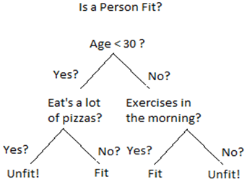
Decision Tree
Ex.: Let’s say you want to predict whether a person is fit given their information like age, eating habit, and physical activity, etc.
The decision nodes here are questions like ‘What’s the age?’, ‘Does he exercise?’, ‘Does he eat a lot of pizzas’? And the leaves, which are outcomes like either ‘fit’, or ‘unfit’.
Binary classification problem (yes /no type)

Slide 5
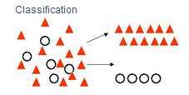
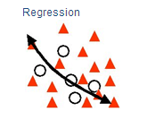
Decision Tree Types
There are two main types of Decision Trees:
Classification trees (Yes/No types)
the outcome variable (like ‘fit’ or ‘unfit’) or decision variable is Categorical. Tree is used to identify the "class"
Regression trees (Continuous data types)
the decision or the outcome variable is Continuous (like 123). tree is used to predict target variable value.

Slide 6
Gini Index:
Gini Index is a score that evaluates how accurate a split is among the classified groups.
Gini index evaluates a score in the range between 0 and 1, where 0 is when all observations belong to one class, and 1 is a random distribution of the elements within classes.
In this case, we want to have a Gini index score as low as possible.
Gini Index is the evaluation metrics we shall use to evaluate our Decision Tree Model.

Slide 7
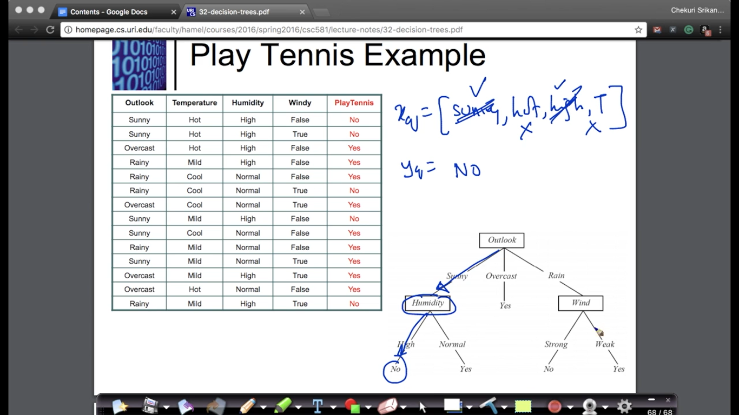

Slide 8
Entropy
Entropy, also called as Shannon Entropy is denoted by H(S) for a finite set S,
It’s the measure of the amount of uncertainty or randomness in data.
Intuitively, it tells us about the predictability of a certain event.
Example, consider a coin toss whose probability of heads is 0.5 and probability of tails is 0.5. Here the entropy is the highest possible, since there’s no way of determining what the outcome might be.
Alternatively, consider a coin which has heads on both the sides, the entropy of such an event can be predicted perfectly since we know beforehand that it’ll always be heads. In other words, this event has no randomness hence it’s entropy is zero.
In particular, lower values imply less uncertainty while higher values imply high uncertainty.

