Slide 1

Support Vector Machine Classifier

Slide 2
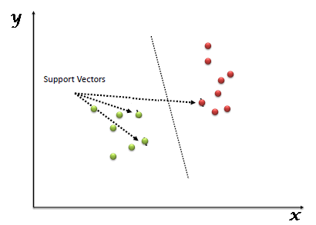
SVM
What is Support Vector Machine?
“Support Vector Machine” (SVM) is a supervised machine learning algorithm which can be used for both classification or regression challenges.
However, it is mostly used in classification problems.
In the SVM algorithm, we plot each data item as a point in n-dimensional space (where n is number of features you have) with the value of each feature being the value of a particular coordinate.
Then, we perform classification by finding the hyper-plane that differentiates the two classes very well

Slide 3
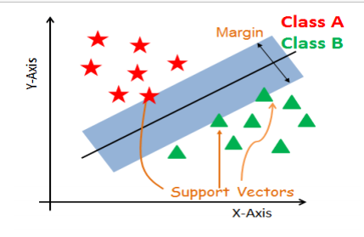
Support Vectors: Support vectors are the data points, which are closest to the hyperplane. These points will define the separating line better by calculating margins.
These points are more relevant to the construction of the classifier.
Hyperplane: A hyperplane is a decision plane which separates between a set of objects having different class memberships.
Margin: A margin is a gap between the two lines on the closest class points.
This is calculated as the perpendicular distance from the line to support vectors or closest points.
If the margin is larger in between the classes, then it is considered a good margin, a smaller margin is a bad margin.

Slide 4
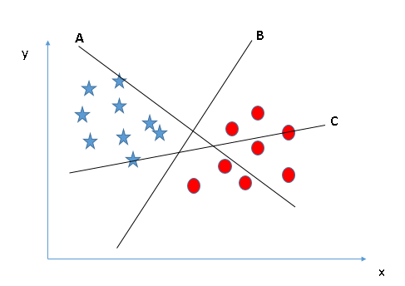
SVM-Different Scenario
Identify the right hyper-plane (Scenario-1): Here, we have three hyper-planes (A, B and C). Now, identify the right hyper-plane to classify star and circle.
You need to remember a thumb rule to identify the right hyper-plane: “Select the hyper-plane which segregates the two classes better”.
In this scenario, hyper-plane “B” has excellently performed this job.

Slide 5
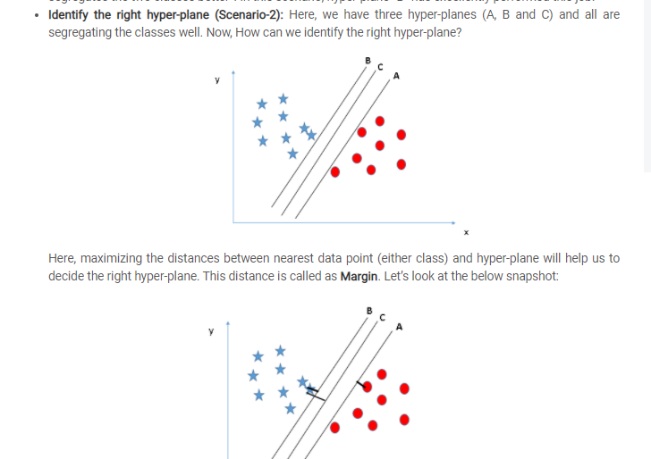

Slide 10
SVM
SVM Kernels :
The SVM algorithm is implemented in practice using a kernel.
A kernel transforms an input data space into the required form.
SVM uses a technique called the kernel trick.
Here, the kernel takes a low-dimensional input space and transforms it into a higher dimensional space.
In other words, you can say that it converts nonseparable problem to separable problems by adding more dimension to it.
It is most useful in non-linear separation problem.
Kernel trick helps you to build a more accurate classifier

Slide 11
SVM
SVM Kernels :
Linear Kernel: A linear kernel can be used as normal dot product any two given observations.
The product between two vectors is the sum of the multiplication of each pair of input values. K(x, xi) = sum(x * xi)
Polynomial Kernel: A polynomial kernel is a more generalized form of the linear kernel. The polynomial kernel can distinguish curved or nonlinear input space.
K(x,xi) = 1 + sum(x * xi)^d
Where d is the degree of the polynomial. d=1 is similar to the linear transformation. The degree needs to be manually specified in the learning algorithm.

Slide 12
THANK YOU

