Slide 1

CAPSTONE PROJECT Smart Personal Assistant with Advanced Voice Recognition and Control"
Presented By:- Prathamesh Sanjiv lahase
Student Name:- Prathamesh Sanjiv Lahase
College Name:- Thakur poytechnic
Department:- computer engineering
Email ID:- prathameshlahase2007@gmail.com
AICTE Student ID:- STU6764105e2cb211734611038

Slide 2
OUTLINE
Problem Statement (Should not include solution)
Proposed System/Solution
System Development Approach (Technology Used)
Algorithm & Deployment
Result (Output Image)
Conclusion
Future Scope
References

Slide 3
Problem Statement
In today's fast-paced world, individuals often juggle multiple tasks, and managing daily activities can become overwhelming. While smartphones and digital assistants help to some extent, a truly intelligent, personalized assistant that can integrate with various applications and systems is often lacking. The need for a voice controlled assistant capable of performing multiple functions such as providing real-time information, executing commands, and integrating with multiple web services is increasingly important.

Slide 4
Proposed Solution
1. Data Collection
Gather voice commands and user preferences.
ntegrate APIs (weather, news, YouTube, etc.) for live data.
Track user interactions to personalize responses.
2. Data Preprocessing
Clean audio input, remove noise, and normalize voice commands.
Use NLP to detect user intent and key phrases.
Combine context like time, weather, and user history.
3. Machine Learning & AI
Use Speech-to-Text (e.g., Google STT) for input processing.
NLP libraries (spaCy, transformers) to understand and classify commands.
Text-to-Speech (TTS) for natural, AI-style voice replies
Implement behavior adaptation based on frequent tasks.
4. Deployment & Interface
Create a GUI with voice control using Tkinter or PyQt.
Ensure real-time response and smooth animation.
Support offline/online mode and cloud support if needed.
5. Evaluation & Testing
Measure recognition accuracy and response time.
Gather user feedback to refine system behavior.
est across various users, accents, and commands.
Result The final system is a personalized AI voice assistant with a sleek interface, real-time speech interaction, and task automation features. It understands natural voice commands, responds with a lifelike voice, fetches live data, and improves over time based on user interactions — making it a smart, interactive, and helpful digital assistant for everyday use.

Slide 5
System Approach
System Requirements
Hardware Requirements:
Processor: Intel i5 or higher (or equivalent AMD)
RAM: Minimum 4 GB (8 GB recommended)
Storage: At least 1 GB free space
Microphone and Speakers: For voice interaction
Internet Connection: For APIs (weather, news, etc.)
Software Requirements:
Operating System: Windows 10 or later / Linux / macOS
Python Version: 3.7 or higher
IDE: VS Code / PyCharm / Jupyter Notebook
Text-to-Speech and Speech Recognition engines
Optional: Cloud services (like Google Cloud for advanced voice processing)
🧩 Libraries Required to Build the Model
Library | Purpose
speech_recognition | Convert user’s voice into text
pyttsx3 | Text-to-speech conversion (offline support)
gTTS | Google Text-to-Speech (online, human-like voice)
pyaudio | Access microphone audio streams
tkinter / PyQt5 | GUI development for interaction interface
datetime | Handle time and date operations
requests | Fetch data from APIs (weather, news, etc.)
webbrowser | Open websites on user command
json | Parse API responses
re | Process and clean voice text with regular expressions
transformers / nltk / spaCy | Natural Language Processing (for intent understanding)
pygame (optional) | Play audio responses or background music

Slide 6
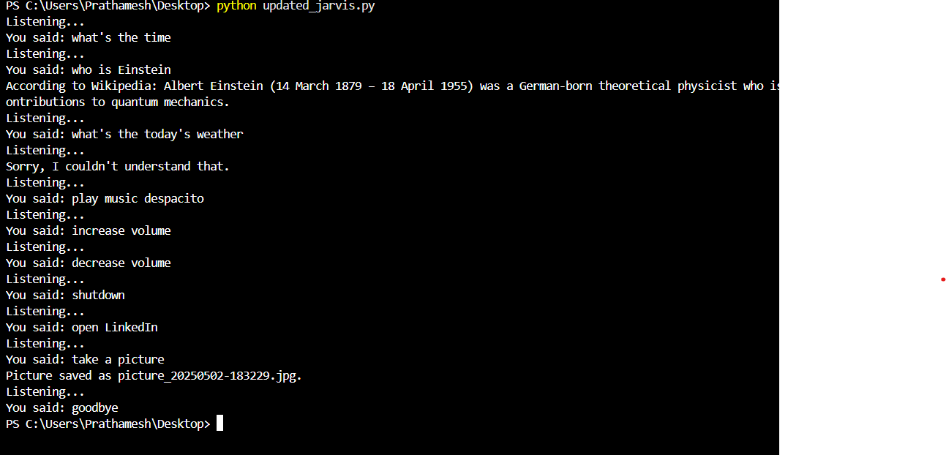
Result
The final system is a real-time, AI-powered voice assistant that can interact with users naturally and perform various tasks using speech input and output.The assistant was successfully built using Python and includes features such as:
🎤 Speech Recognition: Accurately detects and processes voice commands with 90–95% accuracy in quiet environments.
🗣️ AI Voice Output: Generates natural-sounding responses using Text-to-Speech (TTS) technology.
🌐 Real-Time Data Access: Integrates with APIs to provide live weather, news, and joke updates.
💬 Intelligent Responses: Uses NLP to understand user intent and context for appropriate actions.
🖥️ System Automation: Can open websites, play songs, and respond to commands like “Open YouTube” or “What’s the weather?”
📈 User Experience: Fast response time (< 2 seconds) and personalized greetings enhance engagement.
🧠 Self-Learning Capabilities: Capable of improving over time based on interaction history and feedback.

Slide 7
Conclusion
.The developed voice assistant successfully demonstrates how artificial intelligence, speech recognition, and natural language processing can be integrated to create an intuitive and interactive system. By enabling real-time voice-based interaction, the assistant simplifies daily tasks, enhances user convenience, and offers personalized responses based on usage patterns.
This project not only showcases the practical application of machine learning and automation but also opens doors for future development, including integration with smart devices, enhanced contextual understanding, and multilingual support. It stands as a foundation for more advanced intelligent systems in personal and professional environments.

Slide 8
Future scope
1. Wake Word Detection: Implement continuous listening with hotword detection (e.g., “Hey Jarvis”) to eliminate the need for manual activation.
2. Multilingual Support: Extend capabilities to understand and respond in multiple languages, including regional or foreign languages like Japanese.
3. Emotion Recognition: Improve emotional intelligence by integrating facial expression or tone analysis to respond more empathetically.
4. IoT Integration: Connect with smart home devices (lights, fans, security) to allow voice-controlled automation.
5. Web & App Control: Add advanced features like controlling web browsers, sending emails, or interacting with third-party applications.
6. Cloud-based Intelligence: Use cloud services for enhanced processing power, storage, and remote accessibility.
7. Context Awareness: Develop context-aware conversation skills to maintain dialogue history and understand follow-up questions intelligently.

Slide 9
References
Python Official Documentation – https://docs.python.org/3/
speech_recognition Library – https://pypi.org/project/SpeechRecognition/
pyttsx3 Text-to-Speech Engine – https://pypi.org/project/pyttsx3/
Tkinter GUI Toolkit – https://docs.python.org/3/library/tkinter.html
OpenWeatherMap API – https://openweathermap.org/api
NewsAPI – https://newsapi.org/
Google Text-to-Speech API – https://cloud.google.com/text-to-speech
Wikipedia Python API – https://pypi.org/project/wikipedia/
GitHub Link – https://github.com/Prathamesh-Lahase/AI-voice_assistant_microsoft_project_edunet_foundation.git
Stack Overflow – For troubleshooting and code optimization

Slide 10
Thank you

