Slide 1
Big Data Architecture and Governance
Individual Project | Wayfair
Prathamesh Shrikrishna Verlekar

Slide 2
Wayfair
Industry: Retail
History/Background:
Wayfair is an American e-commerce company that sells furniture and home-goods. Niraj Shah and Steve Conine founded Wayfair in August 2002 and headquartered in Boston, Massachusetts. Its digital platform offers 14 million items from more than 11,000 global suppliers.
In May 2019, Wayfair was added to Fortune 500 list for the first time, coming in at number 446. Wayfair has over 12 million square feet of warehouse space in Europe and North America with a dozen fulfillment centers. Wayfair had the largest market share with 33.4% of online furniture sales; Amazon came in second at 29.7% market share.

Slide 3
Company SWOT Analysis

Slide 4
Company Name: Wayfair
Strengths
Automation of activities
Good Returns on Capital Expenditure
Highly skilled workforce
Successful Market strategies
Strong dealer community
Weaknesses
Poor product demand forecasting
Unsuccessful at integrating firms
Inventory time is high
Ineffective financial planning
Poor organizational structure
Opportunities
Increasing stable free cash flow
Decreasing cost of transportation
Lower inflation rate
Economic uptick in customer spending
Organization’s core competencies can be
a success in similar other product fields
Threats
Intense competition from Amazon
Currency fluctuations
Company can face lawsuits in markets
Rising pay level
New technologies developed by the
competitor or could be a serious treat

Slide 5
Project 1: Efficiently managing Logistics

Slide 6
Issue Name: Efficiently managing logistics
Wayfair’s biggest issue is logistics – getting large items to customer’s home safely
Wayfair is reliant on drop-shippers to ship items to their warehouses, where the items are shipped to customers.
Oversized items must go via less-than-truckload (LTL) or van lines. Which is the most disjointed and archaic industry in the supply chain ecosystem, one that leads to additional cost.
Large item freight leads to damage at most twice the rate as what is seen with smaller packages and if they are moved multiple times via forklift, making the opportunity for damage before delivery.
Hence, compounding the problem is the fact that the capital required to fix it would lead to potential bankruptcy and give other competitors like Amazon an opening to come in and gain upper hand.

Slide 7
Impact Statement
The purpose of this instructional design project research study is to gather live information and tracking details by leveraging big data technologies and this can be done by collecting information from suppliers, warehouses and carriers. It will help the leadership to make decisions that will help efficiently manage and improve the logistics and supplies at Wayfair.
Utilizing this Wayfair can save a lot of money in transportation and provide faster shipping to its customers.

Slide 8
Project Name: Efficiently managing logistics
1. PURPOSE
The purpose of this project is to enable real-time order and tracking information to the warehouse owner by leveraging big data technologies to help efficiently manage and improve logistics at Wayfair.
2. SPONSOR
Chief Operating Officer - Thomas Netzer
3. BACKGROUND
The context of the project is to make use of big data technologies to gather live tracking information. Since, Wayfair has been facing issues delivering large parcels efficiently to its customer due to which the inventory time and the cost for transportation are significantly high. Compounding the problem is the fact that the capital required to fix it would lead to potential bankruptcy. Efficiently managing logistics will be a stand-alone activity to fulfill the business requirement.
4. PROJECT OBJECTIVES
The main objectives of the project are as following:
Decrease the inventory time and transportation cost by leveraging big data technologies
Enable real-time tracking information to the warehouse owners
This will aid the company to enable faster delivery to its customers while also increasing the profitability
5. SCOPE
The major deliverables of the project are to efficiently manage and improve the logistics at Wayfair. Leverage Big data technologies to enable real-time data which can used by the Warehouse owners to make decisions
The project will help deliver large items to customer’s homes safely since large item freight leads to damage at most twice the rate as smaller packages. It will help Wayfair save a lot of money on transportation and improve customer satisfaction.

Slide 9
Project Name: Efficiently managing logistics
6. CONSTRAINTS
The amount of investment that will be needed to buy big data technologies and tools
Company will have to invest in hiring engineers that understand and can work on big data technologies
Warehouse owners will need to understand and learn to use big data tools
7. INTERFACES
Internal interface – www.wayfair.com
External interface – Vendor Management System
8. QUALITY EXPECTATIONS
The quality expectations for this project is meeting the set delivery time with some buffer period for additional requirements
Key requirements will be hiring people with big data expertise for handling and maintaining the project
Ease of use can be done by monitoring some orders from a particular warehouse
Warehouse owners can check if the project has brought an increase in sale and profitability
The customer will have to pay less as delivery charges since there will be no additional transportation cost to the company and a smaller number of products will be damaged
9. OUTLINE BUSINESS CASE
To increase the profitability by decreasing the cost of transportation and providing faster delivery service to the customer

Slide 10
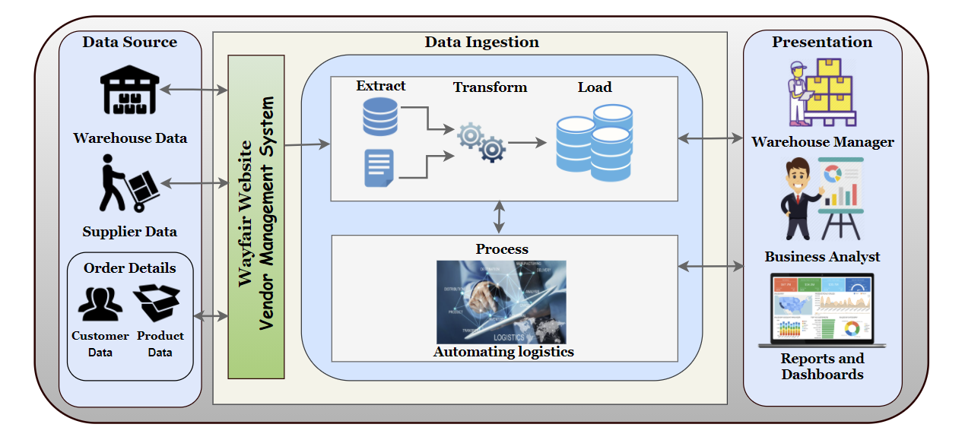
Vision Diagram: Efficiently Managing Logistic

Slide 11
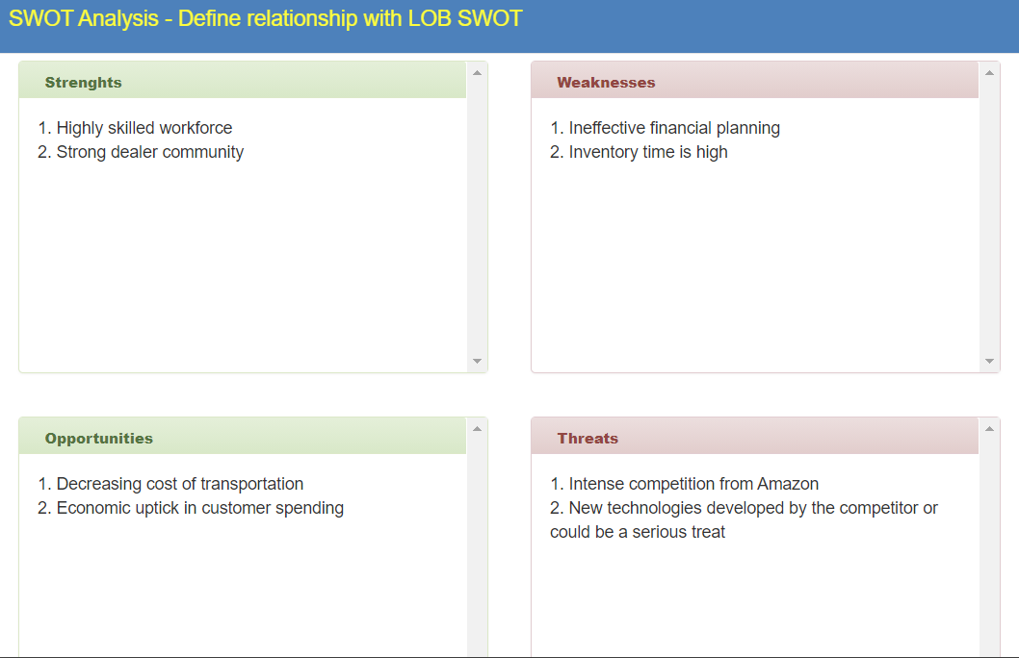
SWOT : Efficiently Managing Logistics

Slide 12
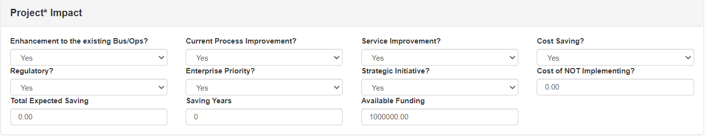
Impact: Efficiently Managing Logistics

Slide 13
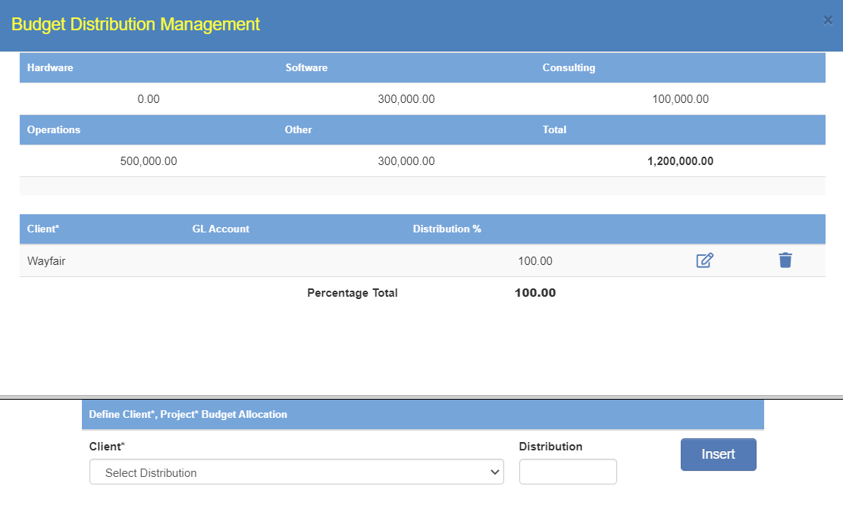
Budget Distribution and Allocation Management: Efficiently Managing Logistics

Slide 14
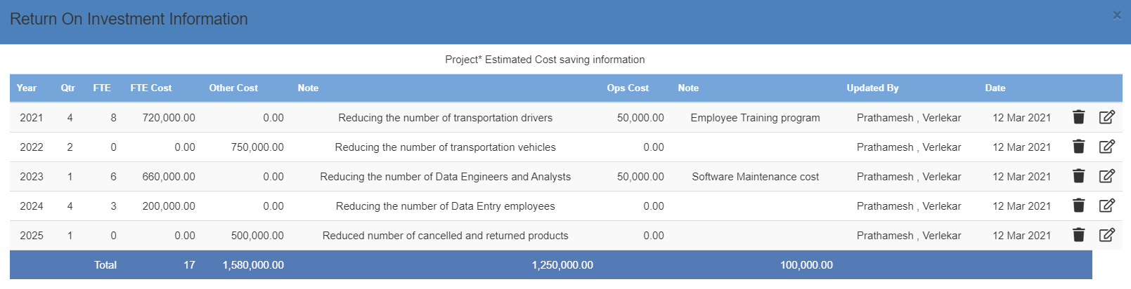
Return on Investment: Efficiently Managing Logistics

Slide 15
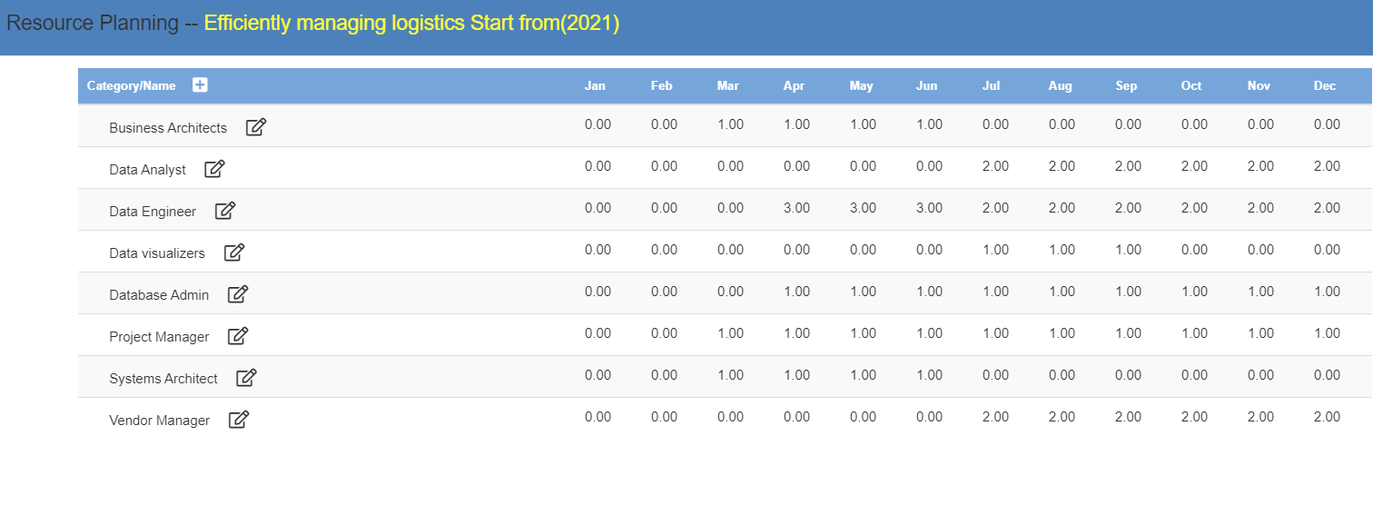
Resource Planning

Slide 16
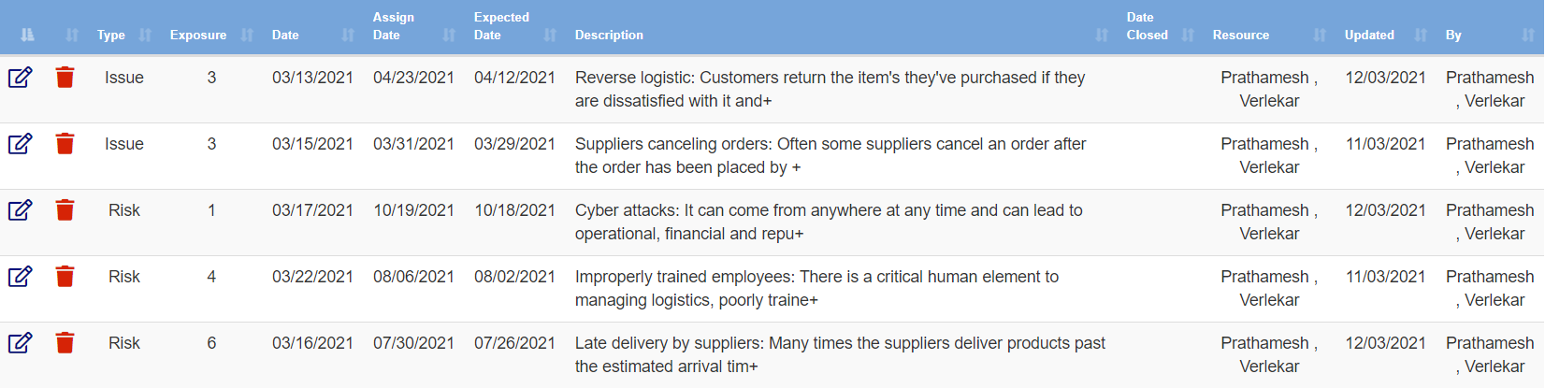
Risk/Issues: Efficiently Managing Logistics

Slide 17
Project 2: Customer Loyalty

Slide 18
Issue Name: Customer Loyalty
Wayfair’s customer retention rate is abysmal
Wayfair is spending egregious amounts on advertising but is losing existing customers faster than they are acquiring new customers.
They are spending about $69 to acquire new customers, but it's only earning $59 back from the customer over the long haul. They are losing money every time they acquire a new customer.
Wayfair is having ugly customer-retention figures i.e., Orders placed by repeat customers are just 55.4% and since it operates on the non-subscription business model, they are losing their old customers to companies like Amazon and Walmart.
Failing to understand customer purchasing patterns that are less predictable and customer churn isn't observable in such business models, Wayfair has been losing a huge amount of money acquiring new customers.
Thus, there is a need for better customer retention policies and ways to improve customer loyalty by understanding the customer needs and patterns effectively.

Slide 19
Impact Statement
The purpose of this instructional design project research study is to understand the customer purchasing patterns and customer churn by leveraging big data technologies to help the Leadership make decisions considering how it will impact the growth and profit of the company.
Additionally, the company will require spending less money in acquiring new customers if they start earning profits from their old and loyal customers.

Slide 20
Project Name: Customer Loyalty
1. PURPOSE
The purpose of this project is to increase the customer retention rate by improving the customer experience. The main aim will be to make use of big data technologies and ML models to provide the customers with personalized services and better rates for their orders
2. SPONSOR
Chief Financial Officer – Michael Fleisher
3. BACKGROUND
The context here is to increase the repeat customer rate, purchase frequency, and average order value by understanding the customer behavior and purchasing patterns. Wayfair’s customer retention rate is abysmal, and they have been losing a huge amount of money acquiring new customers. Improving customer loyalty will be a part of the larger business program
4. PROJECT OBJECTIVES
The main objectives of the project are as following:
The project will try to retain the existing customers by understanding purchasing patterns and providing personalized services
Improve the customer satisfaction and purchase frequency by suggesting only the products which the customer will buy
5. SCOPE
The deliverables of the project is to improve the customer loyalty by understanding customers purchasing pattern, engaging them into royalty programs and improving customer satisfaction.
The project will help the company save egregious amounts on advertising to acquire new customers by retaining old customers

Slide 21
Project Name: Customer Loyalty
6. CONSTRAINTS
Cost constraint can be estimating the costs for using and maintaining big data tools and technologies
Hire experienced ML and Data Engineers that can understand and work on the gathered customer information
Another important constraint can be the restriction of regularity requirements and privacy concerns of the customer data
7. INTERFACES
Internal interface – www.wayfair.com
External interface - www.jossandmain.com, www.allmodern.com
8. QUALITY EXPECTATIONS
The quality expectations for this project are to provide the application on time and proper maintenance
Employing engineers with technical expertise those who can handle situations when the requirement changes and continue maintaining the quality expectations
Customer service team can check if the project has increased customer retention rate by monitoring a group of customers
Improving customer loyalty will aid in giving personalized services to the customers thereby improving the purchasing frequency and average order value which will increase the company’s profit
9. OUTLINE BUSINESS CASE
To increase the customer retention rate and avoid spending a large sum of money acquiring new customers

Slide 22
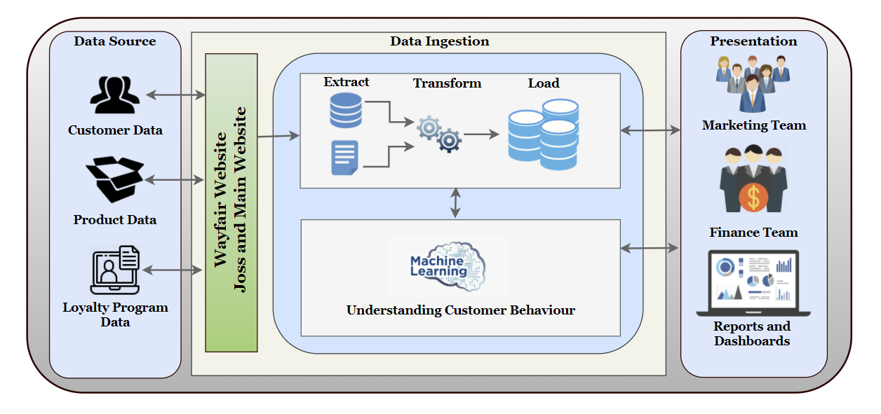
Vision Diagram: Customer Loyalty

Slide 23
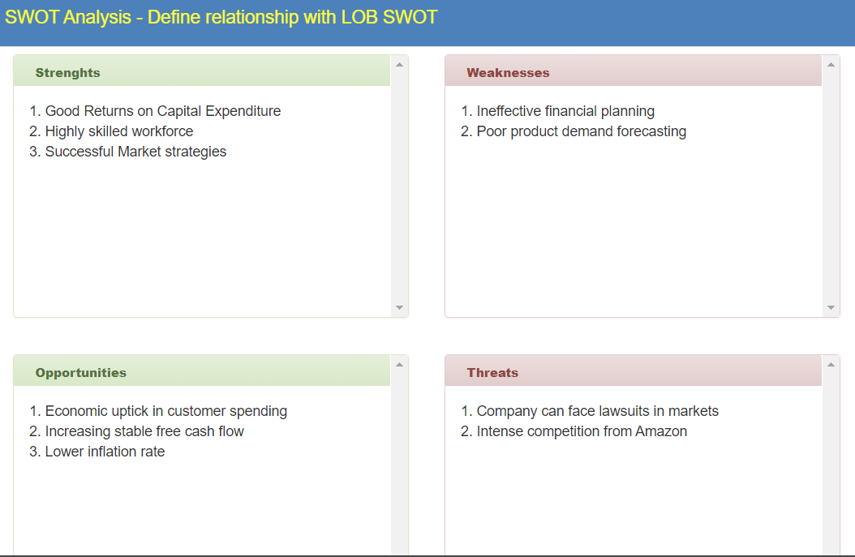
SWOT : Customer Loyalty

Slide 24

Impact: Customer Loyalty

Slide 25
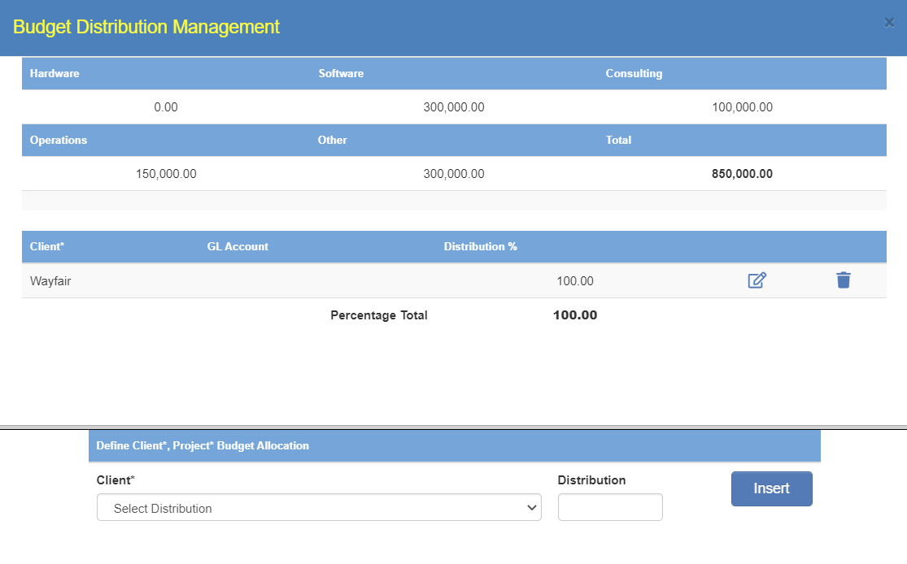
Budget Distribution and Allocation Management: Customer Loyalty

Slide 26
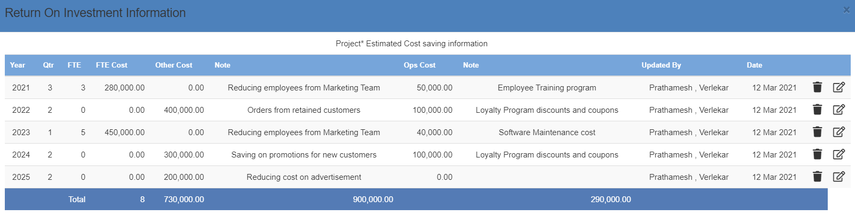
Return on Investment: Customer Loyalty

Slide 27
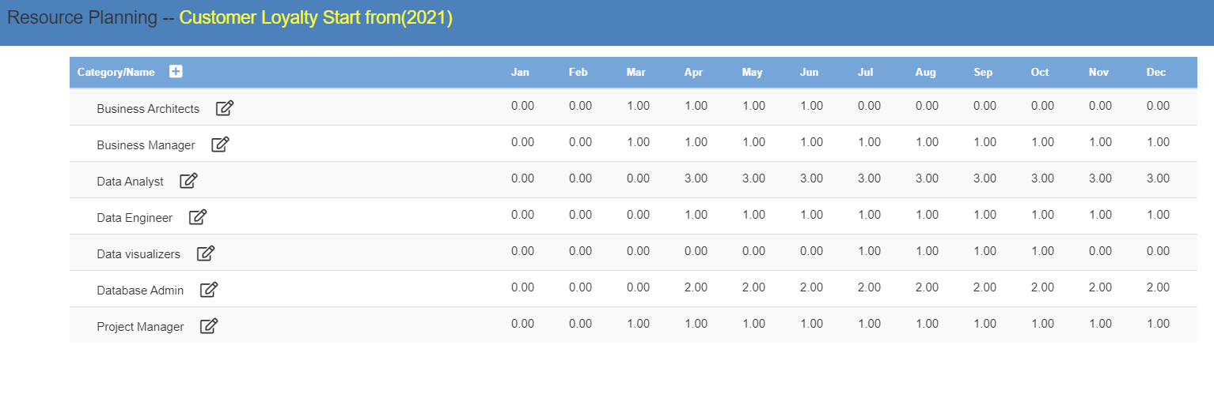
Resource Planning

Slide 28
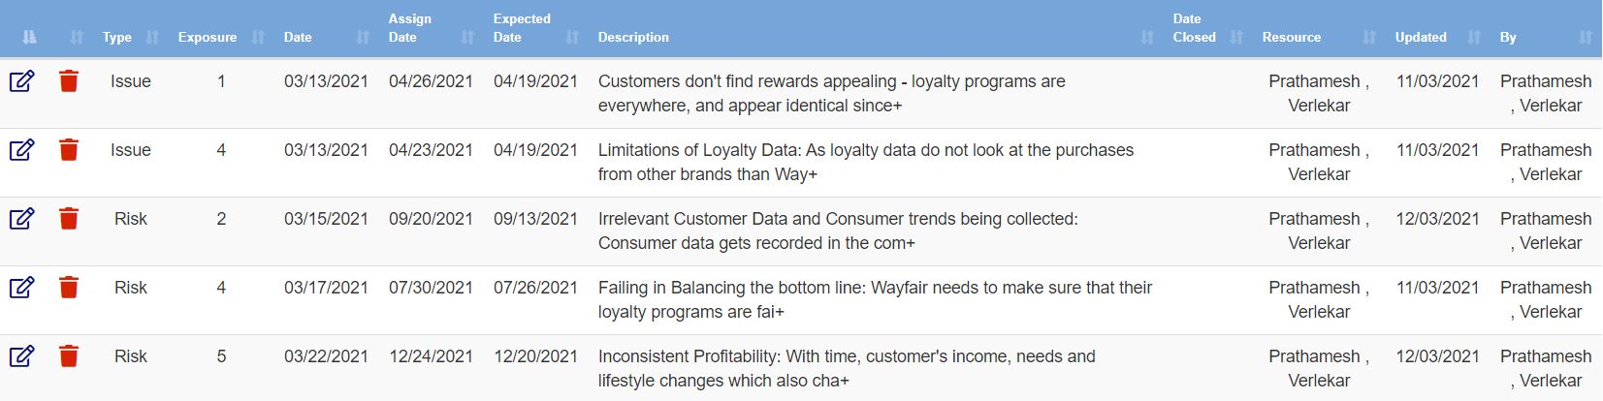
Risk/Issues: Customer Loyalty

Slide 29
Project Selection

Slide 30
Will be choosing Efficiently Managing Logistics project over Customer Loyalty project because of the following reasons:
Business Logic
The company’s primary goal is to build one of the largest online selections of furniture - they completely rely on dropship shippers for their revenue.
Wayfair’s 70% of revenue is generated from its suppliers by cutting on additional delivery cost to the customer and ensuring fast and agile delivery.
This project will help Wayfair’s suppliers ship directly to the customers through the model of Drop Shipping, essentially cutting delivery costs and improving delivery speed significantly which will support their business model.
For Customer Loyalty, there will huge amount of investment needed in the beginning for providing customers with discounts and rewards. Also, we will need lot of historical data to get good results and provide proper recommendations to the customer.

Slide 31
Analytics
Efficiently managing logistics would increase the profit of the company by 25-30% and increase customer satisfaction rate.
For efficiently managing logistics it would be easier to acquire data since it falls under transactional data and will be available of real time basis.
For Customer Loyalty, collecting relevant data would be a difficult task since it will require professional and behavioral understanding of data. Customer Loyalty project will require lot of historical data to be collected for every customer before recommending products to them.
For Customer Loyalty, there will huge amount of investment needed in the beginning without any noticeable profit.
Strategic Analysis
Efficiently managing logistics would also improve customer satisfaction since the customers will receive their products with faster delivery.
This will also help increase in customer retention rate and improvement in customer loyalty and would build a better foundation for Customer Loyalty Project.

Slide 32
Impact Score

Slide 33
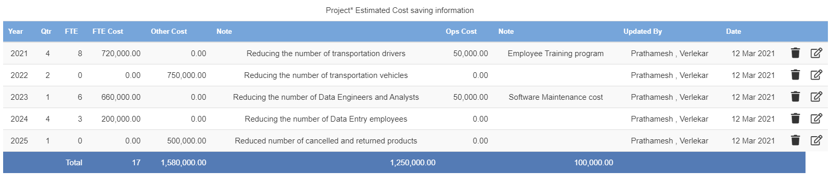
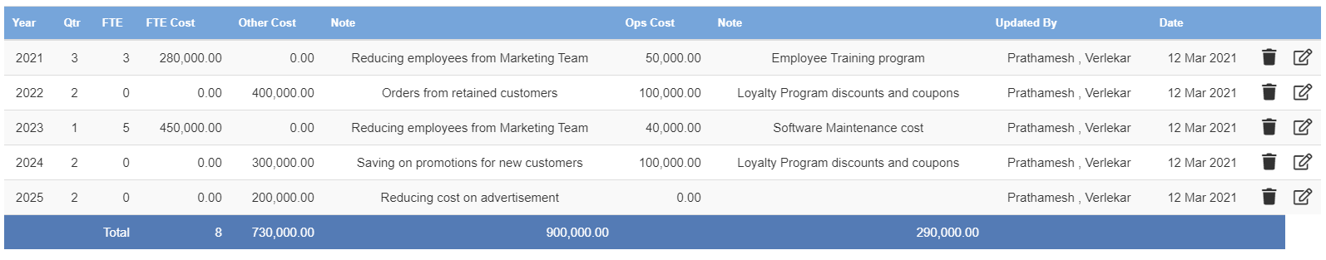
Estimated Return on Investment Comparison shows that ROI for Efficiently Managing Logistic would be more compared to Customer Loyalty Project
ROI for Efficiently Managing Logistics
ROI for Customer Loyalty

