Slide 1
Intelligent Cloud Platform for Smart Homes
Prepared by Jerry Gao, Professor
San Jose State University

Slide 2
What is?
-> a cloud-based service platform to support sustainable smart home community in surveillance monitor and alerting for safety, security, and emergency Support.
This cloud platform is designed and developed based on home-based big data and machine learning models to support home-based and community-oriented surveillance monitor and alerting for community safety watch, security alert, and emergency support.
Major Objectives:
To provide intelligent service solutions for building sustainable connected smart homes and communities and environments by providing smart Ai-powered surveillance framework and service for safety watch, secure monitor, and emergency alerts and responses.
Application cases:
Smart senior home community watch and smart campus security.

Slide 3


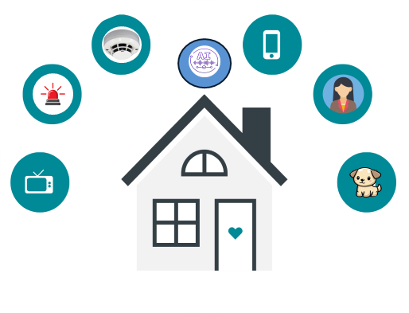


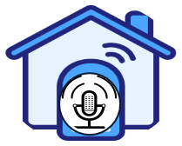

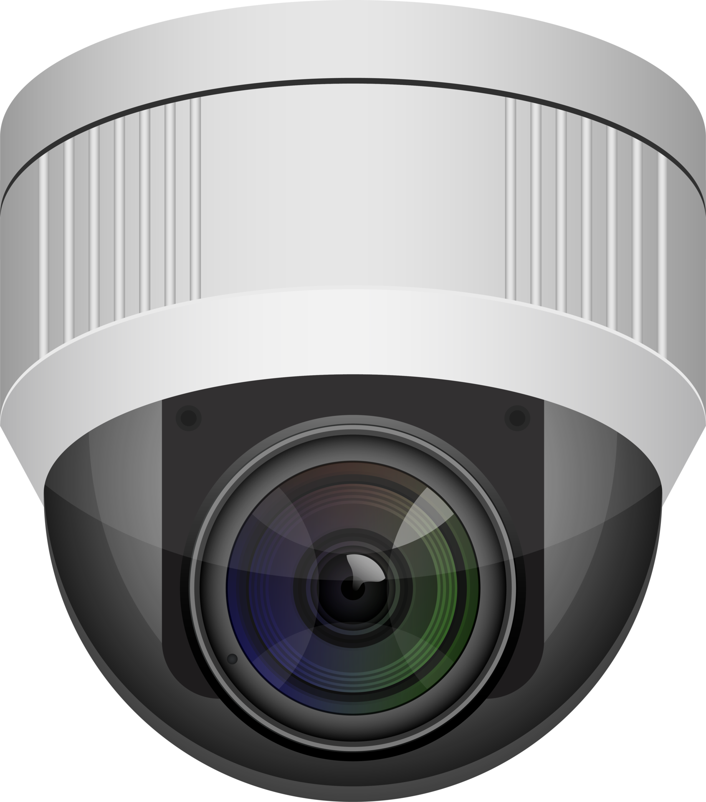







Intelligent Cloud Platform for Smart Homes
– Intelligence Services
Electric Device
Noise
Face
Detection
Alarm
Noise
Phone Noise
Brugler
Emergency
Noise
Human Noise
Stranger
Break-in
TV Noise
Animal Noise
Pet
Bedroom Noise
Kitchen Noise
Kids
Kitchen Fire
Restroom Noise
Resident

Slide 4
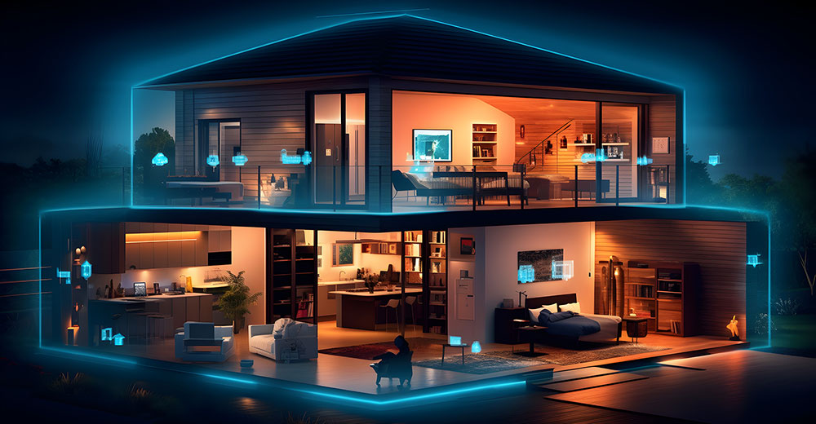
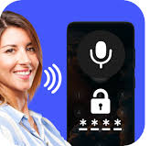


Sound-Based Intelligence Services in Homes and Communities
Voice-based
Smart Locker
Emergency Sound
Detection/Classification
Indoor and Outdoor
Sound Anomaly
Detection/Classification
Emergency Sound
Detection/Classification
Smoke sensor sound
Gas sensor sound
Gun shot sound
Explosion sound
Human-help sound
Outdoor Sound Anomaly
Human-fighting and scream sound
Storm/Wind sound
Police siren sound
Fire-engine sound
Ambulance sound
Other sound Anomaly
Living-room Sound & Pattern Learning, Detection, Classification
Indoor Sound Anomaly
Strange sound
Strange animal sound
New device sound
Kitchen Sound & Pattern Learning, Detection, & Classification
Bedroom Sound & Pattern Learning, Detection, and Classification

Slide 5
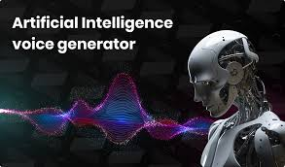
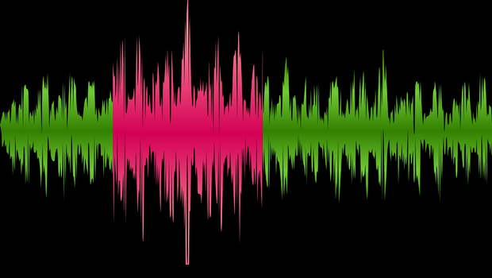

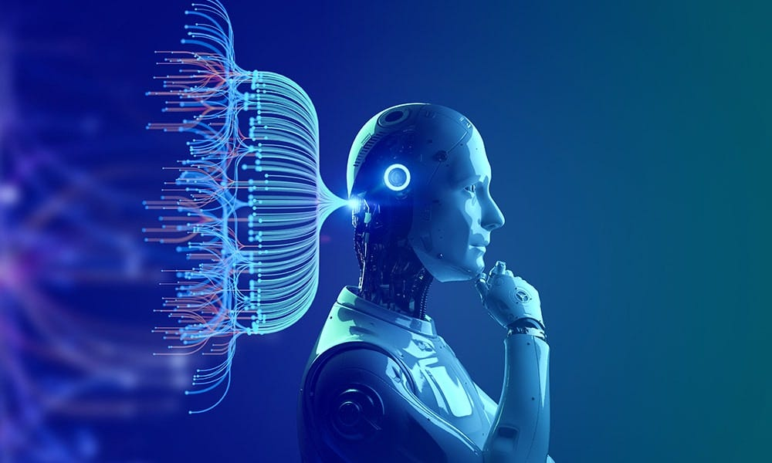
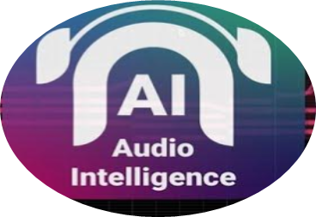
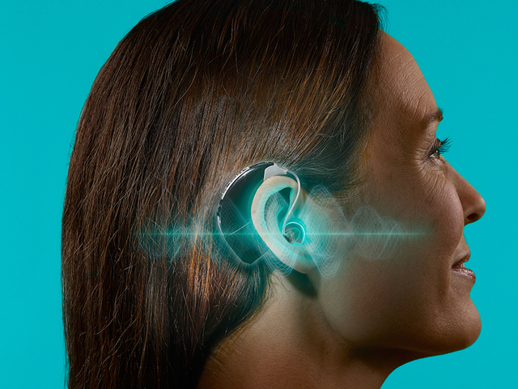
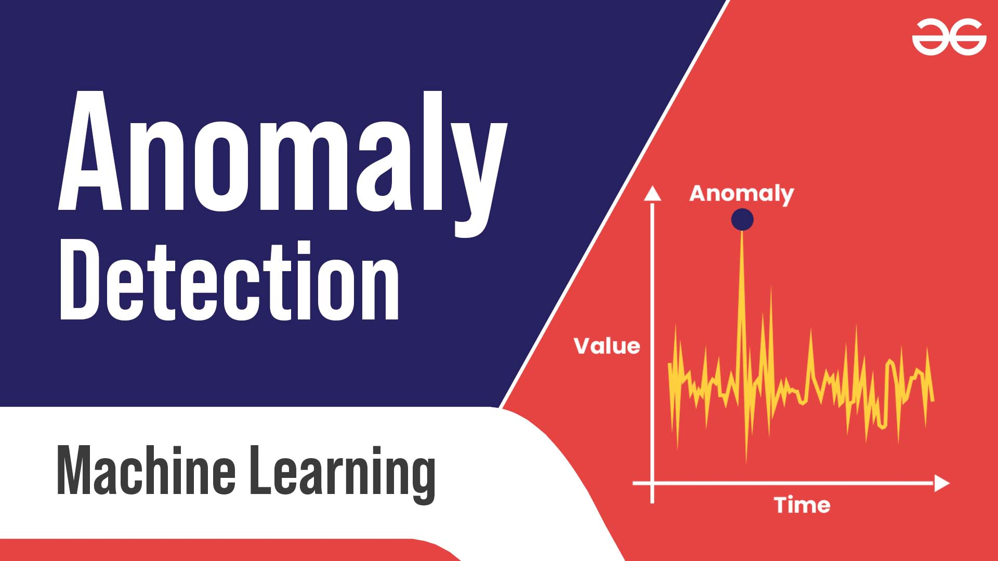
Audio/Sound Intelligence for Smart Homes
Smart Home Audio/Sound
Learning and Analysis
Alert generation and reporting for:
Emergency alert generation
Anomaly alert generation
Safety alert generation
Smart Home Audio/Sound
Detection/Classification
Smart Home
Audio/sound detection and classification for:
Room-based sound detection & classification
(Kitchen/Living/Bedroom/Restroom)
Human-based sound detection/recognition
(Residents/Strangers
Animal-based sound detection/recognition (Dog/cat….)
Emergency audio sound detection & classification
(Ambulance/fire-engine/gun shot/explosion)
IOT sensor sound detection/classification
(Alert from smoke/gas detectors)
- Electronic appliance sound detection & classification
(Microwave/Wash machine/Refrigerator/… )
Audio/sound collection and learning for:
Room-based audio learning
(Kitchen/Living/Bedroom/Restroom)
Human-based audio learning (for Residents)
Animal-based audio learning (Dog/cat….)
Emergency audio learning
(Ambulance/fire-engine/gun shot/explosion)
IOT sensor sound learning
(alert from smoke/gas detectors)
Electronic appliance audio learning
(Microwave/Wash machine/Refrigerator/… )
Smart Home Anomaly Sound Detection
Audio/sound anomaly detection for:
Room-based anomaly sound detection
Human-based anomaly sound detection
Animal-based anomaly sound detection
Home driveway anomaly sound detection
Home backyard anomaly sound detection

Slide 6















Audio/Sound Big Data for Smart Homes
Anomaly
Noise
Analysis
Noise
IOT
Noise
Animal
Noise
Appliance
Noise
TV Noise
Bedroom Room Noise
Rest Room Noise
Kitchen Room Noise
Living Room Noise

Slide 7

Integrated Hybrid Audio-Based
Real-Time Machine Learning Model Framework for​ Smart Homes

Slide 8
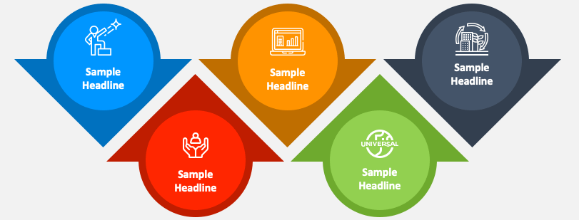






Real-Time Sound-Based Machine Learning Solution for Smart Homes
Sound Detection
And Classification
Alerting and
Reporting
Sound Collection
Sound Learning
And Understanding
Anomaly
Sound Detection and Classification

Slide 9

Real-Time Integrated Hybrid Machine Learning Model Framework
Bedroom Room Noise
Sound Detection and Classification Model
Alerting Report Generation
Rest Room Noise
Sound Collection
Anomaly Detection and Classification Model
Anomaly Alerting and Report Generation
Kitchen Room Noise
Sound Learning and Analysis Model
Anomaly Analysis Report Generation
Living Room Noise

Slide 10
Smart Home Intelligent Cloud Platform
Infrastructures and Components
Smart Home Data Storage
Connectivity
Smart Home intelligent SaaS and Solutions

Slide 11















Intelligent Cloud Platform for Smart Homes
– Major Features
Home-Based
Audio/Sound
Intelligence
Home-Based
Video
Intelligence
Edge-Based
Smart Agent
For Smart Homes
Cloud
Assistant
Agent
Admin Monitor
And Mobile App
Support
Center
Assistants
Connectivity
Network
Home Audio/Sound
Big Data Store

Slide 12

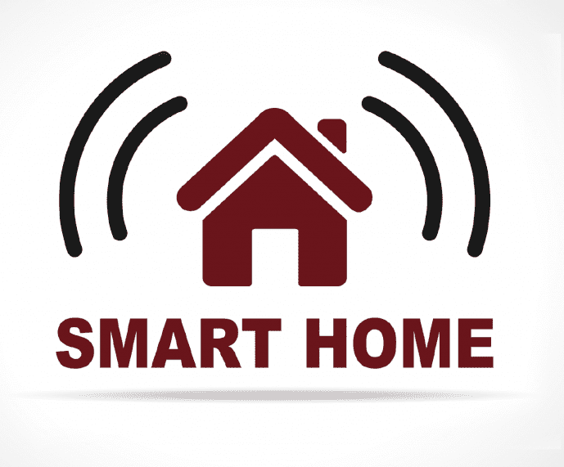
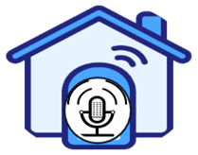

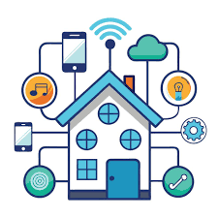




Intelligent Cloud Platform for Smart Homes
– System Infrastructures
Cloud
Assistant
Agent
Home-Based
Audio/Sound
Intelligence
Edge-Based
Smart Agent
For Smart Homes
Home-Based
Video
Intelligence
Admin Monitor
And Mobile App
Edge-Based
Smart Community
Smart Home
IOT & Green
Station
Home Audio/Sound
Big Data Store

Slide 13
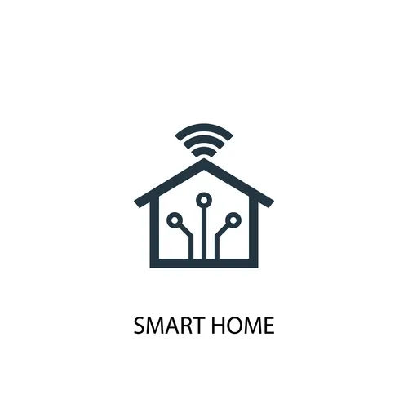






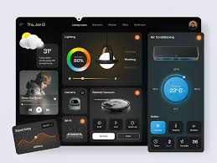
Intelligent Cloud Platform for Smart Homes
– AI Cloud Services
HomeAI
IOT Device
Management
HomeAI
Model
Management
HomeAI
Alert
Management
Smart Home
Intelligent
Home Cloud
Platform
HomeAI
Billing
Management
HomeAI
Data
Management
HomeAI
Cloud
Dashboard
HomeAI
System Admin

Slide 14

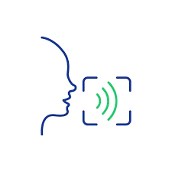

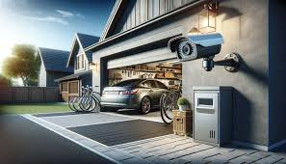



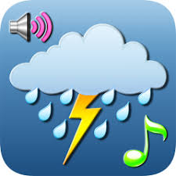




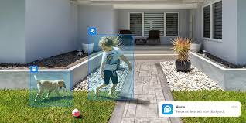
Intelligent Cloud Platform for Smart Homes
– Intelligence Services
Stranger detection
classification
Human & Pet
sound detection
Classification,
recognition
Brugler detection
classification
Hybrid SmartHome
AI Models for Audios
Hybrid SmartHome
AI Models for Videos
Break-in detection
classification
Emergency sound
detection
classification
Face detection
Weather noise
detection
classification
Resident detection
& recognition
Hybrid SmartHome
AI Models with
Decision-Makers
Fire detection
& classification
Appliance noise
detection
classification
Kids & Pets
detection
& classification

