Slide 1
SneakerHeads
Prathamesh Ranshur. 210943120073 Guided by: Mrs. Harshita Maheshwari
Rohit Kale. 210943120082
Jagruti Borse. 210943120022
Shahezad Khan. 210943120088

Slide 2
Contents:
Introduction
Problem Definition
Existing and Proposed System
Objective
Users
Technologies Used
Screenshots of Project
Conclusion
Future Enhancements

Slide 3
Introduction
Sneakers are an integral part of our dressing-up routine, and you can go from formal to party, simple to stylish, casual to trendy in minutes by simply switching your shoes.
A huge variety and design of sneaker shoes are now available in the market for various activities.
The value of a good pair of shoes is constant. Online shopping is the process preferred by many these days.
This online sneaker shopping will relieve people by providing access for purchasing, renting exclusive collection sneakers.
The Purpose of the project is to build an application program to provide a platform to rent expensive shoes at an affordable range that can be convenient for the customer and also manage the sales of the shoes.

Slide 4
Problem Definition
Nowadays, the common people cannot afford the costly exclusive collections of shoes. So, our proposed website is for these people to make these expensive shoes available on a rental basis.
In order to increase online shopping, customer online shopping behavior while shopping online should be given priority.
The Current shopping System is critical to set up online shops, customers to browse through the shops, and a system administrator to approve and reject requests for new shops and maintain lists of shop categories.
This is a small scale project for Online Sneakers shopping System. The basic idea is that the customer can buy sneakers from anywhere during any time by using their email and password through which they have been logged in.
Some sneakers are too expensive for getting a hands-on, so we have provided a feature of buying a sneaker through rental system which is not present in existing systems.

Slide 5
Existing and Proposed System
Existing System:
Traditionally if anyone wanted to buy a sneaker, he/ she would have to physically go a store and buy a sneaker which was good for older days when technology was not that improved but as time passed Online Systems were developed which consisted of an online application for buying sneakers without physically going to the place.
Proposed System:
A website where the customer can afford the exclusive high cost sneakers on the rental basis on a daily charges.

Slide 6
Objective
To develop an easy-to-use web-based interface where users can search for products, view a complete description of the products for renting or ordering.
It provides an easy and convenient way to search for products specific to their needs.
List a set of products based on the search and the user can filter the list based on various parameters.
A user can view the specification of the product with the image.
The objective is to book the shoe from the platform as per the customer demand.

Slide 7
Users
Admin:
Log in to the system.
View the list of all registered customers and shops.
Add, remove, edit and update the details of the product
Maintain a record of the sales.
Customer:
Log in to the system
Select the shop for rent/buy the product
Add/remove the product from the cart
View the product into the catalog
Book the product
Book time slot for rent

Slide 8
Technologies Used
ReactJS: ReactJS is a declarative, efficient, and flexible JavaScript library for building reusable UI components. It is an open-source, component-based front end library responsible only for the view layer of the application.
MySQL:MySQL is a relational database management system based on the Structured Query Language, which is the popular language for accessing and managing the records in the database.
Spring: The Spring Framework provides a comprehensive programming and configuration model for modern Java-based enterprise applications - on any kind of deployment platform.
Spring Boot:It is a Spring module that provides the RAD (Rapid Application Development) feature to the Spring Framework. It is used to create a stand-alone Spring-based application that you can just run because it needs minimal Spring configuration. In short, Spring Boot is the combination of Spring Framework and Embedded Servers.
Testing: Postman is an API platform for building and using APIs. The Postman platform includes a comprehensive set of tools that help accelerate the API lifecycle—from design, testing, documentation, and mocking to the sharing and discoverability of your APIs.

Slide 9
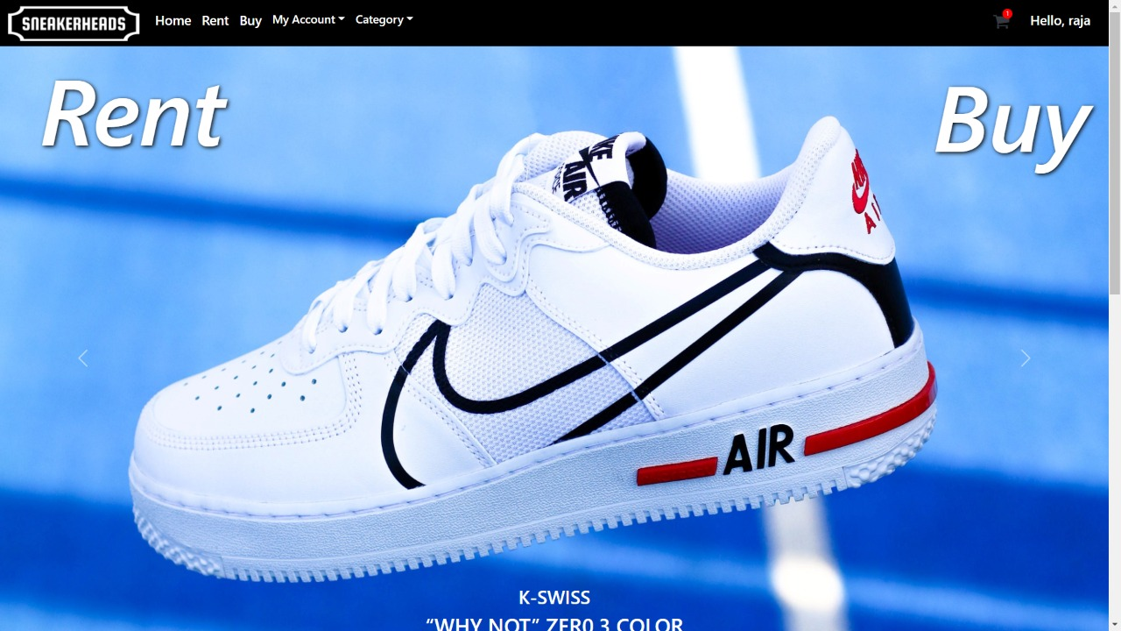
Homepage
Customer Login

Slide 10
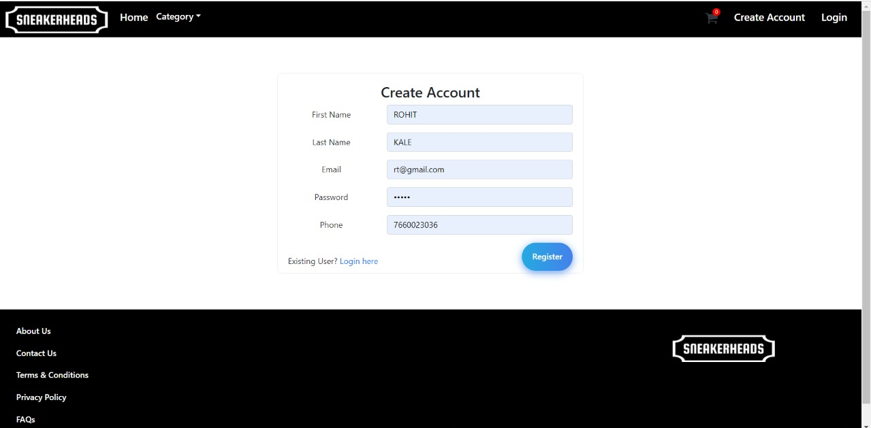
Registration Page
Customer Registration

Slide 11
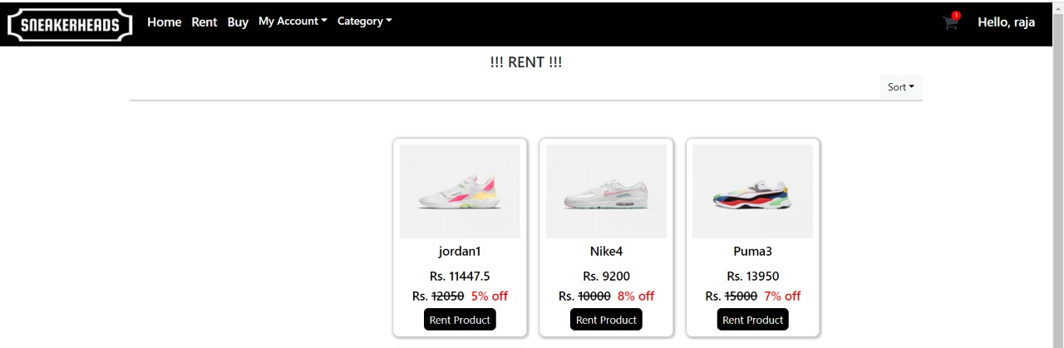
Rent page
Rental functionality for customer

Slide 12
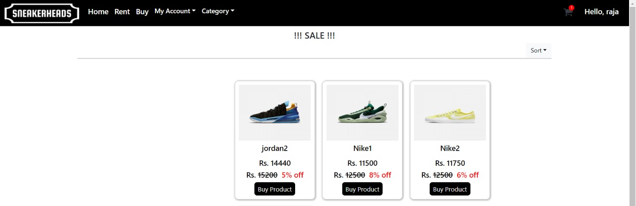
Buying page
Buying functionality for Customer

Slide 13
Conclusion
This proposed system for the buying and renting of the sneakers makes the customer to have the product at an affordable range and experience the most exclusive collection of the sneakers. This varied sneakers are in high demand among the people which gives a boost to the demand in these sneakers.

Slide 14
Future Enhancements
Accessories can be added.
Kids category can be included.
Reliable payments methods with securities can be included.

Slide 15
THANK YOU 🙂

