Slide 1

Code Wizards Introducing you with Chanakya : The ArthaMitra (Financial Friend)
Problem statement 1 - Create an interactive mobile app (can be a web portal too) that educates young adults (especially college students) about personal finance. Cover topics like budgeting, saving, investing, and managing debt. Gamify the learning experience to make it engaging.

Slide 2
Empowering Financial Literacy Across Generations
“Financial Literacy is not an option, it’s a necessity.”
According to survey, only 24% people of total population demonstrate basic financial literacy.
Our presentation aims to empower the individuals across generations with essential money management skills
We have customized our content to suit various age brackets, ensuring that each segment is tailored for maximum impact and relevance.

Slide 3
Interactive Tools | Informative Tools
Expense Tracker | Trends
Goal Setter | Tax System
Quiz | Mutual Funds
SIP Calculator | Insurance Policies
Chat Bot | Blogs (Bnews)
Reward Games

Slide 4
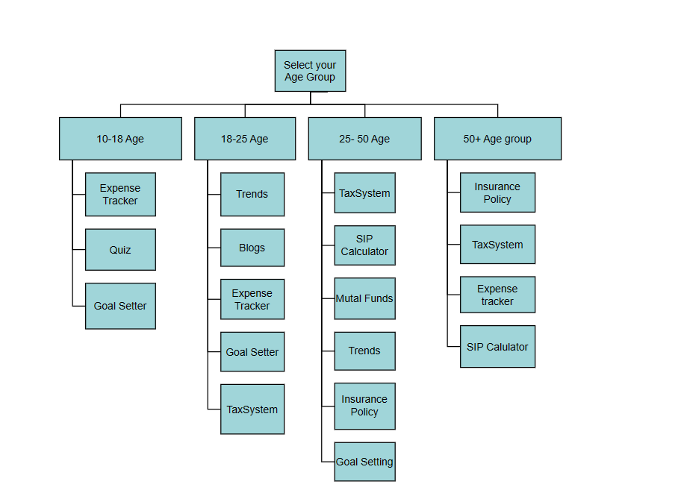
Flowchart For Implementation

Slide 5
Challenges & Future growth potential
Getting Realtime authentic data
Investment tracking systems, which will track all your FD , MF investments at one page showing how your investments are performing using Realtime changing ROR.

Slide 6
Learning Outcomes
1. Responsive Design Implementation: Ensuring the application's responsiveness across different devices and screen sizes, improving user experience and accessibility.
2. Deepened Understanding of Financial Concepts: Exploring tax-saving options and insurance products, gaining practical knowledge in financial planning and management.
3. Integration of External Content: Embedding YouTube videos into the application, showcasing the ability to work with external content seamlessly.
4. Attention to User Needs: Understanding user requirements for tax and insurance information, focusing on user-centric design and content delivery.

Slide 7
References
https://mint.intuit.com/
https://www.nerdwallet.com/
https://www.acorns.com/
https://www.khanacademy.org/college-careers-more/personal-finance
https://www.investopedia.com/
And The most important – ALL THE MENTORS

Slide 8

Thank You

