Slide 1

Multiple Linear Regression on Advertising Sales Dataset
Math 7203-Numerical Analysis
Mini Project – 2

Slide 2
Background
Multiple Linear regression is a statistical technique that uses explanatory variables to predict the outcome of a response variable.
The goal of MLR is to model the linear relationship between the independent variables and dependent variable.
In essence, MLR is the extension of ordinary least square(OLS) regression because it involves more than one independent variables.

Slide 3
Mathematical formula of MLR
yi = B0 + B1xi1 + B2xi2 + … + Bmxim + e
Where, for i = n observations:
yi = dependent variable
xi = independent variable
B0 = y-intercept
Bp = slope coefficients for each independent variable
e = model’s error term (residual)

Slide 4
Assumptions of MLR
There is a linear relationship between the dependent variables and the independent variables
The independent variables are not too highly correlated with each other
Residuals should be normally distributed with mean 0 and variance (sigma)σ

Slide 5
Problems in Regression
Overfitting: Overfitting occurs when a model is too complex and fits the noise in the training data, rather than the underlying patterns. This can result in poor performance on new, unseen data.
Underfitting: Underfitting occurs when a model is too simple and does not capture the underlying patterns in the data. This can result in poor performance on both the training data and new, unseen data.
Outliers: Outliers are data points that are significantly different from the majority of the data. Outliers can have a large impact on the regression model and can cause it to be biased or have poor performance.
Multicollinearity: Multicollinearity occurs when two or more input variables are highly correlated. This can lead to unstable and unreliable estimates of the regression coefficients.
Non-linearity: Some datasets may have non-linear relationships between the input and output variables. If a linear regression model is used, it may not capture these non-linear relationships, resulting in poor performance
Heteroscedasticity: Heteroscedasticity occurs when the variance of the errors in the regression model is not constant across all levels of the input variables. This can result in biased estimates of the regression coefficients and incorrect inference.

Slide 6

Overfitting

Slide 7

Underfitting

Slide 8
Cross Validation
Cross validation is a technique used in statistics to evaluate the performance of a model
It involves dividing a dataset into multiple subsets, or "folds", and using each fold as both a testing set and a training set
The process typically involves the following steps:
Divide the dataset into k folds.
Train the model on k-1 folds of the data.
Test the model on the remaining fold.
Repeat steps 2-3 for each fold.
Calculate the average performance across all the folds.

Slide 9
Why cross-validation
The purpose of cross validation is to ensure that the model is not overfitting or underfitting the data, and that it can generalize well to new, unseen data
It is particularly useful in situations where the dataset is small or when the model has a large number of parameters
Cross validation can be used to compare the performance of different models and select the one that performs best on the data
Cross validation helps to ensure that a model is not overfitting the data, which can occur when the model is too complex or when the dataset is too small
Cross validation can provide a more reliable estimate of a model's performance than a single train/test split, as it uses multiple splits of the data to evaluate the model.

Slide 10
Pros of Linear Regression
It can handle multiple input variables: Multiple linear regression can handle situations where we have multiple input variables that may be related to the output variable. This is useful in many real-world scenarios where the output variable may depend on several factors.
It provides a quantitative measure of the strength of the relationship: Multiple linear regression provides a coefficient of determination (R-squared), which measures the proportion of the variation in the output variable that is explained by the input variables. This provides a quantitative measure of the strength of the relationship between the input and output variables.
It can be used for prediction and inference: Multiple linear regression can be used both for prediction and for inference. That is, it can be used to predict the value of the output variable for new input values, and it can also be used to test hypotheses about the relationship between the input and output variables.
It can handle interactions between input variables: Multiple linear regression can handle situations where the effect of one input variable on the output variable depends on the value of another input variable. This is known as an interaction effect, and it can be included in the model to better capture the relationship between the input and output variables.

Slide 11
Cons of Linear Regression
Linear regression assumes a linear relationship between the input and output variables: Linear regression assumes that the relationship between the input and output variables is linear, which may not be the case in some situations. For example, if the relationship is non-linear, then linear regression may not provide an accurate model
It is sensitive to outliers: Linear regression is sensitive to outliers, which are data points that are significantly different from the majority of the data. Outliers can have a large impact on the regression model and can cause it to be biased or have poor performance
It may not work well with correlated input variables: Linear regression may not work well when the input variables are highly correlated with each other, which is known as multicollinearity. This can lead to unstable and unreliable estimates of the regression coefficients
It may overfit or underfit the data: Linear regression may overfit the data if the model is too complex, resulting in poor performance on new, unseen data. On the other hand, linear regression may underfit the data if the model is too simple and does not capture the underlying patterns in the data
It may not handle categorical variables well: Linear regression may not handle categorical variables well, since they cannot be included in the model directly. Instead, they must be transformed into dummy variables, which can lead to issues with multicollinearity and overfitting

Slide 12
Steps in Code
Our code performs cross-validation for a multiple linear regression model using four validation sets
The data is first partitioned into four sets using the iloc function. Then, a loop is used to perform cross-validation, where for each iteration, one set is used as the validation set, and the remaining three sets are used as the training set
Adding an intercept term to the independent variables to allow the model to fit better to the data.
Estimating Beta_hat by taking inverse of multiplication of Transpose of X matrix with X matrix and then again multiplying by inverse of multiplication of Transpose of X matrix with X matrix
The mean squared error (MSE) and R-squared value are calculated for each validation set, and the results are stored in separate lists

Slide 13
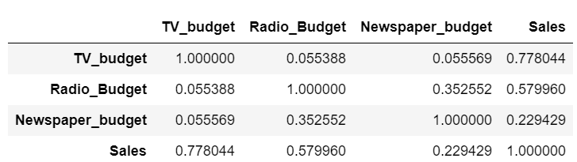
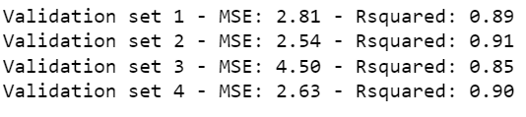
Result

Slide 14

Interpretation
Newspaper shows very less correlation with Sales
Validation set 2 contains less MSE and more R_square value out of all.
It is common practice to use the average performance across all validation sets as the final evaluation metric for the model. This helps to ensure that the model performs well on a variety of data, rather than just one particular subset

Slide 15
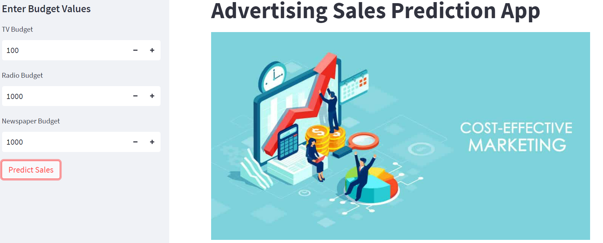
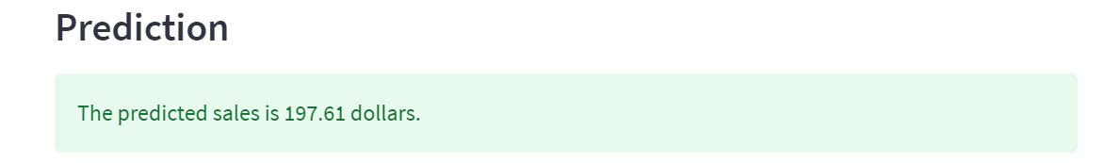
Deployment using Streamlit

Slide 16
Thankyou
Professor - Stuart Brorson
TA - Hiu Ying Man
Student - Abhilasha Jain
Student - Pranav Ahluwalia
Student - Layla Eirwe
Student - Jiazheng Zhao
Student - Anping Ye
Student - Jiayuan Zhang

