Slide 1

FACULTY OF ENGINEERING AND TECHNOLOGY
SCHOOL OF COMPUTER SCIENCE AND ENGINEERING
DEPARTMENT OF COMPUTER ENGINEERING AND TECHNOLOGY
SY M.Tech, Academic Year 2024-2025, Sem-3
Project [CSC7PR01A] Review Presentation on
Lung Cancer Early Detection through AI-Enabled Chest CT Images using Deep Learning
Presented By- Under the Guidance of-
Prathamesh Patil (1032233733) Prof. Jayshree Aher
4/18/2024
1

Slide 2
Outline
Introduction
Problem Statement
Objectives
Literature Review
Methodology
Results
Data Description
Feature Extraction
Model Selection
Results
Evaluation Metrics
Discussion
Limitations
Clinical Relevance
Conclusion
References

Slide 3
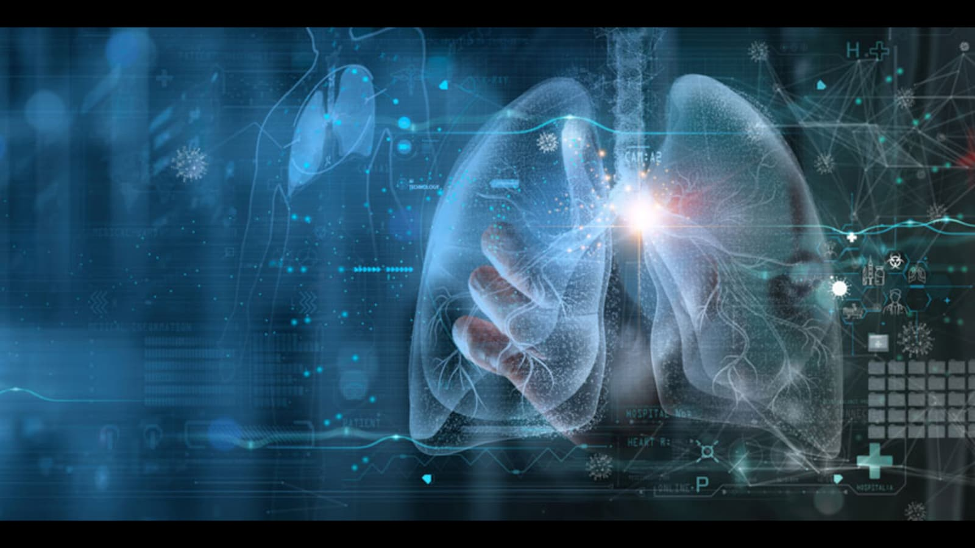

Introduction
Global Health Challenge: Lung cancer is one of the most pressing global health issues known for its aggressive progression and frequent diagnosis at advanced stages.
Smoking Statistics: Approximately 85% of lung cancer cases in men and 75% in
women are linked to smoking, highlighting a significant public health concern.

Slide 4
Introduction
.
Impact in Developing Countries: The burden of lung cancer is particularly severe in
developing countries, where many individuals die from the disease due to limited healthcare resources and rate detection.
Need for Early Diagnosis: There is an urgent need for effective early diagnostic strategies to improve patient outcomes.
Role of Predictive Analytics: The integration of predictive analytics, especially methodologies like fuzzy logic, presents promising opportunities for enhancing early detection of lung cancer.
Potential Benefits: Early detection through predictive analytics could significantly mitigate the devastating impact of lung cancer on patients and healthcare systems.

Slide 5
Problem Statement
This research proposes a smart system to find lung cancer early by looking at X-ray or CT scan pictures. The system should be able to tell what type of lung cancer it is, like adenocarcinoma or squamous cell carcinoma, small cell carcinoma, and large cell carcinoma.
I want to use technology like image processing and machine learning to ensure patients get the right treatment quickly and improve their chances of getting better.

Slide 6
Objectives
Develop an intelligent system for early detection of lung cancer using X-ray or CT scan images.
Utilize advanced image processing techniques and machine learning algorithms for accurate detection.
Identify and classify lung nodules as either benign or cancerous.
Differentiate between various types of lung cancer, including:
Adenocarcinoma
Squamous cell carcinoma
Small cell carcinoma
Large cell carcinoma

Slide 7
LITERATURE SURVEY
CitationA | Author(s) | Paper Title | Methodology | Key Findings | Algorithms | Accuracy
[1] | Xiaojian Ma . | "Research on the Auxiliary Classification and Diagnosis of Lung Cancer Subtypes Based on Histopathological Images" (2021)(Journal). | Developed Sparse Group Lasso (SGL) combined with SVM for tumor classification using histopathological images | SGL-SVM outperformed traditional SVM methods by incorporating sparsity and group-level feature selection, improving interpretability and accuracy. | Sparse Group Lasso Support Vector Machine (SGL-SVM). | 95%
[2] | RABBIA MAHUM 1ANDABDULMALIKS. AL-SALMAN 2 | "Lung-RetinaNet: Lung Cancer Detection Using a RetinaNet" (2022)(Journal) | The model modifies RetinaNet with multi-scale fusion, dilated context modules, k-means anchors, and layer integration for improved tumor detection. | The model improves early-stage lung tumor detection using multi-scale fusion, contextual info, and k-means clustering. | RetinaNet | 96%

Slide 8
LITERATURE SURVEY
CitationA | Author(s) | Paper Title | Methodology | Key Findings | Algorithms | Accuracy
[3] | Tehnan I. A. Mohamed Absalom El-Shamir Ezugwu | "Enhancing Lung Cancer Classification and Prediction With Deep Learning and Multi-Omics Data" (2024)(Journal) | The study develops a deep learning model, addressing data preparation, gene identification, and challenges like imbalance and bias. | The model integrated multi-omics data, identified key genes, and addressed class imbalance with SMOTE. | CNN | 96.5%
[4] | Wang | “Analyzing the Dynamics of Lung Cancer Imaging Data Using Multiscale Entropy and Refined Fuzzy Entropy Techniques” (2019)(Journal) | Lung cancer images were analyzed using multiscale entropy and machine learning techniques to differentiate between non-small cell lung cancer (NSCLC) and small cell lung cancer (SCLC). | Refined fuzzy entropy effectively analyzes lung cancer images, identifying significant features for differentiating NSCLC and SCLC. | SVM and CNN | 97%

Slide 9
LITERATURE SURVEY
CitationA | Author(s) | Paper Title | Methodology | Key Findings | Algorithms | Accuracy
[5] | HENG YU ZHIQING ZHOU , AND QIMING WANG | "Deep Learning Assisted Prediction of Lung Cancer on Computed Tomography Images Using the AHHM" (2020)(Journal) | This study proposes the Adaptive Hierarchical Heuristic Mathematical Model (AHHMM) for lung cancer prediction using deep learning on computed tomography (CT) images | The AHHMM model accurately detected lung cancer in CT images using deep learning. | CNN | 96.67%
[6] | Onur Ozdemir | "A 3DProbabilistic Deep Learning System for Detection and Diagnosis of Lung Cancer Using Low-Dose CT Scans" (2021)(Journal) | Low-dose CT scans are analyzed using 3D CNN models for lung cancer detection and classification. | The proposed system effectively detects and classifies lung cancer in low-dose CT scans, providing reliable probabilistic outputs. | CNN, RNN, | 94.32

Slide 10
Research Gap
Develop sensitive CNN algorithms for early lung cancer detection to improve treatment outcomes.
Combine different medical imaging types (CT scans, X-rays, histopathology) to improve diagnostic accuracy.
Implement techniques to handle imbalanced datasets effectively and enhance model performance.
Improve CNN interpretability to build trust among healthcare professionals and patients.
Validate CNN models extensively in clinical settings for real-world implementation.
.

Slide 11
Methodology
Dataset Collection
Data Sources: Gather X-ray and CT scan images from public databases
Image Types: Use both X-ray and CT scan images to improve detection accuracy.
Image Preprocessing
Resizing: Adjust all images to a standard size (e.g., 512x512 pixels) for consis consistency.
Normalization: Standardize pixel values to enhance model performance.
Filtering: Apply filters to reduce noise and improve image quality.
Image Segmentation
Thresholding: Use methods like Otsu's to separate the lungs from the background.
Morphological Operations: Refine segmented images using techniques like dilation and erosion.

Slide 12
Methodology
Feature Extraction
Texture Features: Gabor filters capture important textures in lung images.
Statistical Features: Calculate key statistics (mean, variance) from the segmented areas.
Model Training
Deep Learning Model: Choose a model architecture (e.g., GoogLeNet) suitable for image classification.
Data Augmentation: Enhance the dataset through techniques like rotation and flipping to improve model robustness.
Training Process: Set hyperparameters (like batch size and number of epochs) and train the model using the prepared dataset.

Slide 13
Methodology
Model Evaluation
Metrics: Assess model performance using accuracy, precision, recall, and F1-score.
Confusion Matrix: Visualize the performance by comparing predicted and actual results.
Results Visualization
Present examples of input images alongside predicted outputs to show model effectiveness.

Slide 14
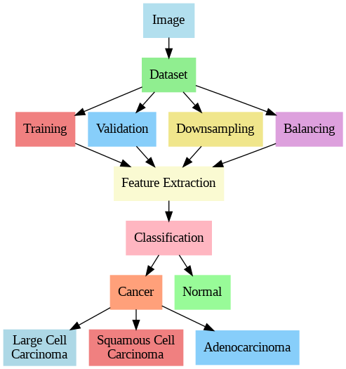
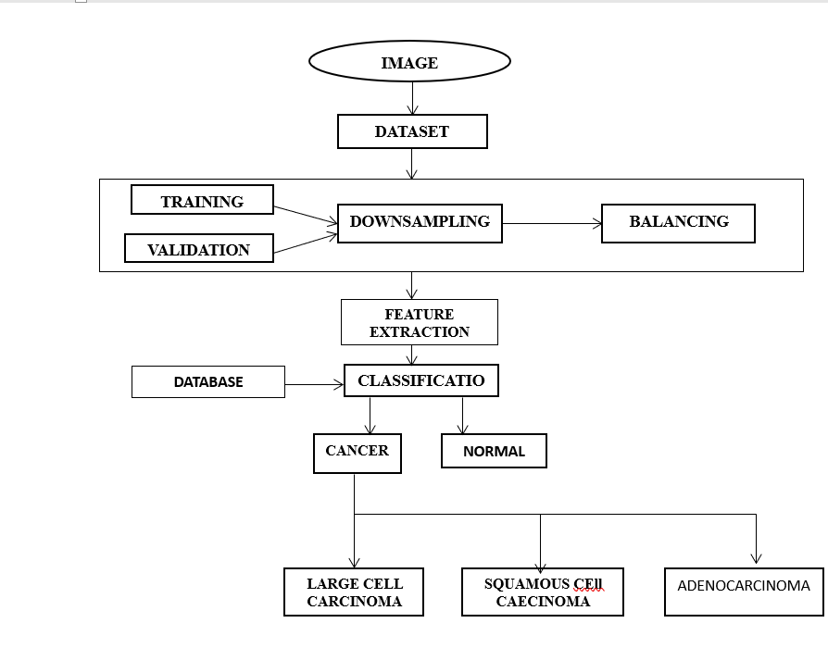
EXECUTED SYSTEM

Slide 15
EXECUTED SYSTEM
1. Dataset:
Collection of labeled chest X-rays or CT images with normal and cancerous lungs (adenocarcinoma, squamous cell carcinoma, large cell carcinoma).
2. Training/Validation:
Training: Model learns patterns from images.
Validation: Evaluates model performance to adjust parameters.
3. Balancing/Downsampling:
Balancing: Corrects unequal class sizes using oversampling/downsampling.
4. Feature Extraction:
CNNs automatically extract important image features (edges, textures).

Slide 16
EXECUTED SYSTEM
5. Database:
Stores images and labels for model training and testing.
6. Classification:
Model classifies images into normal, adenocarcinoma, squamous cell carcinoma, or large cell carcinoma.
7. Cancer Types:
Adenocarcinoma, large cell carcinoma, squamous cell carcinoma—types of lung cancer classified.
8. Model Evaluation:
Performance measured using accuracy, precision, and recall.

Slide 17
DATA DESCRIPTION
Dataset Details
Name: Lung Cancer Detection Dataset
Description: 14000 chest X-ray images categorized into Normal,large cell carcinoma, and Squamous Cell Carcinoma,and adenocarcinoma.
Size: 14000 images
Class Distribution:
Normal:5000
Adenocarcinoma: 4000
Squamous: 5000
Specifications: JPEG, 512x512 pixels
Source: Kaggle
Preprocessing: Resized, grayscale, augmented.
Purpose: Train a deep learning model for lung cancer classification.
Ethics: Anonymized images to protect privacy.

Slide 18
FEATURE EXTRACTION
GoogLeNet's early layers extract low-level features like edges, contours, and textures to detect lung nodule boundaries and tissue abnormalities.
Edges: Captures sharp changes in pixel intensity, useful for detecting lung nodule boundaries.
Contours: Helps identify the shape and outlines of lung structures.
Pixel Intensity: Measures brightness variations, crucial for highlighting differences between healthy and abnormal tissues.
Textures: Identifies patterns within lung tissues that may indicate abnormalities or early signs of cancer.
Shading Differences: Detects variations in shading that can point to the presence of nodules or other irregularities.
.

Slide 19
FEATURE EXTRACTION
In the deeper layers of GoogLeNet, high-level features such as tumor shape, nodule texture, lung tissue classification, vascular structures, and histopathological patterns are extracted to aid in cancer detection and classification.
Tumor Shape: Describes the size and shape of lung nodules, distinguishing benign from malignant.
Nodule Texture: Identifies irregular patterns within nodules indicating cancer.
Lung Tissue Classification: Differentiates between normal and cancerous tissues (adenocarcinoma, squamous cell carcinoma, large cell carcinoma).
Vascular Structures: Detects blood vessel abnormalities linked to tumor growth.
Histopathological Patterns: Reflects microscopic patterns to classify cancer types further.
.

Slide 20
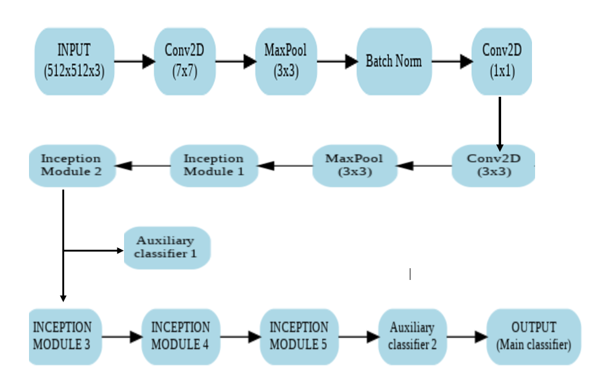
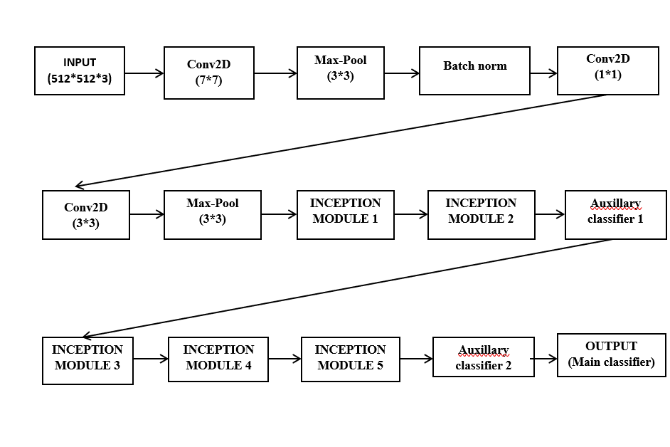

MODEL ARCHITECTURE
.

Slide 21
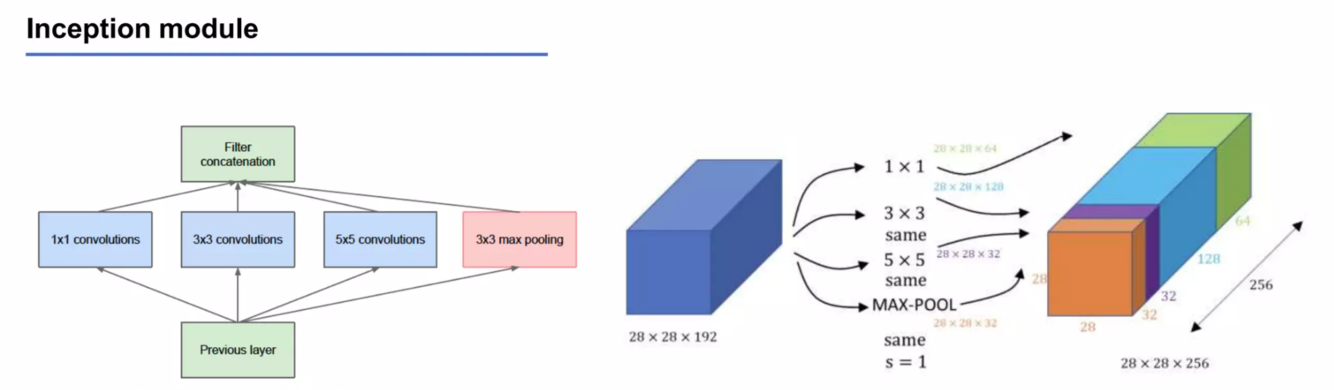
MODEL ARCHITECTURE
INCEPTION MODULE
[64, (96,128), (16,32), 32]
.
512
(512*512*3)
(512, 512, 368).
The Inception Module efficiently extracts features at multiple scales, improving image classification accuracy. It combines (1*1),(3*3),and(5*5) and large filters along with max pooling to capture a wide range of visual patterns.

Slide 22
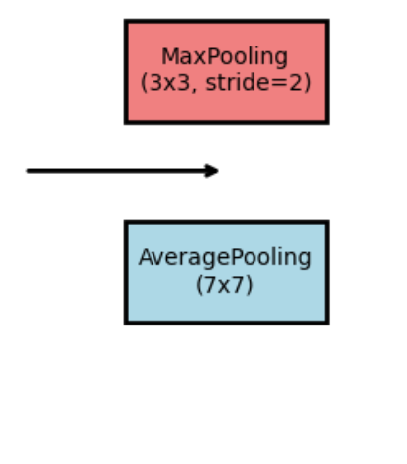
MODEL ARCHITECTURE
.
Max Pooling
Picks the highest number from each small section.
Keeps the most important features and helps with small shifts in the image.
Often used in image classification and object detection.
Average Pooling
Finds the average of numbers in each small section.
Creates smoother results and works better with noisy data.
Useful for tasks like predicting numbers or when general features matter.

Slide 23
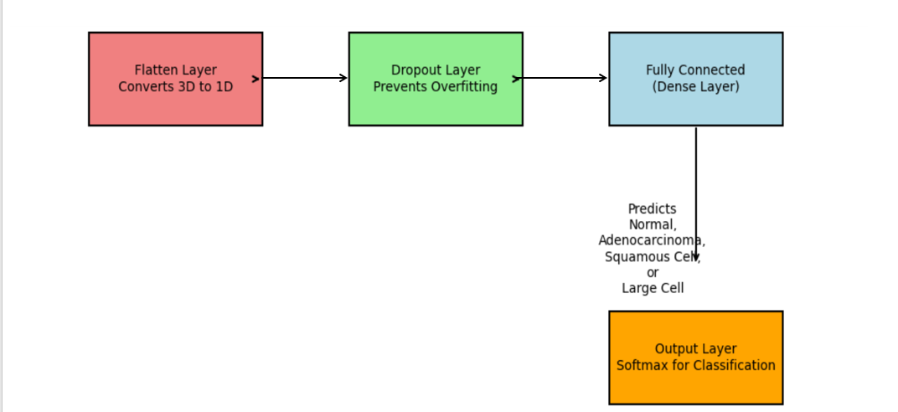
MODEL ARCHITECTURE
.
Flatten & Dropout: Prepares data for dense layers and prevents overfitting.
Fully Connected Layer: Classifies cancer types based on learned features.
Output Layer: Uses softmax to predict Normal, Adenocarcinoma, Squamous Cell, or Large Cell Carcinoma.

Slide 24
Experimental Result
Overall accuracy of 95.33%, demonstrating strong performance.
Excels in identifying "Normal" and "Adenocarcinoma" cases with high precision, sensitivity, and specificity.
Challenges in differentiating "Squamous" from "Normal" cases, with a sensitivity of 90% for "Squamous."
The subtle difference between "Squamous" and normal tissue suggests the need for further optimization.
Fine-tuning the model through data augmentation or advanced feature extraction techniques may improve performance.
Overall, the model shows great potential for cancer classification and can be further enhanced.

Slide 25
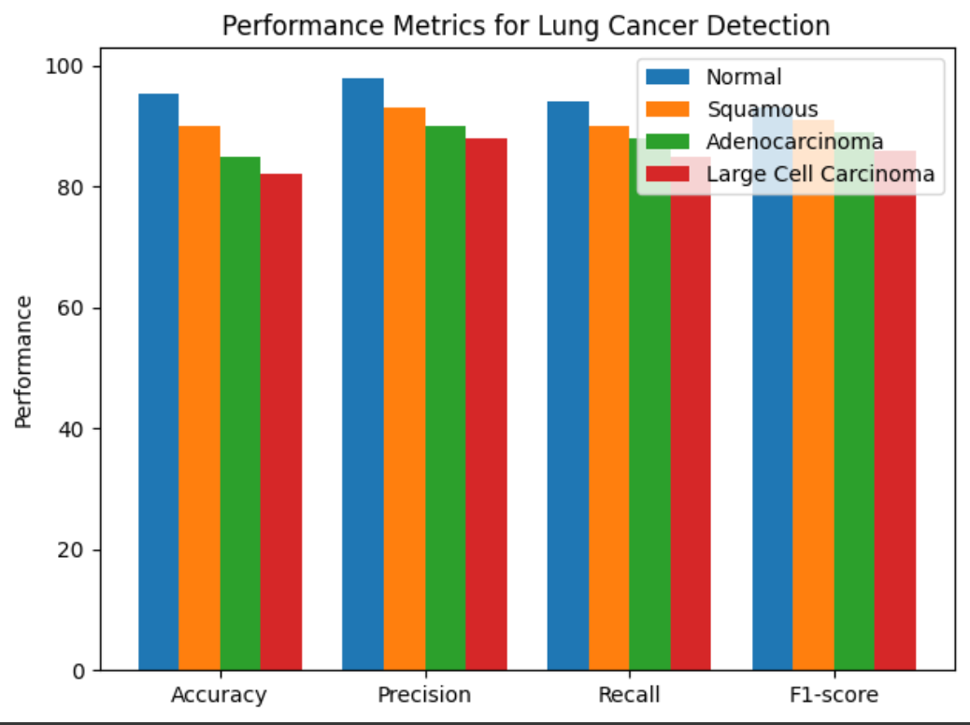
EVALUATION METRICS
.

Slide 26
EVALUATION METRICS
Accuracy: Overall correctness of the model is 95.33%.
Precision: For Normal: 98%, for Squamous: 93%, for Adenocarcinoma: 85%.
Recall (Sensitivity): For Normal: 94%, for Squamous: 90%, for Adenocarcinoma: 98%
F1-score: : For Normal: 93%, for Squamous: 91%, for Adenocarcinoma: 99%
Confusion matrix: A table showing the number of correct and incorrect predictions for each class.
.

Slide 27
LIMITATIONS
Class Imbalance
Limited Data Diversity
Confusion Matrix Interpretation Issues
Overfitting Risk
Model Complexity
Feature Extraction
Limitations
Interpretability Issues
Dependency on Quality of Input Data
.

Slide 28
CLINICAL RELEVANCE
Early Detection and Diagnosis
Personalized Treatment Plans
Reducing Misdiagnosis
Addressing Class Imbalance
Quality Assurance in Healthcare
Training and Resource Allocation
Continuous Improvement of Diagnostic Tools
.

Slide 29
PUBLICATION
This paper title "Harnessing Deep Learning for Lung Cancer Early Detection through AI-Enabled Chest CT Imaging Analysis" has been submitted to scopes ICCUBEA conference for publication.

Slide 30
CONCLUSION
The use of advanced technology to predict lung cancer from chest X-ray images is a significant medical advancement.
With 95.33% accuracy, it enables quick and reliable detection, facilitating timely care, especially in rural areas.
This technology enhances healthcare accessibility and early diagnosis, improving health outcomes for various communities.
Continued development could expand its applications in cancer detection and treatment, promoting a healthier society overall.
.

Slide 31
References
Singh et al., "Impact of COVID-19 in lung cancer detection using image processing techniques artificial intelligence and machine learning approaches" (2023): Singh and colleagues explore the influence of the COVID-19 pandemic on lung cancer detection, employing image processing techniques, artificial intelligence (AI), and machine learning (ML) approaches. The study was published in Smart Science, Informa UK Limited, in August 2023.
Nageswaran et al., "Lung Cancer Classification and Prediction Using Machine Learning and Image Processing" (2022): Nageswaran and her team investigate lung cancer classification and prediction through machine learning and image processing methodologies. Their findings are presented in the journal BioMed Research International in August 2022.
Paliwal and Kurmi, "A Comprehensive Analysis of Identifying Lung Cancer via Different Machine Learning Approach" (2021): Paliwal and Kurmi comprehensively analyze various machine learning approaches for identifying lung cancer. The study is presented at the 10th International Conference on System Modeling & Advancement in Research Trends in 2021
Wang, "Deep Learning Techniques to Diagnose Lung Cancer" (2022): Wang explores the application of deep learning techniques for diagnosing lung cancer. The research was published in Cancers, MDPI AG, in November 2022.
Aharonu et al., "Convolutional Neural Network-based Framework for Automatic Lung Cancer Detection from Lung CT Images" (2022): Aharonu and colleagues propose a convolutional neural network (CNN)-based framework for automatic lung cancer detection from lung CT images. Their work will be presented at the International Conference SMART GENCON in 2022.
Zhang et al., "A Lung Cancer Detection and Recognition Method Combining Convolutional Neural Network and Morphological Features" (2022): Zhang and his team develop a method for lung cancer detection and recognition by combining convolutional neural network (CNN) and morphological features. The study is presented at the International Conference CCET in 2022.

Slide 32
References
Cherukuri et al., "Deep Learning for Lung Cancer Prediction using NSCLS patients CT Information" (2021): Cherukuri and co-authors investigate deep learning techniques for predicting lung cancer using information from non-small cell lung cancer (NSCLS) patients' CT scans. Their findings are presented at the International Conference on Artificial Intelligence and 8 Smart Systems in 2021.
Leela, Iwin, Joseph, Duela, and Devi, "Diabetic Retinopathy Diagnosis in OCT images using Convolutional Neural Network" (2021): Leela and colleague explore the diagnosis of diabetic retinopathy in OCT images using a convolutional neural network (CNN). The research is presented at the 2nd International Conference on Smart Electronics and Communication ICOSEC in 2021.
Zhang, Yang, Gong, Jiang, and Wang, "Classification of benign and malignant lung nodules from CT images based on hybrid features" (2019): Zhang et al. propose a classification system for distinguishing between benign and malignant lung nodules from CT images based on hybrid features. Their study is published in Phys. Med. Biol. in 2019.
Soltani-Nabipour, Khorshidi, and Noorian, "Lung tumor segmentation using improved region growing algorithm" (2020): Soltani-Nabipour and colleagues present a method for lung tumor segmentation using an improved region growing algorithm. Their research is published in Nucl. Eng. Technol. in October 2020.
Wang and Li, "An automatic segmentation method for lung tumor based on improved region growing algorithm" (2022): Wang and Li propose an automatic segmentation method for lung tumors based on an improved region growing algorithm. The study WAS published in Diagnostics in November 2022

Slide 33
References
13. Rehman, M. Kashif, I. Abunadi and N. Ayesha, "Lung Cancer Detection and Classification fromChest CT Scans Using Machine Learning Techniques", 2021 1st International Conference on Artificial Intelligence and Data Analytics (CAIDA). IEEE, Apr. 06, 2021.
14. N. Cherukuri, N. R. Bethapudi, V. S. K. Thotakura, P. Chitturi, C. Z. Basha and R. M. Mummidi,"Deep Learning for Lung Cancer Prediction using NSCLS patients CT Information", 2021 International Conference on Artificial Intelligence and Smart Systems (ICAIS), pp. 325-330, 2021.
15 A. Sultana, T. T. Khan, and T. Hossain, "Comparison of Four Transfer Learning and Hybrid CNN Models on Three Types of Lung Cancer", 2021 5th International Conference on Electrical Information and Communication Technology (EICT). IEEE, Dec. 17, 2021

Slide 34
THANK YOU
Any Questions?

