Slide 1

Beer & Diaper: An Impossible Correlation

Slide 2

Summer Internship
2019
01
Company
Cognifront
02
Domain
Machine Learning
03
Time Span
6th June – 21st June

Slide 3
Why do we need Machine Learning ?
Human Expertise does not exist.
eg. Navigating on Mars
Solution Changes in Time.
eg. Routing on Computer Networks
Improving Sales.
eg. Market Basket Analysis

Slide 4

Machine Learning ?
Machine Learning
is a field of
Computer Science
which gives computer
the ability to learn
without being explicitly programmed.

Slide 5
Relation Between AI, ML & Deep Learning
Artificial
Intelligence
Machine
Learning
Deep
Learning

Slide 6
Machine learning
We have Data
We don’t have Data
Labeled Data
Supervised
Unlabelled
Unsupervised
Reinforcement
Regression
Clustering
Linear
Polynomial
SVD
PCA
K-means
Continuous
Decision Tree
Random forest
Classification
Association analysis
KNN
Trees
Logistic Regression
Naive-Bayes
SVM
Apriori
FP-Growth
Categorical
Hidden Markov Model

Slide 7
Linear Regression
Linear Regression is a linear approach to modeling the relationship between a dependent and one or more independent variable.
Types :
Simple Linear Regression.
Multiple Linear Regression.

Slide 8
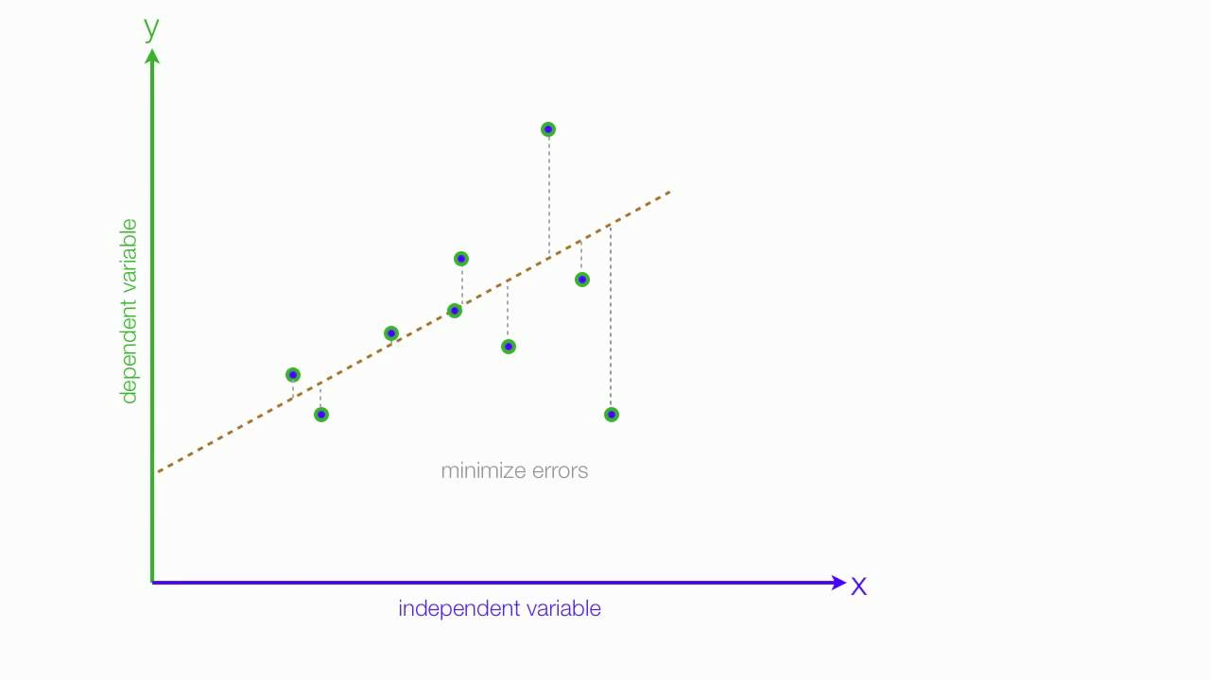

Slide 9
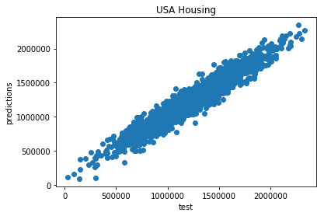
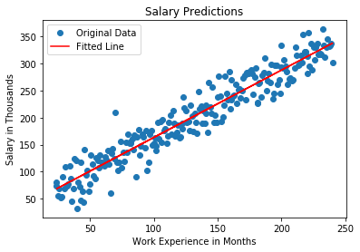
Case Study
Simple Linear Regression
Salary Prediction on basis of work Experience
Multiple Linear Regression
USA Housing price prediction
Accuracy : 90%
Accuracy : 93%

Slide 10
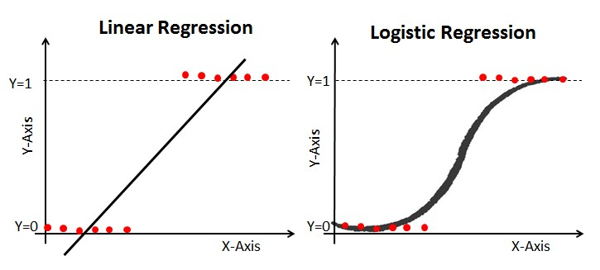

Slide 11
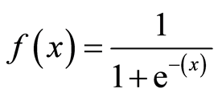
Logistic Regression
It is an Classification Algorithm.
Logistic Regression is used to model the probability of a certain class or event existing such as pass/fail, win/lose, alive/dead or healthy/sick.
Uses Sigmoid Function for finding probability.

Slide 12
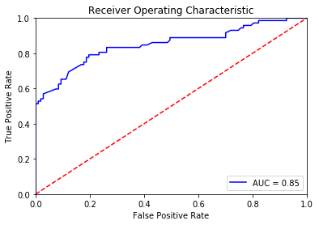
Case Study
Logistic Regression
Titanic Survival Classification
Framingham Heart Study
Accuracy : 84%
Accuracy : 82%

Slide 13
Decision Tree Classifier
A decision tree is a decision support tool that uses a tree-like graph or model of decisions.
A decision tree is a flowchart-like structure in which -
Internal Node : Test.
Branch : Outcome of the test.
Leaf Node : Class label.

Slide 14
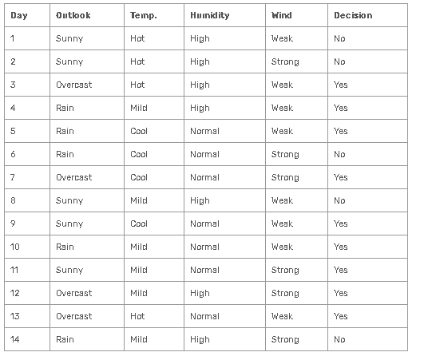
Player will play Tennis or not ?

Slide 15
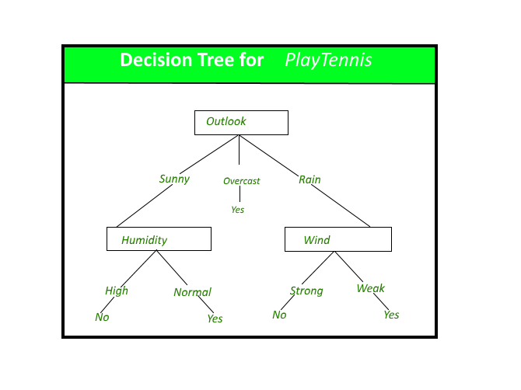
Decision Tree

Slide 16
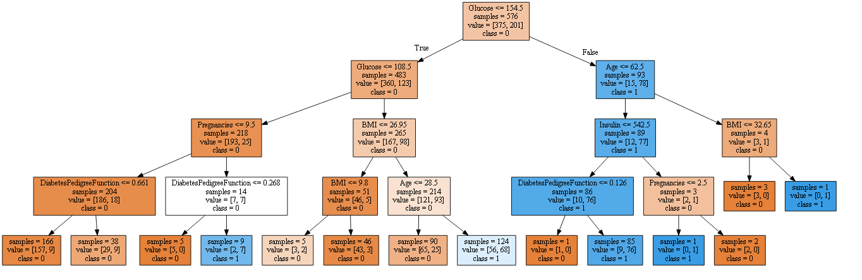
Case Study
Decision Tree Classifier
Diabetes Prediction
Accuracy : 70%
Note : Accuracy can be increased up to 80% if SVM is used instead of Decision Tree classifier

Slide 17
Random Forest Classifier
Random forests method operates by constructing a multiple decision trees at training time and outputting the mean prediction (regression) of the individual trees.
It uses multiple Decision Trees as well as Bagging Method, hence very time consuming (depending on processing power)

Slide 18
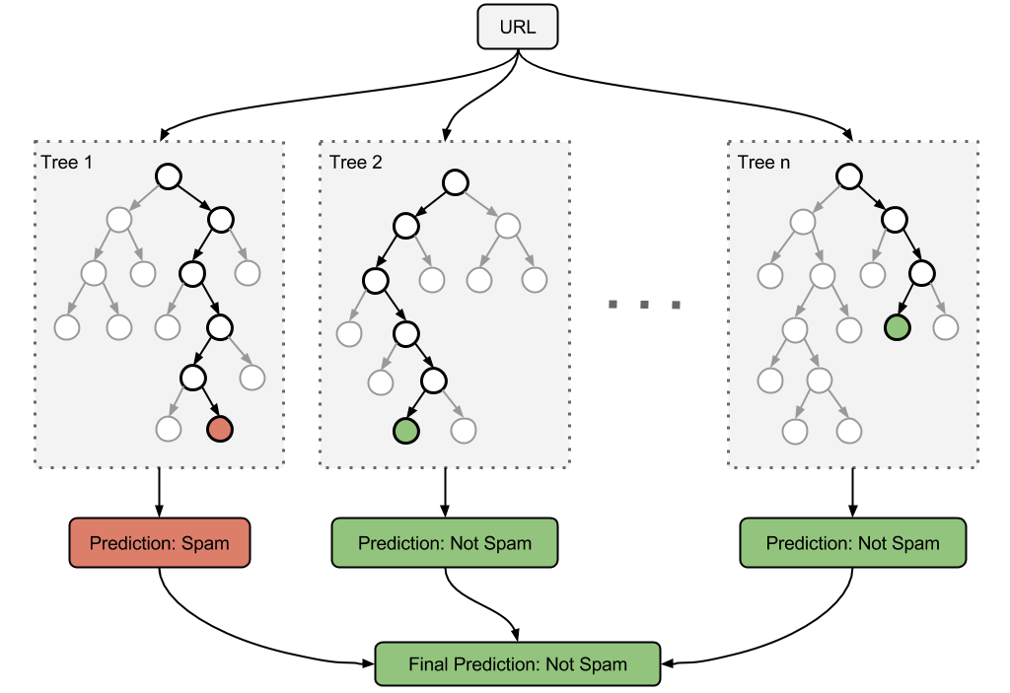
Detecting whether an URL is spam or not

Slide 19
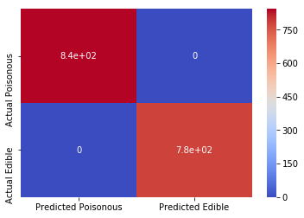
Case Study
Random Forest Classifier
Predicting whether Mushroom is Edible or Poisonous.
Accuracy : 100%

Slide 20
Hierarchical clustering
hierarchical clustering is a method of cluster analysis which seeks to build a hierarchy of clusters.
Strategies for hierarchical clustering generally fall into two types:
Agglomerative (Bottom – Up Approach)
Divisive (Top - Down)

Slide 21
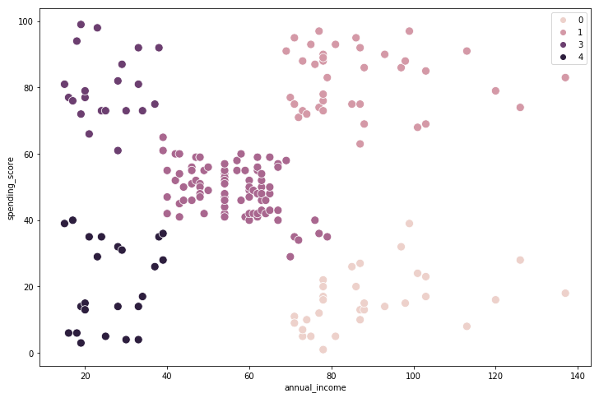
Case Study
Hierarchical Clustering
Clustering of customers on the basis of
Annual Income and Spending Score

Slide 22
K means clustering
k-means clustering aims to partition n observations into k clusters in which each observation belongs to the cluster with the nearest mean, serving as a prototype of the cluster.

Slide 23
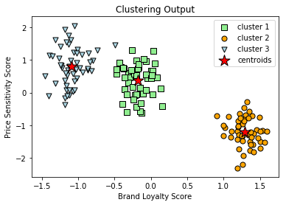
Case Study
K means Clustering
Customer clustering based on brand loyalty score and price sensitivity score

Slide 24
Day Wise Summary
Date | Syllabus Covered
6th June | Inauguration, Introduction to Machine Learning
7th June | Data types & Output Formatting in Python
8th June | Flow Control and Matrices
10th June | Set Operations and Functions
11th June | Modules, File Operations, NumPy Library and Operations
12th June | Pandas Library and operations
13th June | Operations on Dataframes
14th June | MatPlotLib, Seaborne, EDA
15th June | Statistics and Linear Regression
17th June | Logistic Regression
18th June | Decision Tree Classifier
19th June | Random Forest & Clustering
20th June | ANN, Certificate Distribution

