Slide 1

RAILWAY PASSENGER ANALYTICS
Presented by: Prathamesh Balu Patil
Excel • SQL • Power BI • Power Query • DAX

Slide 2
Introduction
Centralized Railway View Provides a single view of passenger volume, bookings, fares, train information and station activity.
Train & Passenger Analysis Connects passenger records with train information to analyze routes, zones, classes and coaches.
Decision Support Helps identify passenger patterns, busy zones, popular classes and operational opportunities.
Interactive Analysis Uses KPI cards, charts and slicers for dynamic exploration of railway passenger data
RAILWAY DATA → CLEANING → ANALYSIS → VISUALIZATION → INSIGHTS

Slide 3
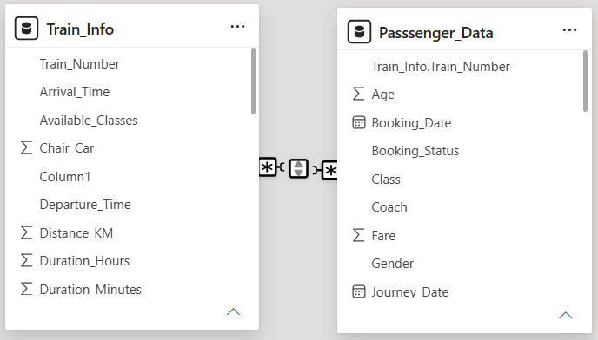
Data Model Structure
Train_Info Stores train details such as Train Number, Train Type, Station information, Train Zone, Distance, Duration and Departure Time.
Passenger_Data Stores passenger details such as Passenger ID, PNR Number, Passenger Name, Age, Gender, Booking Status, Class, Coach, Journey Date and Fare
Key Field Train_Number is the common key used to connect both tables.
Data Model Structure: Passenger_Data → Train_Info | Many-to-One (*:1)

Slide 4
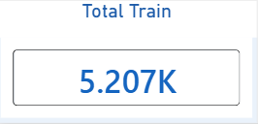
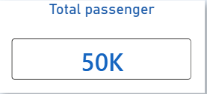
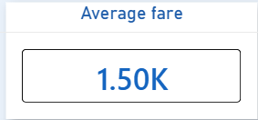
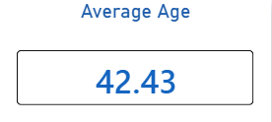
Measures / KPI Cards
🚆 Total Trains
Formula: COUNT(Train_Number) Counts the total number of train records available in the Train_Info dataset. It provides an overall measure of the train volume covered in the analysis.
🎂 Average Age
Formula: AVERAGE(Age) Calculates the average age of passengers in the dataset. It helps identify the general age profile of railway passengers.
👥 Total Passengers
Formula: COUNT(Passenger_ID) Counts all passenger records available in the Passenger_Data table. This KPI represents the overall passenger volume used for analysis.
💰 Average Fare
Formula: AVERAGE(Fare) Calculates the average ticket fare paid by passengers. It helps understand the typical fare value across different classes, trains and passenger segments.

Slide 5
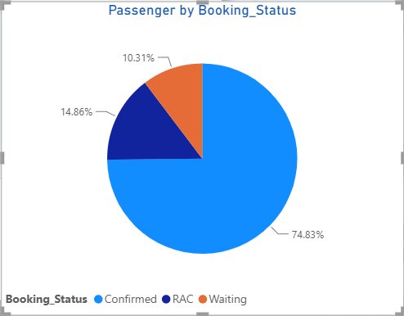
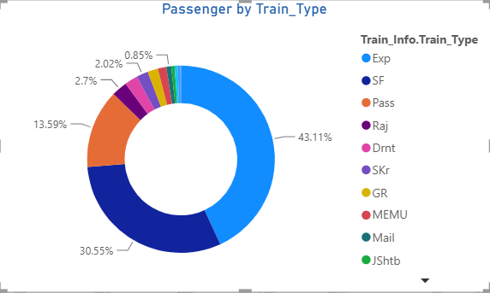
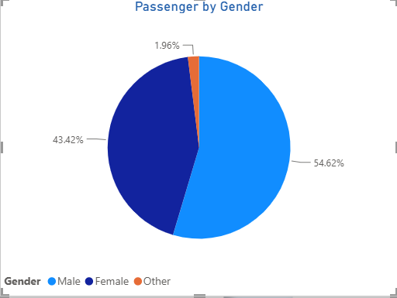
Passenger Distribution Analysis
🥧 Passenger by Booking Status Shows the distribution of passengers based on their booking status, such as Confirmed, RAC, and Waiting.
🍩 Passenger by Train Type Shows how passengers are distributed across different train types, helping identify the most-used train categories.
🥧 Passenger by Gender Highlights the passenger composition across Male, Female, and Other categories.

Slide 6
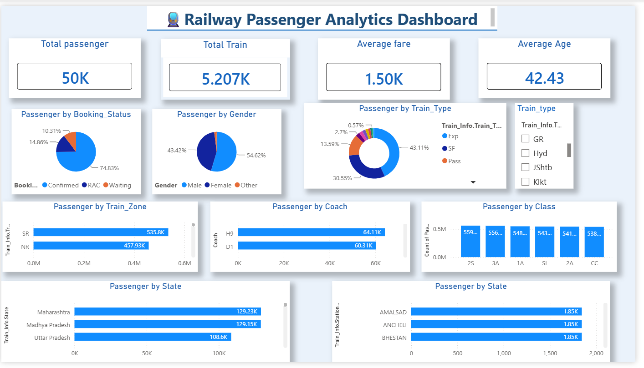
Railway Passenger Analytics — Overview Dashboard

Slide 7
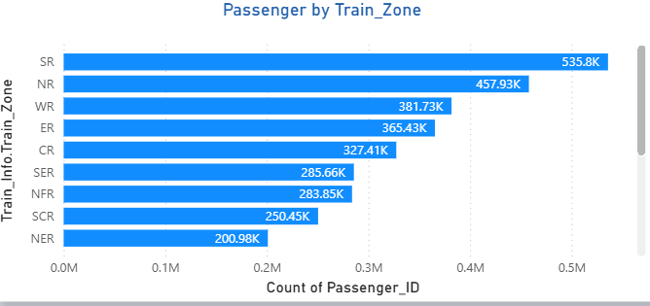
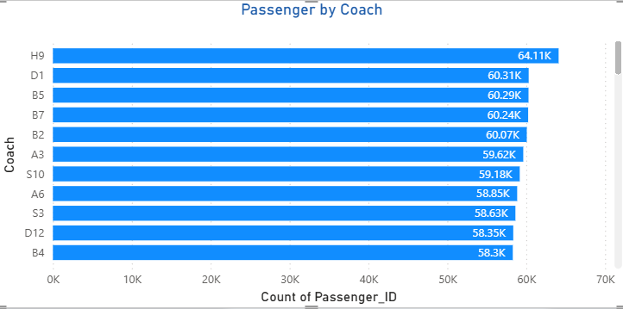
Passenger & Train Trends
Passenger by Train Zone
Chart Type: Horizontal Bar Chart Purpose: Compares the total passenger volume across different railway zones. Analysis: Helps identify which railway zones handle the highest passenger traffic. Key Insight: SR records the highest passenger volume, followed by NR and WR in the displayed dashboard.
Passenger by Coach
Chart Type: Horizontal Bar Chart Purpose: Shows passenger distribution across different coaches. Analysis: Helps compare coach-wise passenger demand and identify coaches with higher occupancy. Key Insight: H9 and D1 show relatively higher passenger volumes among the displayed coaches.

Slide 8
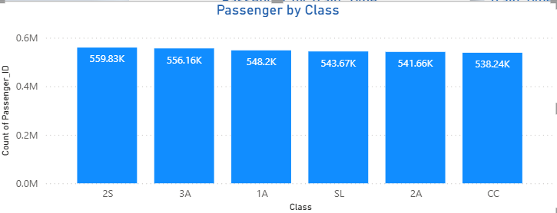
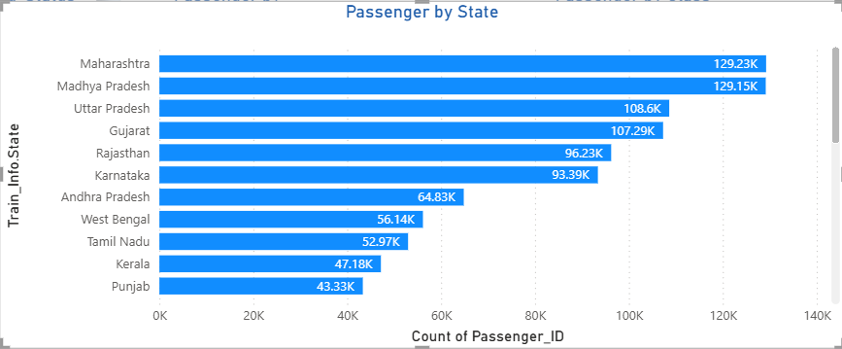
Passenger Distribution Analysis
Passenger by Class
Chart Type: Column Chart Purpose: Compares passenger volume across different travel classes. Analysis: Helps understand passenger preference and demand across classes such as 1A, 2A, 3A, SL, 2S and CC. Key Insight: Passenger volumes are relatively close across the displayed classes, indicating a broad distribution of passengers across different travel categories.
Passenger by State
Chart Type: Horizontal Bar Chart Purpose: Compares passenger volume across different states. Analysis: Helps identify states contributing the highest number of railway passengers. Key Insight: Maharashtra and Madhya Pradesh show high passenger volumes among the displayed states.

Slide 9
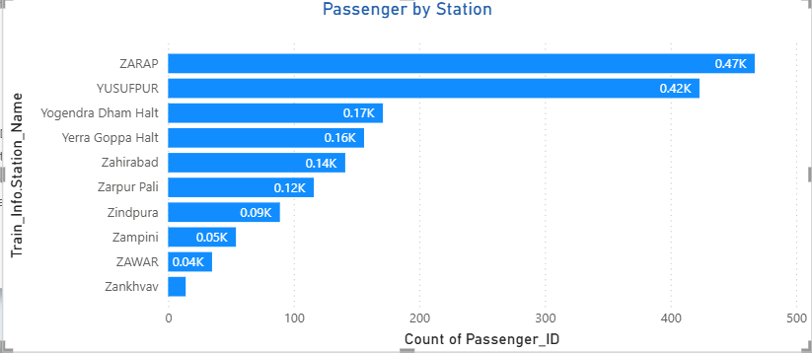
Train & Station Performance
Passenger by Station
Chart Type: Horizontal Bar Chart Purpose: Compares passenger volume across different railway stations. Analysis: Helps identify stations with higher passenger activity and demand. Key Insight: The displayed dashboard shows BILIMORA JN, OLD DELHI and VALSAD among the highest passenger-volume stations.
Passenger by Train Type
Chart Type: Doughnut Chart Purpose: Shows the distribution of passengers across different train types. Analysis: Helps understand which train categories contribute most to total passenger volume. Key Insight: Express (Exp) has the largest share among the displayed train types.

Slide 10
Overall Passenger Comparison
Analysis Area | Key Metric | Observation
Train Zone | Passenger Volume | SR has the highest displayed passenger volume
Train Type | Passenger Distribution | Express has the largest displayed share
Coach | Passenger Volume | H9 and D1 show high passenger volumes
Class | Passenger Distribution | Passenger volume is distributed across major classes
State | Passenger Volume | Maharashtra and Madhya Pradesh show high volumes
Station | Passenger Volume | Bilimora JN, Old Delhi and Valsad are among the displayed high-volume stations
🏆 Highest Passenger Zone SR — 535.8K displayed passengers
🚆 Leading Train Type Express (Exp) — largest displayed share
👥 High-Volume Coach H9 — 64.11K displayed passengers
📍 High-Volume State Maharashtra — 129.23K displayed passengers
🚉 High-Volume Station Bilimora JN — 1.91K displayed passengers

Slide 11
Key Findings, Recommendations & Conclusion
Passenger Demand
Passenger volume varies across railway zones, states, coaches and stations
Train Type
Express trains contribute the largest displayed share of passenger volume.
High-Demand Zone
SR shows the highest passenger volume among the displayed railway zones.
High-Demand Coach
H9 and D1 show relatively high passenger volumes in the displayed analysis.
State & Station
Maharashtra and Madhya Pradesh show high state-wise passenger volume, while Bilimora JN, Old Delhi and Valsad appear among the displayed high-volume stations.
Data-Driven Planning
The dashboard helps identify passenger patterns and supports better railway capacity and demand planning.
Recommendations
Use the dashboard insights to monitor high-demand zones, coaches and stations, improve capacity planning, and support data-driven railway operations
Conclusion
The Railway Passenger Analytics Dashboard transforms passenger and train data into meaningful insights for understanding demand patterns and improving operational decision-making.

Slide 12
