Slide 1
Web development Internship
Kumbhar Prathamesh Dasharath
Roll No: 329
Under the Guidance of
Prof. S.A. Dabhade

Slide 2
Company Details
Company Name: PRODIGY INFOTECH
Website: https://prodigyinfotech.dev/
Prodigy InfoTech is a privately held software development company founded in 2023, with its headquarters in Mumbai.
They offer services like software development, web development, and internship programs for students.

Slide 3
Internship Tasks Overview
Tasks Completed:
1. Landing Page – Visually appealing homepage
2. Stopwatch web page – Digital stopwatch using JavaScript
3. Tic-Tac-Toe – 2-player game with win/draw logic
4. Portfolio Website – Showcasing personal projects

Slide 4
Task Components
Each Task Included:
Planning and UI Layout (HTML/CSS)
Functional Logic (JavaScript)
Responsive Design Testing

Slide 5
Technologies Used
Languages and Frameworks:
HTML: Web structure
CSS: Styling and layout
JavaScript: Interactivity and logic

Slide 6
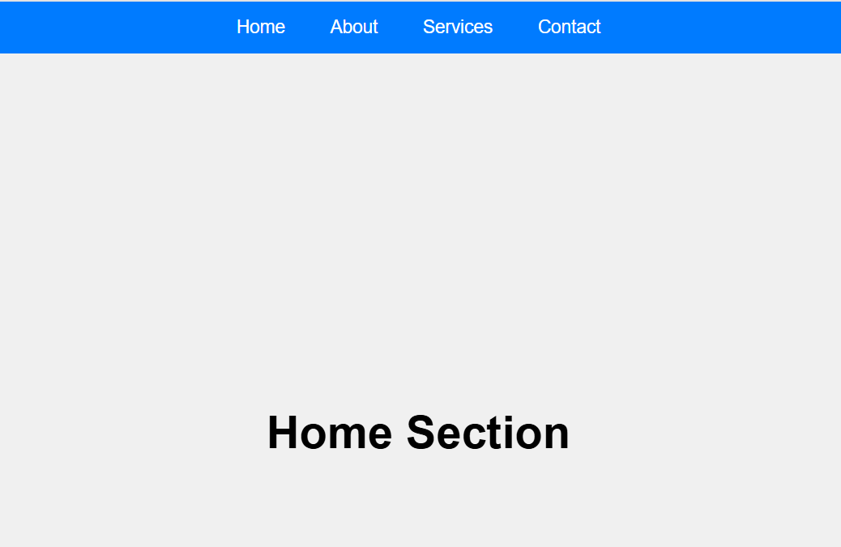
Task 1 - Landing Page
Responsive design with navigation bar, hero banner, and CTA buttons.
Technologies: HTML, CSS .

Slide 7
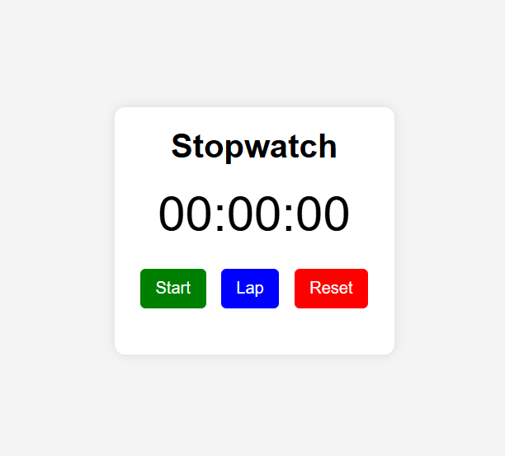
Task 2 - Stopwatch App
Functional stopwatch with Start, Stop, Reset, and Lap features.
Technologies: HTML, CSS, JavaScript

Slide 8
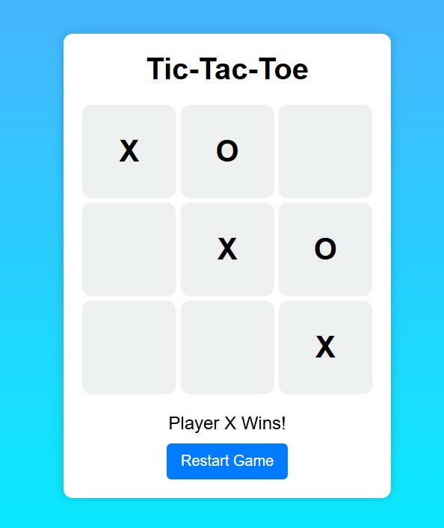
Task 3 - Tic-Tac-Toe
2-player interactive game with win/draw detection and reset option.
Technologies: HTML, CSS, JavaScript

Slide 9
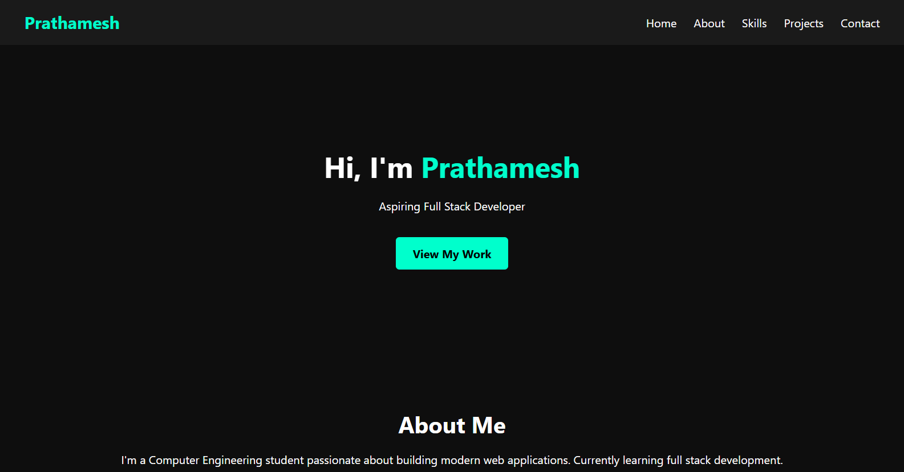
Task 4 - Portfolio Website
Personal portfolio with About, Projects, and Contact sections.
Fully responsive and mobile-friendly.

Slide 10
Learning Outcomes
✔ Gained hands-on experience in web development
✔ Improved skills in HTML, CSS, JavaScript, and Bootstrap
✔ Built responsive and interactive web projects
✔ Enhanced problem-solving through practical tasks
🏆 Recognized as Best Intern by HEAL BHARAT

Slide 11
Thank You

