Slide 1

College of Engineering & SSD IOM, Nashik
Pune Vidyarthi Griha’s
Project On
Aarogya Centre
A Complete Healthcare Platform
Presented By
Bharat Firake Prathamesh Lakawade Rahul Mahajan Prathamesh Gadkari
Guided By
Prof. J. Y. Kapadnis
Group ID
1

Slide 2
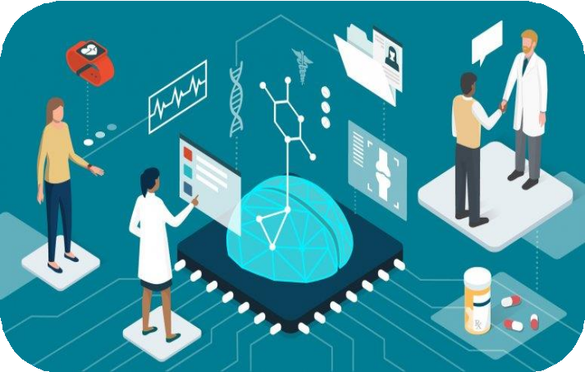
Contents
Introduction
Problem Statement
Literature Survey
Existing System
Proposed System
System Architecture
Modules
Algorithms and Tools
System Requirements
Advantages
Limitations
Applications
Future Scope
Results
Conclusion
Aarogya Centre

Slide 3
[1.1] With increasing birth rate and decreasing death rate due to advancement in the medical field, it’s found that the number of doctors is less to serve the need of the increasing population.
1
[1.2] During the COVID-19 pandemic, everybody was forced to restrict their human interaction. So, getting health-related consultations from doctors was risky as an individual had to physically go to a doctor for a check-up.
[1.3] Minor health-related issues can be resolved at home under proper assistance. So, in this case, an AI-powered platform can help to resolve these issues without leaving the comfort of home.

Slide 4
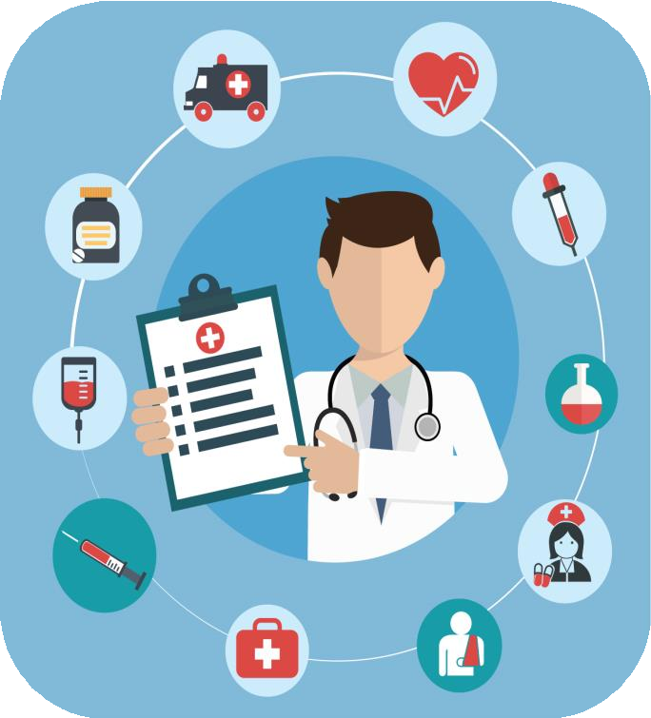
2
To develop an AI-powered platform that can provide immediate quality medical consultation to everyone at any place, make communication between patient and doctor easier, and also can store users’ previous as well as current medical data.
[2.1] Problem Statement

Slide 5
3
[3.1] McKinsey & Company on Transforming healthcare with AI:
“Artificial intelligence (AI) has the potential to transform how healthcare is delivered. A joint report with the European Union’s EIT Health explores how it can support improvements in care outcomes, patient experience, and access to healthcare services. It can increase productivity and the efficiency of care delivery and allow healthcare systems to provide more and better care to more people. AI can help improve the experience of healthcare practitioners, enabling them to spend more time in direct patient care and reducing burnout.”
[3.2] Konstantin Kalinin on Medical Chatbots:
“Top health chatbots run on proprietary AI/ML technologies, support non-scripted intent-based dialogs, protect PHI, and make an impression of an intelligent being overall.”
“A doctor appointment chatbot is the most straightforward variant of implementing AI- powered conversational technology without significant investment.”

Slide 6
3
[3.3] Cynthia Onyefulu on Online Appointment System and Services:
“The online appointment system is “a win-win solution for patients and physicians…”. This view was also expressed by others. This may be one of the reasons why there are several studies about the online or web-based appointment system. In a different study in India, the authors concluded that although the appointment system has several benefits, it is also affected by several factors such as the “arrival and service time variability, patient and provider preferences, available information technology, and the experience level of the scheduling staff”. However, online scheduling, they stated, has more advantages when compared to the traditional appointment system. According to these authors, in the traditional appointment system, the scheduling is done by coming into the facility and the waiting time tends to be reasonably long. The waiting time is minimized with the online appointment system.”

Slide 7
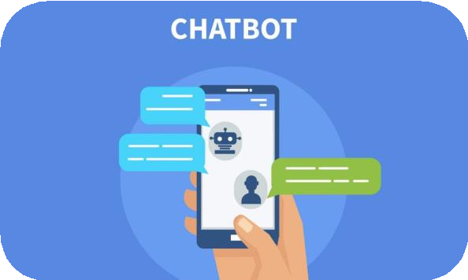
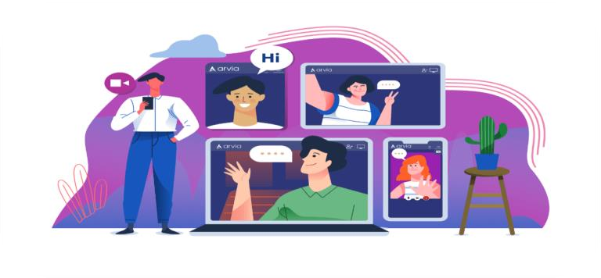
4
Paediatrician
Specialist
Appointment
Patient
General Physician
Dentist
[4.1] Existing Offline Healthcare System
[4.2] Existing Healthcare Chatbot
[4.3] Existing Video Chatting

Slide 8
In the proposed system, there will be three main features healthcare chatbot, communicating with the doctor through messaging or video chatting, and appointment booking. To access these features user will need to create his/her profile on the platform by providing a few details. Additionally, there will be also a feature where the user can store their previous medical records under his/her profile.
5
Profile
Upload Medical Records
Healthcare Chatbot
Video Chat with Doctor
Appointment Booking
[5.1] Basic Over view of Proposed System

Slide 9
6
Login
If new user
Create Profile
Save required information on users profile
Profile
Input Previous Data
Healthcare Chatbot
Video Chat with Doctor
Appointment Booking
Select type of data to insert
Conversation
Chat / Video Chat
Choose doctor, date and time for appointment
Prediction
Fill the data
Satisfied?
No
Yes
If required
[6.1] System Architecture of Aarogya Centre

Slide 10
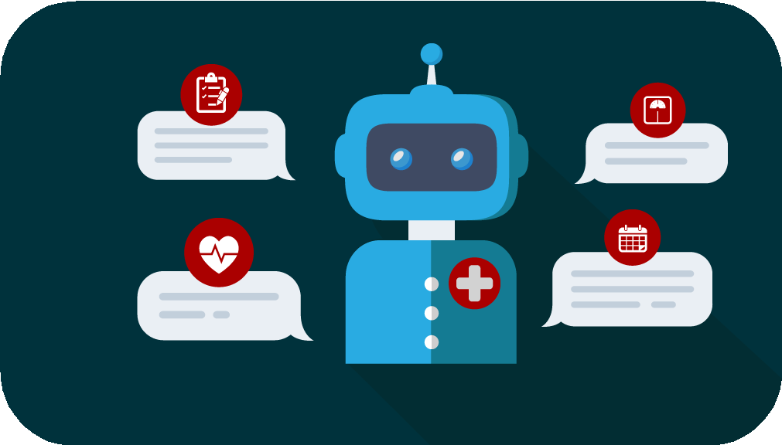
7
User
Personal Information
Initiate Chat
Request for a Doctor
Yes
Display Symptomatic Questionnaire
Assessment
Severity Score
No
Description of Preventive measure
Thank you for
Contacting
End Chat
Frequently Asked Question
[7.1] Healthcare Chatbot

Slide 11
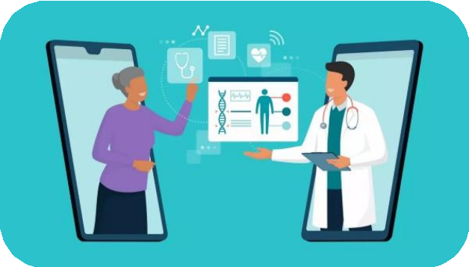
Gather audio, video or other data stream Obtain network information and exchange with other clients
Exchange information about media Stream the audio, video or data
7
[7.2.1]
[7.2.2]
[7.2.3]
[7.2.4]
Output: high resolution video chatting
between two people
Gather Data from user
Share network information with other
Exchange media information
Stream the received data
[7.2] Video Chat

Slide 12
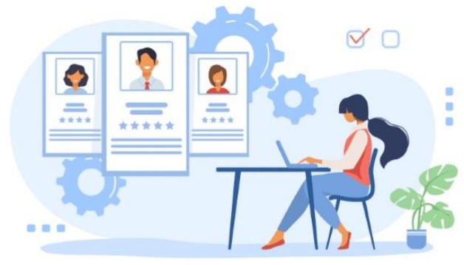
Find Nearby Doctors or Hospitals Search for availability of appointment User can hold the appointment
7
[7.3.1]
[7.3.2]
[7.3.3]
[7.3.4]
[7.3.5]
Book appointment with doctor
After booking, patient’s information is
exchanged
Output: Successful Appointment Booking message with a token
Find Doctor
Appointment availability search
Hold Appointment (Optional)
Book Appointment
Exchange patients information
[7.3] Appointment Booking

Slide 13
8
[8.1] Algorithm:
[8.1.1] Bag of Words Model
This algorithm is used for finding the frequency of a word in a given sentence. It is a way of extracting features from the given text.
Example:
[8.1.1.1] “I have fever”
“I have cough”
“I am feeling runnynose”
“I am having shortness of breadth”

Slide 14
8
[8.1.1.2] “I” = 1
“have” = 1
“fever” = 1
“cough” = 0
“am” = 0
“feeling” = 0
“runnynose” = 0
“having” = 0
“shortnose” = 0 “of” = 0
“breadth” = 0
[8.1.1.3] “I have fever” = [1, 1, 1, 0, 0, 0, 0, 0, 0, 0, 0]
“I have cough" = [1, 1, 0, 1, 0, 0, 0, 0, 0, 0, 0]
“I am feeling runnynose” = [1, 0, 0, 0, 1, 1, 1, 0, 0, 0, 0]
“I am having shortness of breath” = [1, 0, 0, 0, 1, 0, 0, 1, 1, 1, 1]

Slide 15
[8.1.1.4] Matrix Representation of Bag of Words Model:
8
Documents | I | Have | Fever | Cough | Am | Feeling | Runnynose | Having | Shortness | Of | Breadth
1 | 1 | 1 | 1 | 0 | 0 | 0 | 0 | 0 | 0 | 0 | 0
2 | 1 | 1 | 0 | 1 | 0 | 0 | 0 | 0 | 0 | 0 | 0
3 | 1 | 0 | 0 | 0 | 1 | 1 | 1 | 0 | 0 | 0 | 0
4 | 1 | 0 | 0 | 0 | 1 | 0 | 0 | 1 | 1 | 1 | 1
[8.1.1.5] Find the class with the highest probability and return the corresponding response

Slide 16
8
[8.2] Languages:
[8.2.1] Python, SQL, JavaScript, HTML, CSS
[8.3] Tools:
[8.3.1]
[8.3.2]
[8.3.3]
[8.3.4]
[8.3.5]
[8.3.6]
[8.3.7]
[8.3.8]
[8.3.9]
PyCharm Webstorm Tensor Flow
Flask Framework
Natural Language Toolkit (NLTK)
Keras WebRTC Scikitlearn Numpy

Slide 17
9
[9.1] Software Requirements:
[9.1.1] Operating System:
[9.1.2] Web Browser
[9.2] Hardware Requirements:
Windows 7 or later | 64-bit Ubuntu 14 or later | macOS Sierra 10.12 or later
[9.2.1] | Processor: Intel i3 or later
[9.2.2] | Memory: 2GB RAM or more
[9.2.3] | Display: Super VGA with resolution of 102 | 4 x 768 or higher
[9.2.4] | Camera and Microphone
[9.2.5] | Bandwidth greater than 50 KBps (400 kbps)
[9.2.6] | Latency under 150 ms

Slide 18
10
[10.3]
Instant Messaging and Video Chatting
[10.1]
Saves Time
[10.1]
Generalized Appointment
Booking Platform
Saves Money
[10.4]
[10.2]
All records at one place

Slide 19
11
Uninterrupted Internet Connection
Accurate Data should be provided
Instant Communication only with available doctor
[11.3]
[11.1]
[11.2]

Slide 20
12
[12.1]
Distant counselling for the patients.
[12.2]
Patients and Doctors can adopt this platform for hassle-free consultation procedure.
[12.3]
The collected data can be used for the research and development of medicines.
[12.4]
Secure platform to transfer and store medical records.

Slide 21
13
[13.1]
Adding other modules on platform to cover most of the healthcare services.
[13.2]
Potential to replace existing offline treatment procedure.
[13.3]
Can be made as a common platform between patient and doctor.

Slide 22
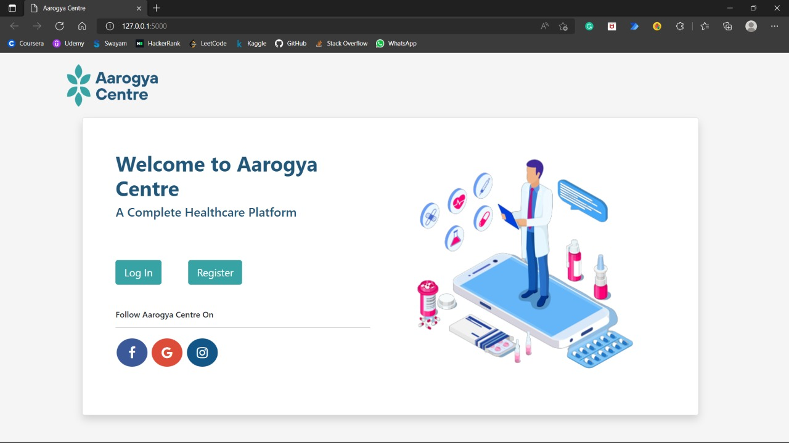
14
Results
Fig. 1 : Welcome Page

Slide 23
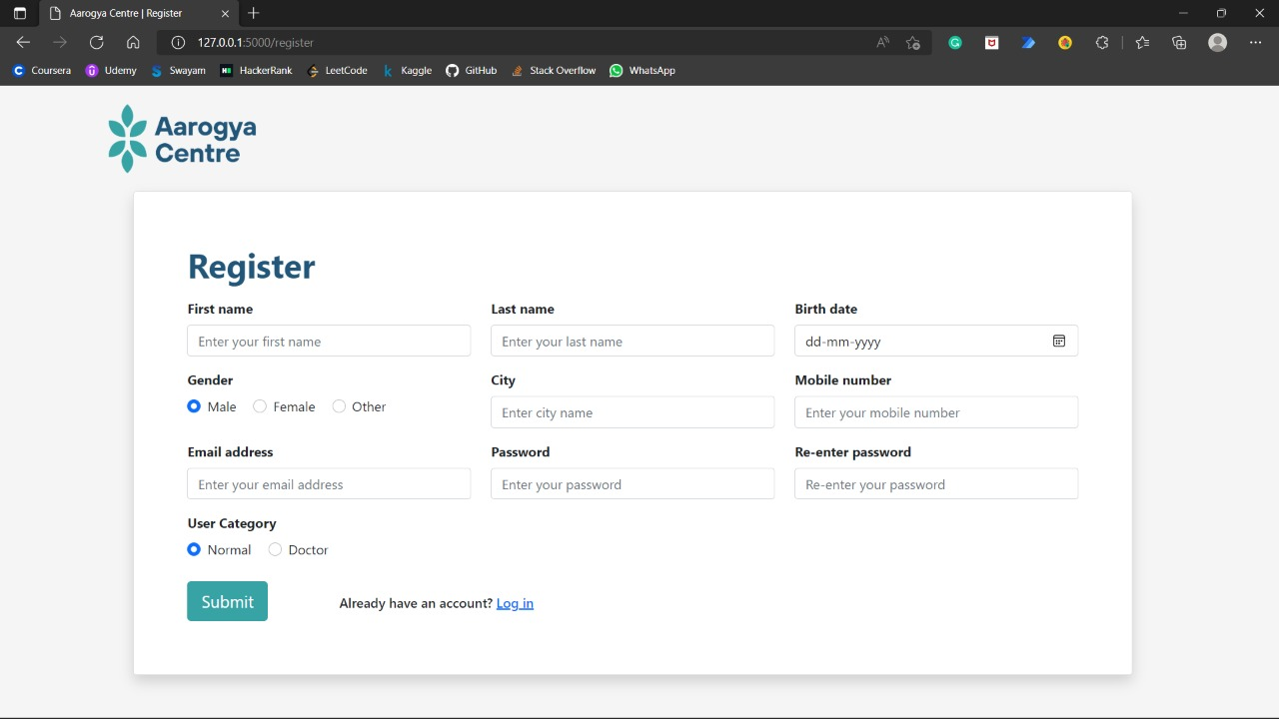
14
Results
Fig. 2 : Register Page

Slide 24
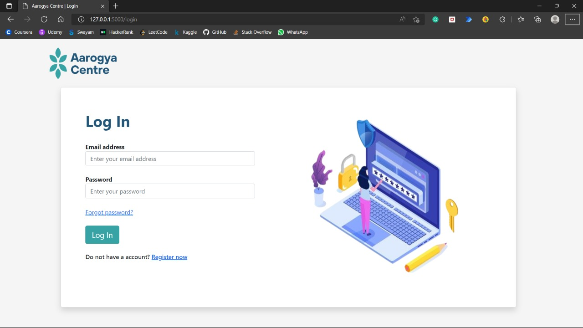
14
Results
Fig. 3 : Login Page

Slide 25
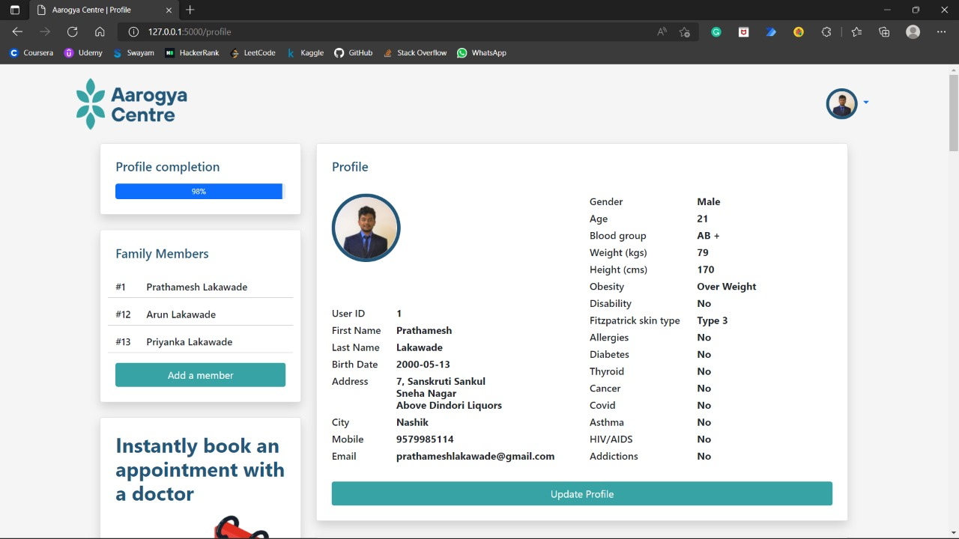
14
Results
Fig. 4 : Update Profile

Slide 26
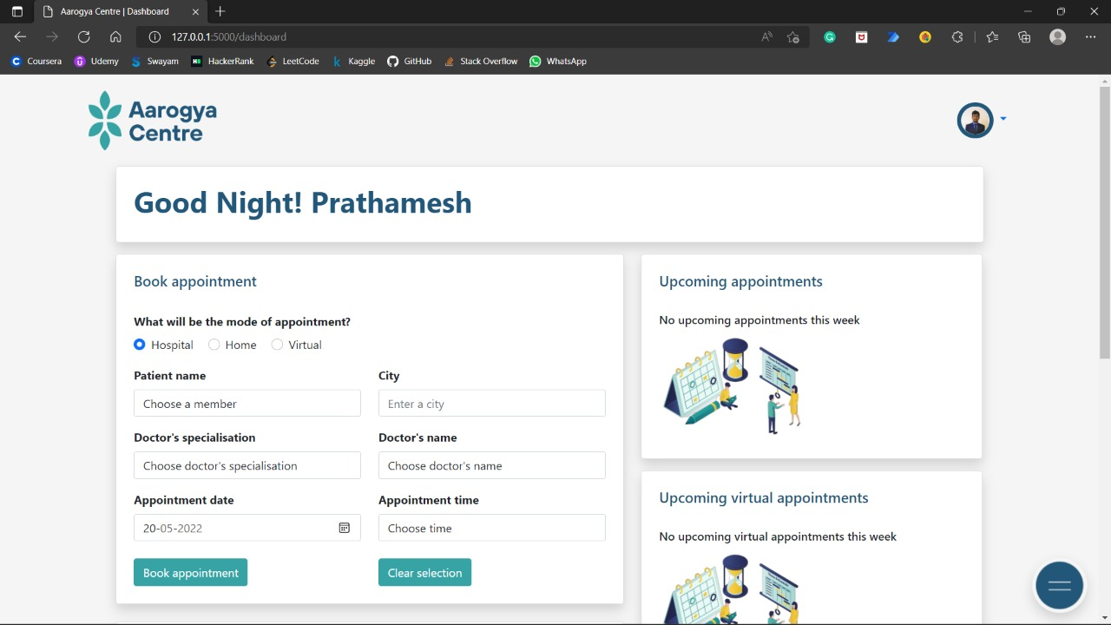
14
Results
Fig. 5 : Appointment Booking

Slide 27
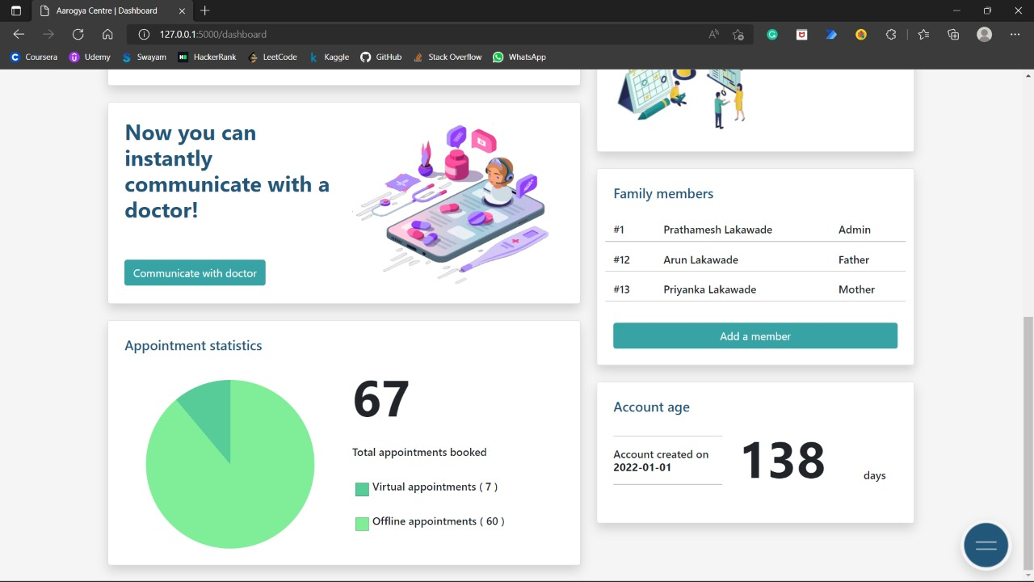
14
Results
Fig. 6 : Add Member

Slide 28
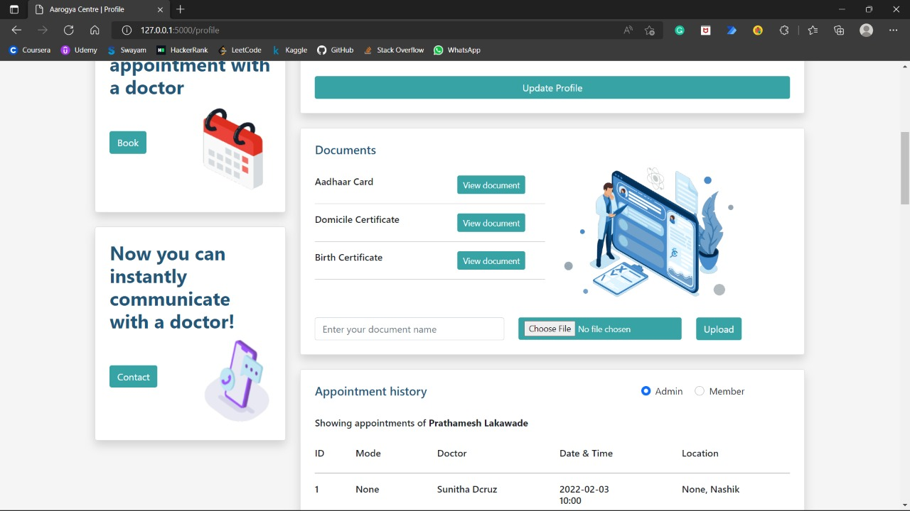
14
Results
Fig. 7 : Upload Document

Slide 29
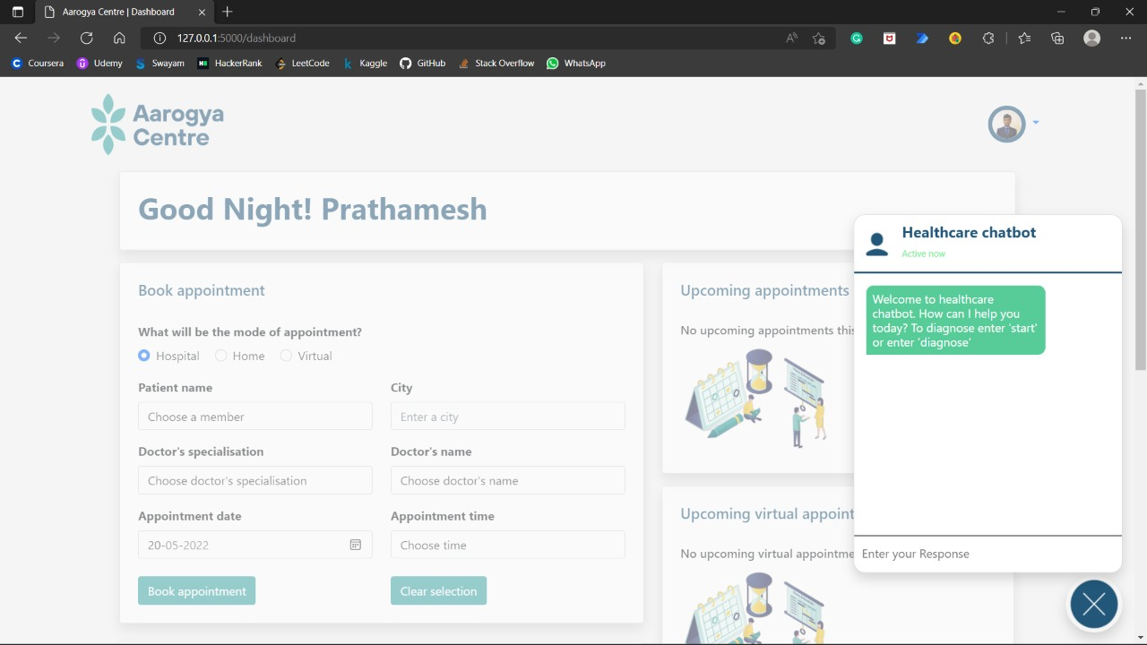
14
Results
Fig. 8 : Healthcare Chatbot

Slide 30
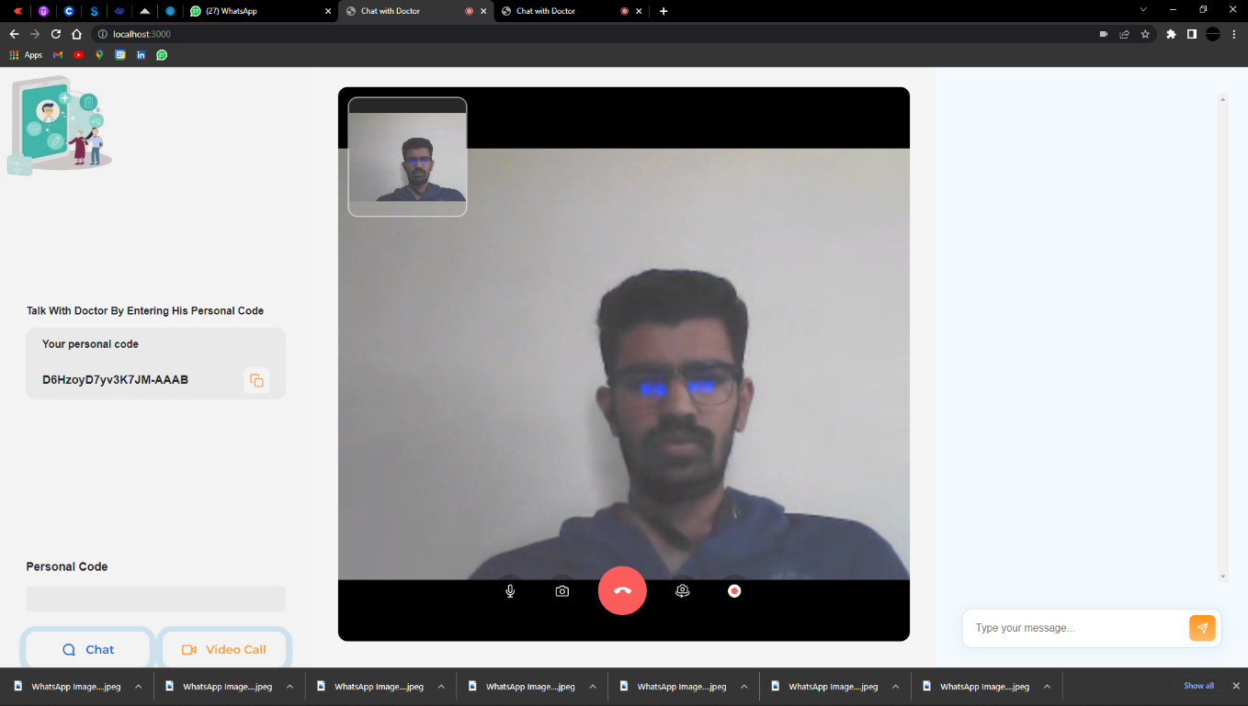
14
Results
Fig. 9 : Video-Calling

Slide 31
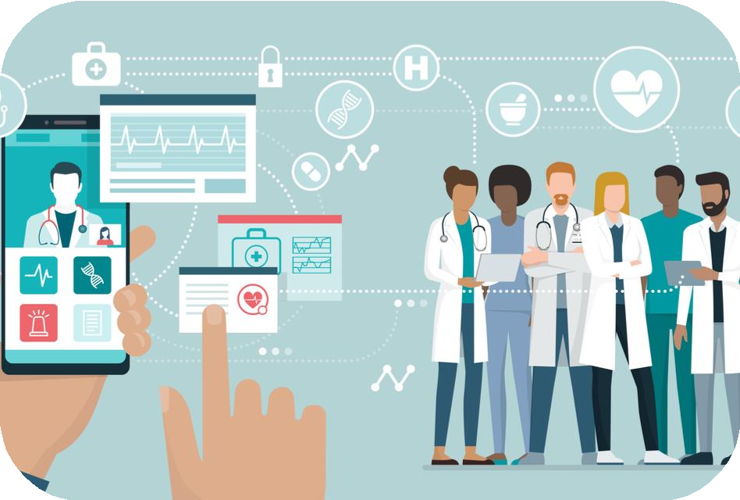
15
In conclusion, we are going to develop an AI-powered platform that can provide immediate quality medical consultation to everyone at any place, make communication between patient and doctor easier through online messaging and video chatting, and also can store users’ previous as well as current medical data.
[14.1] Conclusion

Slide 32
References
Tran Le, Nguyen, Thi Thu Ha, Do, 2019, IEEExplore, accessed 8th December 2021, https://ieeexplore.ieee.org/document/8893884 -
Tanwir Khan, 2019, Towards Data Science, accessed 11 December 2021,
https://towardsdatascience.com/ai-for-healthcare-c975ffad1e8b -
Babylon. (n.d.). We're pioneering Al to make healthcare universally accessible and affordable. Retrieved from https://www.babylonhealth.com/ai
Agro-Scheduling Implementation Guide, 2018, Agronaut Project, accesses 28 December 2021,
https://www.fhir.org/guides/argonaut/scheduling/provider-scheduling.html -
Building a video chat web app, 21 December 2016, Code Project, accessed 28 December 2021, https://www.codeproject.com/Articles/1073738/Building-a-Video-Chat-Web-App-with-WebRTC -
Brian, K. at el. (2018). 10 promising Al applications in healthcare. Retrieved from https://hbr.org/2018/05/10-promising-ai-applications-in-health-care
Buchanan, B. G. (2005). A (very) brief history of artificial intelligence. Ai Magazine, 26(4),53
https://doi.org/10.1609/aimag.v264.1848
A chatbot for medical purpose using deep learning, 2021, IJERT, accessed 28 December 2021, https://www.ijert.org/a-chatbot-for-medical-purpose-using-deep-learning

Slide 33
Thank You!

