Slide 1

Web scraping to gain company insights
15/02/20223

Slide 2
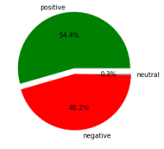
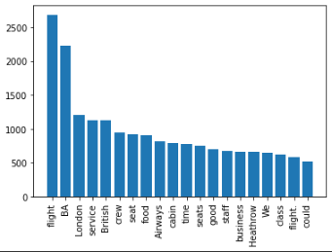
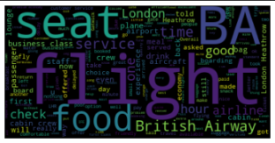
INSIGHTS FROM CUSTOMER REVIEWS
From cleaning 2000 reviews given by the customers, we obtained
Positive Reviews - 1096
Negative Reviews - 898
Neutral Reviews - 6
Word cloud of keywords used in reviews

