Slide 1

INTERNSHIP REVIEW 2
Prathamesh Chandrashekhar Patil
Prn :22220014

Slide 2

AGENDA
Offline Training
Assessment
TalentNext Courses
Project Roadmap
Certificates
Contents

Slide 3
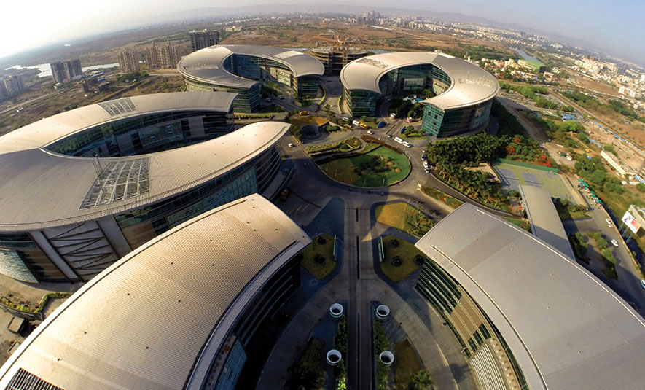
AGENDA
Name: Prathamesh Chandrashekhar Patil
GR No: 22220014
Roll No: 432165
Email ID: Prathamesh.22220014@viit.ac.in
Work Email: Prathamesh.patil2@mphasis.com
Work Profile: Trainee Associate Software Engineer
Stipend: Rs 15000
Internship type: On-Site
Internship through: CTPO
Internship Location: Mphasis Pvt Ltd EON free Zone, Cluster C, Kharadi Knowledge Park, EON Kharadi Infrastructure Pvt. Ltd, SEZ Plot No. 1, Kharadi, Pune
Faculty mentor: Prof. Nilesh Sabale
Company Mentor: Mr. Anadi Sharma

Slide 4
ABOUT COMPANY
Mphasis Limited is an Indian multinational IT solutions provider specializing in cloud and cognitive services, helping enterprises transform businesses globally through next-generation technology.
Our purpose is ‘To be the Driver in the Driverless car' - Our Next Gen Design, Architecture and Engineering services, deliver scalable and sustainable software & technology solutions to Global Enterprises.

Slide 5
TRAINING PERIOD
19 feb- 30 march

Slide 6
TRAINING DESCRIPTION
Following are the topics we have studied during our training period:
GIT/GITHUB
MYSQL Database
Core Java Fundamentals
JDBC, JSP and Servlet
JUNIT Testing and Apache Maven
Hibernate
Spring
Spring boot
Angular and Typescript for Frontend

Slide 7
ASSESSMENT SCORES
Two assessments were held during the training period on 13 march and 26 march whose passing criteria was 70%.
Test 1 Score: 21/25(84%)
Test 2 Score: 22/25(88%)

Slide 8
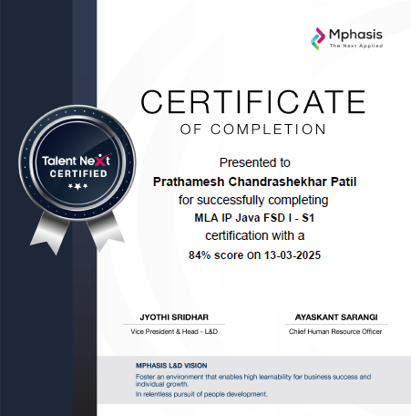


Slide 9
Project Description
Now, we are starting with our projects based on the java spring boot, angular and database where we will be implementing the above topics for completing the project.
A team of 2 members will be created and project title will be allocated and tasks will be divided as frontend, backend, and database.

Slide 10

THANK YOU

