Slide 1

INTERNSHIP REVIEW 3
Prathamesh Chandrashekhar Patil
Prn :22220014

Slide 2

AGENDA
Offline Training
Assessment
TalentNext Courses
Project Roadmap
Certificates
Contents

Slide 3

AGENDA
Name: Prathamesh Chandrashekhar Patil
GR No: 22220014
Roll No: 432165
Email ID: Prathamesh.22220014@viit.ac.in
Work Email: Prathamesh.patil2@mphasis.com
Work Profile: Trainee Associate Software Engineer
Stipend: Rs 15000
Internship type: On-Site
Internship through: CTPO
Internship Location: Mphasis Pvt Ltd EON free Zone, Cluster C, Kharadi Knowledge Park, EON Kharadi Infrastructure Pvt. Ltd, SEZ Plot No. 1, Kharadi, Pune
Faculty mentor: Prof. Nilesh Sabale
Company Mentor: Mr. Anadi Sharma

Slide 4
ABOUT COMPANY
Mphasis Limited is an Indian multinational IT solutions provider specializing in cloud and cognitive services, helping enterprises transform businesses globally through next-generation technology.
Our purpose is ‘To be the Driver in the Driverless car' - Our Next Gen Design, Architecture and Engineering services, deliver scalable and sustainable software & technology solutions to Global Enterprises.

Slide 5
TRAINING PERIOD
19 feb - 31 march

Slide 6
TRAINING DESCRIPTION
Following are the topics we have studied during our training period:
GIT/GITHUB
MYSQL Database
Core Java Fundamentals
JDBC, JSP and Servlet
JUNIT Testing and Apache Maven
Hibernate
Spring
Spring boot
Angular and Typescript for Frontend

Slide 7
ASSESSMENT SCORES
Two assessments were held during the training period on 13 march and 26 march whose passing criteria was 70%.
Test 1 Score: 21/25(84%)
Test 2 Score: 22/25(88%)

Slide 8
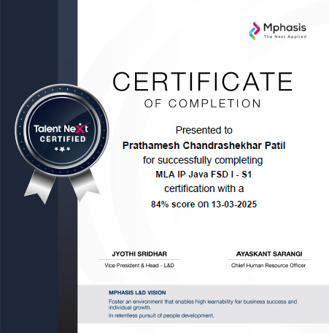
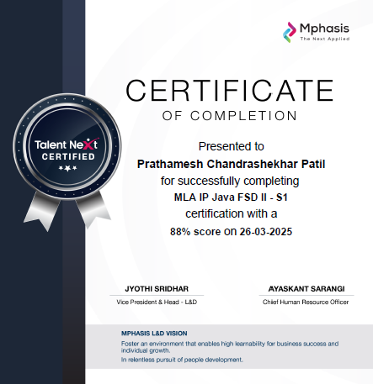

Slide 9
User Story 1
Acceptance Criteria :-
A new Maven project with a parent POM is created.
Four sub-modules are created: api, service, dao, and model.
The parent POM defines the basic project structure and manages dependencies.
Each sub-module has its own POM file, inheriting from the parent POM.
The model module is configured to build a JAR.
The dao module is configured to build a JAR.
The service module is configured to build a JAR.
The api module is configured to build a JAR.
The project builds successfully without errors.
Java 21 and Maven are used.
User Story :-
As a developer, I want to set up a new Spring Boot multi-module Maven project, so that I have a structured foundation for the application.

Slide 10
User Story 2
Acceptance Criteria :-
The api module includes the Spring Security and JWT dependencies.
A UserDetailsService is implemented to load user details.
A JwtRequestFilter is implemented to intercept requests and validate JWT tokens.
A JwtUtil class is implemented to generate and validate JWT tokens.
The security configuration defines which endpoints are public and which are protected.
The application can generate JWT tokens upon successful login.
The application can validate JWT tokens in subsequent requests.
User Story :-
As a developer, I want to configure Spring Security with JWT, so that the API is protected.

Slide 11

THANK YOU

