Slide 1

VIDRIO Innovating Life
Prathamesh Shambhuche.

Slide 2
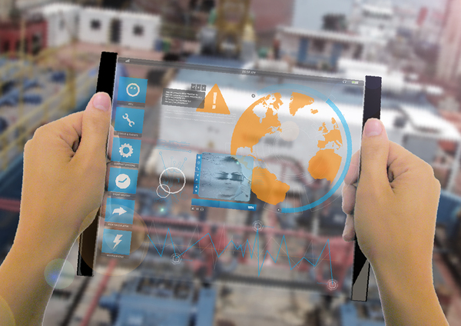

Slide 3

Table of Contents
Introduction
General System Description
Functional Requirements
Physical Requirements
Conclusion

Slide 4
INTRODUCTION
Vidrio- Innovating Life is an OLED eco-friendly, flexible, durable and transparent tablet which is designed in consideration with the future needs and technology.
The main aim of this tab is having and efficient and eco-friendly device which will help us in getting information just with touch.

Slide 5
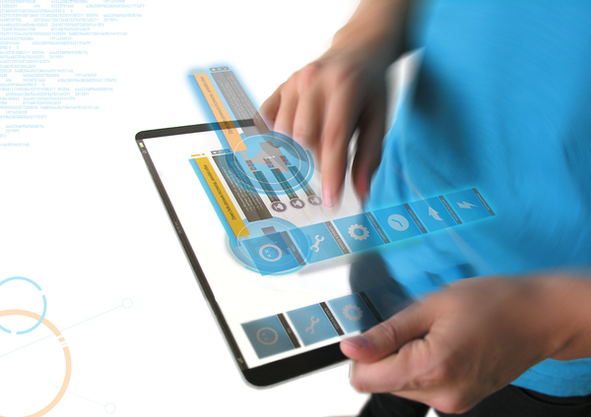

Slide 6
General System Description
Durability of the System
OLED
Accessibility
Capacitive Touchscreen
Technology
Android (Jelly Beans)
Usability

Slide 7
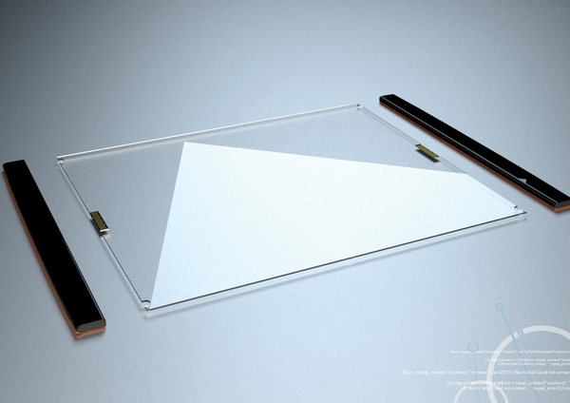
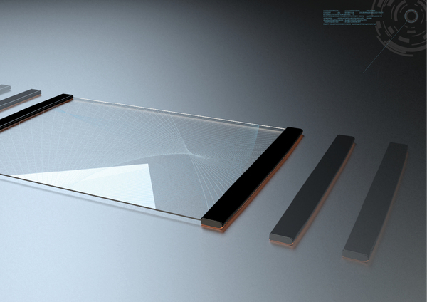

Slide 8
Functional Requirements
Video Calling with Virtual Reality
Voice calling
Messaging
Mailing
Photo and video service
Internet connection Options.
Audio/video playback.
Virtual Reality(Gesture control)

Slide 9
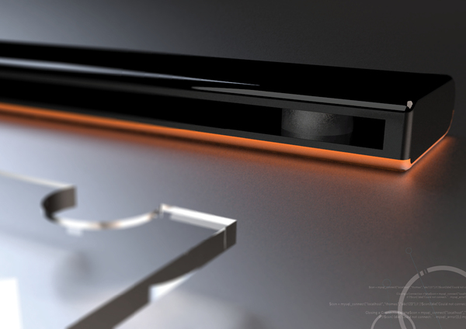

Slide 10
Physical Requirements
Storage
Display
Chip
Wireless and Cellular
Cameras, Photos, and Video Recording
Battery and Power
Sensors
ACCESSIBILITY

Slide 11
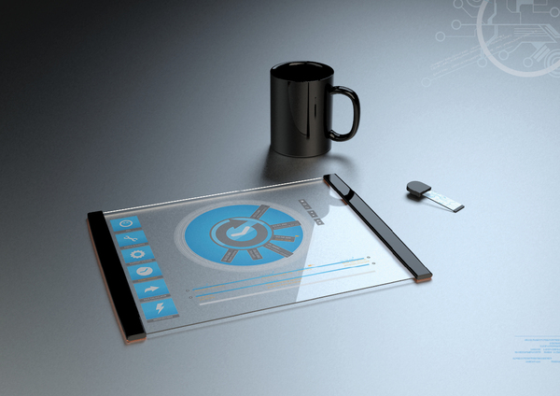

Slide 12
Conclusion
Vidrio- Innovating Life will set a revolution in the market in up-coming days as it will be highly durable, functional and as Android is in boom in Technology it will set a revolution in the Market.

Slide 13
THANK YOU

