Slide 1

Dosage Forms and Cosmetic Products in Rasa Shastra and Bhaishajya Kalpana (BAMS)
Traditional methods for medicine and beauty formulations
Notes:
---

Slide 2
Foundations of Dosage Forms and Cosmetics
Notes:
Introduction to Dosage Forms and Cosmetic Products, Definition and Importance of Dosage Forms in Ayurveda

Slide 3
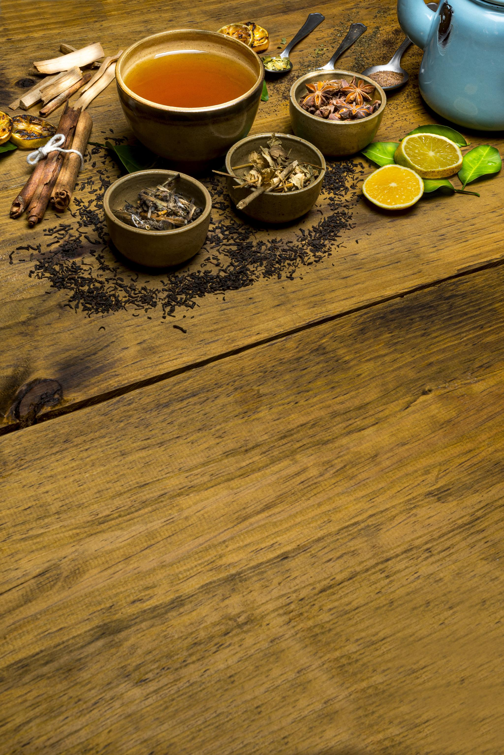
Introduction to Dosage Forms and Cosmetic Products
Role of Dosage Forms
Dosage forms transform raw medicinal substances into effective, patient-friendly preparations based on drug and patient factors.
Classical Ayurvedic Preparations
Classical forms such as Churna, Kwatha, Asava, and Bhasma are detailed in Samhitas with specific therapeutic uses.
Ayurvedic Cosmetic Products
Cosmetics like Ubtana, Taila, and Lepa maintain skin and hair health by balancing Doshas and enhancing appearance.
Modern Adaptations
Handmade preparations are now standardized into modern forms such as creams, gels, lotions, and capsules for global use.
Notes:
In the science of Rasa Shastra and Bhaishajya Kalpana, dosage forms and cosmetic products play a central role in translating raw medicinal substances into usable, effective, and patient-friendly preparations. Dosage forms refer to the physical form in which a medicine is prepared and administered, such as powders, tablets, decoctions, oils, or fermented formulations. These forms are not chosen arbitrarily; they are the result of careful consideration of drug properties, disease condition, patient constitution (Prakriti), and route of administration. In Ayurveda, classical dosage forms like Churna, Kwatha, Vati, Avaleha, Asava, Arishta, Sneha, and Bhasma are described in detail across Samhitas, highlighting their preparation methods, indications, and therapeutic significance. Cosmetic products, though often associated with external beautification, are deeply rooted in Ayurvedic concepts of health, balance, and holistic well-being. Ayurvedic cosmetics aim not only to enhance appearance but also to maintain skin and hair health by correcting underlying Dosha imbalances. Examples include Ubtana for skin cleansing, Taila for nourishment, and Lepa for localized therapeutic and cosmetic benefits. Historically, these preparations were handmade and personalized, but in the modern era, they are increasingly standardized and adapted into contemporary forms such as creams, gels, lotions, and capsules. This introductory slide sets the stage by emphasizing the importance of dosage forms in ensuring drug stability, palatability, bioavailability, and compliance, while also recognizing the growing relevance of Ayurvedic cosmetic products in global healthcare and wellness industries. Understanding these basics is essential for BAMS students to appreciate both classical wisdom and modern pharmaceutical advancements.

Slide 4
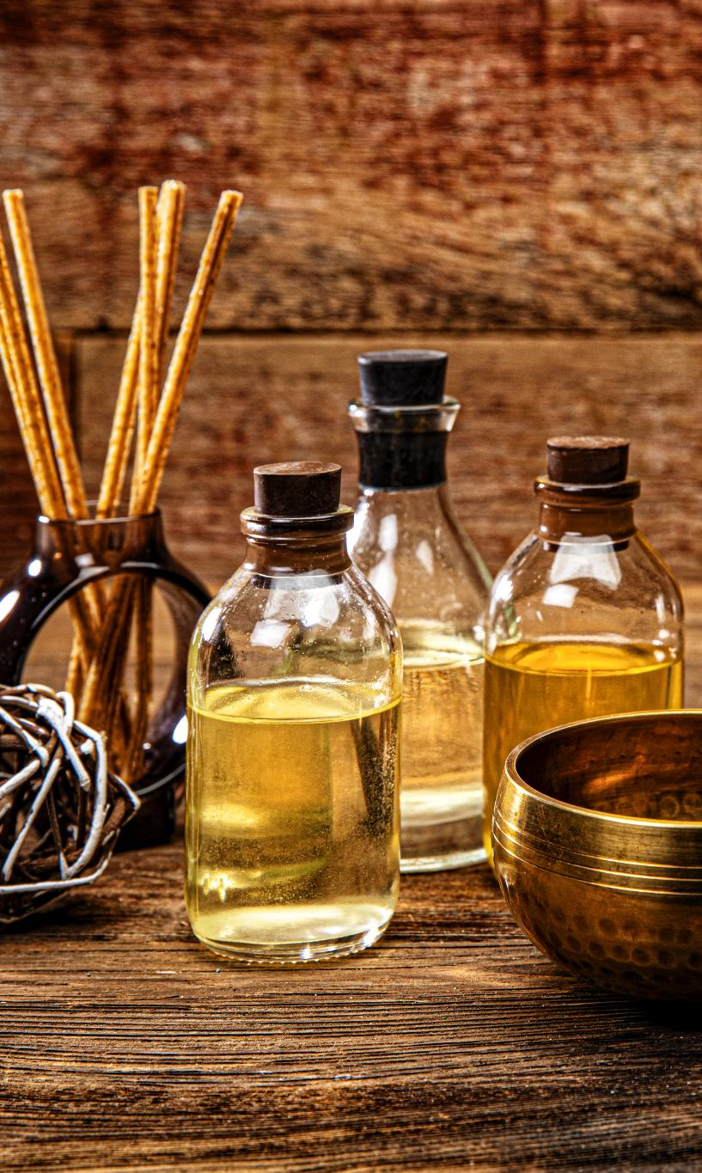
Definition and Importance of Dosage Forms in Ayurveda
Definition of Dosage Forms
Dosage forms are physical preparations of medicinal substances for effective patient administration and therapeutic action.
Role in Ayurveda
In Ayurveda, dosage forms or Kalpana enhance drug efficacy, safety, and patient acceptability through specialized processing.
Therapeutic Significance
Dosage forms control drug delivery, mask unpleasant tastes, improve stability, and influence absorption and bioavailability.
Patient-Centered Choice
Form selection depends on disease severity, patient strength, digestive power, and suitability to ensure compliance.
Notes:
A dosage form can be defined as the physical form in which a medicinal substance is prepared for administration to a patient in order to achieve the desired therapeutic effect. In Ayurveda, dosage forms are known as Kalpana, and Bhaishajya Kalpana specifically deals with the pharmaceutical processing of drugs to enhance their efficacy, safety, and acceptability. The importance of dosage forms lies in their ability to deliver the active principles of a drug in a controlled and effective manner. For example, Kwatha is preferred when rapid action is required, whereas Sneha Kalpana is selected for chronic conditions and for nourishing deeper tissues. Proper dosage forms help in masking unpleasant taste or odor, improving stability and shelf life, and ensuring accurate dosing. They also influence pharmacokinetic factors such as absorption, distribution, and bioavailability. In Ayurvedic practice, different dosage forms are indicated based on factors like Rogabala (severity of disease), Rogibala (strength of patient), Agni (digestive power), and Srotas involved. For instance, Churna may be advised for patients with strong digestion, while Avaleha is suitable for children and the elderly due to its palatability. The choice of dosage form also plays a role in minimizing adverse effects and enhancing patient compliance. Without appropriate dosage forms, even the most potent drugs may fail to produce desired results. Thus, understanding the definition and importance of dosage forms is fundamental for Ayurvedic physicians and pharmacists, especially in the contemporary context where classical formulations are being adapted into modern pharmaceutical formats.

Slide 5
Cosmetics and Routes of Administration
Notes:
Definition and Concept of Cosmetics in Ayurveda, Routes of Administration of Dosage Forms

Slide 6
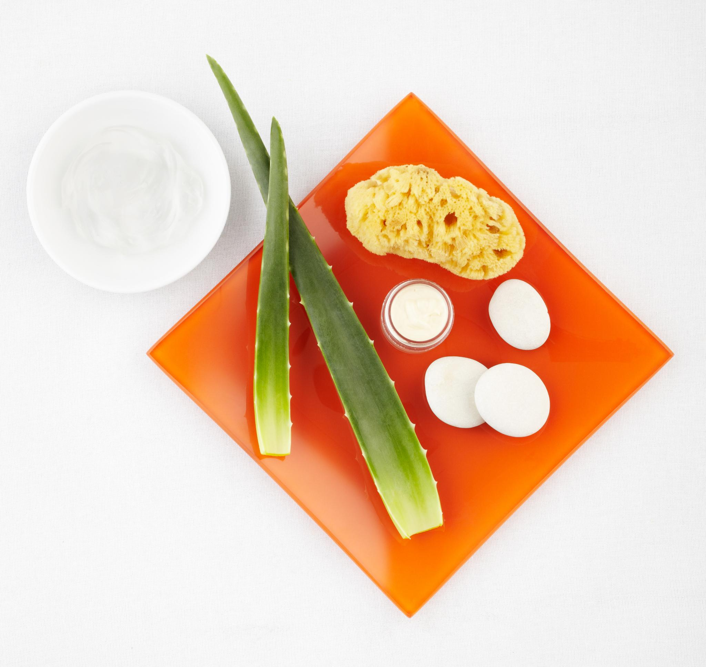
Definition and Concept of Cosmetics in Ayurveda
Ayurvedic Cosmetic Definition
Ayurvedic cosmetics are therapeutic agents promoting external beauty and internal balance.
Natural Ingredients
Common ingredients include turmeric, sandalwood, aloe vera, neem, amla, and herbal oils.
Therapeutic Benefits
Ayurvedic cosmetics provide cleansing, nourishing, anti-inflammatory, antimicrobial, and rejuvenating effects.
Modern Relevance
Ayurvedic cosmetics are popular today for safety, sustainability, and holistic wellness benefits.
Notes:
Cosmetics are defined as substances or preparations applied to the external parts of the body, such as skin, hair, nails, lips, and teeth, primarily for cleansing, beautifying, promoting attractiveness, or altering appearance. In Ayurveda, cosmetics are not merely decorative but are considered therapeutic agents that поддержive physical beauty while maintaining internal balance and health. Ayurvedic cosmetics are based on the principle that external appearance reflects internal harmony of Doshas, Dhatus, and Agni. Classical texts describe numerous cosmetic preparations under topics like Varnya, Keshya, Tvachya, and Mukhalepa, indicating their role in enhancing complexion, hair growth, skin texture, and overall vitality. Ingredients used in Ayurvedic cosmetics are largely natural, such as turmeric, sandalwood, aloe vera, neem, amla, manjistha, and various herbal oils. These substances provide cleansing, nourishing, anti-inflammatory, antimicrobial, and rejuvenating effects without causing long-term damage. Unlike synthetic cosmetics, Ayurvedic cosmetics aim to correct the root cause of skin and hair problems, such as Dosha imbalance or toxin accumulation. In the modern context, Ayurvedic cosmetic products have gained immense popularity due to increasing awareness about safety, sustainability, and holistic wellness. Products like herbal face creams, shampoos, soaps, and lotions are now widely manufactured by Ayurvedic pharmaceutical companies. Understanding the Ayurvedic definition and concept of cosmetics is essential for BAMS students, as it bridges traditional knowledge with contemporary cosmetic science and opens avenues for research and entrepreneurship.

Slide 7
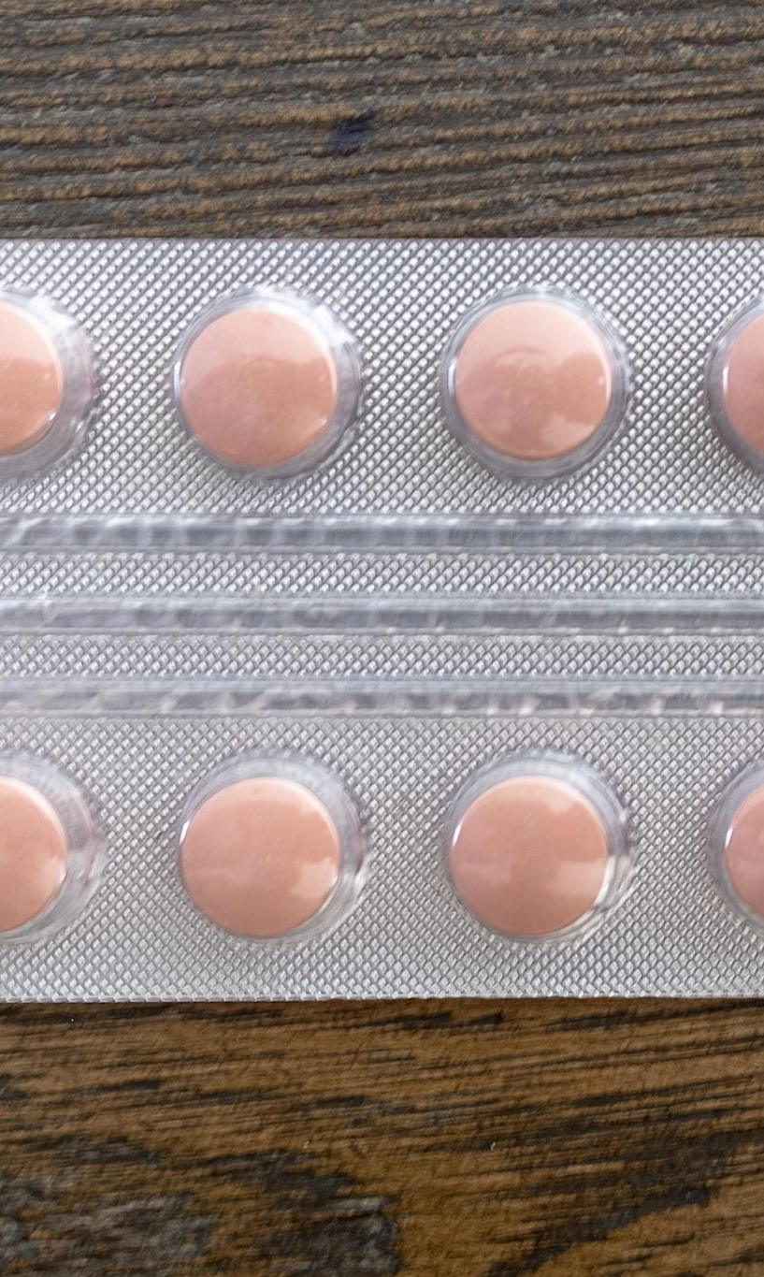
Routes of Administration of Dosage Forms
Oral Administration
Oral route is most common, involving forms like powders and liquids, relying on digestion for drug absorption.
Topical Application
Topical administration applies drugs on skin or mucous membranes for localized effect with minimal systemic side effects.
Parenteral and Nasal Routes
Parenteral and nasal routes bypass digestion, delivering drugs directly to target systems for faster action.
Inhalational and Buccal Routes
Inhalational and buccal routes enable rapid absorption, useful in respiratory and neurological conditions.
Notes:
The route of administration refers to the path by which a drug is introduced into the body to produce its therapeutic effect. In Ayurveda as well as modern medicine, the route of administration significantly influences the onset, intensity, and duration of drug action. Common routes include oral, topical, parenteral, inhalational, sublingual, and buccal routes. Oral administration is the most common route and includes forms such as Churna, Vati, Avaleha, Asava, and Arishta. It is convenient and economical but depends heavily on digestive strength and metabolism. Topical administration involves application on skin or mucous membranes, as seen with Lepa, Taila, creams, and cosmetic products. This route is ideal for localized action and minimizes systemic side effects. Parenteral routes, though limited in classical Ayurveda, are conceptually related to procedures like Basti and Nasya, which bypass the digestive system and act directly on target systems. Inhalational routes are represented by practices like Dhoomapana, useful in respiratory and neurological disorders. Sublingual and buccal routes allow rapid absorption and quick action, reducing first-pass metabolism. Selection of an appropriate route depends on disease condition, drug properties, urgency of action, and patient factors. Understanding routes of administration helps in optimizing therapeutic outcomes and is crucial when modifying classical dosage forms into modern equivalents.

Slide 8
Dosage Forms: Advantages, Disadvantages, and Modern Evolution
Notes:
Advantages of Various Dosage Forms, Disadvantages and Limitations of Dosage Forms

Slide 9

Advantages of Various Dosage Forms
Accurate and Convenient Dosing
Solid dosage forms like tablets ensure uniformity and precise dosing for effective treatment.
Improved Patient Compliance
Palatable forms such as syrups and flavored tablets enhance ease of consumption, especially for children and elderly.
Enhanced Drug Stability
Dosage forms like oils and ghees protect active ingredients from moisture, light, and air, preserving efficacy.
Targeted Drug Delivery
Topical and localized forms enable targeted treatment for specific conditions like skin or colon disorders.
Notes:
Different dosage forms offer distinct advantages that make them suitable for specific therapeutic needs. One of the primary advantages is accurate and convenient dosing, especially in solid dosage forms like Vati and tablets, where uniformity of dose can be ensured. Improved patient compliance is another major benefit, as palatable forms such as Avaleha, syrups, and flavored tablets are easier to consume, particularly for children and elderly patients. Dosage forms also enhance drug stability by protecting active ingredients from environmental factors like moisture, light, and air. For example, oils and ghees preserve fat-soluble active principles for extended periods. Certain dosage forms allow targeted drug delivery, such as topical applications for skin conditions or Basti for colon-related disorders. Modification of classical forms into capsules or tablets reduces issues related to taste, odor, and bulkiness, making Ayurvedic medicines more acceptable in modern lifestyles. Additionally, standardized dosage forms support large-scale manufacturing, quality control, and global distribution. These advantages highlight why dosage forms are a critical aspect of both traditional and modern pharmaceutical sciences.

Slide 10
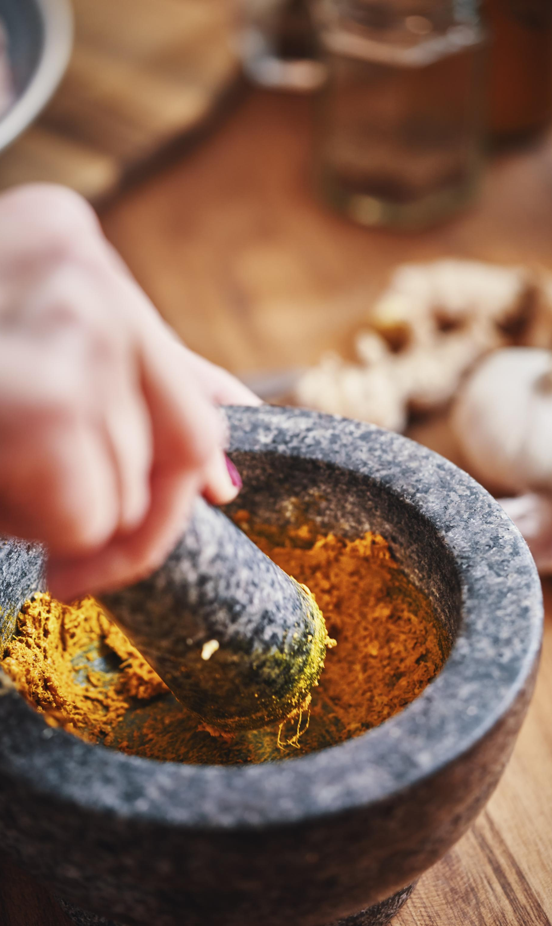
Disadvantages and Limitations of Dosage Forms
Complex Preparation Processes
Classical Ayurvedic dosage forms often require skilled labor and strict methods, making preparation time-consuming and complex.
Stability and Palatability Issues
Certain forms like Kwatha have short shelf life and bitter taste, causing challenges in stability and patient compliance.
Modern Formulations Concerns
Use of excipients, preservatives, and synthetic additives in modern dosage forms raises safety concerns and increases production cost.
Risk of Altered Efficacy
Modification without classical rationale may lose synergistic effects of whole herbs and impact therapeutic efficacy.
Notes:
Despite their benefits, dosage forms also have certain disadvantages and limitations that must be carefully considered. Some classical Ayurvedic dosage forms involve complex and time-consuming preparation processes, requiring skilled labor and strict adherence to traditional methods. Stability issues may arise in forms like Kwatha, which have a short shelf life and require fresh preparation. Palatability remains a challenge for many formulations due to bitter taste or strong odor, leading to poor patient compliance. Modern dosage forms, while convenient, may involve the use of excipients, preservatives, or synthetic additives that are not mentioned in classical texts and may raise safety concerns among purists. Cost of production can increase significantly when converting traditional preparations into advanced forms like capsules, gels, or nano-formulations. There is also a risk of losing synergistic effects of whole herbs when extracts or isolated components are used. Furthermore, improper modification without classical rationale may alter therapeutic efficacy. Understanding these disadvantages helps practitioners strike a balance between tradition and innovation while ensuring safety and effectiveness.

Slide 11
Modern Developments, Research, and Case Studies
Notes:
Research Updates and Modification of Classical Ayurvedic Dosage Forms, Relevant Case Studies and Practical Applications

Slide 12
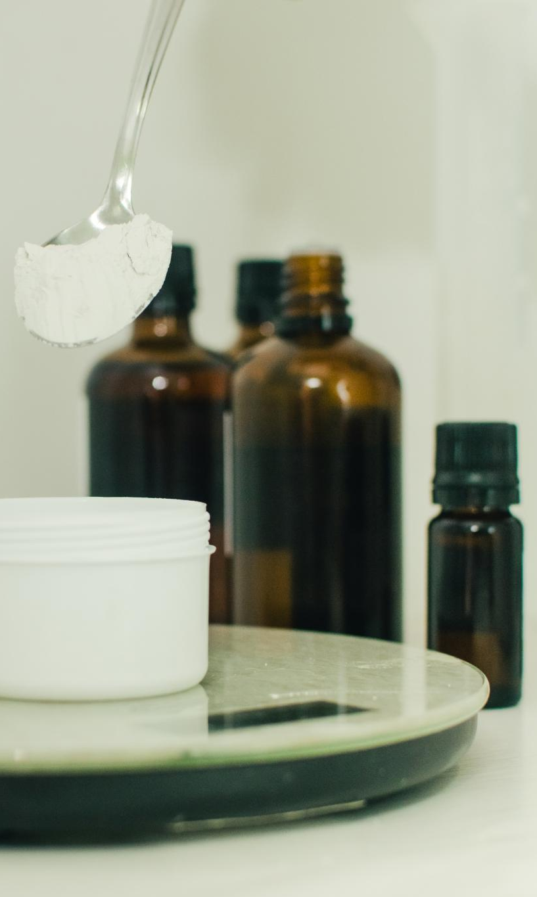
Research Updates and Modification of Classical Ayurvedic Dosage Forms
Modernizing Classical Formulations
Traditional Ayurvedic medicines are being modified into tablets, capsules, syrups, and granules to enhance convenience and patient compliance.
Advanced Nano Bhasma Technology
Nano-sized Bhasma particles improve bioavailability and reduce toxicity, reflecting advances in pharmaceutical technology.
Quality Control Techniques
Analytical methods like HPTLC, GC-MS, and ICP-MS ensure validation and quality control of Ayurvedic preparations.
Herbal Cosmetics and Fermented Preparations
Research on herbal cosmetics and fermented medicines improves stability, probiotic potential, and therapeutic efficacy.
Notes:
Recent research in Ayurvedic pharmaceutics focuses on standardization, optimization, and modernization of classical dosage forms to meet contemporary healthcare needs. One major area of research is the modification of traditional formulations into more convenient forms, such as converting Churna into tablets or capsules and Kwatha into syrups or granules. Advances in pharmaceutical technology have enabled the development of nano-sized Bhasma particles, improving bioavailability and reducing toxicity. Analytical techniques like HPTLC, GC-MS, and ICP-MS are now used for quality control and validation of classical preparations. Research on herbal cosmetics has led to the development of stable creams, gels, and lotions with defined shelf life and reproducible efficacy. Fermented preparations like Asava and Arishta are being studied for their probiotic potential and improved absorption. These innovations aim to preserve the therapeutic principles of Ayurveda while enhancing safety, acceptability, and global acceptance. Continuous research ensures that Ayurvedic dosage forms remain relevant, evidence-based, and competitive in modern medicine.

Slide 13

Relevant Case Studies and Practical Applications
Triphala Dosage Forms
Triphala tablets improve patient compliance while maintaining therapeutic efficacy compared to Churna form.
Herbal vs Synthetic Cosmetics
Ayurvedic herbal cosmetics show fewer side effects and better skin health than synthetic products in acne management.
Herbal Oils to Creams
Conversion of herbal oils into creams enhances usability without losing therapeutic benefits.
Clinical Validation Importance
Case studies emphasize clinical validation and rational modification integrating tradition with modern design.
Notes:
Case studies provide practical insight into the comparative effectiveness of classical and modified dosage forms. One notable example is the use of Triphala in Churna versus tablet form. Clinical observations have shown that Triphala tablets offer better patient compliance due to ease of administration while maintaining similar therapeutic efficacy in conditions like constipation and dyspepsia. Another case study compares herbal cosmetic formulations with synthetic products in managing acne and dermatitis. Ayurvedic formulations demonstrated fewer side effects and better long-term skin health outcomes. Studies on herbal oils converted into creams have shown improved usability without compromising therapeutic benefits. These case studies highlight the potential of integrating traditional wisdom with modern pharmaceutical design. They also emphasize the importance of clinical validation and rational modification. For BAMS students, such examples illustrate real-world applications of Bhaishajya Kalpana principles and encourage evidence-based practice and research-oriented thinking in Ayurvedic pharmaceutics.

