Slide 1
Visualization of Energy Data: Exploring Global Dynamics
Prepared By:
Prathamesh R. Mane
Data Visualization

Slide 2
Content
Introduction to Visualization
Data Source
Visualizations
Methodology
Tools

Slide 3
Introduction to Visualization
What: This project focuses on visualizing energy-related data to understand global dynamics concerning energy production, consumption, and sustainability. By examining a comprehensive dataset from Our World in Data, we explore the intricate details of how energy impacts our planet.
Why: Visualizing energy data is crucial for gaining insights into the challenges and opportunities surrounding energy, including access, sustainability, and climate change mitigation. Through visualization, complex patterns can be unraveled, trends identified, and areas for intervention pinpointed. Visual representations offer a tangible way to grasp the magnitude of energy-related issues and inspire informed decision-making.
How: Utilizing a comprehensive dataset from Our World in Data, visual representations such as cartography maps, time series plots, and area charts are created to illustrate energy trends and patterns over time and across different regions. Through effective visualization, valuable insights are provided for policymakers, researchers, and stakeholders working towards a sustainable energy future.

Slide 4
Data Source
Dataset: "Visualizing Energy Data: Exploring the Dynamics of Power Generation, Consumption, and Sustainability" from https://ourworldindata.org/energy.
Description: This comprehensive dataset provides insights into global energy dynamics, including power generation, consumption patterns, and sustainability indicators, facilitating in-depth analysis and visualization.
Accessibility: Accessible through ourworldindata.org/energy, the dataset is freely available, fostering transparency and facilitating research and analysis in the field of energy studies.
Temporal Limitation: The dataset provides information up to the year 2022, offering a comprehensive yet bounded view of global energy dynamics within this timeframe.
Historical Context: With data spanning back to previous years, the dataset allows for historical analysis, enabling researchers to examine long-term trends and patterns in global energy consumption and production.

Slide 5
Visualizations
Cartography Map: This visualization depicts energy production levels across different countries using a geographical map. Each country is represented by a color or shade indicating its level of energy production, allowing viewers to quickly identify regions with high and low energy production.
Time Series: This visualization tracks energy consumption trends over time, typically spanning multiple years. It presents data points representing energy consumption for each year, enabling viewers to observe long-term patterns, fluctuations, and trends in energy consumption behavior.
Area Chart: This visualization illustrates the changing proportions of fossil fuel consumption over time using an area chart format. The chart consists of stacked areas, with each layer representing a different type of fossil fuel (such as gas, oil, and coal). By comparing the sizes of the stacked areas over time, viewers can discern shifts in the relative contributions of different fossil fuels to overall energy consumption.

Slide 6
Methodology
Data Retrieval
Data Parsing
Data Cleaning
GeoJSON Integration
Frontend Development
Enhancements
Obtained raw energy data from the specified source, https://ourworldindata.org/energy , using appropriate data retrieval techniques.
Parsed the retrieved data using JavaScript to extract relevant information required for visualization, such as energy consumption levels by country and year.
Developed the HTML structure for the visualization, integrated GeoJSON features, applied CSS styling to enhance visual appeal, and implement JavaScript functionality using D3.js for dynamic generation of the chloropleth map and interactive features.
Incorporated interactive features, conducted thorough testing for compatibility, optimized performance, and provided comprehensive documentation for future reference and troubleshooting.
Preprocessed the extracted data to handle inconsistencies, missing values, and outliers that affect the accuracy of the visualization.
Utilized GeoJSON format to represent geographical features such as country boundaries and coordinates necessary for creating the chloropleth map.

Slide 7
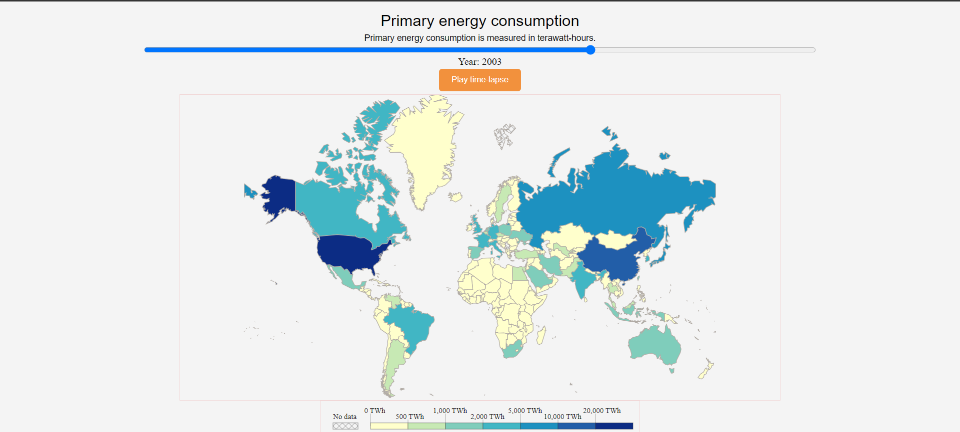
Exploring Global Energy Consumption Dynamics
Map-:

Slide 8
Exploring Global Energy Consumption Dynamics
Map-:

Slide 9
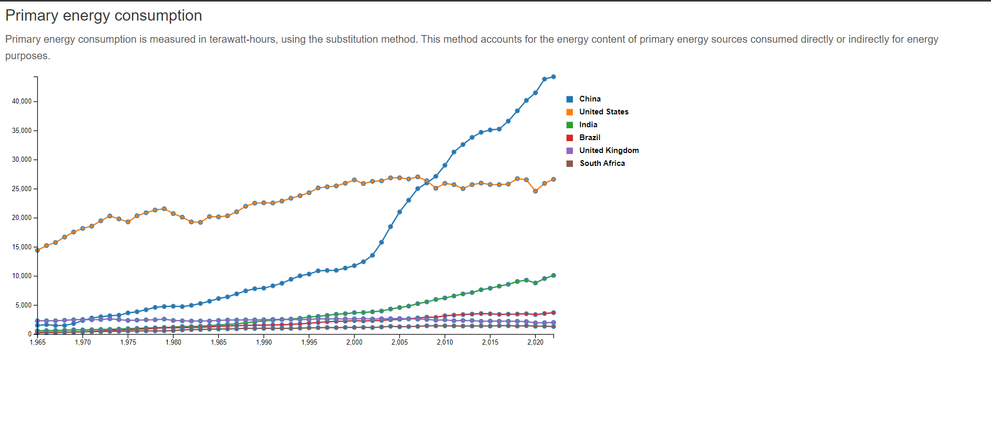
Exploring Global Energy Consumption Dynamics
Chart-:

Slide 10
Visualization Tools
HTML, CSS, and JavaScript with D3.js: Utilized web technologies to create dynamic and interactive visualizations, with D3.js providing powerful data-driven manipulation and rendering capabilities.
Visual Studio: Benefit from features like IntelliSense, code navigation, and built-in debugging tools for seamless development and testing of HTML, CSS, and JavaScript code.
Chrome Developer Tools: Accessed advanced debugging, profiling, and performance analysis tools within the Chrome browser, facilitating real-time troubleshooting and optimization of web-based visualizations.
.geojson Integration: Seamlessly incorporate geographical features into visualizations using .geojson files, enabling precise mapping and spatial analysis.

Slide 11
Conclusion
The visualization presented offers compelling insights into the intricate dynamics of global energy consumption. By tracking consumption trends over nearly six decades, significant shifts in energy sources and consumption patterns become apparent.
A notable observation is the gradual increase in renewable energy adoption, reflecting global efforts to mitigate climate change and transition towards sustainable energy systems. This transition is evident in the decreasing reliance on fossil fuels and the rising share of renewables in the energy mix.
However, challenges persist, particularly in ensuring universal access to clean and affordable energy. Disparities in energy access and the lingering dependence on fossil fuels underscore the need for continued efforts towards energy equity and sustainability.
The visualization serves as a call to action, highlighting the urgency of accelerating the transition to renewable energy and implementing policies that promote energy efficiency and conservation. By visualizing these trends, the aim is to inspire informed decision-making and foster dialogue towards a more sustainable energy future.
While the visualization provides valuable insights, there is room for improvement. Future iterations could explore additional data dimensions, such as regional disparities in energy access or the socio-economic impacts of energy transitions. Additionally, incorporating feedback from stakeholders and experts could further enhance the utility and effectiveness of the visualization in informing policy and driving action

Slide 12
Conclusion and Possible improvement
Through interactive visualizations, I've gained valuable insights into global energy consumption patterns and trends.
The dynamic nature of the visualizations allows for a deeper understanding of how energy shapes our world.
By examining consumption data for both fossil fuels and renewable resources, I've highlighted the need for sustainable energy transitions.
Possible Improvements:
Incorporating more interactive features may allow us to customize and analyze data according to specific parameters.
Enhancing the user interface to improve accessibility and usability for a wider audience.
Exploring additional datasets or data sources to provide a more comprehensive view of global energy dynamics.
Conducting user testing to gather feedback and refine the visualization interface for optimal user experience.
Considering integrating real-time data updates to ensure the visualizations reflect the most current energy trends and developments.
Comparison with Other Visualizations:
My interactive visualizations offer a more dynamic and engaging way to explore energy consumption patterns compared to static charts or graphs.
The inclusion of interactive features allows users to interactively explore and analyze data, fostering a deeper understanding of global energy dynamics.
While traditional visualizations provide valuable insights, my interactive approach offers a more immersive and customizable experience for users to interact with energy data.

Slide 13
Thank you.

