Slide 1




PARTICIPANT PRESENTATION
Participant Details
Qiskit
Fall Fest
2026
PROJECT TITLE
AAROGYAM: Quantum Assisted Early Health Risk Intelligence
TRACK – 7th
Quantum technology for medical application and sensing
TEAM NAME
HackLords
TEAM LEADER
Pranali Basarikatti
EMAIL / CONTACT
pranalib2026@gmail.com / 9663667098
Hackathon · Team Details
TEAM MEMBERS
Pratham W · Shreya Bhadrashetti
INSTITUTION / ORGANISATION
Jain College of Engineering and research
COUNTRY
India
Notes:
Open with the one-line pitch: AAROGYAM turns small public health datasets into an understandable risk-screening prototype AND an honest, reproducible test of whether quantum ML helps. Fill in the bracketed team fields before presenting.

Slide 2






Problem Statement
THE PROBLEM
AAROGYAM’S ANSWER
Risk numbers are hard for people to read
Plain-language, clearly labelled estimates
THE GAP
Understandable, measurable, responsible
Clinicians need clear, organised summaries
Patient and clinician portals
Quantum-ML demos rarely show honest tests
Measured classical vs quantum results
Notes:
Three real pain points: people struggle with risk numbers, clinicians need organised summaries, and many quantum-ML projects use a quantum logo without a real, fair experiment. AAROGYAM closes that gap with a labelled, measurable prototype.

Slide 3





Objectives & Novelty
OBJECTIVES
NOVELTY (QGENE ENGINE)
Two separate tasks:
heart and diabetes
Quantum-readiness check
before training
AAROGYAM
+ QGene engine
Fair classical vs
quantum comparison
Closed-form kernel:
O(n), not O(n²)
Patient and clinician
portals
3 quantum models:
QSVM · VQC · QNN
Safe by design: QR,
dialer, disclaimers
Conformal abstention
+ risk bands
Notes:
Mind map of what we set out to do (left) and what is new (right). The novelty comes from fusing our product layer (portals, QR, dialer) with the QGene hybrid engine: it checks whether quantum kernels can help BEFORE training, computes the kernel in closed form, offers three different quantum models, and abstains when unsure.

Slide 4




Solution & Quantum Advantage
CLASSICAL
LogReg · RF · SVM
Health inputs
form + review step
Pre-process
clean · scale · PCA
Hybrid ensemble
auto-weighted
Risk band + abstain
plain-language result
QUANTUM
QSVM · VQC · QNN
Quantum advantage is tested, not assumed
Quantum is the best single model on 2 of 5 datasets, heart disease included; the ensemble down-weights it elsewhere
Notes:
End-to-end flow: inputs are validated, pre-processed identically for every dataset, scored by three classical and three quantum models, merged by an ensemble that learns how much to trust each branch, then turned into a risk band with a conformal "abstain" option. The banner is our honesty principle: we report where quantum helps and where it does not.

Slide 5










Product Experience
PATIENT
Pick a task
heart or diabetes
Enter + review
validated form
Get estimate
risk band, labelled
Wellness tips
general, no treatment
Share by QR
opaque token only
CLINICIAN
Open record
synthetic demo data
Review inputs
and model result
See the limits
metrics + caveats
Scan QR
consent required
Discuss
aid only, no diagnosis
DEMO DATA
EXPERIMENTAL RESULT
NOT A DIAGNOSIS
Emergency dialer: opens phone, you confirm
Notes:
Two lanes. The patient picks a task, reviews inputs, sees a labelled estimate and general wellness education, and can share a record by QR. The QR carries only an opaque token, never health data. The clinician reviews synthetic or consented records, sees metrics and limitations, and uses it as a discussion aid only. The emergency button just opens the phone dialer; the user confirms the call. Number must be verified for the demo locale.

Slide 6
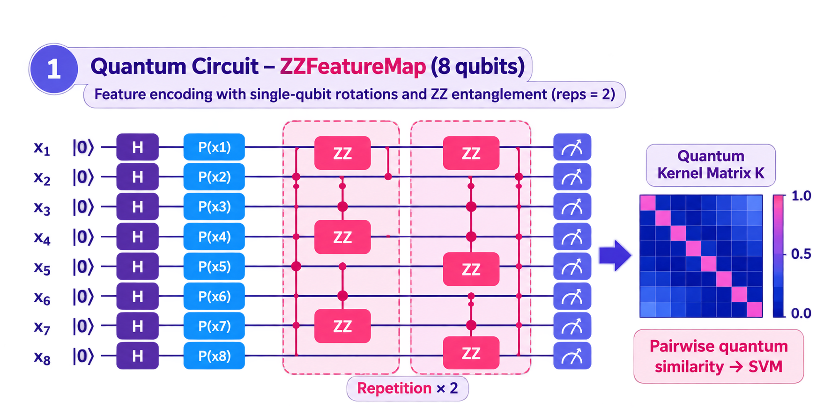
Algorithm & Circuit Design
Hybrid pipeline
1
Clean · impute · denoise
2
Normalise (train-fit only)
3
PCA → 8 components
4
Rescale to [0, π]
5
ZZFeatureMap → 8 qubits
K(x, y) = |⟨φ(x) | φ(y)⟩|²
Statevector kernel: states built once, a 4000×4000 Gram matrix in about 1 s
fidelity between encoded states
Notes:
Schematic of the ZZFeatureMap: Hadamards, data-dependent phase rotations, and ZZ entangling between all qubit pairs, repeated. Eight PCA features map onto eight qubits. Instead of running one circuit per pair of samples (O(n squared)), the statevector simulator prepares each state once and the kernel is K = |Psi Psi-dagger| squared. The closed form is verified against Qiskit on every run.

Slide 7




Implementation & Tech Stack
Experience
React + Vite
React Three Fiber
QR + dialer
Recharts
API
Python · FastAPI
Input validation
/predict · /metrics
/records · /qr
ML engine
scikit-learn
Qiskit 2.x
Closed-form kernel
SPSA · COBYLA
Data
Heart (Cleveland)
Diabetes (Pima)
Synthetic demo records
Upload your CSV
Ship
Docker
Render · Fly.io
Python 3.12
Pinned dependencies
Notes:
Five layers. The frontend and API follow the PRD (React + Vite, Python API with validated schemas). The ML engine is the QGene pipeline: scikit-learn baselines plus Qiskit-based quantum models with the closed-form kernel. Data are public benchmark datasets and synthetic demo records only. It ships as a Docker image and runs on a 512 MB instance.

Slide 8
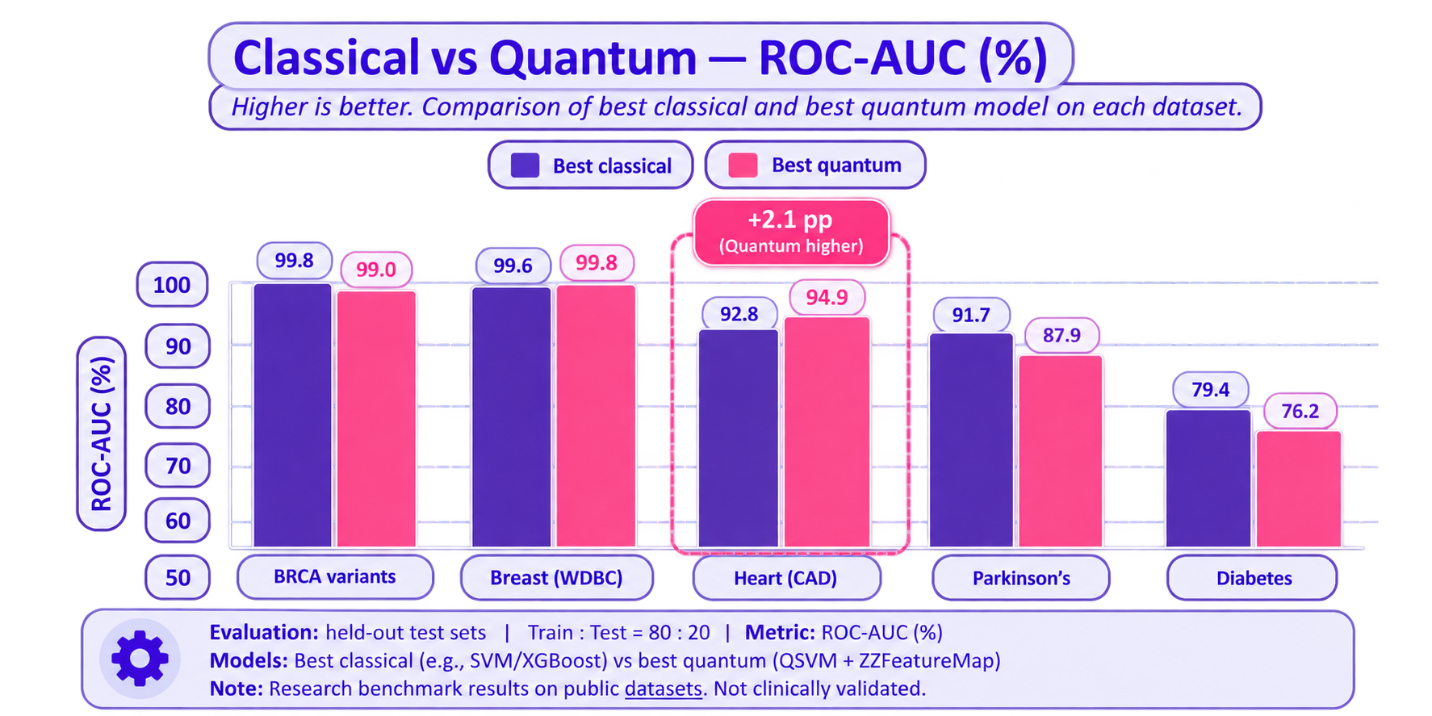
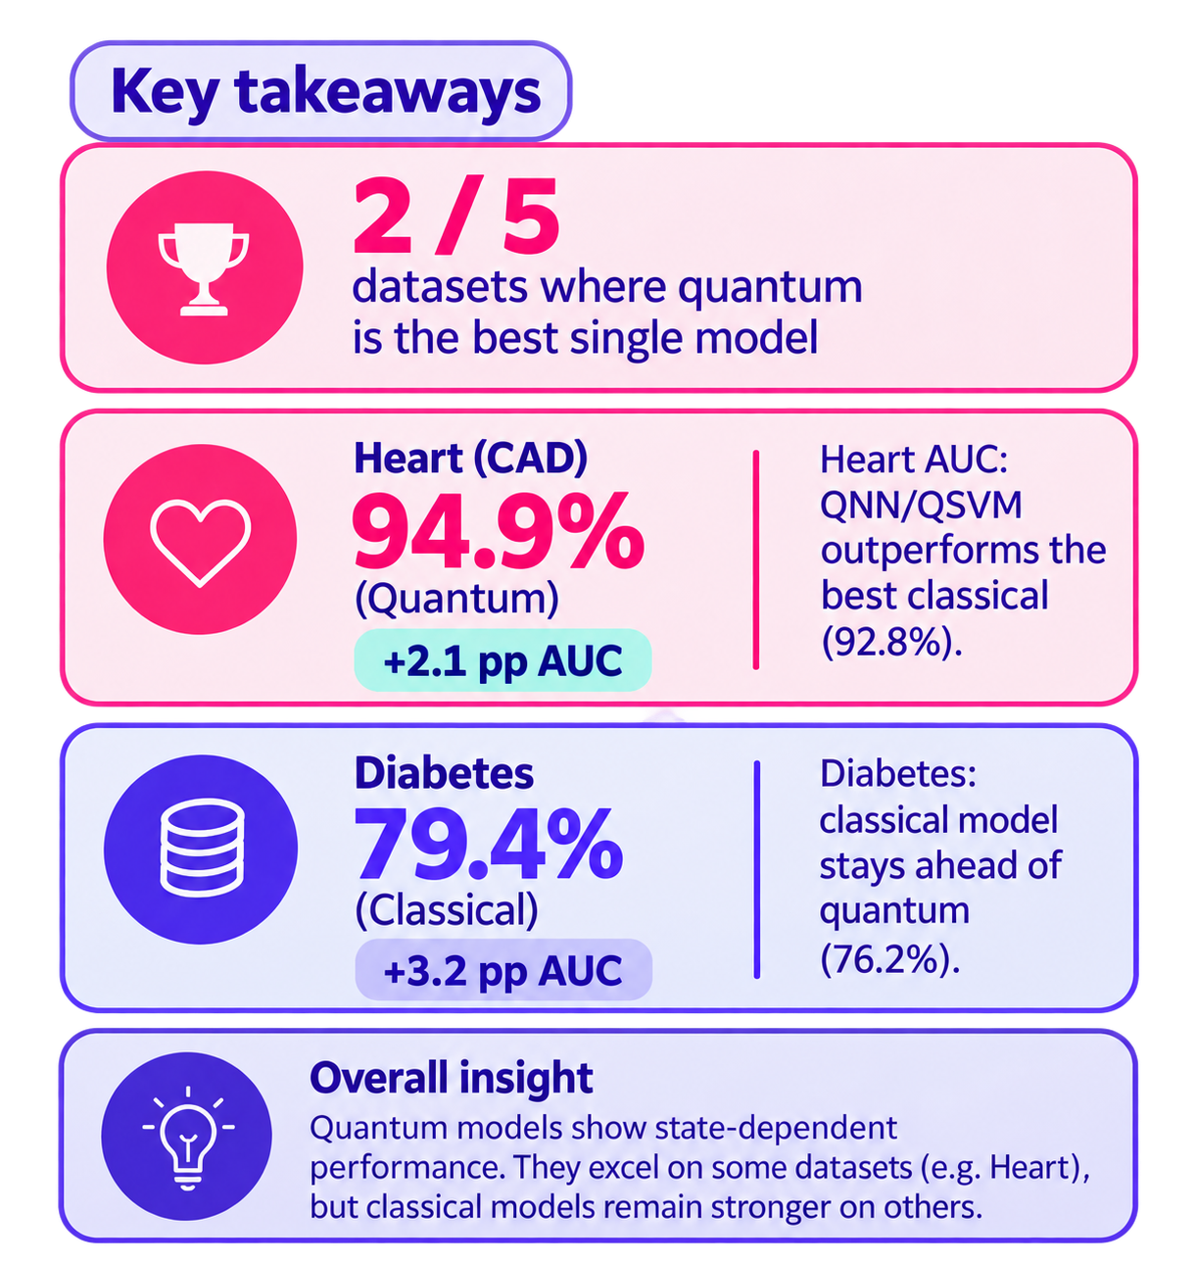
Results & Analysis
Notes:
All numbers are measured on held-out test sets from the QGene benchmark. Quantum wins on breast-imaging features and on coronary artery disease (QNN, AUC 94.9 vs 92.8) and loses on the other three, including diabetes. Axis starts at 50 because that is chance level. We report both the wins and the losses.

Slide 9
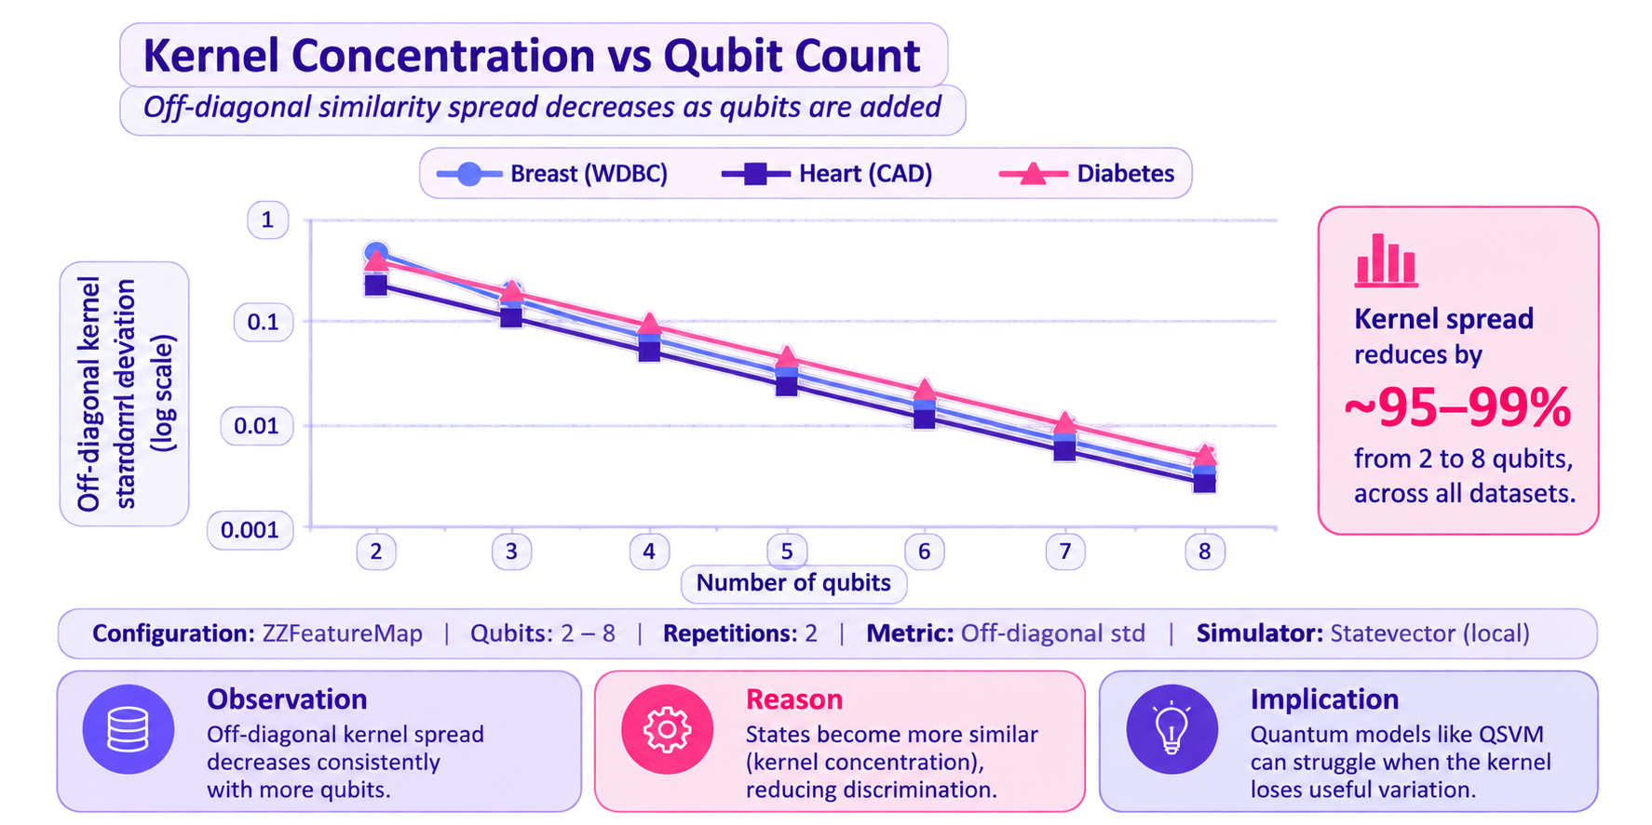
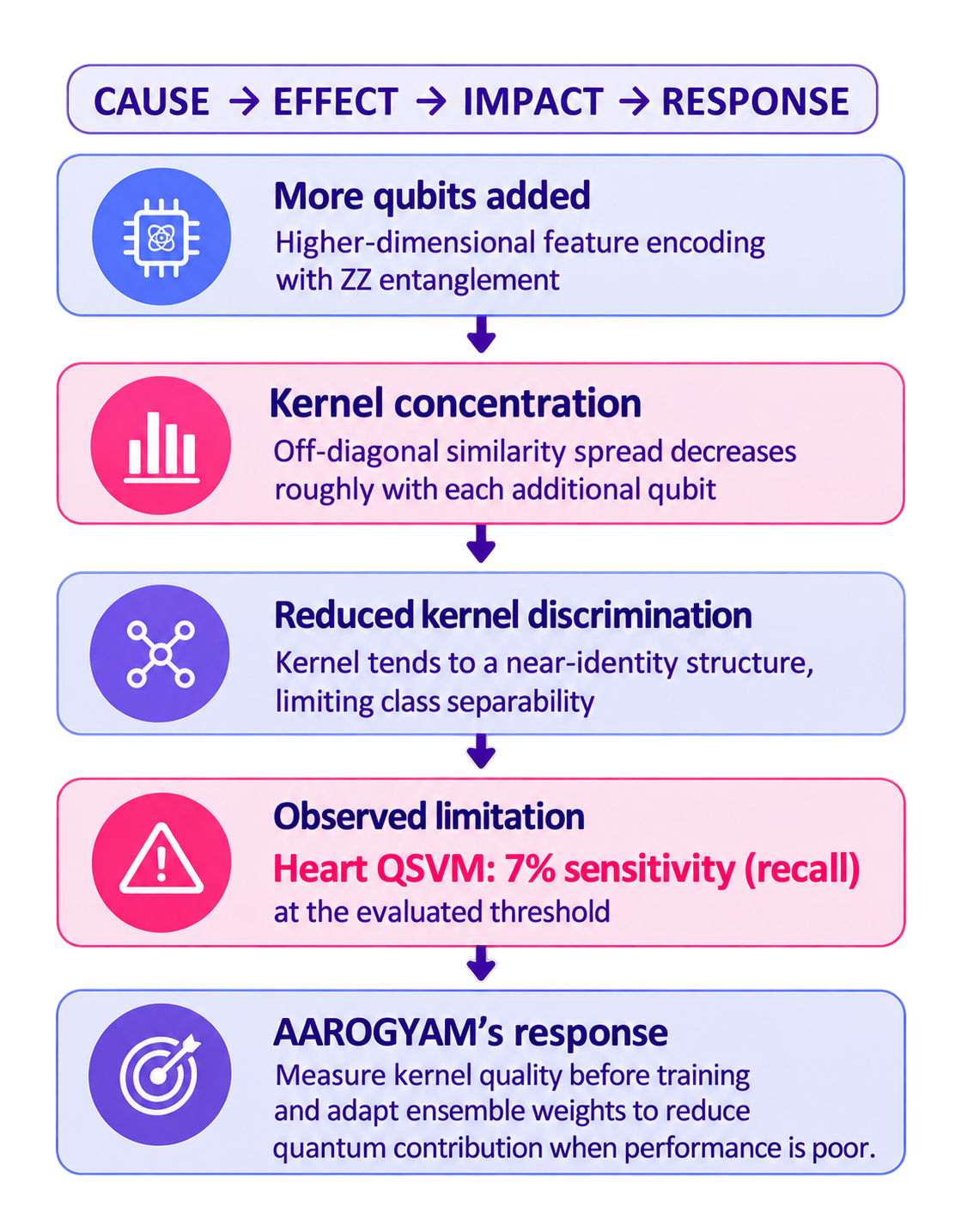
Why Quantum Wins, or Loses
Notes:
This is the scientific core. As qubits are added the kernel off-diagonal spread roughly halves (exponential concentration), so the kernel matrix tends toward the identity and a quantum-kernel SVM has nothing to separate: its sensitivity collapses to 7% on heart and under 4% on diabetes. The data re-uploading QNN avoids this and recovers 93% heart sensitivity. The platform measures this before training, and the ensemble gives quantum a share of 6% on heart and 0% on diabetes.

Slide 10
Decision Support
Observed outcome rate in each risk band
Conformal prediction: commit or abstain
43%
abstain
39%
abstain
Heart
97% accurate
when it commits
Diabetes
82% accurate
when it commits
Observed rates mostly rise with band · small held-out test sets
Calibration sets are small, so guarantees are loose
Notes:
Decision support rather than a bare score. Probabilities are mapped to five risk bands and we check each band against the observed outcome rate on held-out data. Conformal prediction lets the system abstain instead of guessing: on heart it abstains on 43% of cases but is 97% accurate when it commits. Calibration sets here are tiny (61 and 154 rows), so we say plainly that the coverage guarantees are loose.

Slide 11
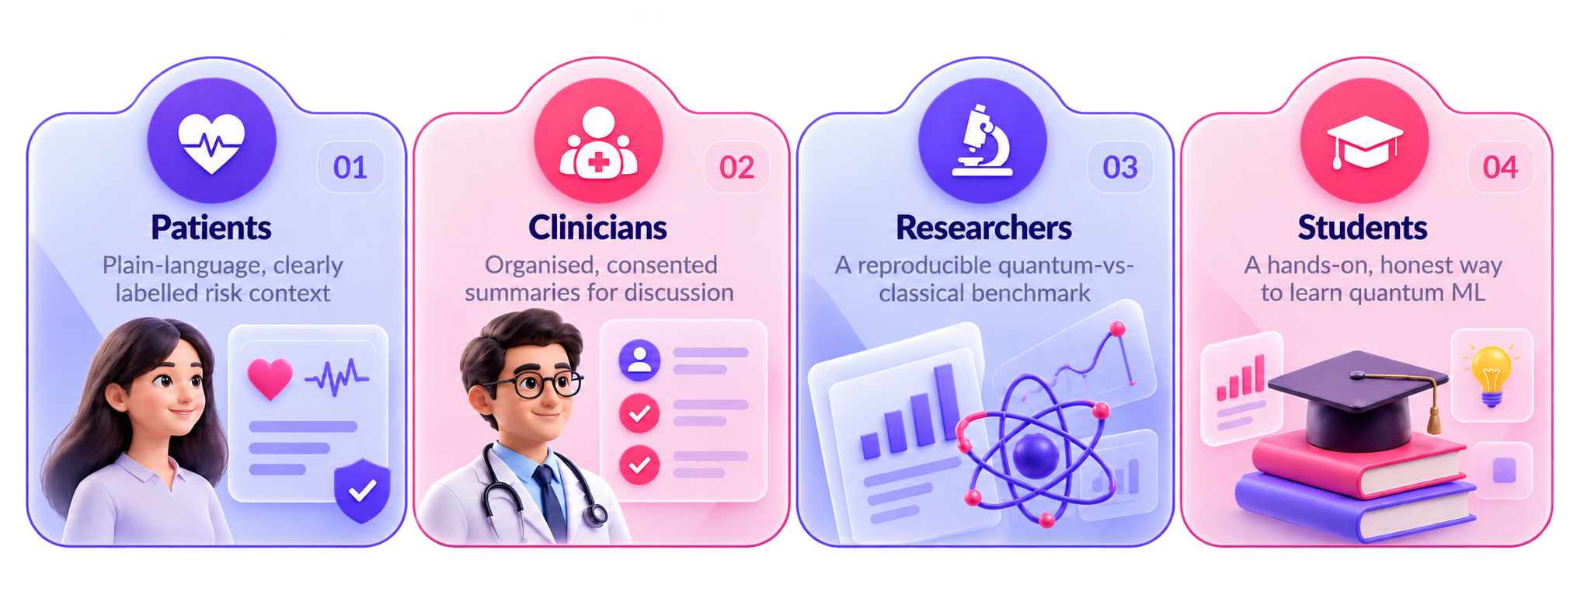
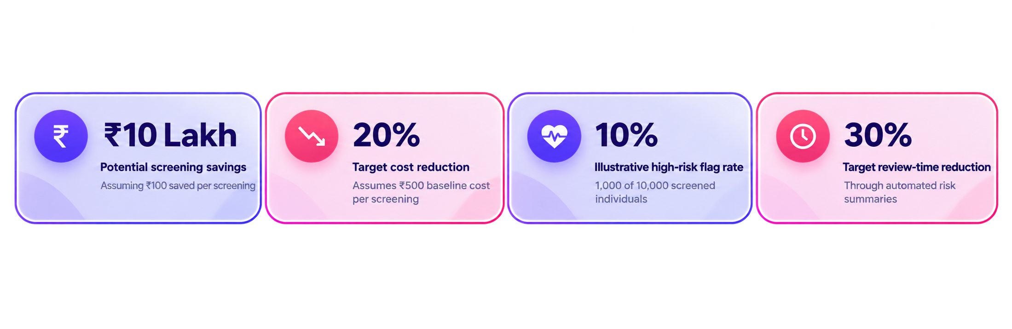
Impact & Real-World Applications
Notes:
Who benefits: patients get understandable context, clinicians get organised summaries for conversations, researchers get a reproducible benchmark, and students get an honest introduction to quantum ML. The same pipeline already runs on five public datasets and accepts an uploaded CSV, so adding new disease tasks does not need new model code. No claims of clinical outcomes are made.

Slide 12
Challenges & Future Scope
CHALLENGE
HOW WE HANDLE IT
ROADMAP
Kernel concentration
Diagnose it before training
1
MVP
Dual portals, honest benchmarks, synthetic records
Tiny public datasets
Conformal abstention, honest labels
2
NEXT
Authentication, consent, audit trail, clinician review
Public data ≠ real patients
Synthetic demo records, no claims
Slow quantum simulation
Closed-form O(n) kernel
3
LATER
Real IBM quantum hardware, error mitigation, more diseases
Notes:
Left: the four real challenges and how each is handled. Right: roadmap. After the MVP, the priorities are real authentication and consent with an audit trail, clinician review of all health-facing language, and finally runs on real quantum hardware with error mitigation.

Slide 13
CLOSING
Thank You
Questions?
Inspiring Minds. Shaping Tomorrow.
GITHUB REPOSITORY
Click here
DEMO VIDEO LINK
Click here
Notes:
Close on the honesty message: a stable demo, real measured results, and clear limits. Add the demo video link before submitting. Disclaimer: educational prototype only, not for diagnosis, treatment or emergency decisions.

