Slide 1
Virtual Trainer For Fitness Using Artificial Intelligence
Under the guidance of
Dr. Arul Kumar N
Prathana M(2248063)
Hiranya J Bontra (2248036)

Slide 2
Table of Contents
Introduction
Why Fitness Tracking Using AI
Related Works
Problem Statement
Objective
System Requirement
Proposed Work (Techniques, Algorithm, etc )
Planned UI
Conclusion

Slide 3
Introduction:
Can an AI-Powered Fitness App Outperform a Human Trainer?

Slide 4
Why Fitness Tracking Using AI Needed?
Leveraging the power of AI technology to track user’s workout performance
Immediate FeedBack
Performance History and progress tracking
Gamification to make workouts more enjoyable and celebrating Milestones
Extensive data on user’s workouts and behaviors
Identify trends,pattern and areas of improvement
24/7 availability
Cost-Effective

Slide 5
Related Works
A review of real-time human action recognition involving vision sensing
Authors :Sharmin Majumder
Nasser Kehtarnavaz
https://www.researchgate.net/publication/350821419_A_review_of_real-time_human_action_recognition_involving_vision_sensing
2.
1.
2.
3.
4
A review of real-time human action recognition involving vision sensing
Human Action Recognition from Various Data
Modalities: A Review
The Effectiveness of a Personalized Virtual Fitness Trainer in Teaching Physical Education by Applying the Artificial Intelligent Algorithm
Virtual Fitness Trainer using Artificial Intelligence
AUTHORS:
Neha D, Dr. S. K. Manju Bargavi
AUTHORS:
Sharmin Majumder
Nasser Kehtarnavaz
AUTHORS:
Zehua Sun, Qiuhong Ke, Hossein Rahmani, Mohammed Bennamoun, Gang Wang, and Jun Liu
AUTHOR: Nur Azlina
LINK :
https://www.researchgate.net/publication/350821419_A_review_of_real-time_human_action_recognition_involving_vision_sensing
LINK:
https://arxiv.org/pdf/2012.11866.pdf
LINK:
https://www.researchgate.net/publication/351122142_The_Effectiveness_of_a_Personalized_Virtual_Fitness_Trainer_in_Teaching_Physical_Education
LINK:
https://www.ijraset.com/research-paper/virtual-fitness-trainer-using-artificial-intelligence

Slide 6
Problem Statement
In today's fast-paced world, maintaining a healthy lifestyle is crucial. However, traditional gyms often clash with busy schedules, making regular visits challenging. Moreover, the availability of fitness trainers is limited and not always round the clock. This situation raises doubts about exercise techniques and progress. To address these issues, a solution is needed that provides flexible, guided workouts, ensuring effective exercise anytime, anywhere.

Slide 7
Objective
The core objective of this project is to create an robust fitness tracking website using AI which serves in capturing users' health information and recommends tailored exercise recommendations. The overarching aim is to ensure the accuracy of exercise performance through real-time monitoring and corrective measures. Additionally, the website strives to empower users to engage in their workout routines from any location, transcending the confines of a traditional fitness setting.

Slide 8
SYSTEM REQUIREMENTS
01
GPU
WEBCAM
Network Connectivity
Display
HARDWARE
02
OS
Web Server
Virtual Processing Libraries
Database Management Services
Data visualization tools
Deployment Tools
SOFTWARE

Slide 9
Proposed work(Techniques,Algorithms.etc)
Processing video from webcam by converting BGR2RGB image frame
Techniques to calculate angle
Extracting part of human body as landmarks using MediaPipe
Counting number of times the exercise is been done
Human pose detection using MediaPipe
Providing real-time feedback during the workout by setting conditions
Displaying Dashboard to see their progress and performance

Slide 10

Planned UI
Login page:

Slide 11

Personalized Information:

Slide 12
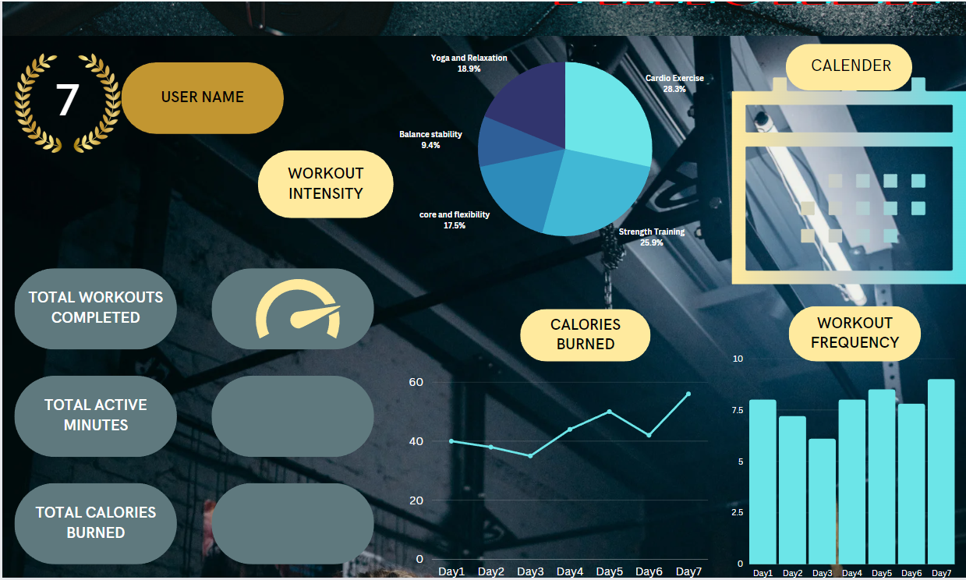
Dashboard:

Slide 13
Conclusion
In conclusion, our project aims to revolutionize the way individuals approach fitness and well-being. By leveraging the power of AI and technology, the virtual fitness tracker empowers users to stay on track,get motivated to achieve their target, and have personalized guidance. Our solution eliminates the barriers of time constraints and the scarcity of round-the-clock trainers, offering a seamless and user-friendly experience by having daily track on progress.This project not only transforms the fitness landscape but also highlights the potential of AI to enhance various aspects of daily life.

