Slide 1
DIGITAL MARKETING | SOCIAL MEDIA ANALYTICS
Instagram Performance Analytics for Sugar Cosmetics
Key insights, business implications and strategic recommendations from 50K posts (Apr 2024 – Apr 2025)
Data Analysis Project | Stakeholder Presentation
Notes:
Introduce the project: analysing Sugar Cosmetics Instagram performance to recommend social media strategy.

Slide 2
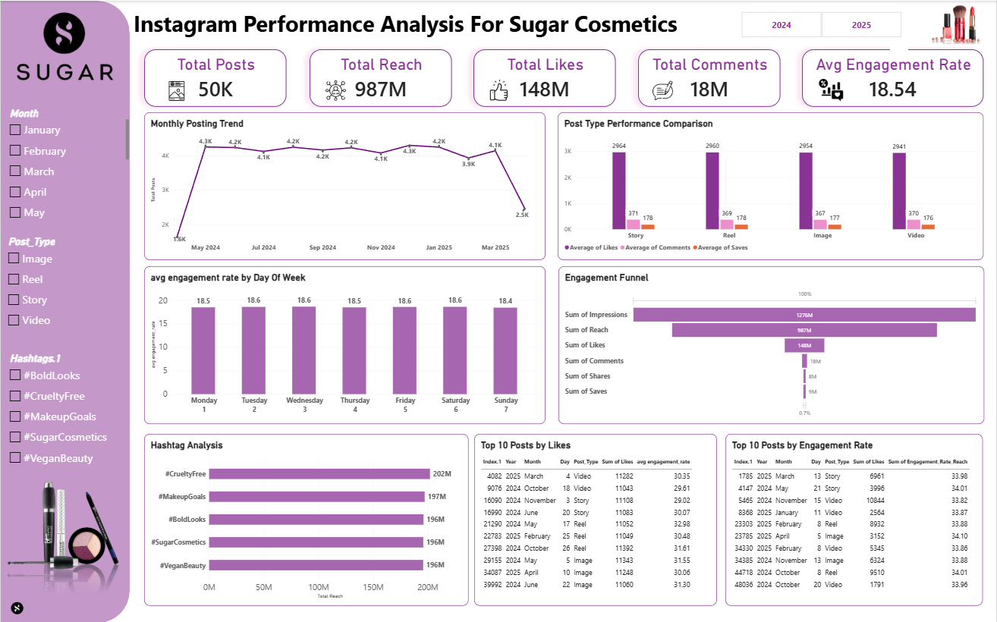
The Instagram Insights Dashboard
What it answers
Overall account health (5 KPIs)
Posting consistency over time
Best formats, days and hashtags
Where users drop off in the funnel
Top posts by likes and by engagement rate
Filters: Month, Post Type, Hashtag
2
Notes:
Single interactive dashboard combining all analyses, filterable by month, post type and hashtag.

Slide 3
How is the account performing overall?
50K
987M
148M
18M
18.54%
Total Posts
Total Reach
Total Likes
Total Comments
Avg Engagement Rate
~2,960
~360
~19.7K
avg likes per post (148M ÷ 50K)
avg comments per post (18M ÷ 50K)
avg reach per post (987M ÷ 50K)
So what? An 18.54% engagement rate (interactions ÷ reach) shows the audience is highly responsive; the opportunity is scaling that consistently.
3
Notes:
Engagement rate = (likes+comments+shares+saves)/reach, roughly 183M/987M.

Slide 4
Monthly posting trend: a steady ~4.2K posts a month
Consistent cadence
May-24 to Mar-25 stays between 3.9K and 4.3K
Dec-24 is the peak at 4.3K
Two edges to check
Apr-24 (1.6K) looks like the ramp-up start
Apr-25 (2.5K) drop: confirm if the month is partial or output truly fell
4
Notes:
Posting is very consistent. The first and last months are the outliers and should be validated against the data window.

Slide 5
Post type: all formats perform almost identically
So what? Story (2,964) and Reel (2,960) lead by under 1%, so no format needs cutting. Format choice matters less than creative quality.
5
Notes:
The dataset contains Image, Reel, Story and Video. Differences between formats are under 1%.

Slide 6
Best days and hashtags: small edges, useful tie-breakers
So what? Tue, Wed, Fri and Sat edge out Sunday (18.6% vs 18.4%). #CrueltyFree leads reach at 202M, so make it the anchor hashtag.
6
Notes:
Weekday spread is only 0.2 points. Hashtag reach spread is about 3%.

Slide 7
Engagement funnel: reach converts well, shares and saves lag
Impressions
1276M
77.4%
of impressions are unique reach
Reach
987M
15.0%
of reached accounts like a post
Likes
148M
Comments
18M
12.2%
of likes are matched by comments
Shares
8M
~1.7%
of reach shares or saves
Saves
9M
So what? Likes are healthy, but only about 17M shares and saves come from 987M reach. That is the biggest untapped engagement lever.
7
Notes:
Impressions to reach shows moderate repeat viewing. The steepest drop is from likes to shares and saves.

Slide 8
Top 10 posts: by likes vs by engagement rate
Top 10 by likes
Top 10 by engagement rate
# | Date | Type | Likes | Eng. rate
1 | 26 Oct 2024 | Reel | 11,392 | 31.61%
2 | 5 May 2024 | Image | 11,343 | 31.55%
3 | 4 Mar 2025 | Video | 11,282 | 30.35%
4 | 10 Apr 2025 | Image | 11,248 | 30.06%
5 | 3 Nov 2024 | Story | 11,108 | 29.02%
6 | 20 Jun 2024 | Story | 11,083 | 30.07%
7 | 22 Jun 2024 | Image | 11,060 | 31.30%
8 | 17 May 2024 | Reel | 11,052 | 32.98%
9 | 25 Feb 2025 | Reel | 11,049 | 30.48%
10 | 18 Oct 2024 | Video | 11,043 | 29.61%
# | Date | Type | Likes | Eng. rate
1 | 5 Apr 2025 | Image | 3,152 | 34.10%
2 | 21 May 2024 | Story | 3,996 | 34.01%
3 | 8 Oct 2024 | Reel | 9,510 | 34.01%
4 | 13 Mar 2025 | Story | 6,961 | 33.98%
5 | 20 Oct 2024 | Video | 1,791 | 33.96%
6 | 8 Feb 2025 | Reel | 8,932 | 33.88%
7 | 13 Nov 2024 | Image | 6,324 | 33.88%
8 | 11 Jan 2025 | Video | 2,564 | 33.87%
9 | 8 Feb 2025 | Video | 5,345 | 33.86%
10 | 15 Nov 2024 | Video | 10,844 | 33.82%
So what? Top-liked posts span all four formats. The top-engagement list includes a 1,791-like Video at 33.96%: small posts can be hidden gems worth reusing.
8
Notes:
Ranking by likes rewards big reach; ranking by engagement rate reveals efficient content.

Slide 9
Strategic recommendations
Timing and frequency
Content mix
Hold the ~4.2K posts/month cadence; investigate the Feb-25 and Apr-25 dips
Prioritise Tue, Wed, Fri and Sat; test Sunday-specific content
Lead with Stories and Reels, but keep all four formats
Reuse the high-engagement "hidden gem" posts as creative templates
Engagement and growth
Campaign ideas
Add save-worthy tutorials, shade guides and share CTAs to lift saves and shares
Anchor posts with #CrueltyFree and #MakeupGoals; use comment prompts and polls
#CrueltyFree x #VeganBeauty education series
#BoldLooks Reel challenge with user-generated content
"Save this" shade-match guides
So what? Data gap: no audience demographics, follower counts or Carousel posts in the data. Add them next cycle to measure growth and audience fit.
9
Notes:
Recommendations tie back to the dashboard: consistent cadence, near-equal formats, funnel drop at shares/saves, and data gaps.

