Slide 1

Smart Vision Sentry: CCTV False Alarm Elimination
Design Thinking for AI-Powered Video Analytics (Task 01 C29)
Student Name
Roll Number
Prathap S
25102159 (RTC2025BAI360)
Department
Institution
BTech AI&DS / C29 Batch
Rathinam Technical Campus
Site Location
Residential Corridor Site
Empathise
Analyse
Observe users and corridor conditions
Investigate data and edge cases
Define
Ideate
Frame false-alarm problem scope
Generate AI model and sensor ideas

Slide 2
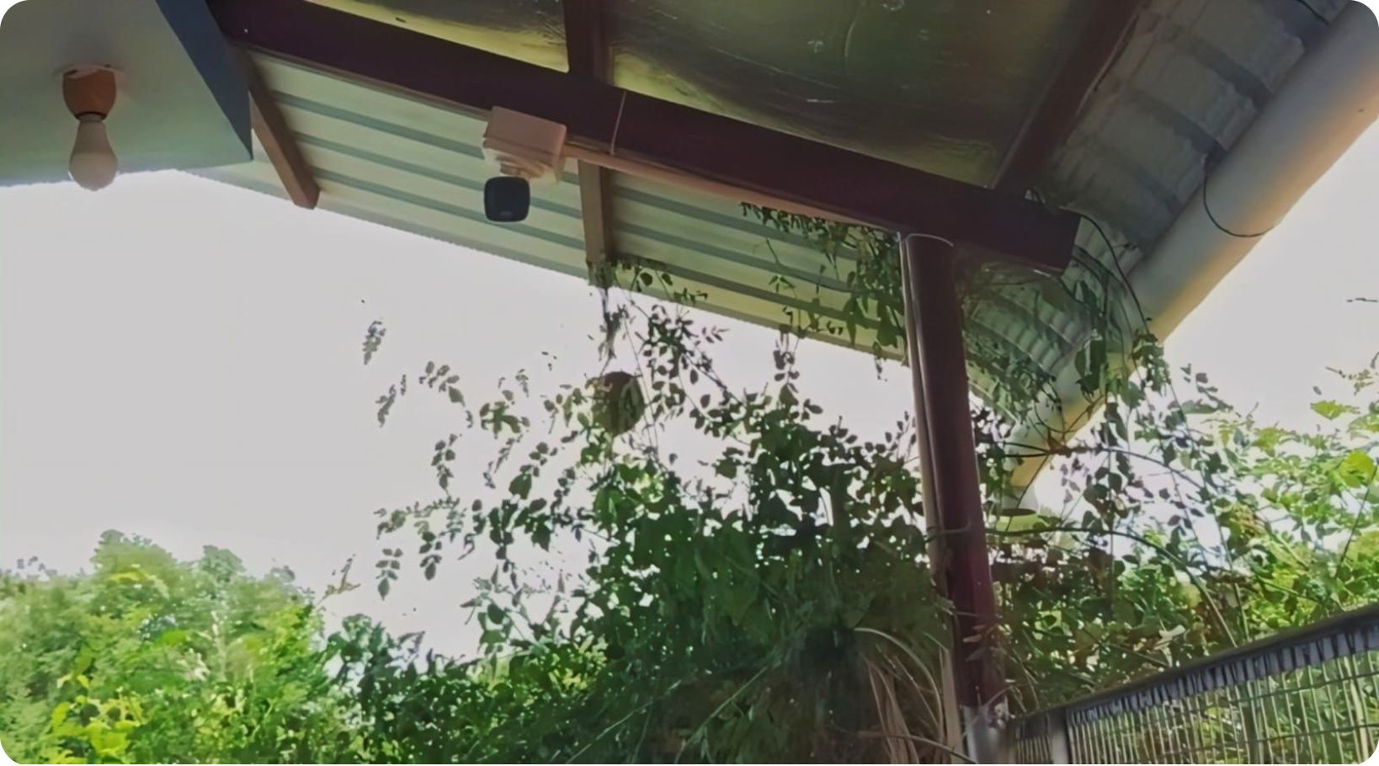
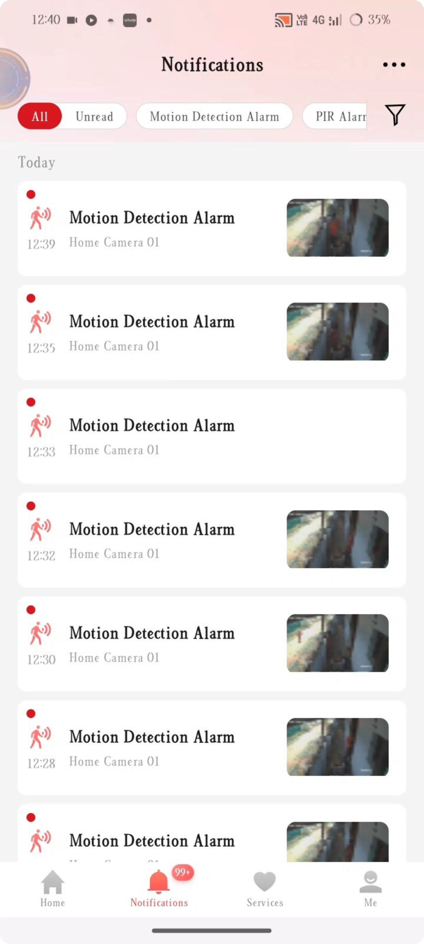
PHASE 01: EMPATHISE
Field Observation
Direct on-site ethnographic observation of the residential corridor security installation revealed three compounding failure signals:
Physical Context
Digital Evidence

Slide 3

PHASE 02: DEFINE
Problem Statement
Residents at independent residential homes currently monitor corridor security using basic PIR and pixel-motion CCTV alerts, which causes over 99+ false alarm notifications daily and complete notification muting because outdoor wind and moving foliage trigger pixel-change thresholds indiscriminately. Existing companion app sensitivity settings fall short because reducing sensitivity causes the system to fail in detecting actual human presence.
The Core Paradox
Why Pixel-Threshold Fails
Too sensitive: 99+ daily false alarms → muting
Less sensitive: Real intruders go undetected
No middle ground exists in pixel-threshold logic
Cannot distinguish foliage from human silhouette
Wind, sunlight, and shadow all register as motion events
No temporal or semantic reasoning applied to frames

Slide 4





TARGET OBJECTIVES
Project Objectives
Four measurable engineering goals define success for Smart Vision Sentry, each directly countering a specific failure mode identified in field observation:
1
2
False Positive Reduction
Zone-Based Loitering Detection
Reduce false positive alerts by >90% using lightweight object classification — replacing pixel-delta logic with semantic human detection.
Implement virtual tripwire and dwell tracking — alert only when a human remains within the corridor zone for >20 seconds, eliminating transient false triggers.
3
4
Resident Face Whitelisting
Low-Latency Alert Delivery
Enable whitelisted face verification for resident recognition — known residents are silently logged; only unknown faces trigger a security alert.
Deliver Telegram/Web alerts within <2 seconds of a verified threat event — maintaining real-time awareness without notification flooding.

Slide 5




PHASE 03: ANALYSE
Problem Analysis — 6M Framework & Key Metrics
Key Impact Metrics
6M Root Cause Breakdown
99+
Machine
Milieu (Environment)
Pixel-difference thresholding without ML frame analysis — the detector has no concept of object semantics.
Sunlight shifts and swaying leaves continuously trigger pixel deltas — the physical site amplifies the algorithmic weakness.
False Alarms/Day
20m
Method
Wasted Daily (Log Checks)
Raw un-debounced push notifications — every individual frame-delta fires an alert with no temporal aggregation or deduplication.
4
Family Members Impacted

Slide 6


PHASE 04: IDEATE
Existing Solutions vs. Innovation Opening
Two incumbent approaches were evaluated in the field. Both represent dead-ends — creating the innovation gap that Smart Vision Sentry fills.
❌ Solution 1 — App Sensitivity Sliders
❌ Solution 2 — Muting Notifications
How it works: Vendor app allows lowering motion detection threshold via a slider control.
Why it fails: Reducing sensitivity below operational threshold means real human intruders are silently missed — a direct security regression with no middle ground achievable.
How it works: Resident silences app push notifications to escape alert fatigue.
Why it fails: Eliminates all real-time security coverage entirely. The system continues recording, but nobody receives any alerts — rendering the CCTV investment useless as a live deterrent.
Innovation Opening: Local Edge AI pipeline combining YOLOv8 + ByteTrack for real-time human filtering & loitering detection — understanding what moved, not just that pixels changed.

Slide 7

PHASE 05: PROTOTYPE — SHORTLISTING
Proposed AI Solution & Shortlisting
🏆 WINNER SOLUTION
RUNNER-UP
Smart Vision Sentry
Cloud LMM Vision Stream
YOLOv8-Nano + ByteTrack + InsightFace
GPT-4o Vision API
Real-time human filtering (semantic object detection)
Virtual line-crossing tripwire enforcement
Dwell-time alerts triggered at >20 seconds loitering
Resident face matching via InsightFace biometrics
Fully local edge inference — zero cloud costs
Alert latency: <2 seconds
High visual reasoning capability
Requires no local GPU hardware
Why Runner-Up Lost
Cost: $150+/month API fees — unsustainable for residential deployment
Latency: 3–5 second network round-trip vs. local edge inference speed
Privacy: Video frames transmitted to external cloud servers

Slide 8

PHASE 05: PROTOTYPE — ARCHITECTURE
System Architecture — Data Flow & AI Pipeline
Data Source
Acquisition
AI Engine
Decision Logic
User Interface
FEEDBACK LOOP: Resident flags false alert on Web UI → Updates model confidence thresholds
Step 1
Step 2
Data Source
CCTV Camera RTSP Stream | 1080p @ 10fps
Acquisition & Pre-processing
OpenCV Frame Buffer & ROI Crop
Step 3
Step 4
AI Engine
YOLOv8-Nano + ByteTrack + InsightFace
Decision Logic
Human Detected AND Dwell > 20s AND Unknown Face
Step 5
User Interface
Web Dashboard & Telegram Bot API | <2s Alert

Slide 9



EXPECTED IMPACT & RISK MITIGATION
Expected Impact & Risk Mitigation
Before vs. After — Impact Metrics
Risk Register & Mitigations
Daily False Alerts
Risk 1 — Low-Light IR Flare
Risk 2 — Edge Hardware Overhead
99+ pings/day → <4 verified pings/day
Scenario: Night-time infrared illumination causes face recognition model to hallucinate or fail biometric matching.
Mitigation: Fallback to temporal line-crossing tracking at night — dwell-time logic remains active even without face matching.
Scenario: Running YOLOv8 + ByteTrack + InsightFace simultaneously exceeds edge device compute budget.
Mitigation: Quantize YOLOv8 to INT8 precision & cap frame rate to 5 FPS — reduces inference load by ~60% with minimal accuracy loss.
Time Wasted on Log Checks
20 minutes/day → <1 minute/day

Slide 10


CONCLUSION
Summary & AI Tool Usage Declaration
Key Learnings
AI Tool Usage Declaration
Design Thinking Solves Root Causes
Tool
Purpose
Structured empathy and field observation revealed that notification fatigue — not hardware — was the true failure mode requiring intervention.
ChatGPT / Gemini
Root cause & 6M classification logic
Gamma AI
Presentation deck structure & visual layout
Edge AI is Economically Viable
YOLOv8-Nano delivers semantic object understanding at near-zero recurring cost, eliminating false motion alerts without cloud dependency.
Ultralytics YOLOv8
Computer vision pipeline design
Triple-Gate Logic is the Innovation
Human + Dwell Time + Unknown Face — three simultaneous conditions required to fire an alert, making false positives structurally improbable.
Smart Vision Sentry transforms a broken pixel-threshold alarm into a semantically-aware, cost-free, resident-safe edge AI security layer — 99+ daily false alarms reduced to <4 verified alerts.

