Slide 1


Group 2 Project 1
DAB 303 Marketing Analytics
Group S2 - 2 Alfred George,
Deepa Taneja Chawla, Nikulkumar Devataja,
Pratap David Carlo,
Rajesh Gandham

Slide 2

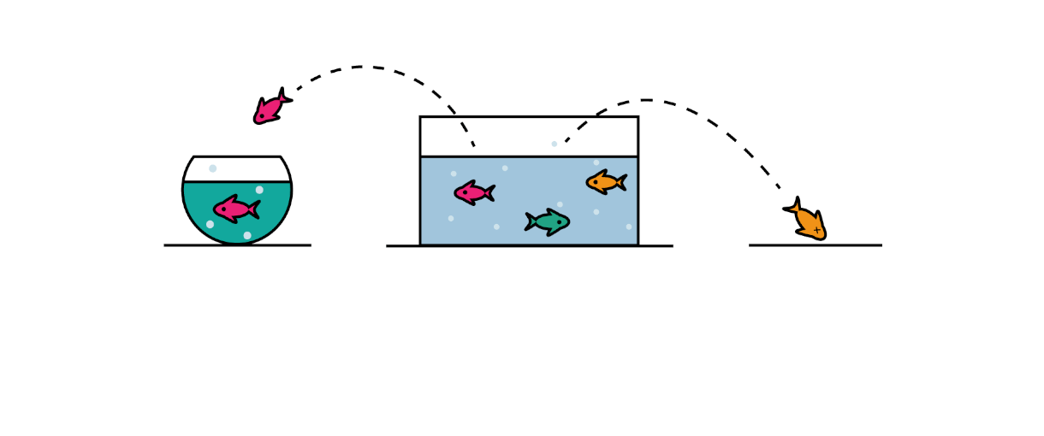
Overview
Churn Prediction Analysis
Churn data analysis allows prediction of likelihood of churn rate among the customers known as Churn Prediction analysis.
Determining how many customers are predicted to churn?
Determining who those customers are that are likely to churn.
Recommend ways in determining the root reason of customer loss
Recommending customer retention strategies.
Overview of Problem / Requirement

Slide 3
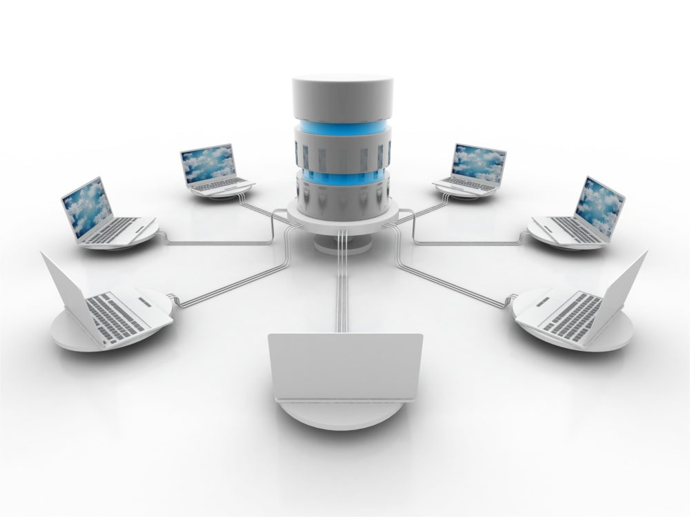
Review Data Source
Telco-Customer-Churn.csv
Description of Data
Structure: 7043 Records and 21 Features
20 Explanatory Features and 1 target value
3 Numerical, 17 Categorical

Slide 4

Cleansing required
Renaming Fields to remove spaces in the field names
Total_Charges had missing data (11) : removed rows
Modifications
Standardization
Some Categorical had similar values hence the values were normalized
Removed Cust_ID unique identifier
Created Tenure_grp field to categorize tenure
Numeric values were standardized or scaled for the model
Used Label Encoding to convert binary value categorical features them to numeric 0/1 type
Used dummies to convert multiple value categorical features them to numeric 0/1 type
Modified Structure:
7032 Records
33Features
1 target value

Slide 5


Insights
Churn and its correlation with other features

Slide 6
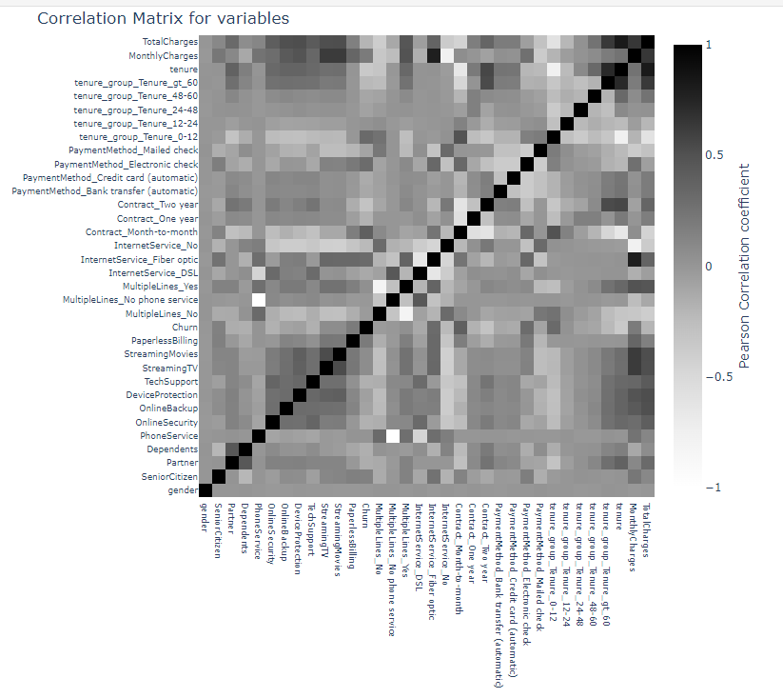
Key -Observations
Through Correlation Efficient matrix
Gender, phone service, having multiplelines, don't have much impact on churn
SeniorCitizens, people with no partner and dependents had more churn rate.
Churn rate was also higher among customers who used Fiber Optic internetService, Streaming TV and Streaming Movies services.
Customers with no OnlineSecurity, no OnlineBackup, no DeviceProtection and no tech support also have high churn rate.
People with monthly contract, paperless billing are churning more that goes hand in hand with 0_24 tenure group. People who are paying with e_check are churning more too.

Slide 7
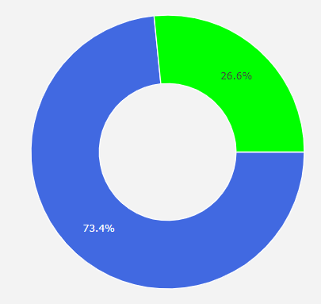

Distribution
Majority of churning customers have monthly charges ranging from 70 to 100.
Most of the customers have charges between 500 - 4000 and churn was higher mainly when the total charges were less than 2500. There are only few churns at higher charges. The average total charges among churners is below 1000. We do have some potential outliers.
We saw in graphs that churned customers were more in short term tenures, as the tenure increased churn rate decreased however the model suggested that we should focus on tenure more than 48.
Churn vs Non - Churn
More than one fourth of the customers had churned, retention rate is 73.4% and churn rate is 26.6%.
Model Predicted the similar percentage of churn and non churn customers as the original data, 1294 Non Churn 73% - 464 Churn 26.39%

Slide 8
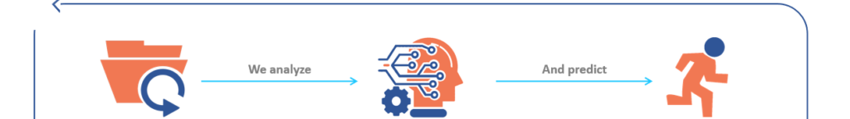
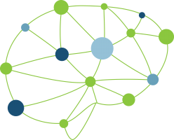
Results
Logistic Regression with RFE has the same accuracy as Decision Tree Model.

Slide 9
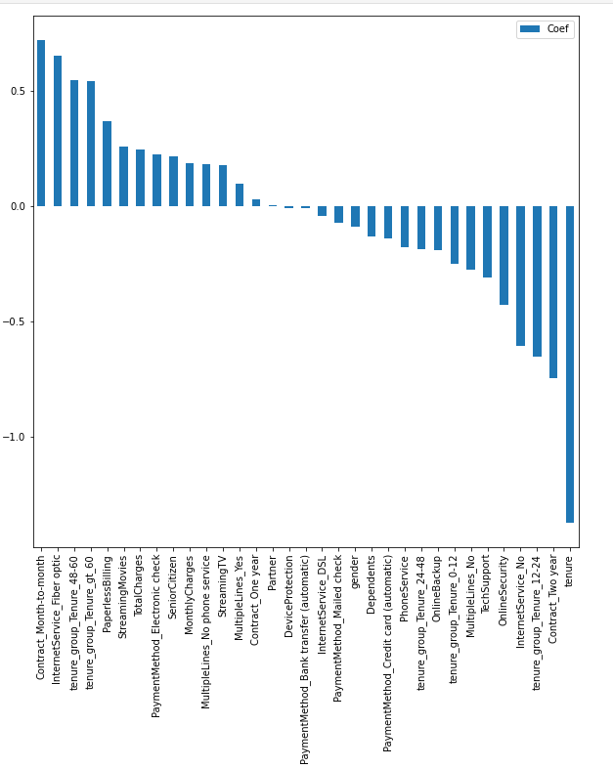
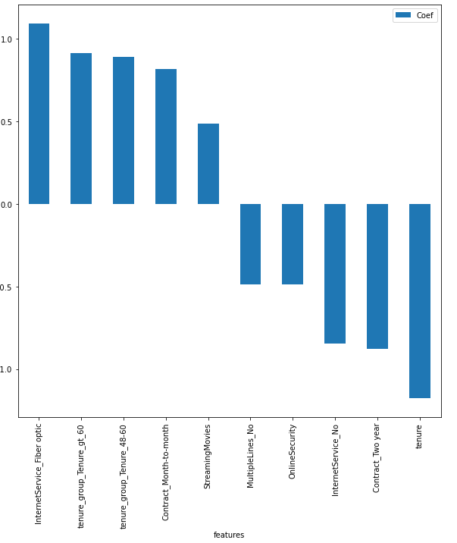
Feature Importance resonates key observations in the model

Slide 10
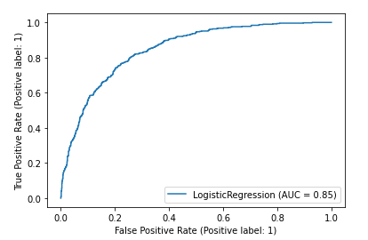
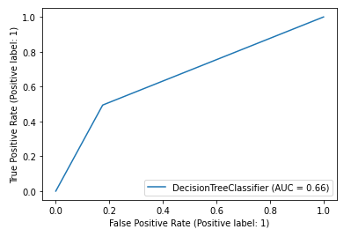
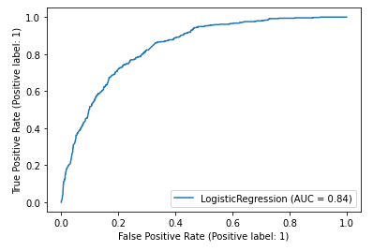
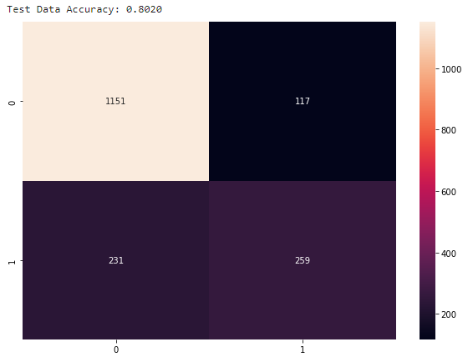
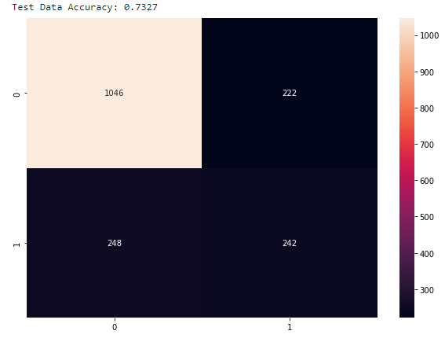
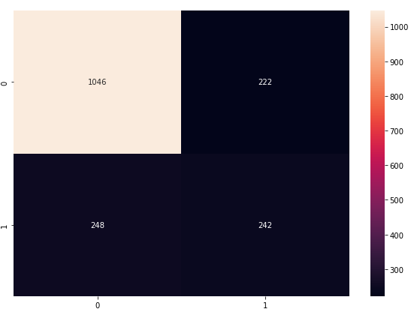
ML Models
K- fold Cross Validation Accuracy Mean: .80
Logistic Regression Decision Tree Logistic Regression with RFE
Accuracy Score 0.80
Precision Score 0.68
Recall Score 0.528
F1 Score0.598
Accuracy Score 0.7326
Precision Score 0.521
Recall Score 0.4938
F1 Score0.5073
Accuracy Score 0.7326
Precision Score 0.521
Recall Score 0.49387
F1 Score0.507

Slide 11

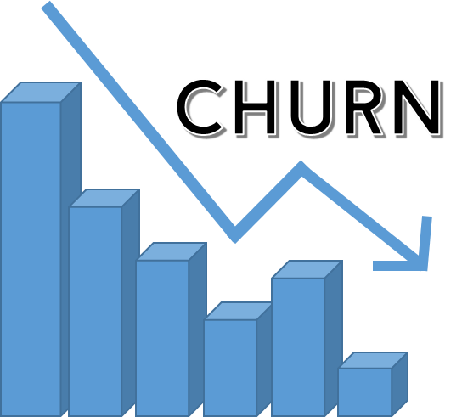
Future Recommendations
Business Value could be implemented considering features highlighted by models
InternetService_FiberOptic, tenure_group_Tenure_gt_60, tenure_group_Tenure_48-60, Contract_Month-to-Month and Streaming_Movies

Slide 12
Next Steps
The service specific feedback surveys with the customers (what’s working, how much usage, concerns)
who have fibre optic service
who have been with company for more than 4 years,
customers who have streaming movies services.
Further Study the service usage and segment customers based on it to identify the root reason of customers churning within that specific segment.
Further do RFM customer segmentation with data
Develop a better binding offer for people who are potentially buying month to month contract
Review with people who are buying monthly contracts every quarter how they are doing and what are their future plans, the survey and calls should be to understand their needs and expectations.

Slide 13
Next Steps
Provide customer deals and promotions/discounts for the customers whose tenure group is more than 2 years. (Loyalty promotions)
Build robust post purchase rapport building strategy and procedure.
Offer free tech support to Seniors.
Evaluate and study customers who need support with online security, internet services, backups etc. and offer those as rewards or bundled packages.
Educate the customers regarding offers and the benefits from the company.
Engagement with customers is very important to assess their understanding of features provided, company should dig to find out if their is an element of overselling in relation to some features where monthly charges are high, people could be given upgrade options when their monthly charges are very high or go beyond a threshold.

Slide 14

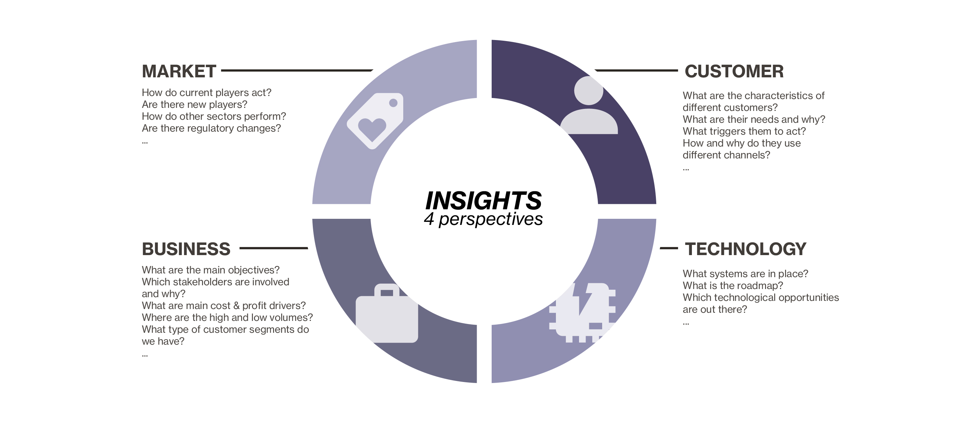
Thank You

