Slide 1

Slide 1
Customer Segmentation
- Group Project 2 (S2 – 2) -
Alfred George,
Deepa Taneja Chawla, Nikulkumar Devataja,
Pratap David Carlo,
Rajesh Gandham

Slide 2
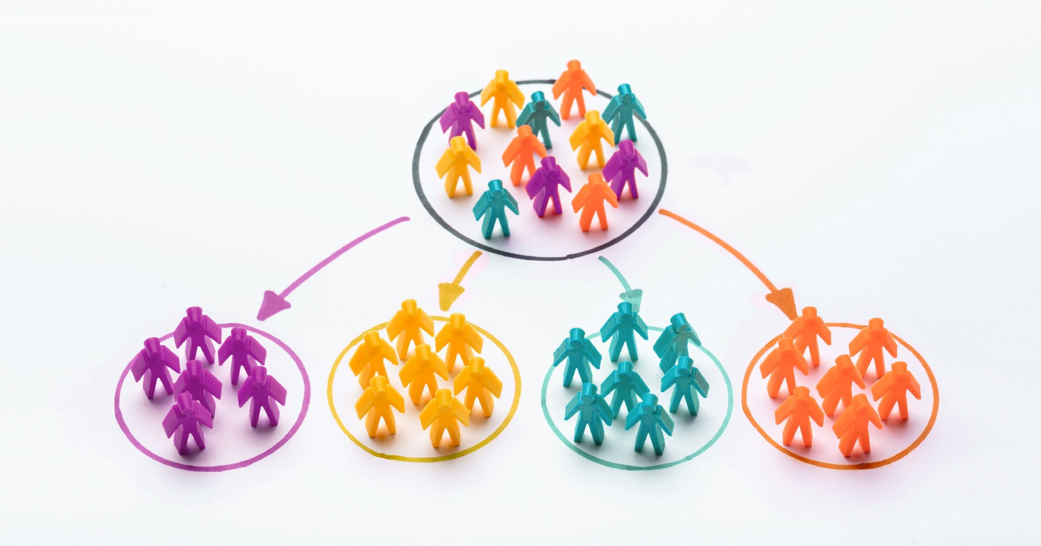
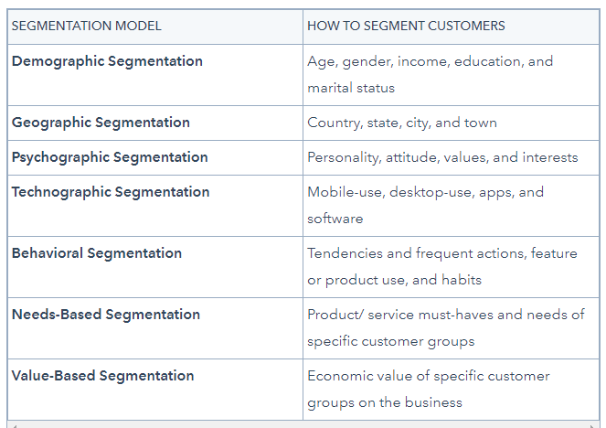
Customer Segmentation
Who are our best customers?
Which of our customers could leave us ?
Who have the potential to become valuable customers?
Which of our customers can be retained?
Which of our customers are likely to respond to campaign?
Where and what should be the campaign?
What should we study about our customers?
Notes:
Customer segmentation is a way of grouping or clustering clients based on shared demographic, psychographic and behavioural features such as age, gender, interests and spending habits. Occupation, gender, age, location, and marital status are all different examples of demographic traits. Social class, lifestyle, and personality traits are all psychographic features. Spending habits, consuming patterns, product/service usage, and previously acquired products are all behavioural traits.
The power of customer segmentation, could benefit in following ways:
1. Improved marketing campaigns: customer segmentation makes it possible to build tailored marketing messages to each particular segment. In fact, segmented campaigns have almost a 15% higher open rate than non-segmented ones.
2. Better offerings: knowing our customers allows to develop an offer for them so that it meets their particular needs to the best extent.
3. Greater return on sales: adjusting marketing efforts to company’s most successful customer segments can bring about an increase in revenue in the long run.
4. Increased loyalty and retention: personalization in every case matters. 80% of clients are more likely to do business with a brand that provides personalized experiences. So, customized content and individualized approach are what savours customer satisfaction and retention.
5. Untapped cross-selling and upselling opportunities: by segmenting existing and potential clients into groups, we realize what things they could be more interested in. It promotes the update of new products and services relevant to the targeted audience.
Conclusively, it is **important** because it aids in the identification of the most likely clients, makes it easier to manage and communicate with a specific audience. It boosts customer satisfaction, loyalty, and retention by improving customer relationships through better comprehending segment demands. Allows upselling and cross-selling opportunities by creating special offers for certain clients in order to persuade them to purchase more items. Customer segmentation aids in the identification of new customers by allowing for a better knowledge of the demands of various categories. **Each customer is valuable, and segmentation helps to create value for each one.**

Slide 3
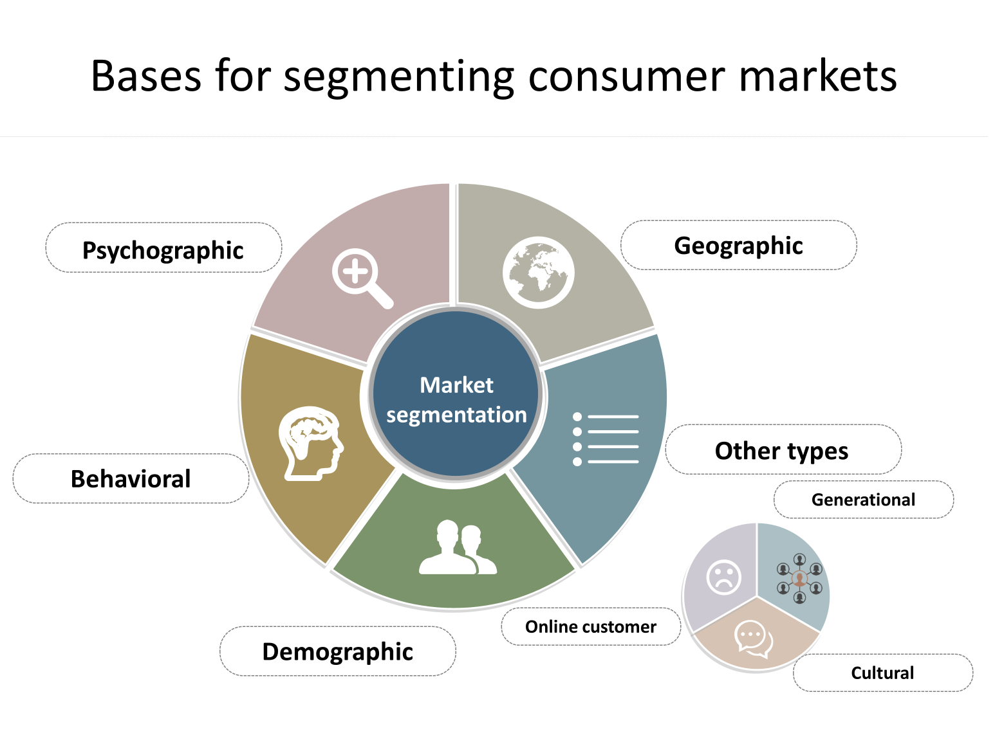
Benefits of Customer Segmentation
Improved marketing campaigns
Better offerings
Greater return on sales
Increased loyalty and retention: personalization in every case matters. 80% of clients are more likely to do business with a brand that provides personalized experiences.
5. Untapped cross-selling and upselling opportunities

Slide 4
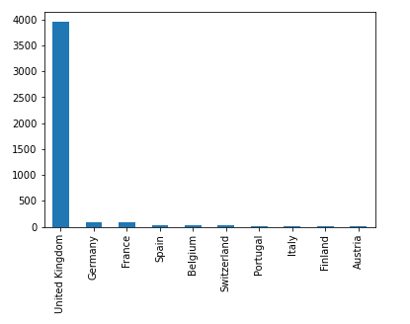
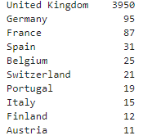
Review Data
Sales_data.csv (provided)
Description of Data
Structure: 541,909 Records and 8 Features
We have nearly 1 Years Sales data
Data has wide geographic distribution, 90% customer belongs to UK from the total of 4380
Cleansing required
Remove all records with null customer ID (135,080 records removed ) approx. 25%
4380 Duplicate Records
Invoice Date Changed data type from Object to Date type
Modified Structure:
406,829 Records (5 features) CustomerID','InvoiceDate','InvoiceNo','Quantity','UnitPrice'

Slide 5
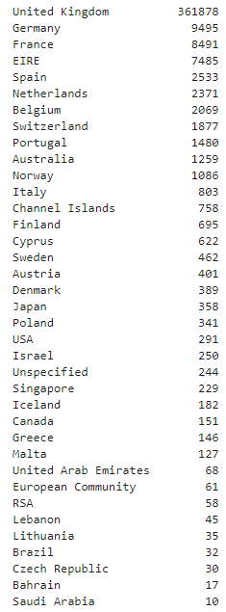
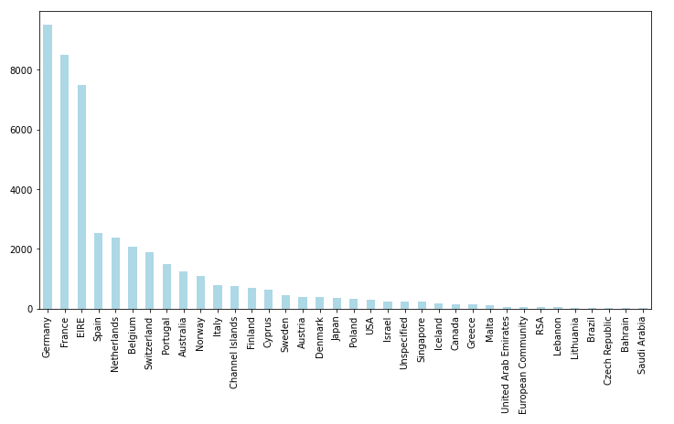
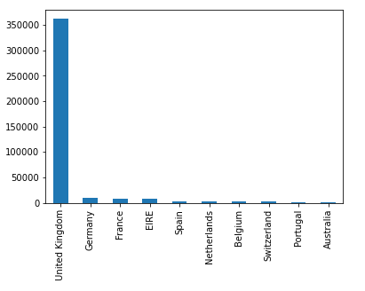
We segment data based on Geographic distribution for further study : UK has the most orders, 88.95% of data

Slide 6
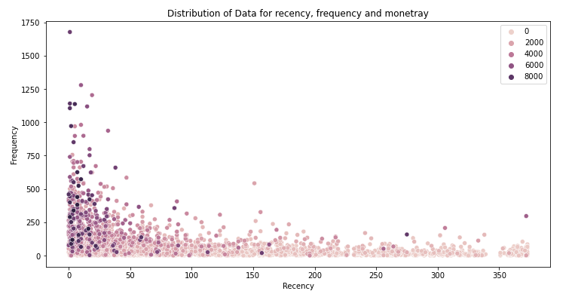
Recency: the number of days between present date and date of last purchase for each customer. Frequency: the number of orders for each customer. Monetary: sum of purchase price for each customer
Convert Data to RFM matrix
More modest bills than the higher worth bills.
More customers have bought below 500
Some have spent between 500- 2500.
Very few spent between 4000 - 10000. (Potential Outliers)
Consumers who purchased within the last two months (up to 50 days) are more numerous,
Some have note returned in nearly a year.
Just visited customers have given more revenue than those who had visited in the past.
Limited customers who have bought frequently

Slide 7
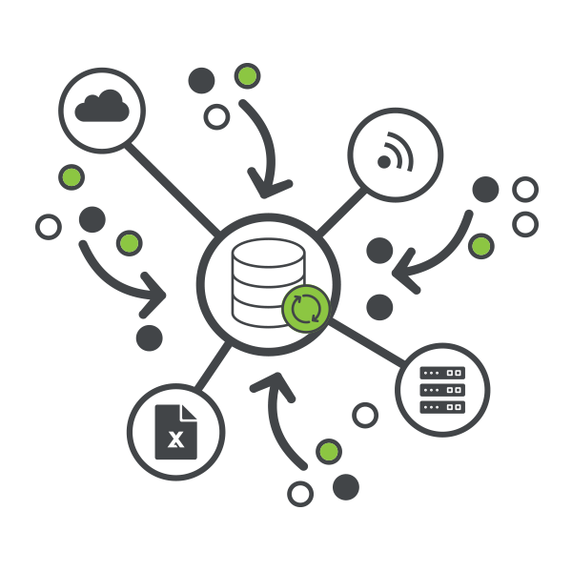
RFM matrix to RFM Score (1-5)
Segmented data into 5 blocks based on 20% quintiles of the population and ranked them 1-5
A lower Recency value is better (People who bought recently have low score)
Higher Frequency value is better that means that the customer bought frequently
and Monetary is also better when higher which means high value.
Segments
R[1-2] F[1-4] At risk
R[1-2] F 5 Cannot loose
R3 F[1-3] Needs Attention
R[3-4] F [4-5] Loyal Customers
R[4-5] F1 New customers
R[4-5] F[2-5] Champions
At Risk Customers are customers who purchased often and spent big amounts, but haven’t purchased recently. Likely Churn customers.
Can’t Lose are customers who used to visit and purchase quite often, but haven’t been visiting recently.
Need Attention are customers who had good frequency and moderate spending some time ago.
Loyal Customers are recent customers with good frequency and who spent a good amount.
New Customers are those who have a very high recency score but are very low frequency.
Champions are best customers, who bought most recently, most often, and are good spenders.

Slide 8
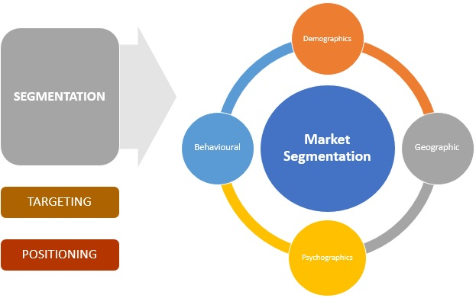
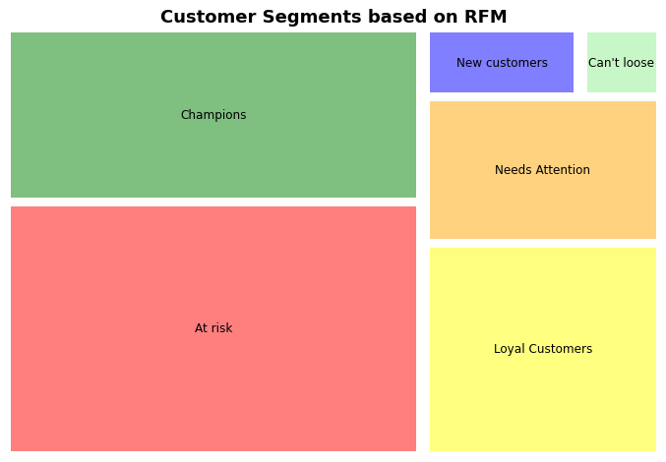
RFM Analysis
Calculated RFM score and then created 6 segments
4%
2%
26%
12%
38%
18%

Slide 9
Recommendations (for identified customers)
At Risk Customers Send them personalized reactivation campaigns to reconnect, and offer renewals and helpful products to encourage another purchase. Take feedback. A 5% increase in retention could produce 25% increase in profit.
Can’t Lose & Need Attention Bring them back with relevant promotions, and run surveys to find out what went wrong and avoid losing them to a competitor. Offer Combo products, call them, provide free trials, create relevant updates since their last visit, offer store credits etc. The probability of converting an existing customer is between 60% - 70%.
Loyal Customers Offer membership or loyalty programs or recommend related products to upsell them and they could become Champions. Existing customers spend 67% more on average than new customers.
New Customers Start building relationships with these customers by providing onboarding support, run contests, gift them discounts, and special offers to increase their visits. Provide free trials, create further brand awareness, offer store credits etc
Champions Reward these customers and build credibility. They could become early adopters for new products and could help promote brand. As champions of the brand they will drive word-of-mouth marketing. Brands with loyal customers are likely to see a higher than normal customer lifetime value.
craft highly targeted marketing campaigns

Slide 10
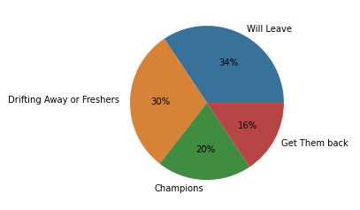
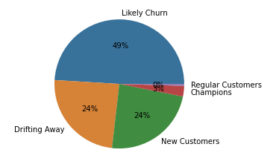
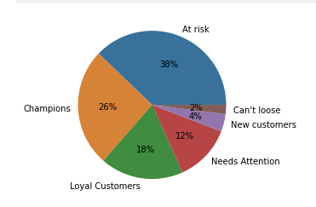
Higher number of segments are better as they help in better analysis
4 Segments
5 Segments
6 Segments
When we have very few segments, we might put customers into bigger chunks and fail to identify their needs properly.
We should look at patterns carefully to identify the right number of segments.
More the number of segments, more specific crafted campaign can we have. 6-7 types of segments are good enough to divide customer base and run segment based campaigns

Slide 11
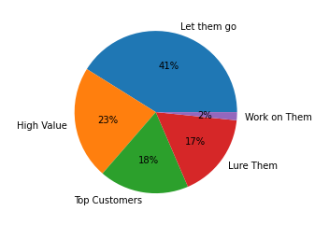
Fm Analysis
Top Customers : They have been regularly spending high, reward them and upsell.
High Value: They spent high but not frequently, send them feedbacks and specific campaign according to their likings
Lure Them / Work on Them: Work Hard on these they are cash cows.
Let them Go: Who spend too low, possible shop hoppers. The last on the list to please. Perhaps “Sale” targets.

Slide 12
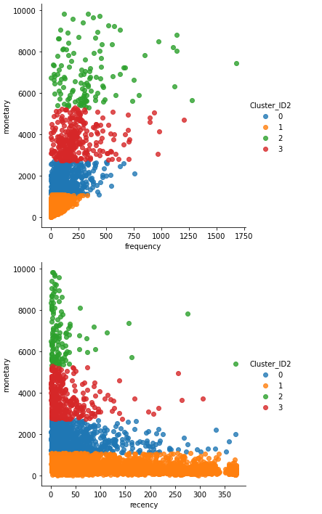
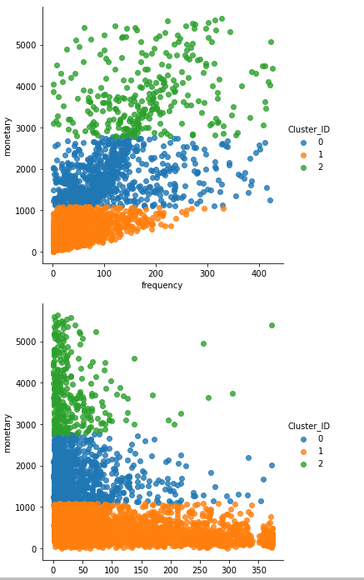
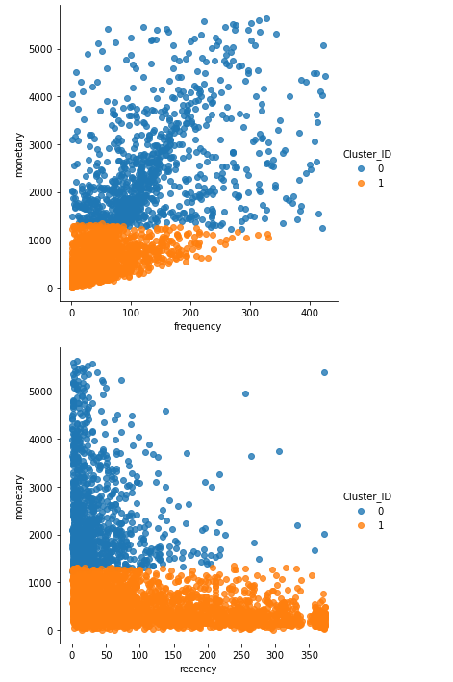
Three Cluster Analysis is better than two or four Data with no outliers gives a better perspective into customers.
4 Clusters from data with outliers
3 Clusters from data without outliers
2 Clusters from data without outliers

Slide 13
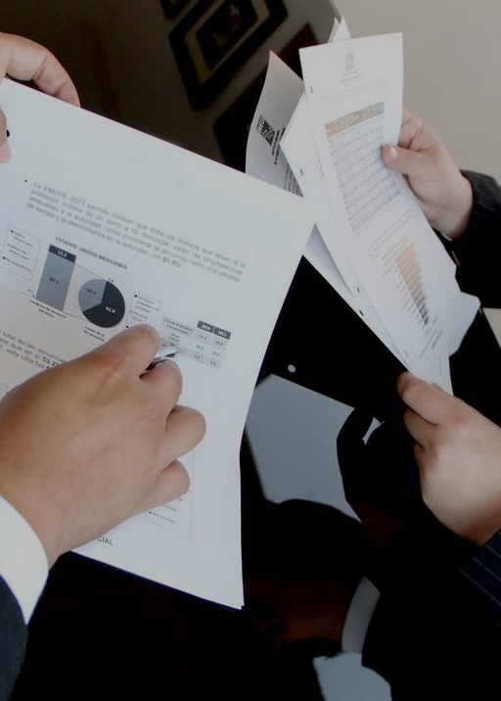
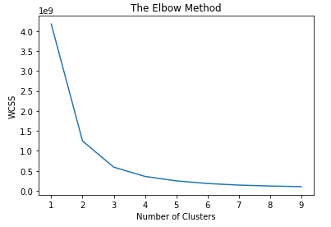
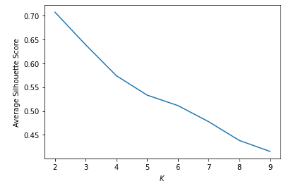
Slide 6
3 K- Cluster Analysis is best for our data based on elbow method and Average Silhouette Score
We should study following clusters to analyze our customers
Recency - Monetary
And
Frequency – Monetary

Slide 14
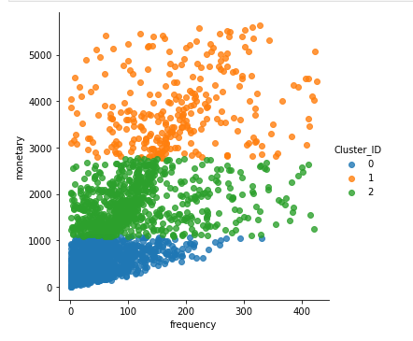
Cluster Analysis
Having looked at Frequency vs. Monetory Clusters
Blue Cluster [Low Spenders] – Encourage
(range: frequency(0-300), monetary(0-1000), these customers are not frequent customers, must be buying odd products and spending less.
Green Cluster: [ Mid Spenders] - Promote
Customers are spending more and 25% among them have more frequency. They are spending in the range of 1000-2800, they have higher frequency to blue cluster however around 1% of these have frequency more than 350.
Orange cluster [High Spenders] – Reward
Customers have the highest monetary distribution. They have good frequency.

Slide 15
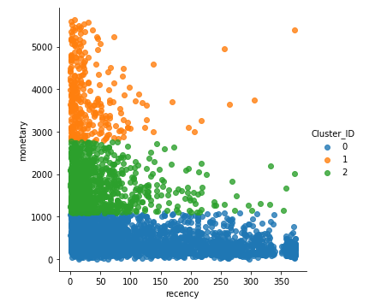
Cluster Analysis
Having looked at Frequency vs. Monetary Clusters
Blue Cluster [Late and New Low Spenders] – Engage & Encourage
Customers who spent low long time ago, however some of these are new but have spent very low.
Green Cluster: [ Recent Good Spenders] – Promote & Retain
Customers that have purchased within last three months and spent good amount.
Orange cluster [Recent High Spenders] – Make Them Loyal
Maximum spending customers who have spend recently within less than 50 days. Some of them were old but we can contact them and engage them with updated products.

Slide 16
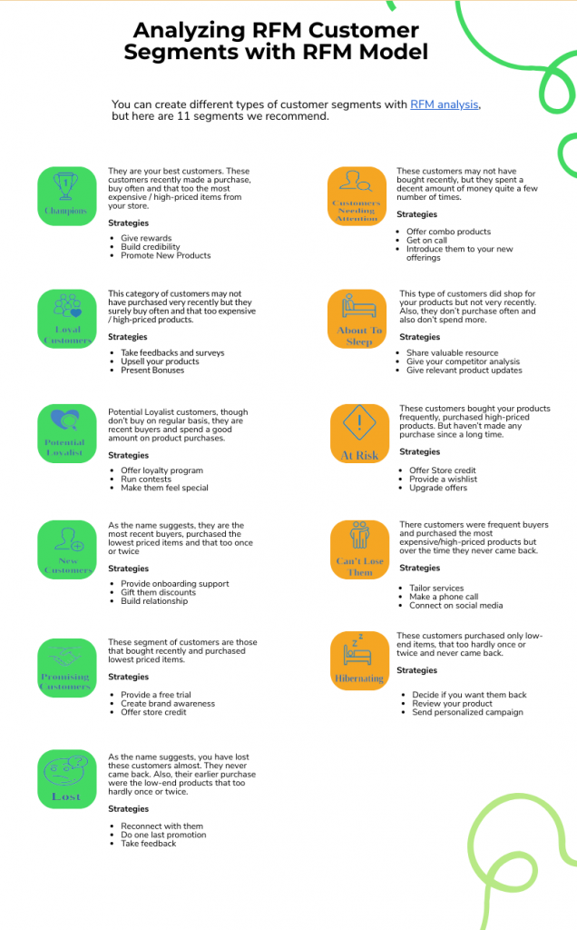
Recommendations
Combine RFM analysis and Cluster analysis to craft a specific crafty campaign for each segment.
Combine it with other tools /data to get detailed customer analytics and customer insights.
Optimize target segmenting with follow up evaluation and metrics (Campaign Performance Reporting)
Take regular feedbacks and add value to service.
Repeat RFM with other countries data
This data will do very well if combined with behavioural and income data, also A/B Testing.
Adjust Personalization Strategies, Calculate Customer Lifetime Value
Create layered Loyalty Program and add continuous challenge and reward within it.

Slide 17

Slide 10
THANK YOU

