Slide 1
Solar Power Generation Prediction
The objective of this project is to predict the power generated based on environmental variables such as temperature, wind speed, humidity, and sky cover.

Slide 2
PROCESS
Data Understanding & Preprocessing
Exploratory Data Analysis (EDA)
Feature Engineering
Model Training & Evaluation
Deployment & Future Improvements

Slide 3
Dataset Description
Dataset: solarpowergeneration.csv
Total Rows: 2920
Total Columns: 10
Target Variable: Power generated (in Joules per 3 hours)

Slide 4
Features
Distance to solar noon
Average Wind Speed
Average Pressure
Power generated
Temperature
Wind Direction
Wind Speed
Sky cover
Visibility
Humidity

Slide 5
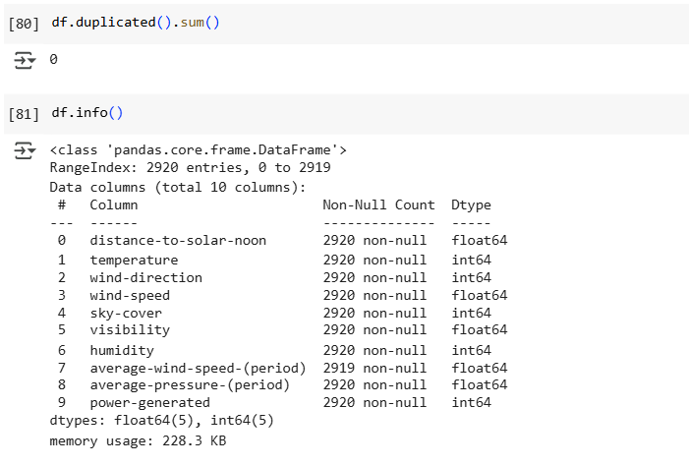
EXPLORATORY DATA ANALYSIS (EDA)

Slide 6
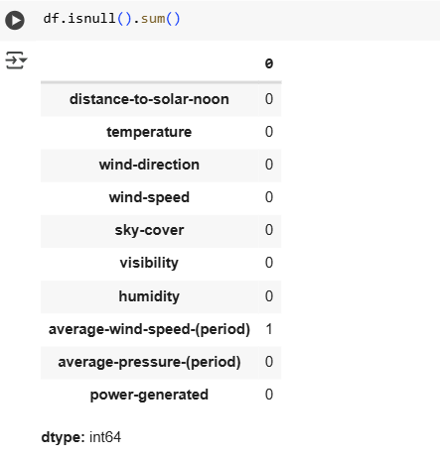
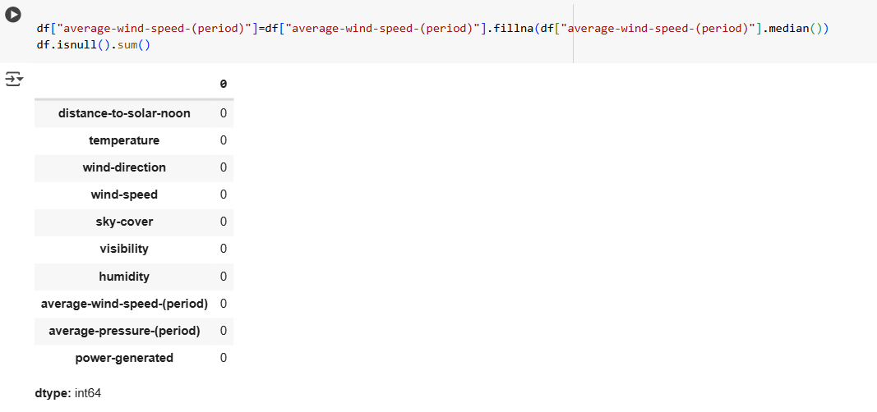
BEFORE HANDLING MISSING VALUES
AFTER HANDLING MISSING VALUES

Slide 7
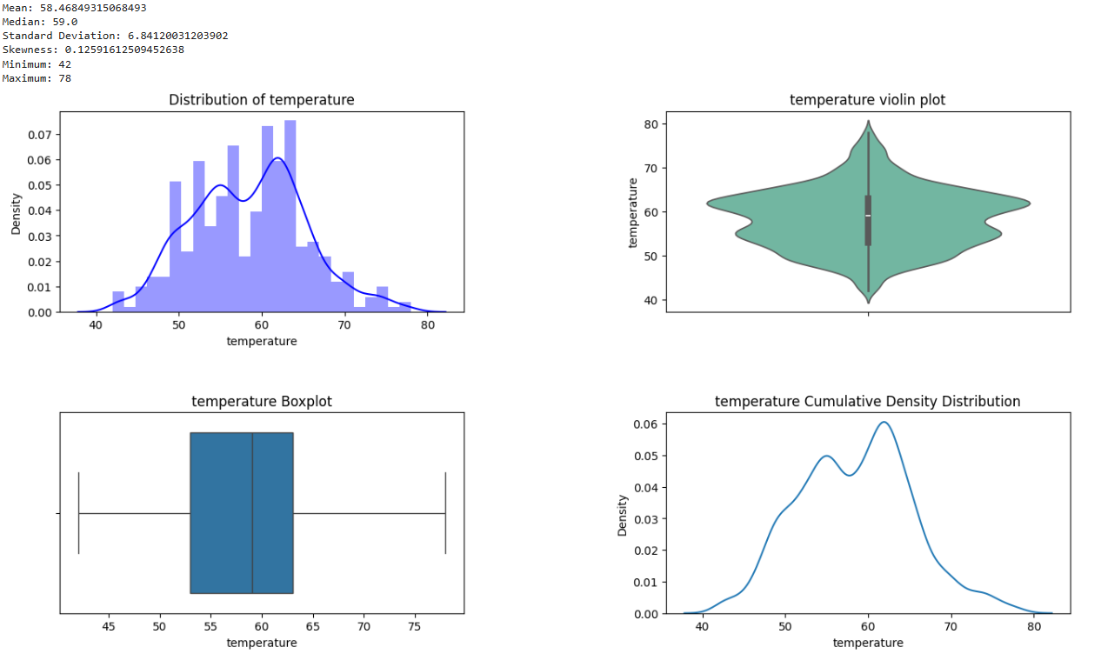
UNI-VARIATE ANALYSIS

Slide 8
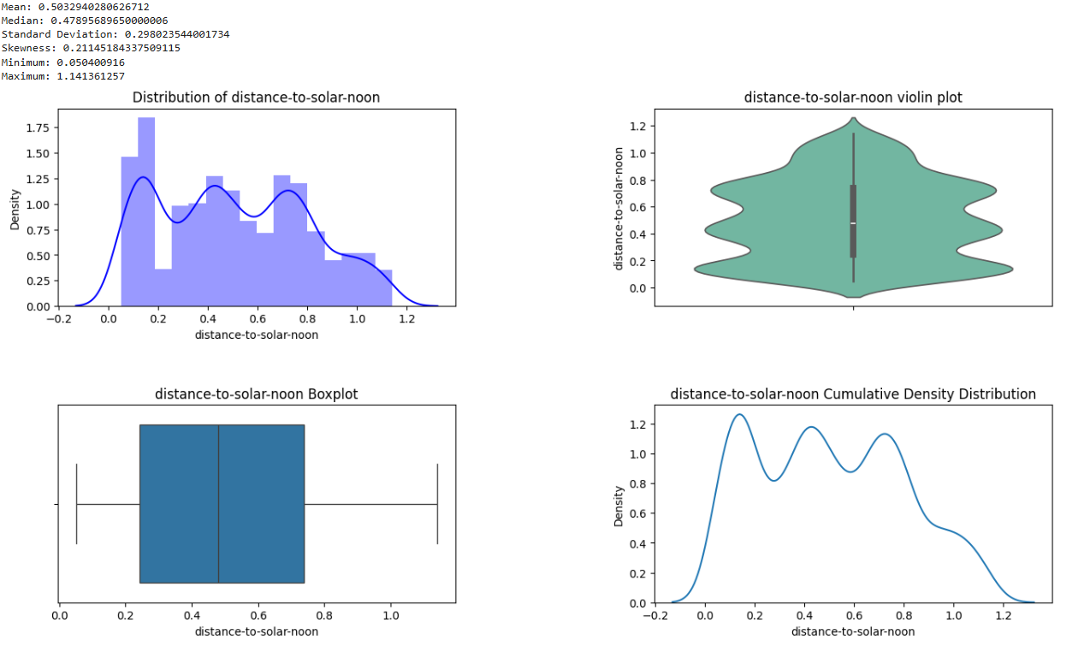

Slide 9
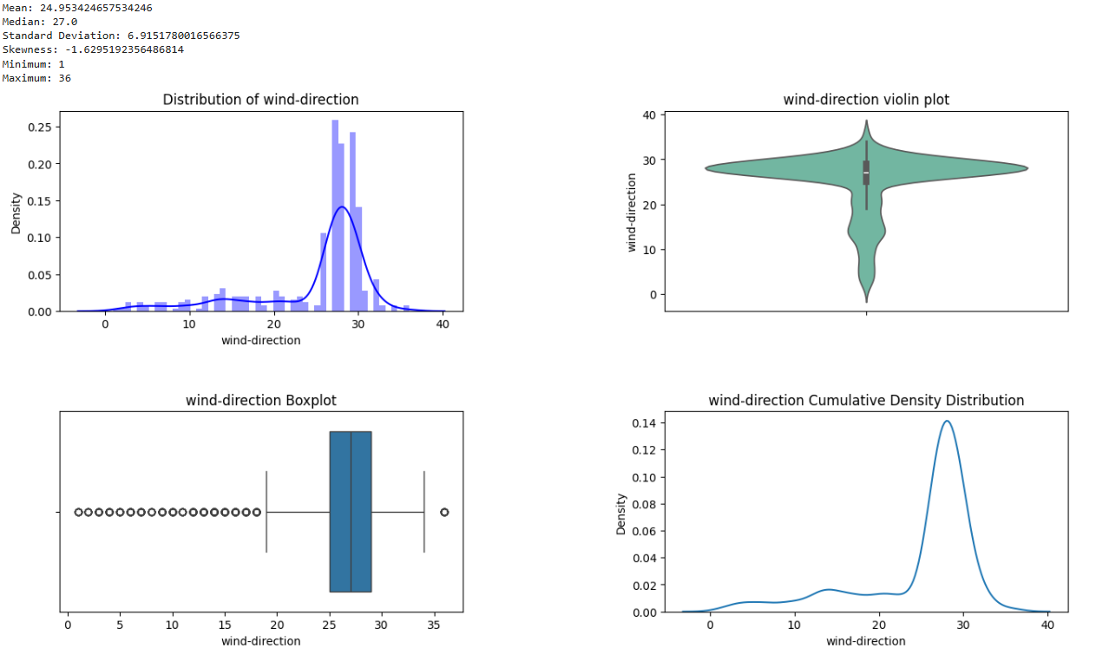

Slide 10
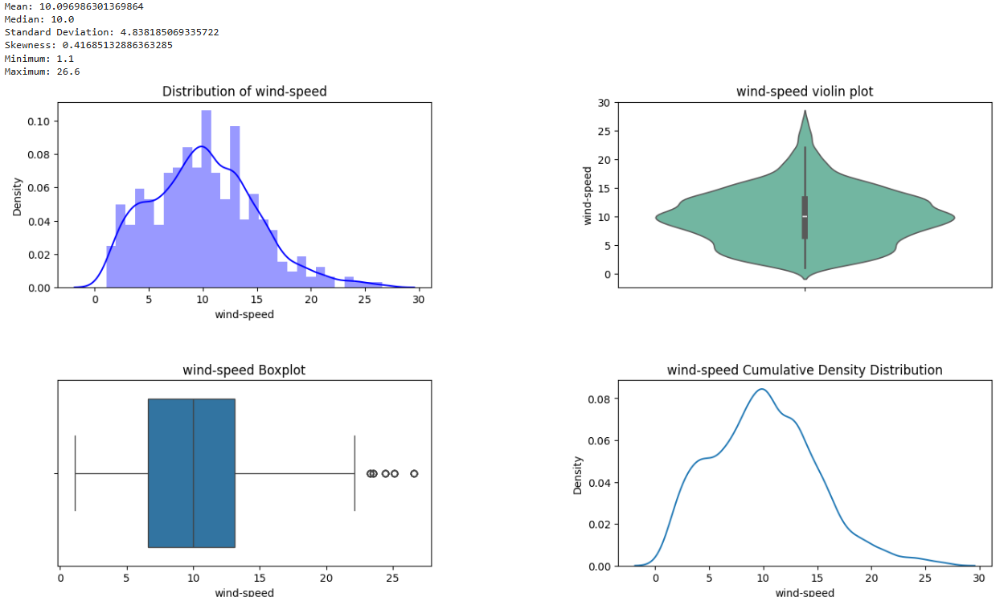

Slide 11
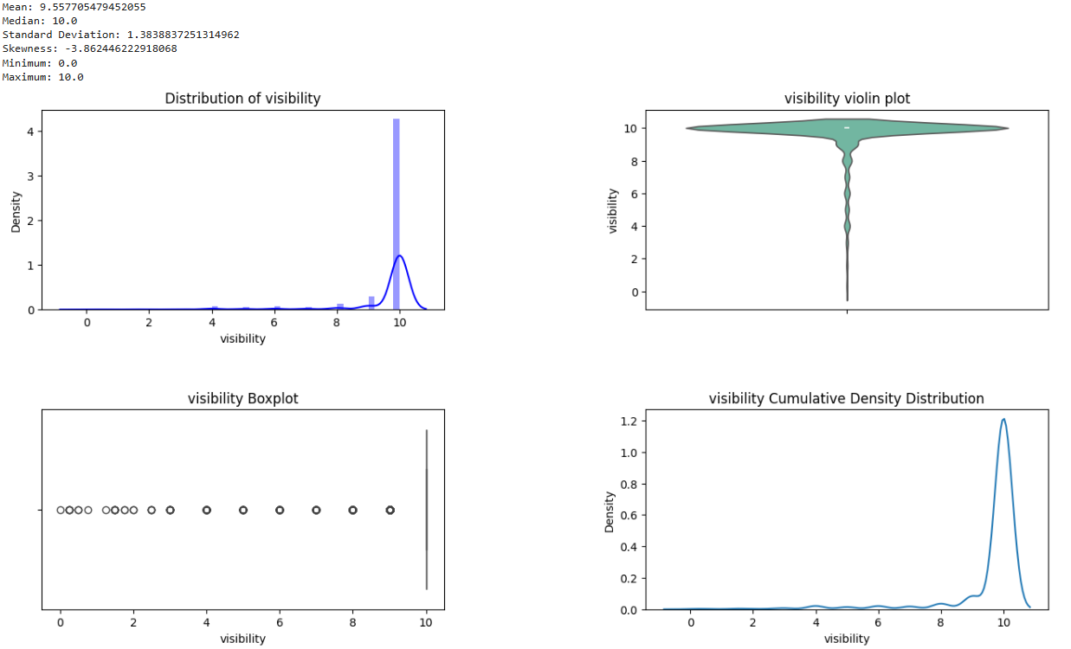

Slide 12
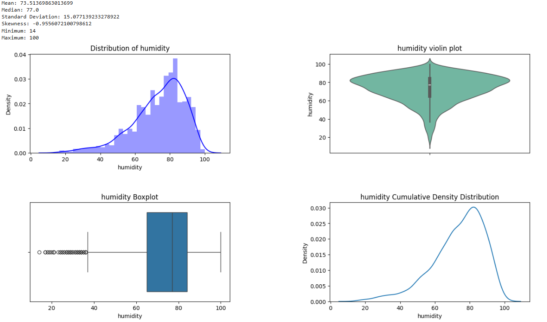

Slide 13
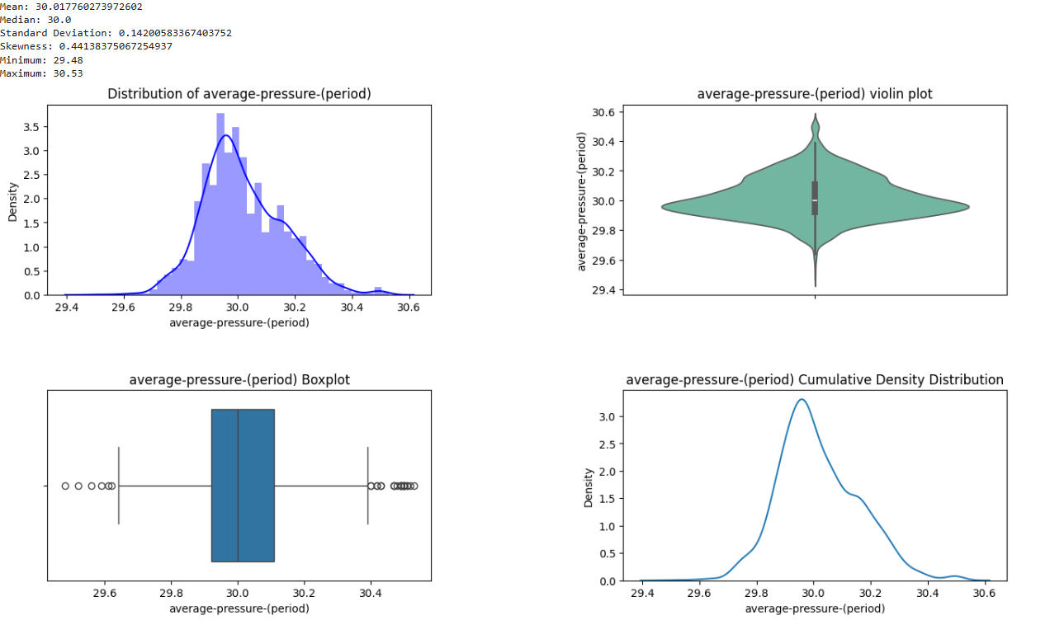

Slide 14
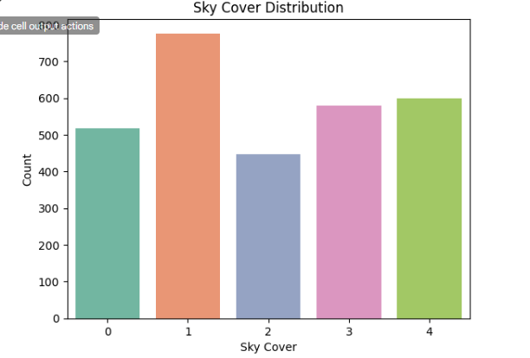

Slide 15
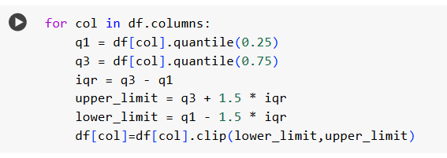
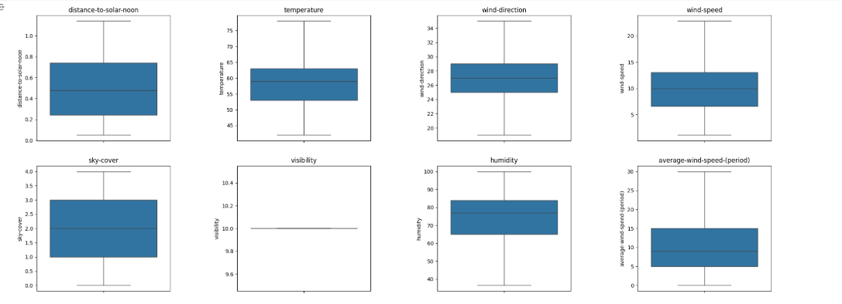
HANDLING OUTLIERS

Slide 16
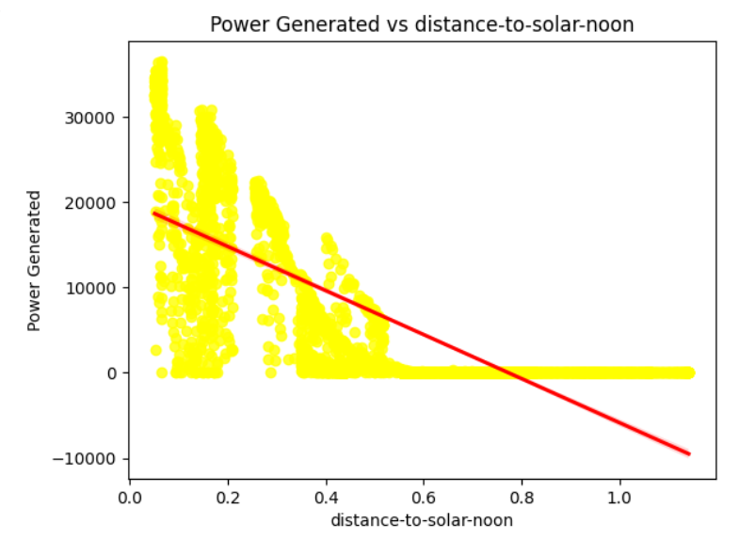
BI-VARIATE ANALYSIS

Slide 17
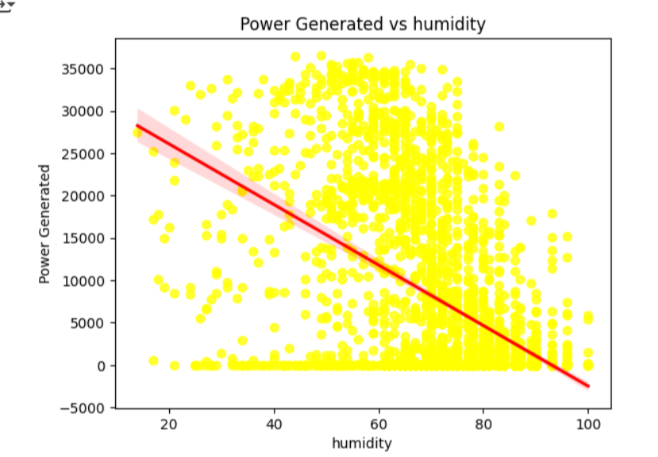

Slide 18
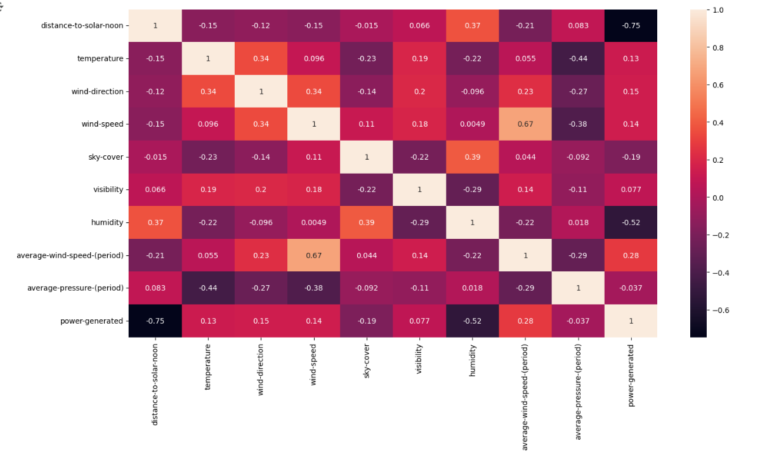
CORRELATION ANALYSIS

Slide 19
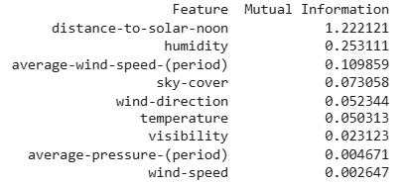
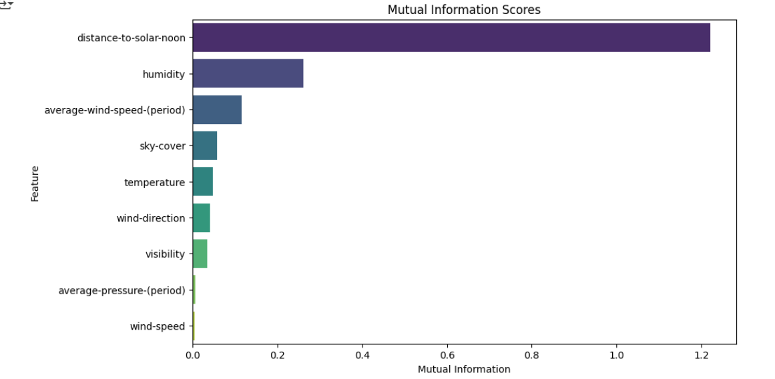
MUTUAL INFORMATION SCORES

Slide 20
MODEL BUILDING
SPLITTING DATA INTO FEATURES AND TARGET
Why Split Data?
To evaluate model performance on unseen data.
Helps prevent overfitting by ensuring a balanced dataset.
Standard practice: 80% training, 20% testing.

Slide 21
The dataset is divided into features (X) and target variable (y).
X = df.drop(columns=['power-generated']) removes the target column from the dataset, keeping only independent variables.
y = df['power-generated’] stores the dependent variable (what we want to predict).

Slide 22
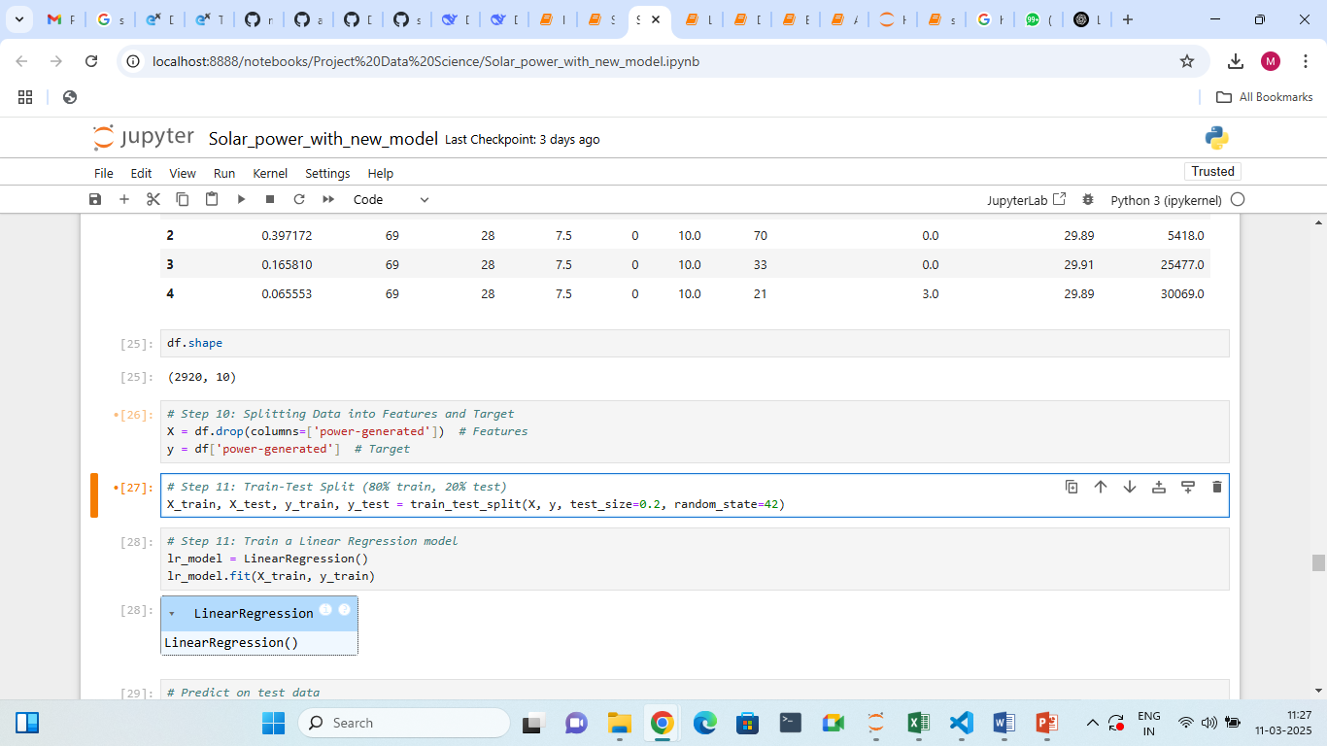
Training data is used to train the model.
Testing data is used to evaluate performance.
random_state=42 ensures reproducibility.
Common split ratios: 80/20, 70/30, 90/10 (depends on dataset size).

Slide 23
FEATURE SCALING ON DATASET
Use StandardScaler for Data Normalization
Feature Scaling ensures that all numerical features are on the same scale.
Helps machine learning models converge faster and improve performance.

Slide 24
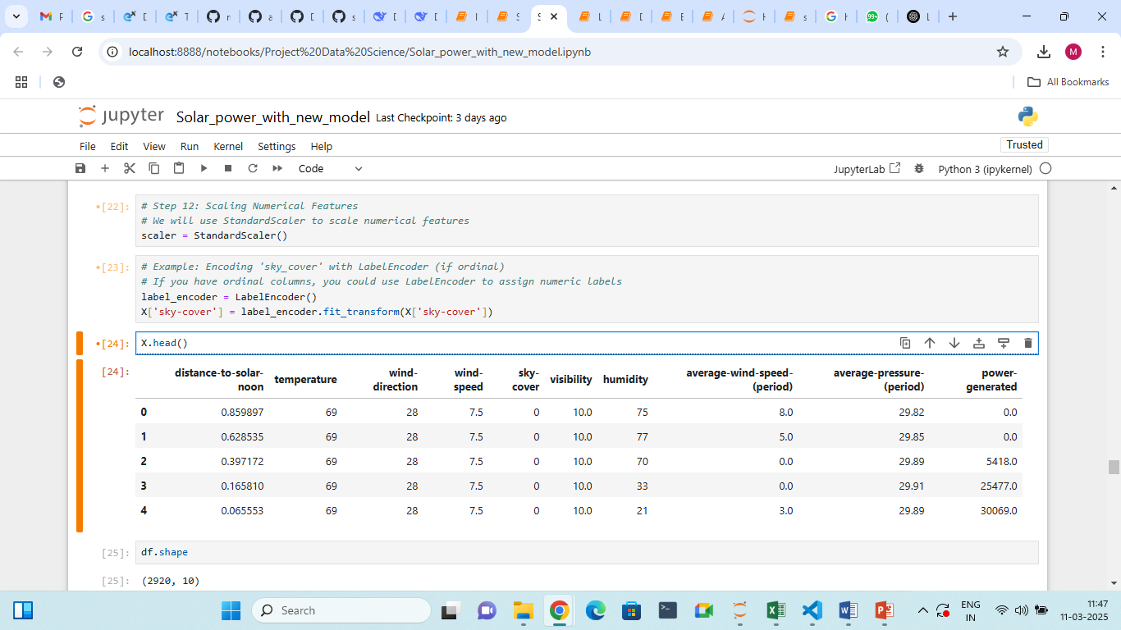

Slide 25
TRAIN A LINEAR REGRESSION MODEL
Linear Regression is a statistical method to model the relationship between independent variables (features) and the dependent variable (target).
The LinearRegression() model learns the best-fit line that minimizes the error between actual and predicted values.
fit(X_train, y_train) trains the model using training data.

Slide 26
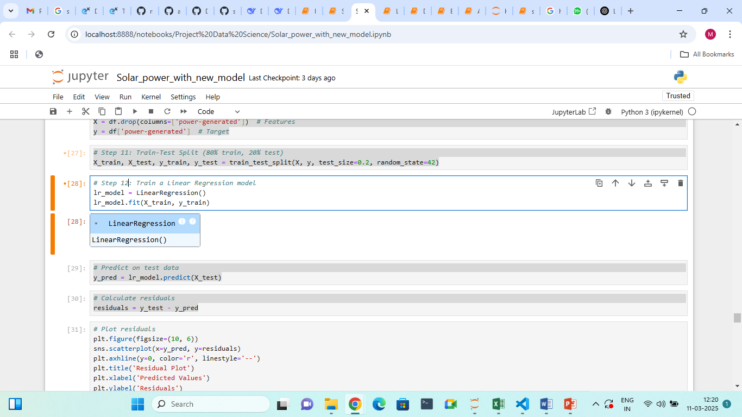

Slide 27
PREDICTING AND EVALUATING MODEL PERFORMANCE
Predict on Test Data:
Use the trained model (lr_model) to make predictions on the test set (X_test).
Store predictions in y_pred.
Calculate Residuals:
Residuals are the differences between actual values (y_test) and predicted values (y_pred).
Formula: residuals = y_test - y_pred.

Slide 28
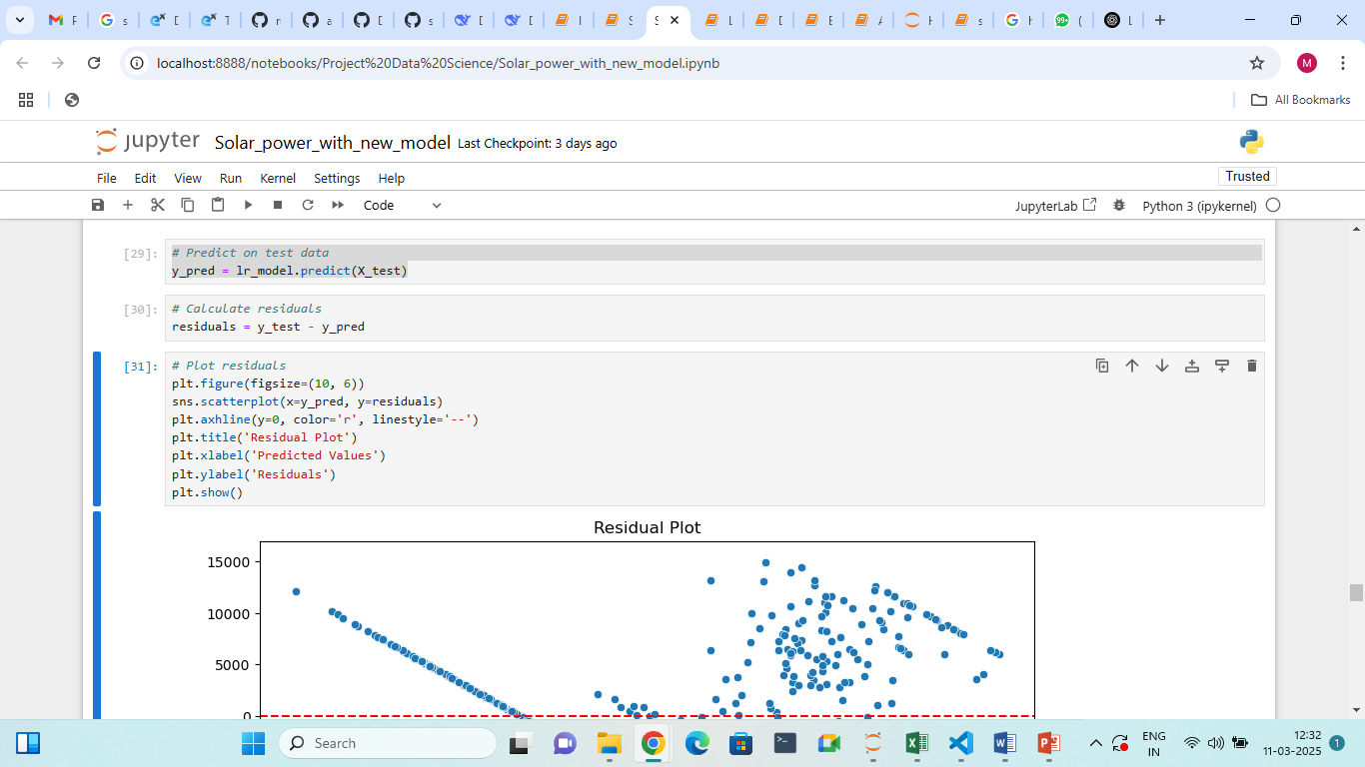

Slide 29
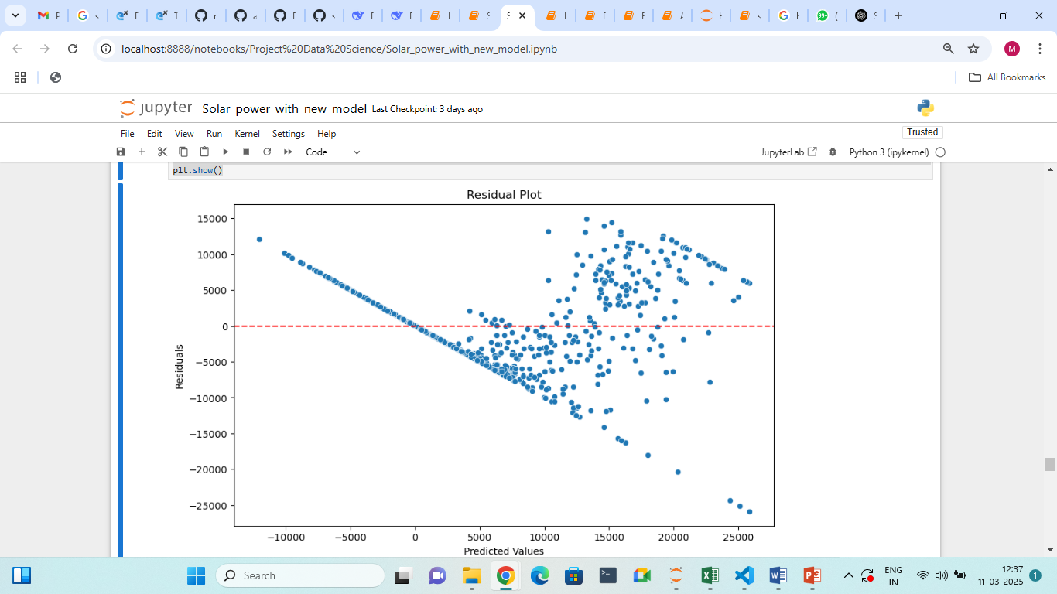

Slide 30
CALCULATES KEY REGRESSION EVALUATION METRICS
MSE (Mean Squared Error): Penalizes larger errors, making it sensitive to outliers.
RMSE (Root Mean Squared Error): Interpretable as it has the same units as the target variable.
MAE (Mean Absolute Error): Represents the average absolute error in predictions.
R-squared: Measures how much variance in the target variable is explained by the model (closer to 1 indicates a better fit).

Slide 31
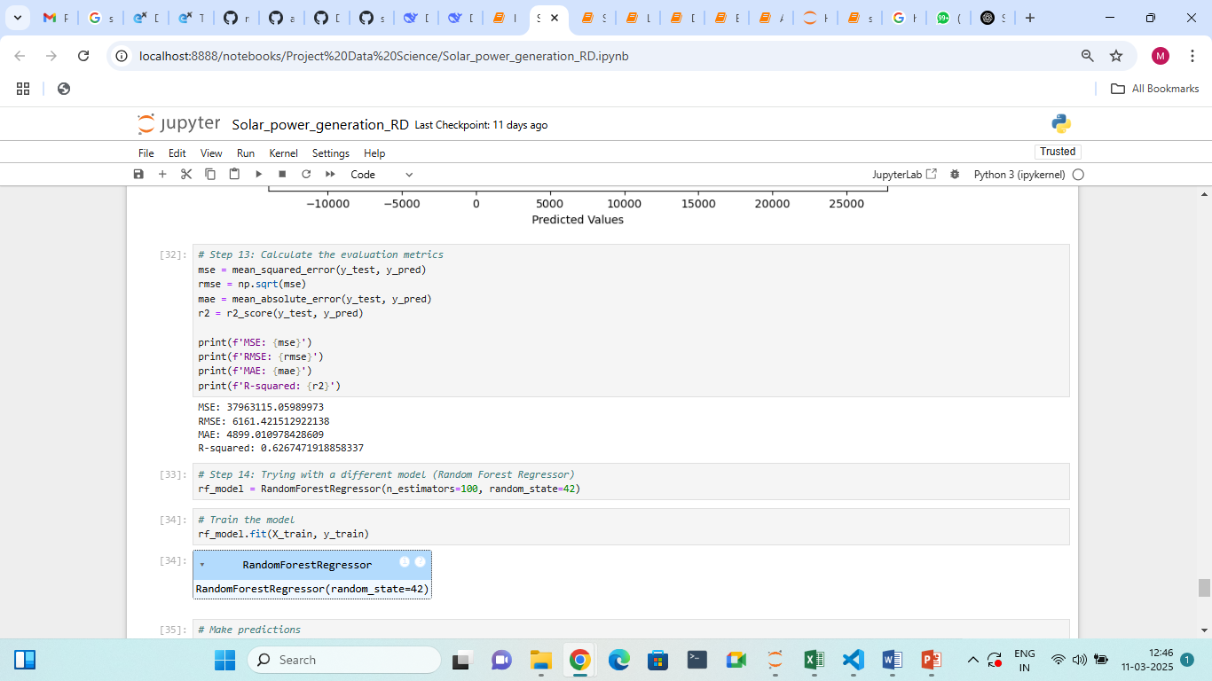

Slide 32
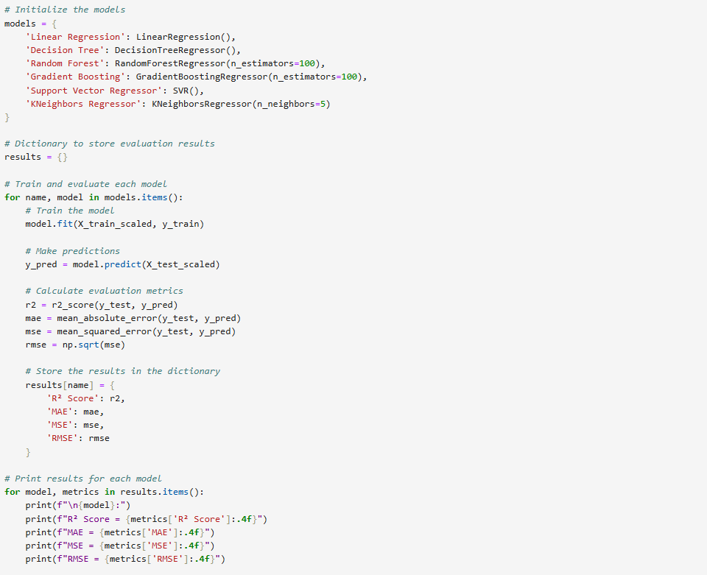
TRYING A DIFFERENT MODEL

Slide 33
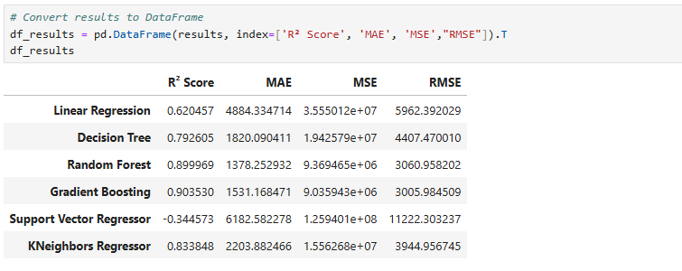
Output

Slide 34
What is Hyperparameter tuning ?
Hyperparameter tuning is the process of selecting the best set of hyperparameters for a machine learning model to improve its performance. In machine learning, hyperparameters are the parameters that are set before training a model and cannot be learned directly from the data.
Why is Hyperparameter Tuning Important?
Improves Model Performance: Machine learning models are sensitive to the settings of hyperparameters. Choosing the right values can significantly improve the model's accuracy, generalization, and ability to make predictions. Poorly chosen hyperparameters can lead to overfitting or underfitting.
Finds the Optimal Model Configuration: Every model has a set of hyperparameters that maximize its performance for a given dataset. By tuning the hyperparameters, we can find this optimal configuration.
Helps Avoid Overfitting or Underfitting: If hyperparameters like the learning rate or regularization are set incorrectly, the model might either overfit (learning the noise in the data) or underfit (not learning the underlying patterns), leading to poor generalization.
Fine-Tunes Performance: While training a model, hyperparameters control the speed, convergence, and behavior of the learning algorithm. Tuning them properly can make the training process faster or more stable.

Slide 35
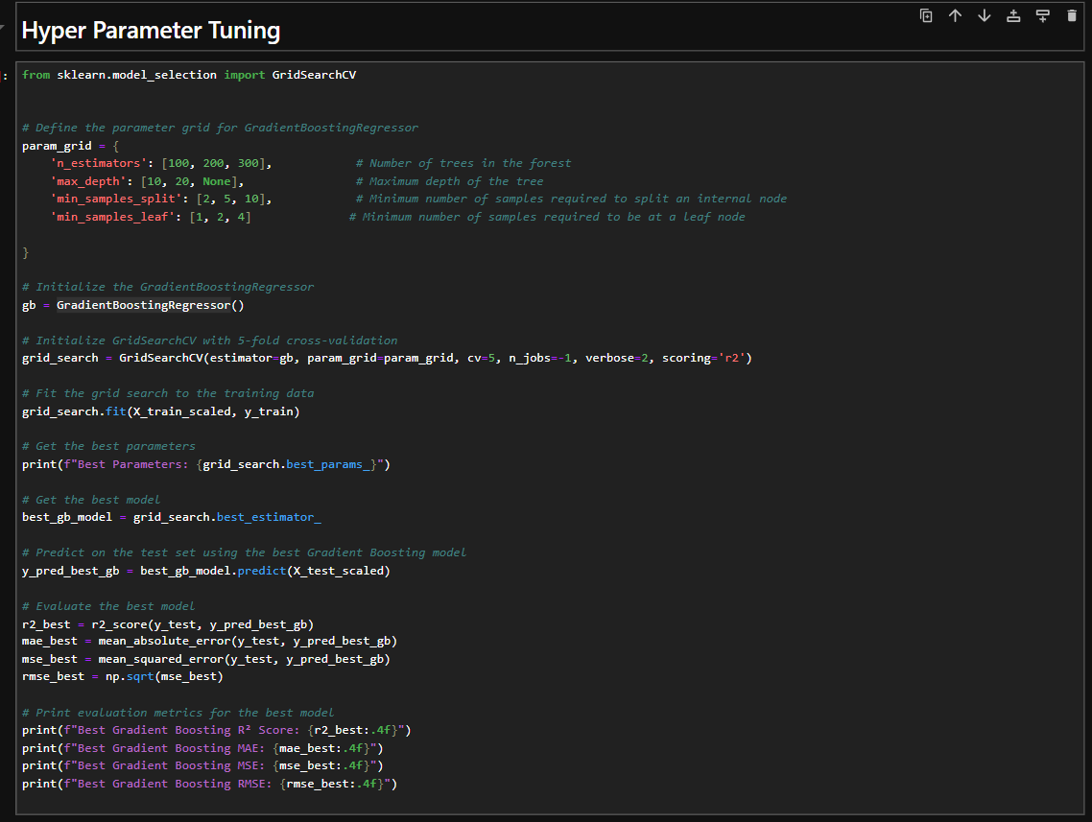
Hyper Parameter Tuning
Applying Hyper parameter tuning for GradientBoostingRegressor()

Slide 36
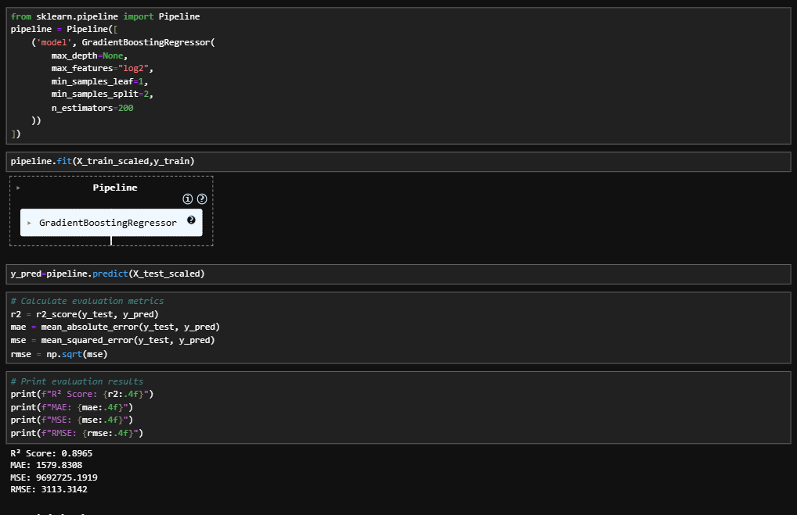
A pipeline in machine learning is a sequence of data processing and modeling steps that automate the workflow from data preparation to model training and evaluation. It ensures consistency, reduces errors, and makes the process reproducible.

Slide 37
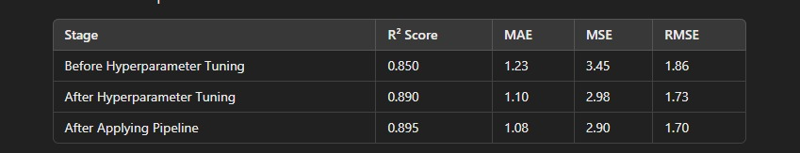
Result For Gradient Boosting Regressor Model

Slide 38
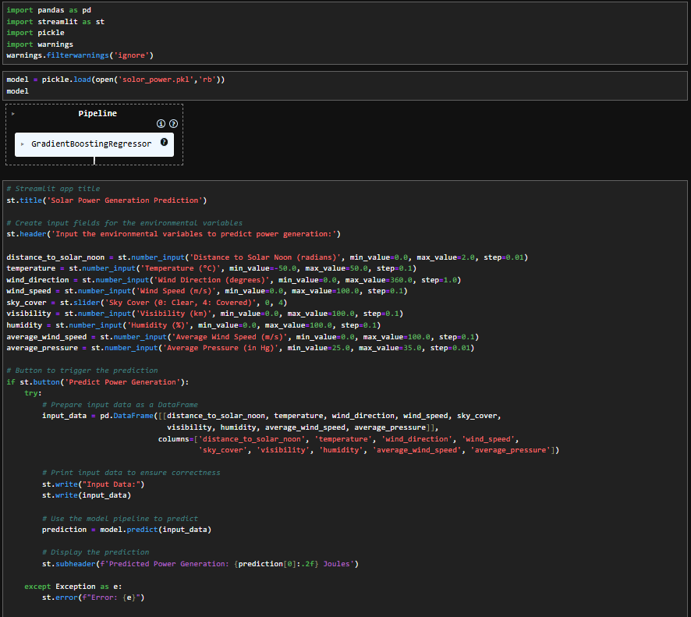
Model deployment is the process of taking a trained machine learning model and making it available for use in a real-world application or production environment. This allows the model to make predictions on new, unseen data in real-time or in batch processes.

Slide 39
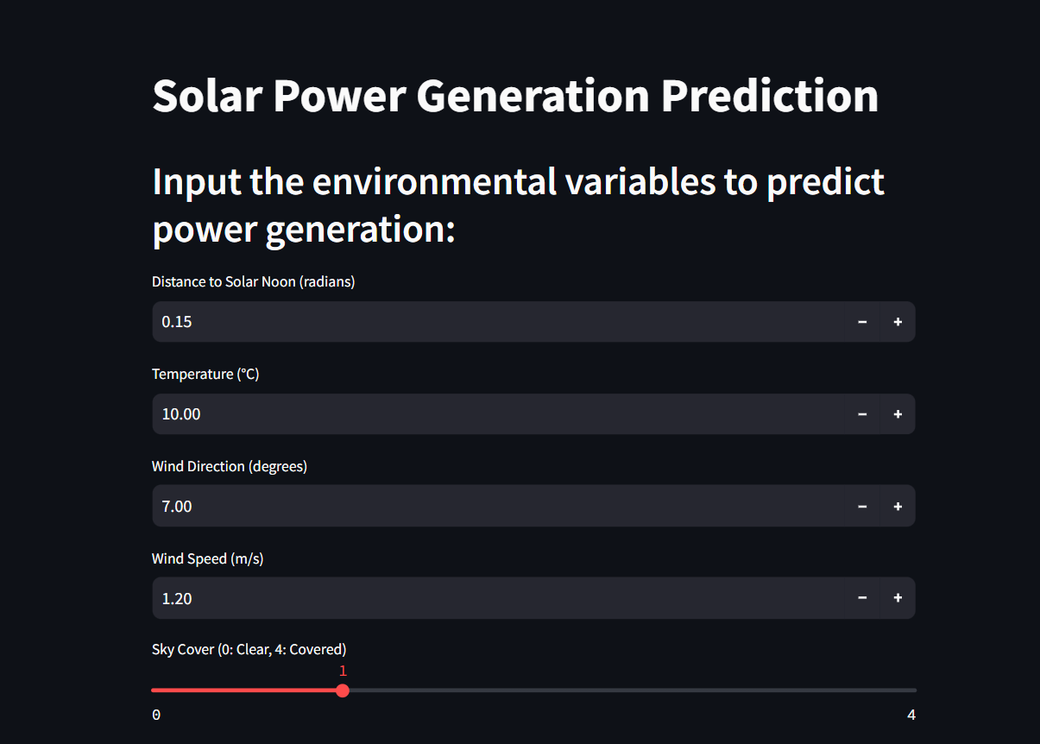
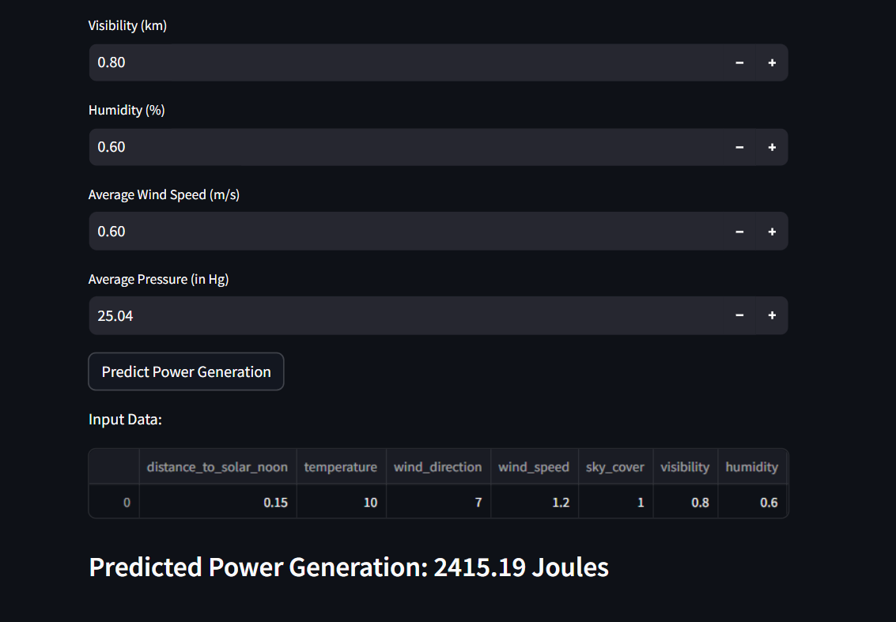
Predicter Power Result

Slide 40
Thank You

