Slide 1
Solar Power Generation Prediction

Slide 2
Mentor’s Name Gopi Chirag Dilvar basha Chaitra
Team Members
Chengodi Bhanu Prakesh
Mayuri Alpesh Bodke
Prajwal Rotte
Prathap B D

Slide 3
OBJECTIVE
The variable to be predicted is continuous (energy production). Therefore, this is an Regression project. The primary goal is to model energy production as a function of environmental variables
The objective of this project is to predict the power generated based on environmental variables such as temperature, wind speed, humidity, and sky cover.

Slide 4
Dataset Description
Dataset: solarpowergeneration.csv
Total Rows: 2920
Total Columns: 10
Target Variable: Power generated (in Joules per 3 hours)

Slide 5
PROCESS
Data Understanding & Preprocessing
Exploratory Data Analysis (EDA)
Feature Engineering
Model Training & Evaluation
Deployment & Future Improvements

Slide 6
Features
Distance to solar noon
Average Wind Speed
Average Pressure
Power generated
Temperature
Wind Direction
Wind Speed
Sky cover
Visibility
Humidity

Slide 7
Data Understanding & Preprocessing
Insights:
The dataset consists of 2920 rows and 10 columns, with "Power Generated" as the target variable.
Preprocessing involved handling missing values, removing outliers, and normalizing data to improve model performance.
Feature engineering and correlation analysis were performed to identify important predictors.
Conclusion:
Data cleaning and preprocessing significantly improve model accuracy by ensuring data quality.
Normalizing features aids in faster convergence of machine learning models.

Slide 8
Exploratory Data Analysis (EDA)
Insights:
Univariate and bivariate analysis revealed data distribution and relationships between features.
Correlation and mutual information scores highlighted key influencing factors on power generation.
Conclusion:
Understanding data patterns helps select the most relevant features for model building.
Correlation analysis ensures we focus on impactful variables, reducing model complexity.

Slide 9
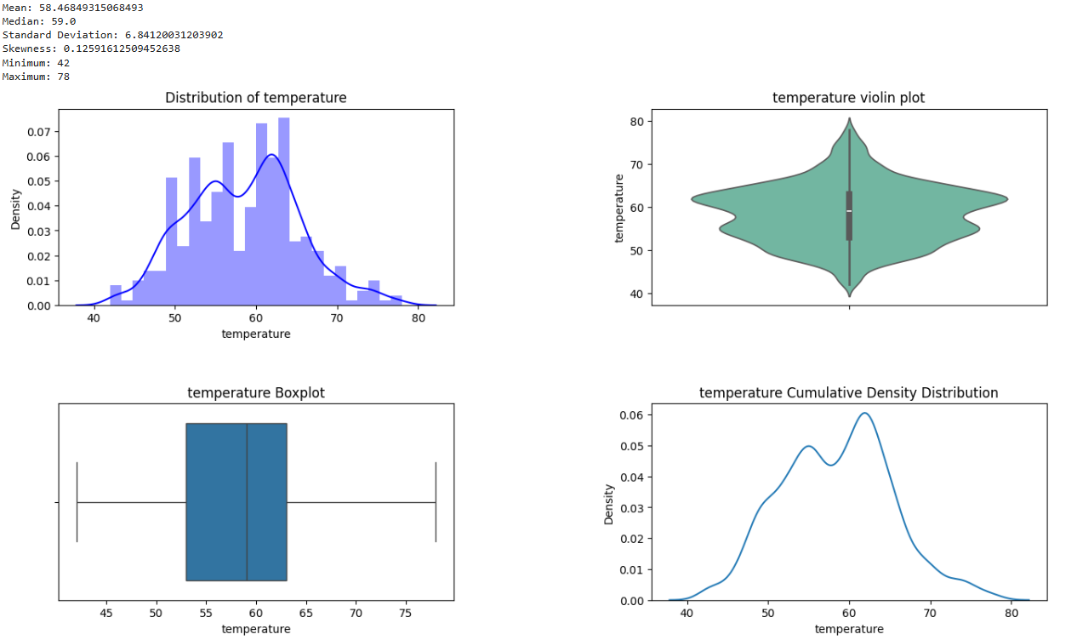
UNI-VARIATE ANALYSIS
The temperature distribution is slightly right-skewed, with most values ranging between 50°C and 65°C. The boxplot shows no significant outliers, and the violin plot highlights dense clustering near the median (59°C). The cumulative density plot suggests a bimodal trend, possibly due to seasonal variations.

Slide 10
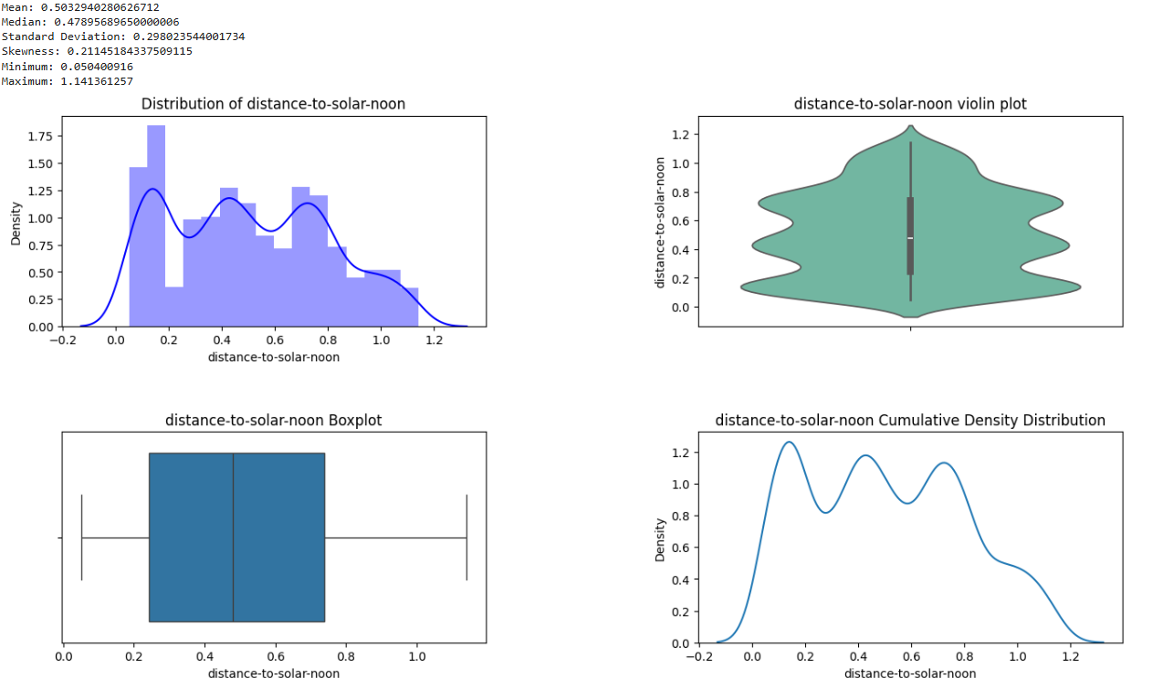
The distance-to-solar-noon distribution is multimodal, indicating multiple peaks in the dataset. The boxplot shows no significant outliers, and the violin plot highlights dense clustering around the median (0.48). The cumulative density plot confirms variability, suggesting different periods of solar intensity throughout the day.

Slide 11
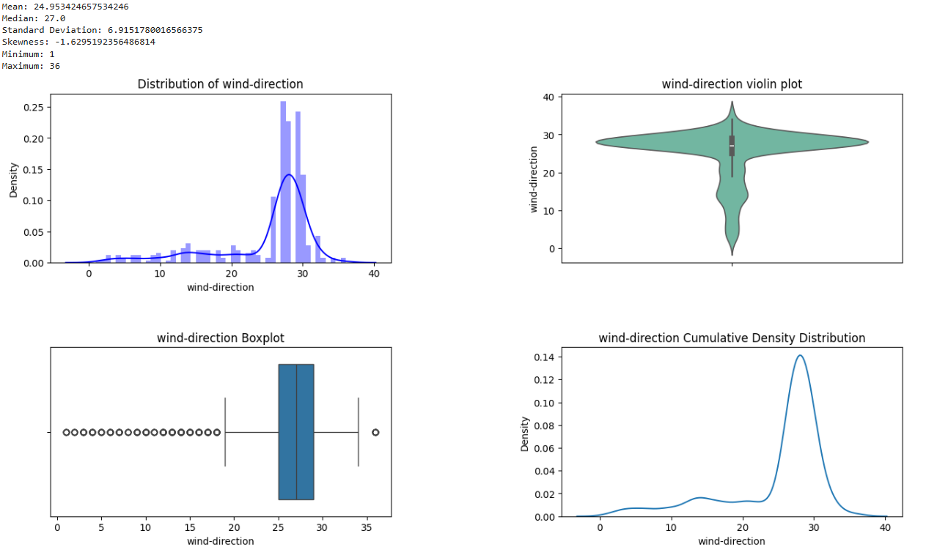
The wind direction distribution is left-skewed, with most values clustering around 27°. The boxplot reveals multiple outliers on the lower end, suggesting some unusual wind directions. The cumulative density plot confirms a sharp peak, indicating that wind direction is generally consistent with minor variations.

Slide 12
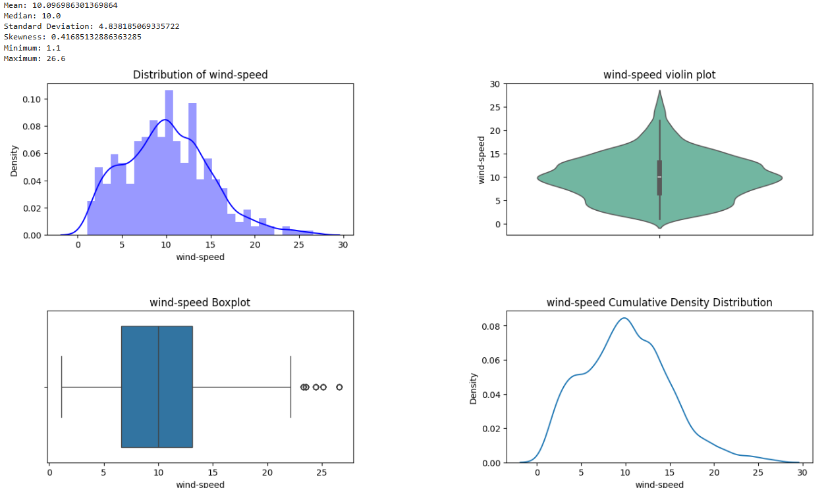
The wind speed distribution is slightly right-skewed, with most values centered around 10 m/s. The boxplot shows a few outliers at higher speeds, while the violin plot confirms dense clustering near the median. The cumulative density plot suggests a steady increase, indicating gradual variations in wind speed.

Slide 13
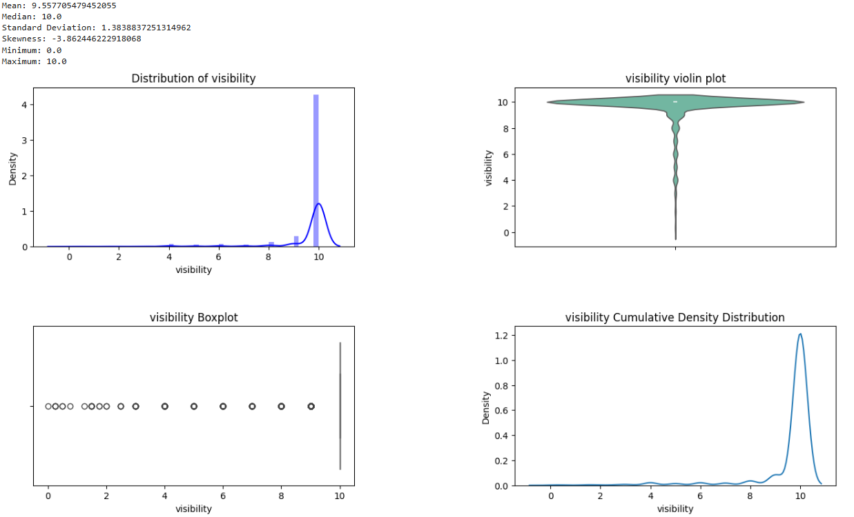
The visibility distribution is highly left-skewed, with most values concentrated at 10 km. The boxplot reveals multiple outliers at lower visibility levels, indicating occasional foggy or hazy conditions. The cumulative density plot confirms that low visibility events are rare but impactful.

Slide 14
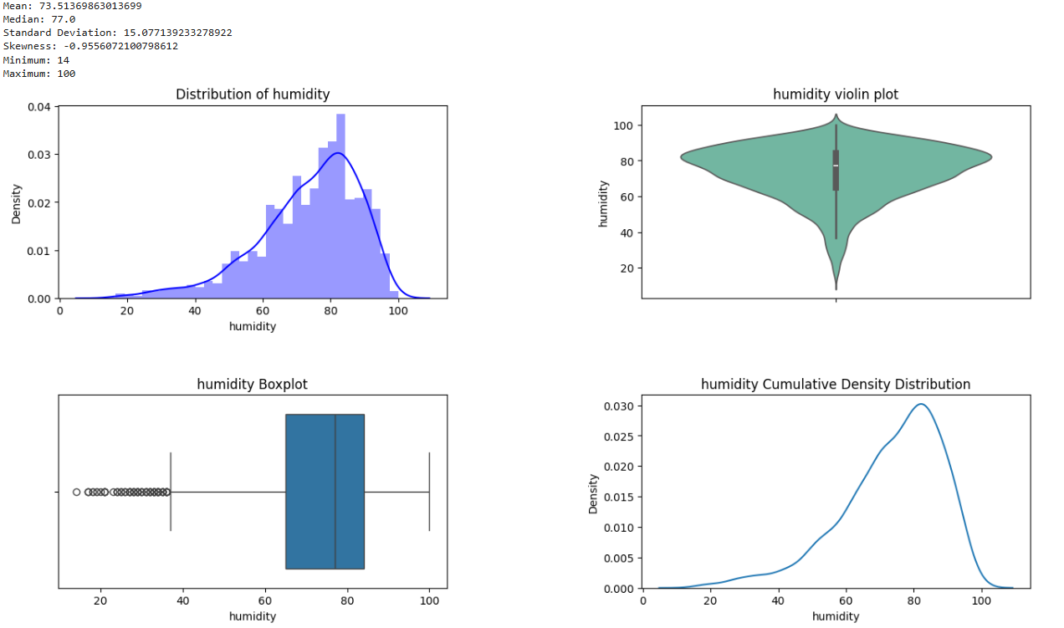
The humidity distribution is left-skewed, with most values concentrated around 77%. The boxplot reveals multiple low-humidity outliers, suggesting occasional dry conditions. The cumulative density plot confirms a peak around 70-80%, indicating that high humidity is common.

Slide 15
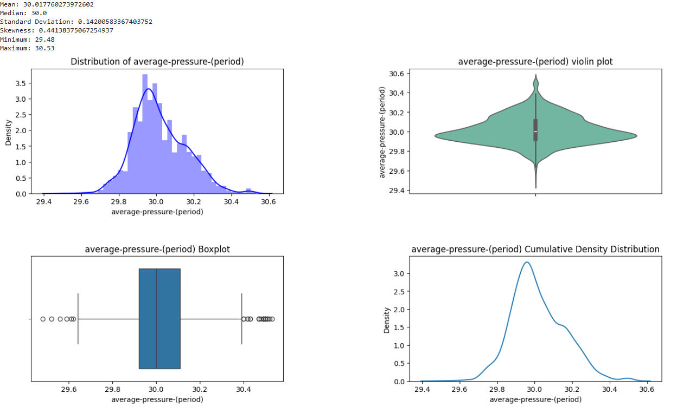
The average pressure distribution is nearly normal, centered around 30.0 hPa. The boxplot reveals some minor outliers, but most values fall within a narrow range. The cumulative density plot confirms a peak near 30.0, indicating stable atmospheric pressure.

Slide 16
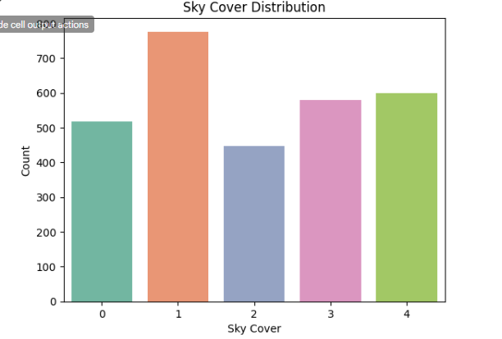
The sky cover distribution shows that category 1 (partly cloudy) is the most frequent, while category 2 has the lowest occurrence. The relatively balanced distribution suggests varied cloud conditions, which may impact solar power generation differently.

Slide 17
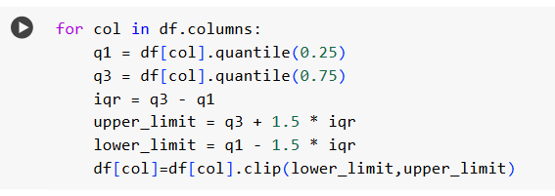
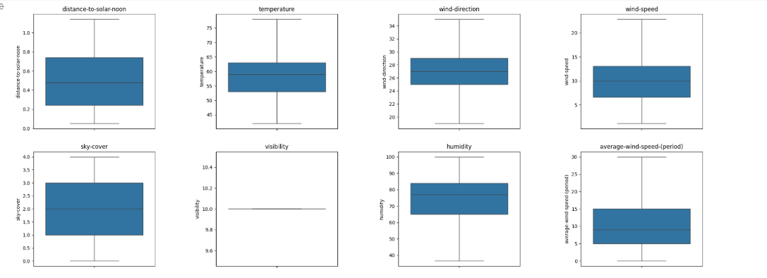
HANDLING OUTLIERS

Slide 18
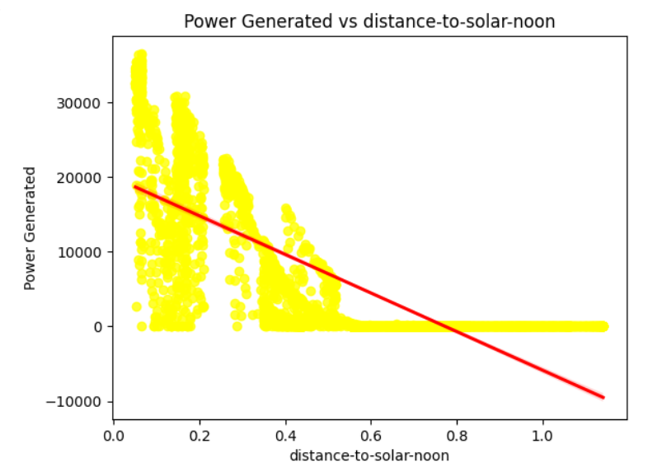
BI-VARIATE ANALYSIS
The scatter plot shows a negative correlation between power generated and distance-to-solar-noon, meaning power generation is highest near solar noon and decreases as the sun moves away. The red trendline confirms this decline, highlighting the importance of peak sunlight hours.

Slide 19
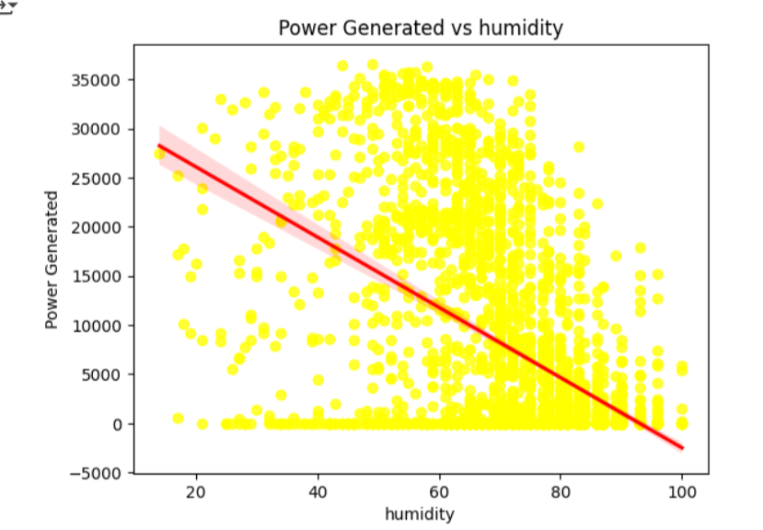
The scatter plot shows a negative correlation between humidity and power generation, meaning higher humidity levels reduce solar power output. The red trendline confirms this decline, likely due to increased atmospheric moisture blocking sunlight.

Slide 20
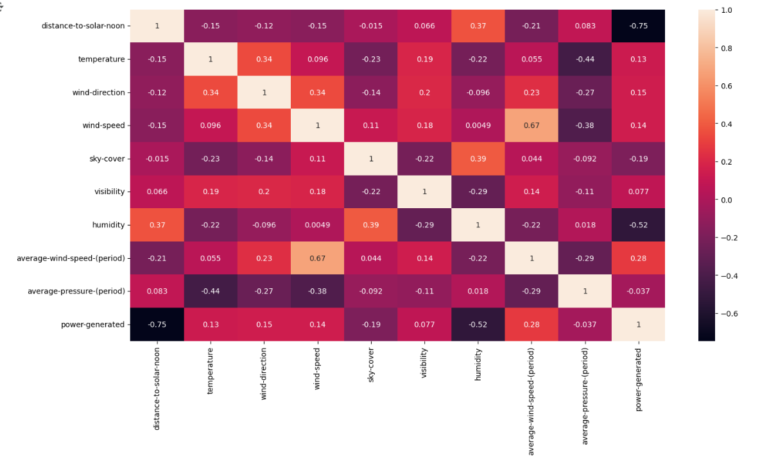
CORRELATION ANALYSIS
The correlation heatmap shows that power generation is strongly negatively correlated (-0.75) with distance-to-solar-noon, meaning generation peaks near noon. Humidity (-0.52) also reduces power output, while wind speed (0.28) has a slight positive impact. Other factors show weaker correlations.

Slide 21
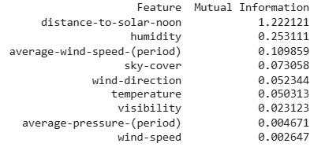
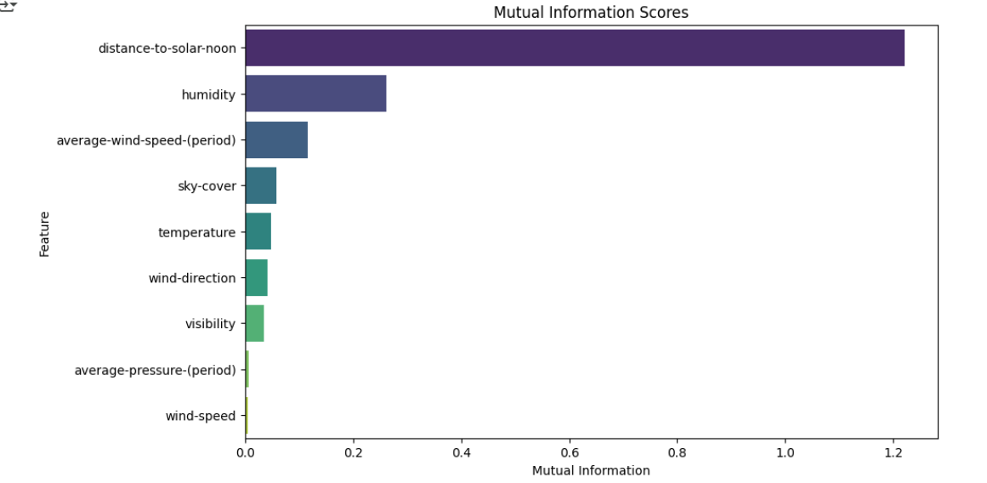
MUTUAL INFORMATION SCORES

Slide 22
Model Building
Insights:
Data split into 80% training and 20% testing to prevent overfitting.
StandardScaler used for normalization, ensuring consistent feature scaling.
Conclusion:
Proper data splitting prevents information leakage, ensuring reliable model evaluation.
Standardizing features helps regression-based models perform better.

Slide 23
Training a Linear Regression Model
Insights:
Linear Regression was applied to establish a baseline model.
Model fitting involved training with independent variables and making predictions on the test set.
Conclusion:
Linear Regression provides a simple yet effective starting point for predicting solar power generation.
Evaluating residuals and error metrics helps refine model performance.

Slide 24
Model Evaluation Metrics
Insights:
Key evaluation metrics included Mean Squared Error (MSE), Root Mean Squared Error (RMSE), and R-squared.
R-squared closer to 1 indicates a better fit of the model.
Conclusion:
RMSE and MAE provide an understanding of model accuracy.
A lower MSE and a higher R-squared suggest better predictive power.

Slide 25
CALCULATES KEY REGRESSION EVALUATION METRICS
MSE (Mean Squared Error): Penalizes larger errors, making it sensitive to outliers.
RMSE (Root Mean Squared Error): Interpretable as it has the same units as the target variable.
MAE (Mean Absolute Error): Represents the average absolute error in predictions.
R-squared: Measures how much variance in the target variable is explained by the model (closer to 1 indicates a better fit).

Slide 26
Trying Different Models & Hyperparameter Tuning
Insights:
Gradient Boosting Regressor was applied to improve prediction accuracy.
Hyperparameter tuning optimized performance and reduced overfitting.
Conclusion:
Gradient Boosting performed better than Linear Regression due to its ability to capture non-linear relationships.
Hyperparameter tuning is crucial for maximizing model performance.

Slide 27
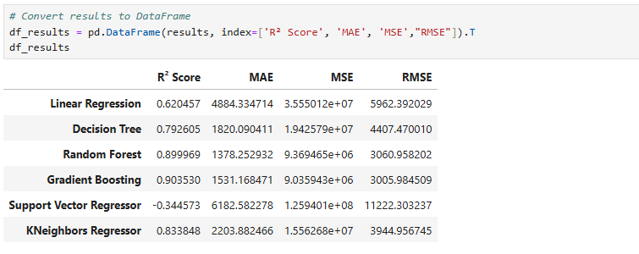
Output
The Gradient Boosting model performed best with an R² score of 0.903, indicating high accuracy, and the lowest RMSE (3005.98). Random Forest also performed well (R² = 0.899), while Support Vector Regressor performed poorly (R² = -0.344), suggesting it is unsuitable for this dataset.

Slide 28
What is Hyperparameter tuning ?
Hyperparameter tuning is the process of selecting the best set of hyperparameters for a machine learning model to improve its performance. In machine learning, hyperparameters are the parameters that are set before training a model and cannot be learned directly from the data.
Why is Hyperparameter Tuning Important?
Improves Model Performance: Machine learning models are sensitive to the settings of hyperparameters. Choosing the right values can significantly improve the model's accuracy, generalization, and ability to make predictions. Poorly chosen hyperparameters can lead to overfitting or underfitting.
Finds the Optimal Model Configuration: Every model has a set of hyperparameters that maximize its performance for a given dataset. By tuning the hyperparameters, we can find this optimal configuration.
Helps Avoid Overfitting or Underfitting: If hyperparameters like the learning rate or regularization are set incorrectly, the model might either overfit (learning the noise in the data) or underfit (not learning the underlying patterns), leading to poor generalization.
Fine-Tunes Performance: While training a model, hyperparameters control the speed, convergence, and behavior of the learning algorithm. Tuning them properly can make the training process faster or more stable.

Slide 29
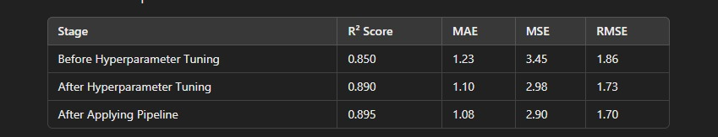
The table shows the impact of hyperparameter tuning and pipeline implementation on model performance. Initially, the model had an R² score of 0.850 with an RMSE of 1.86. After hyperparameter tuning, the model improved to R² = 0.890, with lower errors (RMSE = 1.73, MSE = 2.98). Further applying a pipeline refined the model, achieving R² = 0.895 and RMSE = 1.70, indicating better generalization and accuracy. These improvements highlight the importance of tuning and structured workflows in machine learning.

Slide 30
Model deployment is the process of taking a trained machine learning model and making it available for use in a real-world application or production environment. This allows the model to make predictions on new, unseen data in real-time or in batch processes.
Model Deployment
Insights:
The trained model was deployed to make real-time predictions on new data.
Deployment ensures practical usability in energy forecasting applications.
Conclusion:
Deploying models transforms analytical insights into actionable solutions.
Continuous monitoring and improvements ensure the model remains accurate over time.

Slide 31
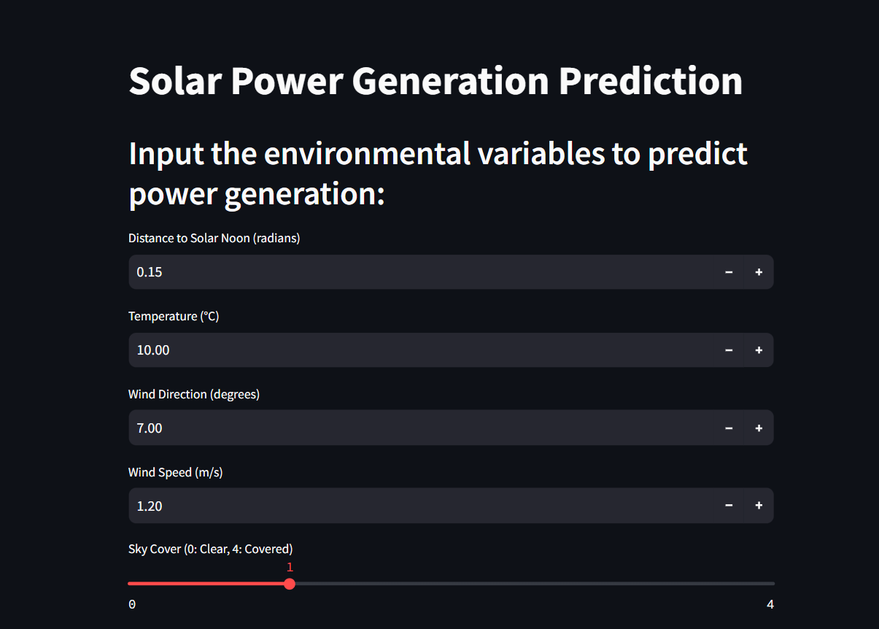
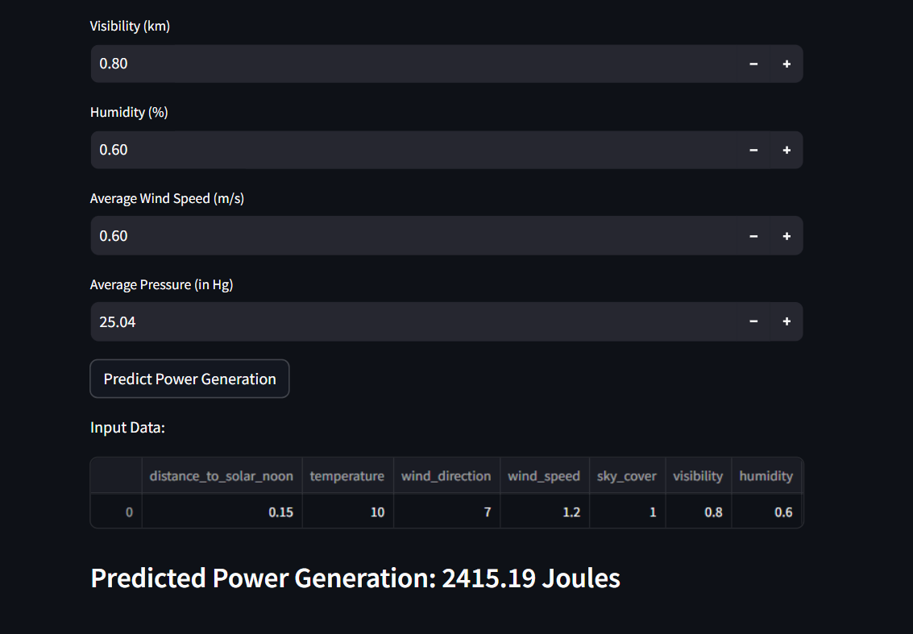
Predicter Power Result

Slide 32
Final Conclusion
Data preprocessing is essential for handling missing values, outliers, and feature scaling.
EDA plays a vital role in understanding data distributions and correlations.
Model evaluation ensures that the chosen approach provides reliable predictions.
Gradient Boosting with Hyperparameter Tuning proved to be the most effective model.
Deployment allows real-world application, making solar power forecasting accessible and actionable.

Slide 33
Challenges Faced in the Project
Data Quality Issues
The dataset had missing values, requiring imputation techniques.
Outliers in wind speed, humidity, and pressure affected model performance.
Feature Selection & Engineering
Identifying the most impactful variables for power generation was challenging.
Some features had low correlation, leading to dimensionality reduction concerns.
Model Selection & Performance Optimization
Finding the best regression model required extensive comparisons.
Hyperparameter tuning was time-consuming but crucial for improving accuracy.

Slide 34
4.Overfitting & Generalization
Some models like Decision Trees performed well on training data but overfitted.
Regularization techniques were applied to ensure better generalization.
5.Deployment & Scalability
Implementing the model in a real-time prediction system required performance optimization.
Handling varying environmental conditions made deployment more complex.

Slide 35
Thank You

