Slide 1
Binary Palindrome

Slide 2
Introduction to Binary Palindrome
A palindrome is a sequence that is the same both forwards and backward.
The binary representation of a number is checked for being a palindrome but no leading 0's are considered.
Number = 5
Binary representation = 101

Slide 3
What is Binary Palindrome?
Palindromic numbers can be considered in numeral systems other than decimal. For example, the binary palindromic numbers are the ones with the binary representations: 0, 1, 11, 101, 111, 1001, 1111, 10001, 10101, 11011, 11111, 100001 etc..

Slide 4
Example Program
public class Example {
public static void main(String argc[]) {
long num = 5, n1;
long reverse = 0;
n1 = num;
while (n1 > 0) {
reverse =reverse << 1;
if ((n1 & 1) == 1)
reverse =reverse ^ 1;
n1 >>= 1;
}
if(num == reverse) {
System.out.println("Binary representation of " + num + " is palindrome");
}
else {
System.out.println("Binary representation of " + num + " is not palindrome");
}
}
}
OUTPUT
The binary representation of 5 is a palindrome

Slide 5
Euclid's Algorithm

Slide 6
Euclid's Algorithm
Euclid's algorithm is an efficient way to find the GCD of two numbers and it's pretty easy to implement using recursion in the Java program.
According to Euclid's method GCD of two numbers, a, b is equal to GCD(b, a mod b) and GCD(a, 0) = a.

Slide 7
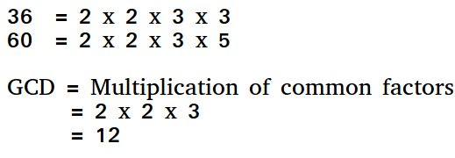
Euclid's Algorithm
GCD of two numbers is the largest number that divides both of them. A simple way to find GCD is to factorize both numbers and multiply common prime factors.
Basic Euclidean Algorithm for GCD The algorithm is based on the below facts:
If we subtract a smaller number from a larger (we reduce a larger number), GCD doesn’t change. So if we keep subtracting repeatedly the larger of two, we end up with GCD.
Now instead of subtraction, if we divide the smaller number, the algorithm stops when we find remainder 0.

Slide 8
Example Program
import java.util.*;
import java.lang.*;
class GFG
{
// extended Euclidean Algorithm
public static int gcd(int a, int b)
{
if (a == 0)
return b;
return gcd(b%a, a);
}
// Driver Program
public static void main(String[] args)
{
int a = 10, b = 15, g;
g = gcd(a, b);
System.out.println("GCD(" + a + " , " + b+ ") = " + g);
a = 35; b = 10;
g = gcd(a, b);
System.out.println("GCD(" + a + " , " + b+ ") = " + g);
a = 31; b = 2;
g = gcd(a, b);
System.out.println("GCD(" + a + " , " + b+ ") = " + g);
}
}
Output
GCD(10, 15) = 5
GCD(35, 10) = 5
GCD(31, 2) = 1

Slide 9
Booth's Algorithm

Slide 10
Booth's Algorithm
Booth’s algorithm is a multiplication algorithm that multiplies two signed binary numbers in 2’s complement notation
Booth used desk calculators that were faster at shifting than adding and created the algorithm to increase their speed.
Booth’s algorithm is of interest in the study of computer architecture. Here’s the implementation of the algorithm.

Slide 11
Algorithm
Put multiplicand in BR and multiplier in QR and then the algorithm works as per the following conditions : 1. If Q_{n} and Q_{n+1} are same i.e. 00 or 11 perform arithmetic shift by 1 bit. 2. If Q_{n} +Q_{n+1} = 10 do A= A + BR and perform arithmetic shift by 1 bit. 3. If Q_{n} +Q_{n+1} = 01 do A= A – BR and perform arithmetic shift by 1 bit.
Notes:
Java Program:
https://www.maixuanviet.com/java-program-to-implement-booth-algorithm.vietmx

Slide 12
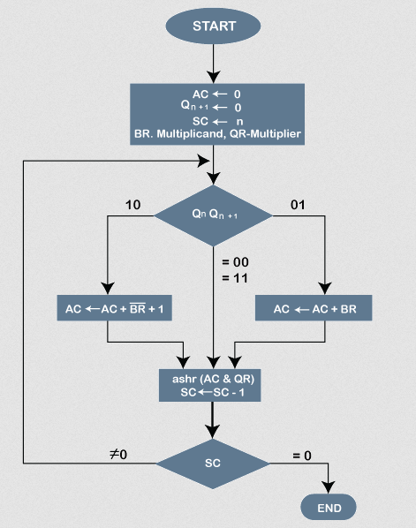

Slide 13
Example Program
// Java code to implement booth's algorithm
class GFG
{
// function to perform adding in the accumulator
static void add(int ac[], int x[], int qrn)
{
int i, c = 0;
for (i = 0; i < qrn; i++)
{
// updating accumulator with A = A + BR
ac[i] = ac[i] + x[i] + c;
if (ac[i] > 1)
{
ac[i] = ac[i] % 2;
c = 1;
}
else
{
c = 0;
}
}
}
// function to find the number's complement
static void complement(int a[], int n)
{
int i;
int[] x = new int[8];
x[0] = 1;
for (i = 0; i < n; i++)
{
a[i] = (a[i] + 1) % 2;
}
add(a, x, n);
}
// function ro perform right shift
static void rightShift(int ac[], int qr[],
int qn, int qrn)
{
int temp, i;
temp = ac[0];
qn = qr[0];
System.out.print("\t\trightShift\t");
for (i = 0; i < qrn - 1; i++)
{

Slide 14
Example Program
ac[i] = ac[i + 1];
qr[i] = qr[i + 1];
}
qr[qrn - 1] = temp;
}
// function to display operations
static void display(int ac[], int qr[], int qrn)
{
int i;
// accumulator content
for (i = qrn - 1; i >= 0; i--)
{
System.out.print(ac[i]);
}
System.out.print("\t");
// multiplier content
for (i = qrn - 1; i >= 0; i--)
{
System.out.print(qr[i]);
}
}
// Function to implement booth's algo
static void boothAlgorithm(int br[], int qr[], int mt[],
int qrn, int sc)
{
int qn = 0;
int[] ac = new int[10];
int temp = 0;
System.out.print("qn\tq[n+1]\t\tBR\t\tAC\tQR\t\tsc\n");
System.out.print("\t\t\tinitial\t\t");
display(ac, qr, qrn);
System.out.print("\t\t" + sc + "\n");
while (sc != 0)
{
System.out.print(qr[0] + "\t" + qn);
// SECOND CONDITION
if ((qn + qr[0]) == 1)
{
if (temp == 0)
{
// subtract BR from accumulator
add(ac, mt, qrn);
System.out.print("\t\tA = A - BR\t");
for (int i = qrn - 1; i >= 0; i--)
{
System.out.print(ac[i]);
}
temp = 1;
}
// THIRD CONDITION
else if (temp == 1)
{
// add BR to accumulator
add(ac, br, qrn);

Slide 15
Example Program
System.out.print("\t\tA = A + BR\t");
for (int i = qrn - 1; i >= 0; i--)
{
System.out.print(ac[i]);
}
temp = 0;
}
System.out.print("\n\t");
rightShift(ac, qr, qn, qrn);
}
// FIRST CONDITION
else if (qn - qr[0] == 0)
{
rightShift(ac, qr, qn, qrn);
}
display(ac, qr, qrn);
System.out.print("\t");
// decrement counter
sc--;
System.out.print("\t" + sc + "\n");
}
}
static void reverse(int a[])
{
int i, k, n = a.length;
int t;
for (i = 0; i < n / 2; i++)
{
t = a[i];
a[i] = a[n - i - 1];
a[n - i - 1] = t;
}
}
// Driver code
public static void main(String[] args)
{
int[] mt = new int[10];
int sc;
int brn, qrn;
// Number of multiplicand bit
brn = 4;
// multiplicand
int br[] = {0, 1, 1, 0};
// copy multiplier to temp array mt[]
for (int i = brn - 1; i >= 0; i--)
{
mt[i] = br[i];
}
reverse(br);
complement(mt, brn);
// No. of multiplier bit
qrn = 4;
// sequence counter
sc = qrn;
// multiplier
int qr[] = {1, 0, 1, 0};
reverse(qr);
boothAlgorithm(br, qr, mt, qrn, sc);

Slide 16
System.out.print("\n" + "Result = "); for (int i = qrn - 1; i >= 0; i--) { System.out.print(qr[i]); } } } Output : qn q[n + 1] BR AC QR sc initial 0000 1010 4 0 0 rightShift 0000 0101 3 1 0 A = A - BR 1010 rightShift 1101 0010 2 0 1 A = A + BR 0011 rightShift 0001 1001 1 1 0 A = A - BR 1011 rightShift 1101 1100 0 Result = 1100
Example Program

Slide 17
Thank You …

