Slide 1
Recursion

Slide 2
Sorted Unique Permutation

Slide 3
Print distinct sorted permutations with duplicates allowed in input
Write a program to print all distinct permutations of a given string in sorted order. Note that the input string may contain duplicate characters. In mathematics, the notion of permutation relates to the act of arranging all the members of a set into some sequence or order, or if the set is already ordered, rearranging (reordering) its elements, a process called permuting.
Examples:
Input : BAC Output : ABC ACB BAC BCA CAB CBA Input : AAB Output : AAB ABA BAA Input : DBCA Output: ABCD ABDC ACBD ACDB ADBC ADCB BACD BADC BCAD BCDA BDAC BDCA CABD CADB CBAD CBDA CDAB CDBA DABC DACB DBAC DBCA DCAB DCBA

Slide 4
sorted Permutations
Concept Used: The number of Strings generated by a string of distinct characters of length ‘n’ is equal to ‘n!’. Sorting any given string and generating the lexicographically next bigger string until we reach the largest lexicographically string from those characters.
Different permutations of word “geeks” Length of string = 5 Character ‘e’ repeats 2 times. Result = 5!/2! = 60.

Slide 5
sorted Permutations
Steps:
Example: Consider a string “ABCD”. Step 1: Sort the string. Step 2: Obtain the total number of permutations which can be formed from that string. Step 3: Print the sorted string and then loop for the number of (permutations-1) times as 1st string is already printed. Step 4: Find the next greater string.

Slide 6
sorted Permutations –Example Program
import java.io.*;
import java.util.*;
class Solution {
static int factorial(int n) {
int f = 1;
for (int i = 1; i <= n; i++)
f = f * i;
return f;
}
static void print(char[] temp){
for (int i = 0; i < temp.length; i++)
System.out.print(temp[i]);
System.out.println();
}
static int calculateTotal(char[] temp, int n) {
int f = factorial(n);
HashMap<Character, Integer> hm =
new HashMap<Character, Integer>();
for (int i = 0; i < temp.length; i++) {
if (hm.containsKey(temp[i]))
hm.put(temp[i],hm.get(temp[i])+1);
else
hm.put(temp[i], 1);
}

Slide 7
sorted permutations –Example Program
// Traversing hashmap and finding duplicate elements.
for (Map.Entry e : hm.entrySet()) {
Integer x = (Integer)e.getValue();
if (x > 1) {
int temp5 = factorial(x);
f = f / temp5;
}
}
return f;
}
static void nextPermutation(char[] temp) {
// Start traversing from the end and
// find position 'i-1' of the first character
// which is greater than its successor.
int i;
for (i = temp.length - 1; i > 0; i--)
if (temp[i] > temp[i - 1])
break;

Slide 8
sorted permutations –Example Program
// Finding smallest character after 'i-1' and
// greater than temp[i-1]
int min = i;
int j, x = temp[i - 1];
for (j = i + 1; j < temp.length; j++)
if ((temp[j] < temp[min]) && (temp[j] > x))
min = j;
// Swapping the above found characters.
char temp_to_swap;
temp_to_swap = temp[i - 1];
temp[i - 1] = temp[min];
temp[min] = temp_to_swap;
// Sort all digits from position next to 'i-1'
// to end of the string.
Arrays.sort(temp, i, temp.length);
// Print the String
print(temp);
}

Slide 9
sorted permutations –Example Program
static void printAllPermutations(String s) {
// Sorting String
char temp[] = s.toCharArray();
Arrays.sort(temp);
// Print first permutation
print(temp);
// Finding the total permutations
int total = calculateTotal(temp, temp.length);
for (int i = 1; i < total; i++)
nextPermutation(temp);
}
// Driver Code
public static void main(String[] args) {
String s = "AAB";
printAllPermutations(s);
}
}
Output:AAB ABA BAA

Slide 10
Combination

Slide 11
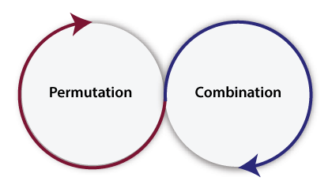
Permutation and Combination
Permutation and Combination are two important concepts.
Permutation is the different arrangements of the set elements. The arrangements can be made by taking one element at a time, some element at a time and all elements at a time.
Combination is the different selections of the set of elements taken one by one, or some, or all at a time. In Java, the definition of Permutation and Combination is the same.

Slide 12
Combination
Combination is the different selections of the set of elements taken one by one, or some, or all at a time.
In Java, the definition of Permutation and Combination is the same.
For example, if we have a set having only two elements, X and Y.
Combination value is very easy in Java but to get all the combination of array, list, and set elements is more difficult than getting permutations. For getting the combination value programmatically in Java, we use the following formula:
Combination = fact(n) / (fact(r) * fact(n-r));

Slide 13
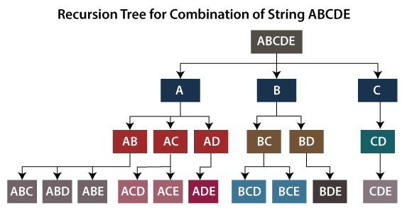
Combination

Slide 14
CombinationExample.java
numbers.add(9);
numbers.add(12);
numbers.add(19);
numbers.add(61);
numbers.add(19);
int n = numbers.size();
int r = 2; int result;
result = fact(n) / (fact(r) * fact(n-r));
System.out.println("The combination value for the numbers list is: " + result);
}
}
import java.util.*;
public class CombinationExample {
static int fact(int number) {
int f = 1;
int j = 1;
while(j <= number) {
f = f * j;
j++;
}
return f;
}
public static void main(String args[]) {
List<Integer> numbers = new ArrayList<Integer>();

Slide 15
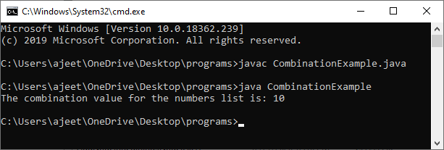
Output:

Slide 16
Maneuvering

Slide 17
Maneuvering a Cave Problem
Problem:
The task is to count all the possible paths from top left to bottom right of a m x n matrix with the constraints that from each cell you can either move only to right or down.
Examples :
Input : m = 2, n = 2;
Output : 2
There are two paths
(0, 0) -> (0, 1) -> (1, 1)
(0, 0) -> (1, 0) -> (1, 1)

Slide 18
Let NumberOfPaths(m, n) be the count of paths to reach row number m and column number n in the matrix, NumberOfPaths(m, n) can be recursively written as following.
Maneuvering a Cave Problem-Program
class GFG {
static int numberOfPaths(int m, int n){
if (m == 1 || n == 1)
return 1;
return numberOfPaths(m-1,n)+numberOfPaths(m,n-1);
// + numberOfPaths(m-1, n-1);
}
public static void main(String args[])
{
System.out.println(numberOfPaths(3, 3));
}
}
Output:6

Slide 19
Thank you…

