Slide 1
Josephus trap

Slide 2
Introduction to Josephus trap
In computer science and mathematics, the Josephus Problem (or Josephus permutation) is a theoretical problem.
The problem statement:
There are n people standing in a circle waiting to be executed. The counting out begins at some point in the circle and proceeds around the circle in a fixed direction.
How is the Josephus problem solved?
The Josephus problem can be solved using recursion. For each iteration, recursively delete the Kth position until only one person is left.

Slide 3
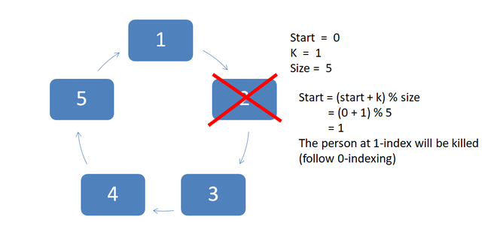
Example Diagram

Slide 4
Example Program
import java.io.*;
class GFG {
static int josephus(int n, int k){
if (n == 1)
return 1;
else
return (josephus(n - 1, k) + k - 1) % n + 1;
}
public static void main(String[] args){
int n = 14;
int k = 2;
System.out.println("The chosen place is "
+ josephus(n, k));
}
}
Output
The chosen place is 13

Slide 5
Maze Solving

Slide 6
Maze Solving
Introduction
Consider the maze to be a black and white image, with black pixels representing walls, and white pixels representing a path. Two white pixels are special, one being the entry to the maze and another exit.
Given such a maze, we want to find a path from entry to the exit.
Modelling the Maze
0 -> Road
1 -> Wall
2 -> Maze entry
3 -> Maze exit
4 -> Cell part of the path from entry to exit

Slide 7
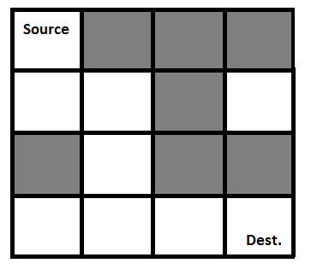
Example Maze
Gray blocks are dead ends (value = 0).
binary matrix representation of the above maze.
{ 1, 0, 0, 0}
{1, 1, 0, 1}
{0, 1, 0, 0}
{1, 1, 1, 1}

Slide 8
Example Maze Program
public class RatMaze {
final int N = 4;
void printSolution(int sol[][]){
for (int i = 0; i < N; i++) {
for (int j = 0; j < N; j++)
System.out.print(" " + sol[i][j] + " ");
System.out.println();
}
}
boolean isSafe(int maze[][], int x, int y){
return (x >= 0 && x < N && y >= 0 && y < N && maze[x][y] == 1);
}
{
int sol[][] = { { 0, 0, 0, 0 },
{ 0, 0, 0, 0 },
{ 0, 0, 0, 0 },
{ 0, 0, 0, 0 } };
if (solveMazeUtil(maze, 0, 0, sol) == false) {
System.out.print("Solution doesn't exist");
return false;
}
printSolution(sol);
return true;
}
boolean solveMazeUtil(int maze[][], int x, int y,int sol[][]){
if (x == N - 1 && y == N - 1) {
sol[x][y] = 1;
return true;
}
if (isSafe(maze, x, y) == true) {
sol[x][y] = 1;
if (solveMazeUtil(maze, x + 1, y, sol))
return true;
if (solveMazeUtil(maze, x, y + 1, sol))
return true;

Slide 9
sol[x][y] = 0; return false; } return false; } public static void main(String args[]){ RatMaze rat = new RatMaze(); int maze[][] = { { 1, 0, 0, 0 }, { 1, 1, 0, 1 }, { 0, 1, 0, 0 }, { 1, 1, 1, 1 } }; rat.solveMaze(maze); } } Output: 1 0 0 0 1 1 0 0 0 1 0 0 0 1 1 1
Example Maze Program

Slide 10
N Queens

Slide 11
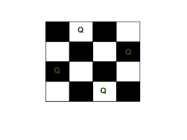
N Queens
The N Queen is the problem of placing N chess queens on an N×N chessboard so that no two queens attack each other.
Example
The following is a solution for 4 Queen problem. The expected output is a binary matrix which has 1s for the blocks where queens are placed.

Slide 12
N Queens Problem
What is Backtracking?
In backtracking, we start with one pos­si­ble move out of many avail­able moves. We then try to solve the prob­lem.
What is the N-Queens Problem?
How can N queens be placed on an NxN chessboard so that no two of them attack each other?
This problem is commonly seen for N=4 and N=8.
Let’s look at an example where N=4

Slide 13
N Queens Problem-Movement of Queen
Before solving the problem, you need to know about the movement of the queen in chess.
A queen can move any number of steps in any direction. The only constraint is that it can’t change its direction while it’s moving.
One thing that is clear by looking at the queen’s movement is that no two queens can be in the same row or column.
That allows us to place only one queen in each row and each column.
When N=4, the solution looks like :

Slide 14
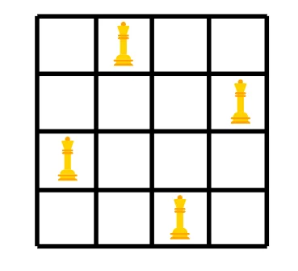
Queen solution
N Queens Problem-Movement of Queen
Solution to the N-Queens Problem
The way we try to solve this is by placing a queen at a position and trying to rule out the possibility of it being under attack. We place one queen in each row/column.
If we see that the queen is under attack at its chosen position, we try the next position.
If a queen is under attack at all the positions in a row, we backtrack and change the position of the queen placed prior to the current position.
We repeat this process of placing a queen and backtracking until all the N queens are placed successfully.

Slide 15
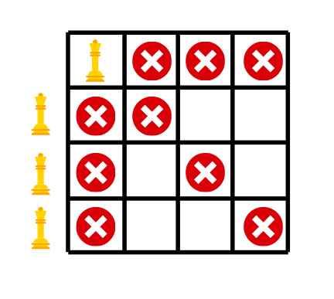
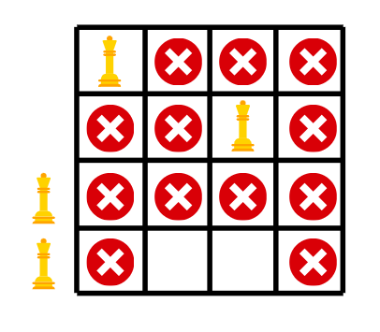
The step by step backtracking is shown as follows:
N Queens Problem-Movement of Queen
Start
No place for queen 3, so we backtrack

Slide 16
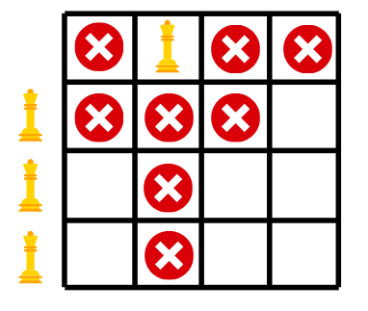
After backtracking we are not able to place queen 4, so again we backtrack.
N Queens Problem-Movement of Queen
This time we backtrack all the way to the first queen.

Slide 17
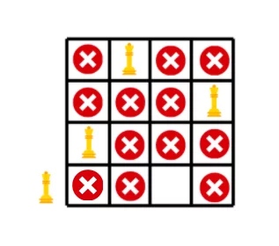
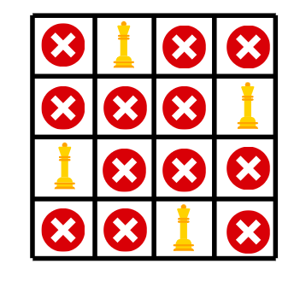
First three queens placed successfully after backtracking.
N Queens Problem-Movement of Queen
All the queens placed

Slide 18
Example Program
public class NQueenProblem {
final int N = 4;
void printSolution(int board[][]){
for (int i = 0; i < N; i++) {
for (int j = 0; j < N; j++)
System.out.print(" " + board[i][j]
+ " ");
System.out.println(); }
}
boolean isSafe(int board[][], int row, int col){
int i, j;
for (i = 0; i < col; i++)
if (board[row][i] == 1)
return false;
for (i = row, j = col; i >= 0 && j >= 0; i--, j--)
if (board[i][j] == 1)
return false;
for (i = row, j = col; j >= 0 && i < N; i++, j--)
if (board[i][j] == 1)
return false;
return true;
}
boolean solveNQUtil(int board[][], int col){
if (col >= N)
return true;
for (int i = 0; i < N; i++) {
if (isSafe(board, i, col)) {
board[i][col] = 1;

Slide 19
if (solveNQUtil(board, col + 1) == true)
return true;
board[i][col] = 0; // BACKTRACK
} }
return false;
}
boolean solveNQ()
{
int board[][] = { { 0, 0, 0, 0 },
{ 0, 0, 0, 0 },
{ 0, 0, 0, 0 },
{ 0, 0, 0, 0 } };
if (solveNQUtil(board, 0) == false) {
System.out.print("Solution does not exist");
return false;
}
printSolution(board);
return true;
}
public static void main(String args[]){
NQueenProblem Queen = new NQueenProblem();
Queen.solveNQ();
}}
Output:
0 0 1 0
1 0 0 0
0 0 0 1
0 1 0 0

Slide 20
Thank You …

