Slide 1
Warnsdorff’s Algorithm

Slide 2
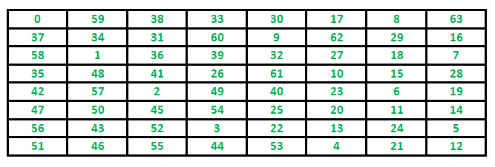
Warnsdorff’s Algorithm
Definition
Warnsdorff's rule is a heuristic for finding a single knight's tour.
The knight is moved so that it always proceeds to the square from which the knight will have the fewest onward moves.
When calculating the number of onward moves for each candidate square, we do not count moves that revisit any square already visited.
Example :

Slide 3
Warnsdorff’s Algorithm –Knight’s Tour Problem
// Java program to for Knight's tour problem using
// Warnsdorff's algorithm
import java.util.concurrent.ThreadLocalRandom;
class GFG
{ public static final int N = 8;
// Move pattern on basis of the change of
// x coordinates and y coordinates respectively
public static final int cx[] = {1, 1, 2, 2, -1, -1, -2, -2};
public static final int cy[] = {2, -2, 1, -1, 2, -2, 1, -1};
// function restricts the knight to remain within
// the 8x8 chessboard
boolean limits(int x, int y)
{
return ((x >= 0 && y >= 0) &&
(x < N && y < N));
}
/* Checks whether a square is valid and
empty or not */
boolean isempty(int a[], int x, int y)
{
return (limits(x, y)) && (a[y * N + x] < 0);
}
/* Returns the number of empty squares
adjacent to (x, y) */
int getDegree(int a[], int x, int y) {
int count = 0;
for (int i = 0; i < N; ++i)
if (isempty(a, (x + cx[i]),
(y + cy[i])))
count++;
return count; }
// Picks next point using Warnsdorff's heuristic.
// Returns false if it is not possible to pick
// next point.
Cell nextMove(int a[], Cell cell) {
int min_deg_idx = -1, c,
min_deg = (N + 1), nx, ny;
// Try all N adjacent of (*x, *y) starting
// from a random adjacent. Find the adjacent
// with minimum degree.
int start = ThreadLocalRandom.current().nextInt(1000) % N;
for (int count = 0; count < N; ++count)
{

Slide 4
Warnsdorff’s Algorithm –Knight’s Tour Problem
int i = (start + count) % N;
nx = cell.x + cx[i];
ny = cell.y + cy[i];
if ((isempty(a, nx, ny)) &&
(c = getDegree(a, nx, ny)) < min_deg)
{
min_deg_idx = i;
min_deg = c; } }
// IF we could not find a next cell
if (min_deg_idx == -1)
return null;
// Store coordinates of next point
nx = cell.x + cx[min_deg_idx];
ny = cell.y + cy[min_deg_idx];
// Mark next move
a[ny * N + nx] = a[(cell.y) * N +
(cell.x)] + 1;
// Update next point
cell.x = nx;
cell.y = ny;
return cell; }
/* displays the chessboard with all the
legal knight's moves */
void print(int a[])
{
for (int i = 0; i < N; ++i)
{
for (int j = 0; j < N; ++j)
System.out.printf("%d\t", a[j * N + i]);
System.out.printf("\n"); } }
/* checks its neighbouring squares */
/* If the knight ends on a square that is one
knight's move from the beginning square,
then tour is closed */
boolean neighbour(int x, int y, int xx, int yy)
{
for (int i = 0; i < N; ++i)
if (((x + cx[i]) == xx) &&
((y + cy[i]) == yy))
return true;
return false; }
/* Generates the legal moves using warnsdorff's
heuristics. Returns false if not possible */
boolean findClosedTour()
{
// Filling up the chessboard matrix with -1's
int a[] = new int[N * N];
for (int i = 0; i < N * N; ++i)
a[i] = -1;
// initial position

Slide 5
Warnsdorff’s Algorithm –Knight’s Tour Problem
int sx = 3;
int sy = 2;
// Current points are same as initial points
Cell cell = new Cell(sx, sy);
a[cell.y * N + cell.x] = 1; // Mark first move.
// Keep picking next points using
// Warnsdorff's heuristic
Cell ret = null;
for (int i = 0; i < N * N - 1; ++i)
{
ret = nextMove(a, cell);
if (ret == null)
return false; }
// Check if tour is closed (Can end
// at starting point)
if (!neighbour(ret.x, ret.y, sx, sy))
return false;
print(a);
return true; }
// Driver Code
public static void main(String[] args)
{
// While we don't get a solution
while (!new GFG().findClosedTour())
{
;
} } }
class Cell
{ int x;
int y
public Cell(int x, int y)
{ this.x = x;
this.y = y; }
}
Output:
59 14 63 32 1 16 19 34
62 31 60 15 56 33 2 17
13 58 55 64 49 18 35 20
30 61 42 57 54 51 40 3
43 12 53 50 41 48 21 36
26 29 44 47 52 39 4 7
11 46 27 24 9 6 37 22
28 25 10 45 38 23 8 5

Slide 6
Hamiltonian Cycle

Slide 7
Hamiltonian Cycle
Hamiltonian cycle is a path in a graph that visits each vertex exactly once and back to starting vertex.
This program is to determine if a given graph is a hamiltonian cycle or not.
This program assumes every vertex of the graph to be a part of hamiltonian path.

Slide 8
Example Hamiltonian Cycle in the following graph is {0, 1, 2, 4, 3, 0}. (0)--(1)--(2) | / \ | | / \ | | / \ | (3)-------(4) And the following graph doesn’t contain any Hamiltonian Cycle. (0)--(1)--(2) | / \ | | / \ | | / \ | (3) (4)
Hamiltonian Cycle

Slide 9
Hamiltonian Cycle-Example
class HamiltonianCycle{
final int V = 5;
int path[];
boolean isSafe(int v, int graph[][], int path[], int pos){
if (graph[path[pos - 1]][v] == 0)
return false;
for (int i = 0; i < pos; i++)
if (path[i] == v)
return false;
return true;
}
boolean hamCycleUtil(int graph[][], int path[], int pos){
if (pos == V){
if (graph[path[pos - 1]][path[0]] == 1)
return true;
else
return false;
}
for (int v = 1; v < V; v++){
if (isSafe(v, graph, path, pos)){ path[pos] = v; if (hamCycleUtil(graph, path, pos + 1) == true) return true; path[pos] = -1; } } return false; } { path = new int[V]; for (int i = 0; i < V; i++) path[i] = -1; path[0] = 0;
if (hamCycleUtil(graph, path, 1) == false){
System.out.println("\nSolution does not exist");
return 0;
}
printSolution(path);
return 1;
}

Slide 10
Hamiltonian Cycle-Example
void printSolution(int path[]){
System.out.println("Solution Exists: Following" +
" is one Hamiltonian Cycle");
for (int i = 0; i < V; i++)
System.out.print(" " + path[i] + " ");
System.out.println(" " + path[0] + " "); }
public static void main(String args[]){
HamiltonianCycle hamiltonian =
new HamiltonianCycle();
int graph1[][] = {{0, 1, 0, 1, 0},
{1, 0, 1, 1, 1},
{0, 1, 0, 0, 1},
{1, 1, 0, 0, 1},
{0, 1, 1, 1, 0},
};
hamiltonian.hamCycle(graph1);
path[0] = 0;
if (hamCycleUtil(graph, path, 1) == false){
System.out.println("\nSolution does not exist");
return 0;
}
printSolution(path);
return 1;
}
void printSolution(int path[]){
System.out.println("Solution Exists: Following" +
" is one Hamiltonian Cycle");
for (int i = 0; i < V; i++)
System.out.print(" " + path[i] + " ");
int graph2[][] = {{0, 1, 0, 1, 0}, {1, 0, 1, 1, 1}, {0, 1, 0, 0, 1}, {1, 1, 0, 0, 0}, {0, 1, 1, 0, 0}, }; hamiltonian.hamCycle(graph2); } }

Slide 11
/* Let us create the following graph (0)--(1)--(2) | / \ | | / \ | | / \ | (3) (4) */ int graph2[][] = {{0, 1, 0, 1, 0}, {1, 0, 1, 1, 1}, {0, 1, 0, 0, 1}, {1, 1, 0, 0, 0}, {0, 1, 1, 0, 0}, }; // Print the solution hamiltonian.hamCycle(graph2); } } Output: Solution Exists: Following is one Hamiltonian Cycle 0 1 2 4 3 0
Hamiltonian Cycle-Example

Slide 12
Kruskal's Algorithm

Slide 13
Kruskal's Algorithm
Kruskal algorithm is another most important algorithm used for Minimum Spanning Tree.
MST is a spanning tree having a weight less than or equal to the weight of every spanning tree.
Kruskal algorithm in Java takes a connected and undirected graph and returns the Minimum Spanning Tree of it.

Slide 14
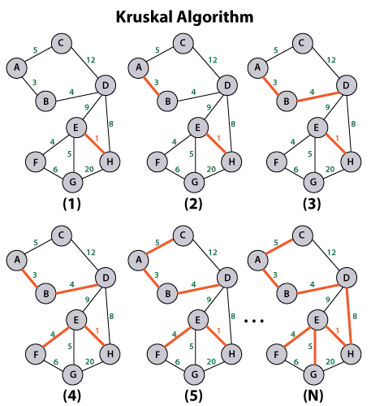
Kruskal's Algorithm

Slide 15
Kruskal's Algorithm-Example
import Java.util.*;
minimum spanning tree of the given graph
class KruskalAlgorithm {
class Edge implements Comparable<Edge> {
int source, destination, weight;
public int compareTo(Edge edgeToCompare) {
return this.weight - edgeToCompare.weight;
} };
class Subset {
int parent, value;
};
int vertices, edges;
Edge edgeArray[];
KruskalAlgorithm(int vertices, int edges) {
this.vertices = vertices;
this.edges = edges;
edgeArray = new Edge[this.edges];
for (int i = 0; i < edges; ++i)
edgeArray[i] = new Edge();
}
void applyKruskal() {
Edge finalResult[] = new Edge[vertices];
int newEdge = 0;
int index = 0;
for (index = 0; index < vertices; ++index)
finalResult[index] = new Edge();
Arrays.sort(edgeArray);
Subset subsetArray[] = new Subset[vertices];
for (index = 0; index < vertices; ++index)
subsetArray[index] = new Subset();

Slide 16
// it is used to create subset with single element for (int vertex = 0; vertex < vertices; ++vertex) { subsetArray[vertex].parent = vertex; subsetArray[vertex].value = 0; } index = 0; // use for loop to pick the smallers edge from the edges and increment the index for next iteration while (newEdge < vertices - 1) { // create an instance of Edge for next edge Edge nextEdge = new Edge(); nextEdge = edgeArray[index++]; int nextSource = findSetOfElement(subsetArray, nextEdge.source); int nextDestination = findSetOfElement(subsetArray, nextEdge.destination); //if the edge doesn't create cycle after including it, we add it in the result and increment the index if (nextSource != nextDestination) { finalResult[newEdge++] = nextEdge; performUnion(subsetArray, nextSource, nextDestination); } }
Kruskal's Algorithm-Example
for (index = 0; index < newEdge; ++index)
System.out.println(finalResult[index].source + " - " + finalResult[index].destination + ": " + finalResult[index].weight); }
// create findSetOfElement() method to get set of an element
int findSetOfElement(Subset subsetArray[], int i) {
if (subsetArray[i].parent != i)
subsetArray[i].parent = findSetOfElement(subsetArray, subsetArray[i].parent);
return subsetArray[i].parent;
}
// create performUnion() method to perform union of two sets
void performUnion(Subset subsetArray[], int sourceRoot, int destinationRoot) {
int nextSourceRoot = findSetOfElement(subsetArray, sourceRoot);
int nextDestinationRoot = findSetOfElement(subsetArray, destinationRoot);
if (subsetArray[nextSourceRoot].value < subsetArray[nextDestinationRoot].value)
subsetArray[nextSourceRoot].parent = nextDestinationRoot;

Slide 17
else if (subsetArray[nextSourceRoot].value > subsetArray[nextDestinationRoot].value) subsetArray[nextDestinationRoot].parent = nextSourceRoot; else { subsetArray[nextDestinationRoot].parent = nextSourceRoot; subsetArray[nextSourceRoot].value++; } } //main() method starts public static void main(String[] args) { int v, e; //create scanner class object to get input from user Scanner sc = new Scanner(System.in); //show custom message System.out.println("Enter number of vertices: "); //store user entered value into variable v v = sc.nextInt(); //show custom message System.out.println("Enter number of edges"); //store user entered value into variable e e = sc.nextInt(); KruskalAlgorithm graph = new KruskalAlgorithm(v, e);
Kruskal's Algorithm-Example
// use for creating Graph
for(int i = 0; i < e; i++){
System.out.println("Enter source value for edge["+ i +"]");
graph.edgeArray[i].source = sc.nextInt();
System.out.println("Enter destination value for edge["+ i +"]");
graph.edgeArray[i].destination = sc.nextInt();
System.out.println("Enter weight for edge["+i+"]");
graph.edgeArray[i].weight = sc.nextInt();
}
// call applyKruskal() method to get MST
graph.applyKruskal();
} }

Slide 18
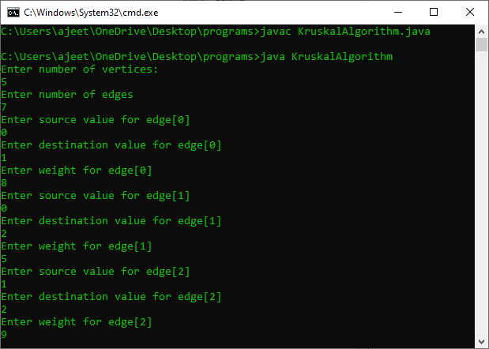
Output

Slide 19
Thank You …

