Slide 1
Strobogrammatic number

Slide 2
Strobogrammatic number
A strobogrammatic number is a number whose numeral is rotationally symmetric so that it appears the same when rotated 180 degrees.
In other words, the numeral looks the same right-side-up and upside down
Examples :
Input : n = 2
Output : 88 11 96 69
Input : n = 4
Output : 8008 1001 9006 6009 8888 1881 9886 6889 8118 1111
9116 6119 8968 1961 9966 6969 8698 1691 9696 6699

Slide 3
Strobogrammatic number
For the given length n, find all n-length Strobogrammatic numbers.
Strobogrammatic Number is a number whose numeral is rotationally symmetric so that it appears the same when rotated 180 degrees. In other words, Strobogrammatic Number appears the same right-side up and upside down.
0 after 180° rotation : (0 → 0) 1 after 180° rotation : (1 → 1) 8 after 180° rotation : (8 → 8) 6 after 180° rotation : (6 → 9) 9 after 180° rotation : (9 → 6)

Slide 4
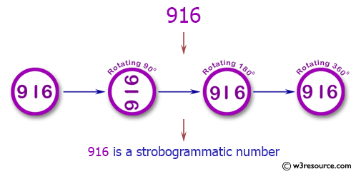
Strobogrammatic number

Slide 5
Strobogrammatic number

Slide 6
Java Program
import java.util.*;
public class Solution {
public static void main(String[] args) {
String n = "9006";
System.out.println("Is " + n + " is Strobogrammatic? " + is_Strobogrammatic(n));
}
public static boolean is_Strobogrammatic(String n) {
if (n == null || n.length() == 0) {
return true;
}
HashMap < Character, Character > map = new HashMap < Character, Character > ();
map.put('0', '0');
map.put('1', '1');
map.put('8', '8');
map.put('6', '9');
map.put('9', '6');
int left = 0;
int right = n.length() - 1;
while (left <= right) {
if (!map.containsKey(n.charAt(right)) || n.charAt(left) != map.get(n.charAt(right))) {
return false;
}
left++;
right--;
}
return true;
}
}
Output:
Is 9006 is Strobogrammatic? true

Slide 7
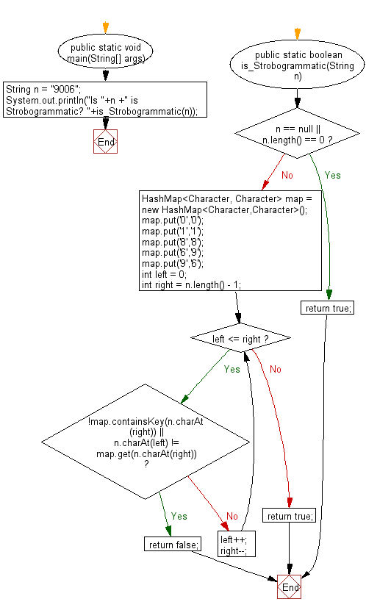
Strobogrammatic number-Flow Chart

Slide 8
Remainder Theorem

Slide 9
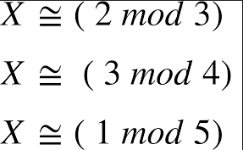
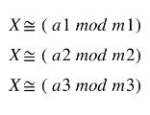

Slide 10
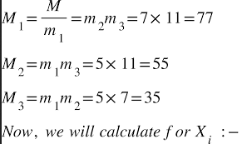
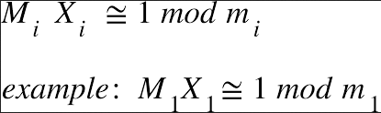

Slide 11
Remainder Theorem
Remainder Theorem is an approach of Euclidean division of polynomials. According to this theorem, if we divide a polynomial P(x) by a factor ( x – a); that isn't essentially an element of the polynomial; you will find a smaller polynomial along with a remainder.
What is the remainder theorem formula?
The remainder theorem formula is: p(x) = (x-c)·q(x) + r(x). The basic formula to check the division is: Dividend = (Divisor × Quotient) + Remainder.

Slide 12
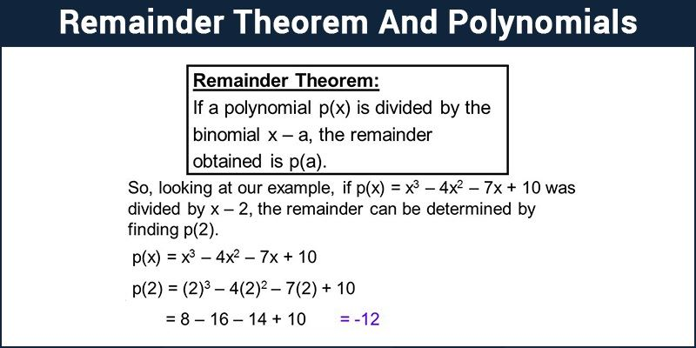
Remainder Theorem

Slide 13

Remainder Theorem
Why do we use the remainder theorem?
The Polynomial Remainder Theorem allows us to determine whether a linear expression is a factor of a polynomial expression easily.

Slide 14
x = ( ∑ (rem[i]*pp[i]*inv[i]) ) % prod

Slide 15
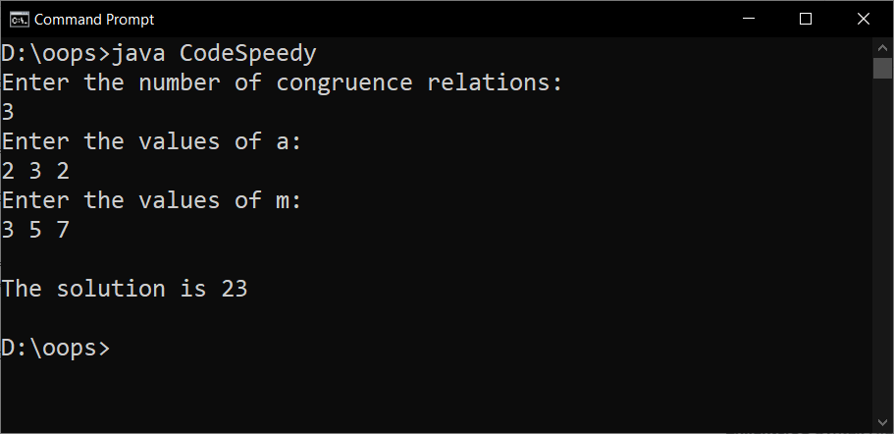
Example program
import java.util.*;
class CodeSpeedy{
static int CRT(int a[], int m[], int n, int p){
int x = 0
for(int i = 0; i<n; i++){
int M = p/m[i], y = 0; // M1 = p/m1, M2 = p/m2 ....., Mn = p/mn
for(int j=0; j<m[i]; j++){
if((M*j)%m[i]==1){
y = j; break; // Finding the values for y1, y2,..., yn
}
}
x = x + a[i]*M*y; // x = a1*M1*y1 + a2*M2*y2 + ... + an*Mn*yn
}
return x%p;
}
public static void main(String args[]){
Scanner sc = new Scanner(System.in);
System.out.println("Enter the number of congruence relations: ");
int size = sc.nextInt();
System.out.println("Enter the values of a: ");
int a[] = new int[size];
for(int i=0; i<size; i++)
a[i] = sc.nextInt();
System.out.println("Enter the values of m: ");
int m[] = new int[size], p = 1;
for(int i=0; i<size; i++){
m[i] = sc.nextInt();
p = p*m[i]; // p = m1*m2*...*mn
}
System.out.println("The solution is "+CRT(a,m,size,p));
}
}
Output

Slide 16
Minimum number of Apples to be collected from trees to guarantee M red apples

Slide 17
There are different kinds of apple trees in the four directions (East, West, North, South), which may grow both red and green apples such that each tree grows exactly K apples, in the following manner: N – number of trees to the north does not have red apples. S – number of trees to the south does not have green apples. W – number of trees in the west has some red apples. E – number of trees in the east have some green apples.
Alice Apple tree

Slide 18
Example:
Input: M = 10, K = 15, N = 0, S = 1, W = 0, E = 0 Output: 10 Explanation: It simply gets 10 apples from the 1st south tree
Input: M = 10, K = 15, N = 3, S = 0, W = 1, E = 0 Output: -1 Explanation: There are no red apples in the South, North and East. But in the West there are
atleast 1 red apple and total tree is 1,
So, total no. of guaranteed red apple is 1 * 1 = 1 which is less than M.
Approach:
Every apple in the south ensures that it is red. So first, take an apple from the south. In the East and West, there is at least 1 red apple in each tree. That’s why, for guaranteed it is considered that there is only 1 red apple on each tree in east and west. For the north there is no red apple, so, neglect that. Follow the steps below to solve the problem:
If M is less than equal to S*K then print M.
Else if M is less than equal to S*K+E+W then print S*K + (M-S*K) * K
Else print -1.

Slide 19
Example Program
import java.io.*;
class GFG {
// Function to minimum no. of apples
static int minApples(int M,int K,int N,int S,int W,int E)
{
// If we get all required apple
// from South
if(M <= S * K)
return M;
// If we required trees at
// East and West
else if(M <= S * K + E + W)
return S * K + (M-S * K) * K;
// If we doesn't have enough
// red apples
else
return -1;
}
// Driver code
public static void main(String[] args)
{
// No. of red apple for gift
int M = 10;
// No. of red apple in each tree
int K = 15;
// No. of tree in North
int N = 0;
// No. of tree in South
int S = 1;
// No. of tree in West
int W = 0;
// No. of tree in East
int E = 0;
// Function Call
int ans = minApples(M,K,N,S,W,E);
System.out.println(ans);
}
}
Output
10

Slide 20
Toggle the switch

Slide 21
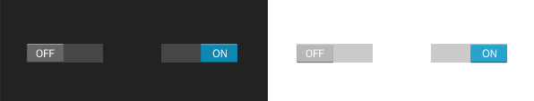
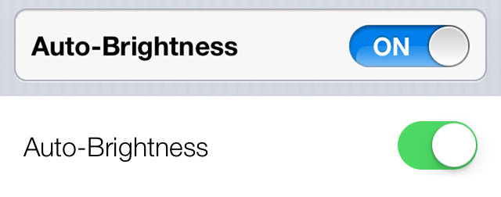
A Toggle Switch is a control that is very popular nowadays, especially on touch-based devices. You can see it in Android:

Slide 22
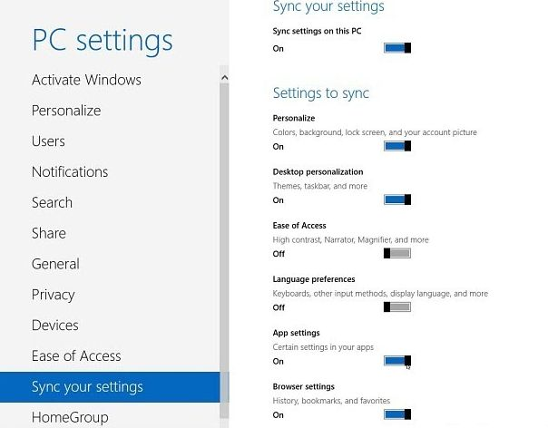
Functionally it works just like a check-box but for touch devices, it has one big advantage: when your finger is over the touch device it won’t obscure the control and so you can see instant feedback when you press it.

Slide 23
Implementation: Implementation of the Toggle Switch allows you to change the text for the on and off state that appears right next to the toggle switch.

Slide 24
Example Program
/* Java Program to show the functioning to Toggle Button*/
import javax.swing.*;
import java.awt.*;
import java.awt.event.*;
import javax.swing.JToggleButton;
class Toggle implements ItemListener
{
static JLabel text;
//Driver function
public static void main(String args[])
{
//Create a frame
JFrame frame = new JFrame("Toggle Button");
frame.setSize(500,500);
frame.setDefaultCloseOperation(JFrame.EXIT_ON_CLOSE);
frame.getContentPane().setBackground(Color.white);
frame.setLayout(null);
//Create an object
Toggle obj = new Toggle();
//Create a Toggle Button
JToggleButton button = new JToggleButton("Toggle Button");
button.setBounds(150,100,200,100);
button.addItemListener(obj);
frame.add(button);
//Create a label
text = new JLabel();
text.setBounds(150,250,300,100);
text.setText("Click on the Toggle Button");
frame.add(text);
//Display the frame
frame.setVisible(true);
}
public void itemStateChanged(ItemEvent e)
{
if(e.getStateChange()==ItemEvent.SELECTED)
text.setText("Status of Toggle Button : SELECTED");
else
text.setText("Status of Toggle Button : DESELECTED");
}
}

Slide 25
Program Explanation 1. To create a toggle button use JToggleButton class. 2. Add ItemListener to the toggle button. 3. Use method getStateChange to get the state change of toggle button. Runtime Test Cases Here’s the run time test case to show the functioning of toggle button. Test case 1 – To View the Toggle Button.

Slide 26

Test case 1 – To View the Toggle Button.

Slide 27

Test case 2 – To View the Selected status of Toggle Button.

Slide 28
Thank You …

