Slide 1
Resume Builder
Full Stack case study

Slide 2
Resume Builder
Objective
You will develop a web application that will auto-generate a nice and properly formatted Resume from the information filled up in a form.
Project Context
Creating a resume is a bit tedious task for any working professional from any industry. One has to keep it short, simple, and with the latest work experience, and constantly update it over a while.
This project will help you through the process that can be followed to build your
resume-builder using React JS/Angular and NodeJS/Spring Boot. Implementing the project will give you the satisfaction of auto-generating it on your own and helping working professionals with the same.

Slide 3
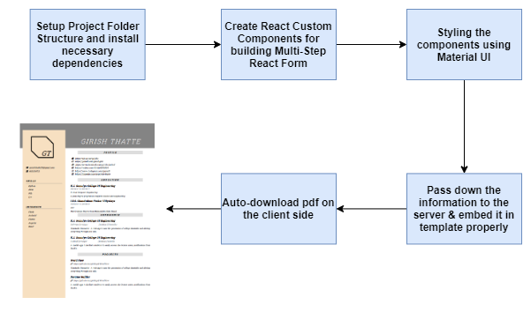
Resume Builder
Project Stages
This project consists of following stages:

Slide 4
Resume Builder
Approach
1.Create a basic client-server setup of Node & React and install necessary libraries required.
2.Build a React form by making modularized components using Material UI and React- Boostrap & calling these components in sequence to get required input data to generate resume.
3.Process the information on the server(Node) and using some HTML to PDF libraries to generate the resume.
4.Finally, make it auto-download on client side.
Demo Link
https://youtu.be/JkcP06CYVpc

Slide 5
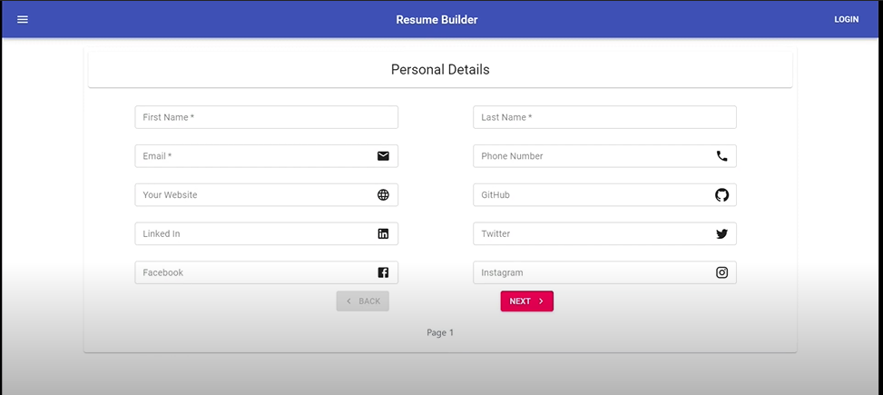
Design
Screens

Slide 6
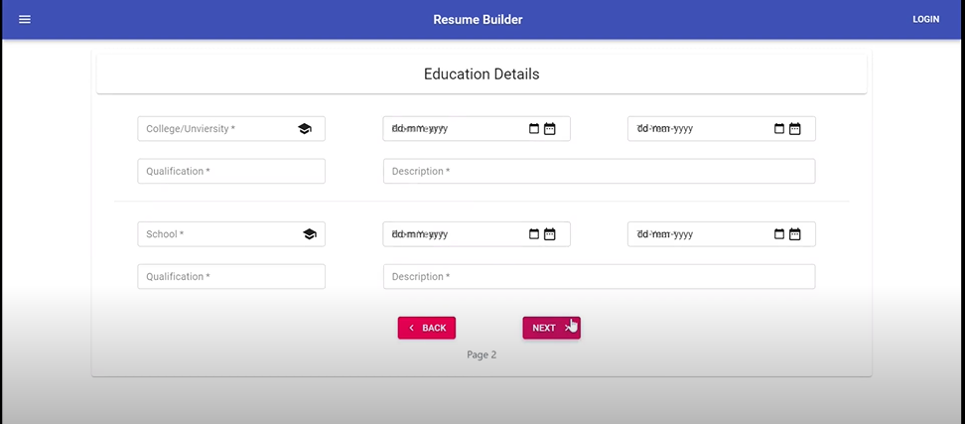
Design

Slide 7
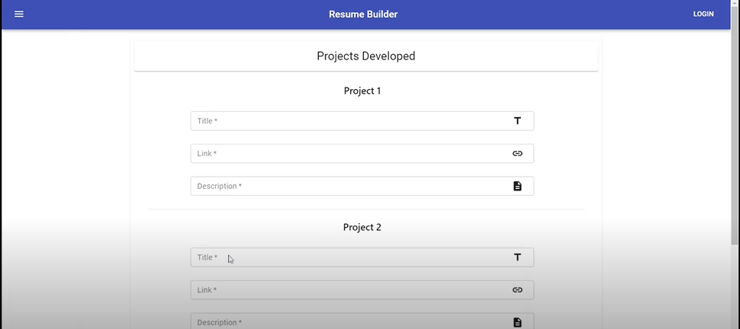
Design

Slide 8
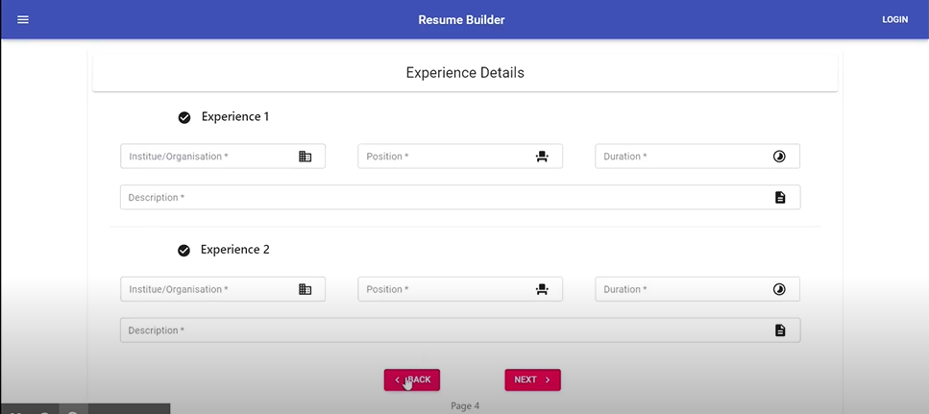
Design

Slide 9
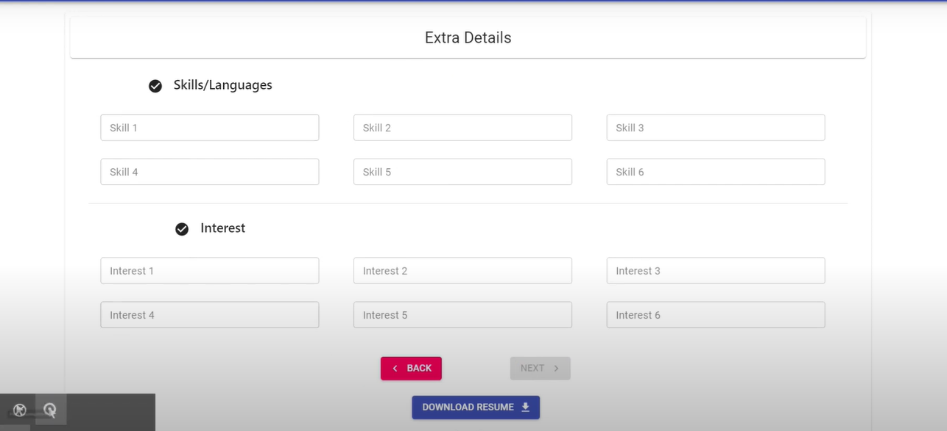
Design

Slide 10
Pavankumar M G
+91 9741347447
Pavankumar.g@testyantra.com

