Slide 1
Recurrent Neural Networks (RNN)
A beginner-friendly guide: what, why, how and where
h1
h2
h3
No prior knowledge needed

Slide 2
Main deep learning types (1/2)
ANN (Artificial Neural Network)
CNN (Convolutional)
RNN (this deck)
What: Layers of connected neurons; data flows one way, no memory.
Used for: Tabular data, simple prediction
Examples: Credit scoring, price prediction
What: Small filters slide over an image to find edges, shapes and objects.
Used for: Images and video
Examples: Face unlock, photo search, medical scans
What: A loop passes memory (hidden state) from step to step.
Used for: Text, speech, time series
Examples: Autocomplete, sensor and stock data
LSTM / GRU
Transformer
Rule of thumb
Table data → ANN
Images → CNN
Sequences → RNN / LSTM / GRU
Language at scale → Transformer
What: RNN with gates that decide what to keep or forget.
Used for: Longer sequences
Examples: Older Google Translate, forecasting
What: Self-attention looks at all words at once, in parallel, with no loop.
Used for: Language, vision, audio
Examples: Base of ChatGPT, Gemini, Claude
Trend: Transformers replaced most RNNs for large language tasks, but RNN ideas are the foundation.

Slide 3
Main deep learning types (2/2): generative and graph
GAN
Diffusion Model
What: A generator makes fakes and a discriminator judges them; both improve together.
Used for: Creating realistic data
Examples: Face generation, style transfer, data augmentation
What: Learns to remove noise step by step to create new data.
Used for: Generating images, audio, video
Examples: Stable Diffusion, Midjourney, DALL·E
Autoencoder
GNN (Graph Neural Network)
What: Squeezes input into a small code, then rebuilds it.
Used for: Compression, noise removal, anomaly detection
Examples: Fraud detection, image denoising
What: Nodes pass messages along the edges of a graph.
Used for: Data made of connections
Examples: Social networks, molecules, recommendations
Together: ANN, CNN, RNN, LSTM/GRU, Transformer, GAN, Diffusion, Autoencoder and GNN cover the main deep learning families.

Slide 4
Why do we need RNNs? Order matters!
Some data is a sequence: the order changes the meaning.
"Dog bites man"
≠
"Man bites dog"
Stock price today depends on past days
Next word in "I live in France, I speak ___"
Normal neural networks treat every input independently – they have no memory.
Sequences (text, speech, time series, music) need memory of what came before.
RNN = a network with a loop that remembers the past.

Slide 5
Normal network vs RNN
Feed-forward network
Recurrent network
Input
Hidden
Output
Input
Hidden
Output
Data flows one way. Forgets everything after each input.
The loop feeds the hidden layer's output back to itself = memory.
Key idea: current output depends on current input AND past information

Slide 6
Simple analogy: reading a sentence
When you read "The cat sat on the ___", you remember the earlier words to guess "mat".
You do not restart your thinking at every word. You carry a running summary in your head.
An RNN does exactly this: it reads one item at a time and keeps a running summary called the hidden state.
The
cat
sat
on
the
?
Memory (hidden state) travels along the arrows →

Slide 7
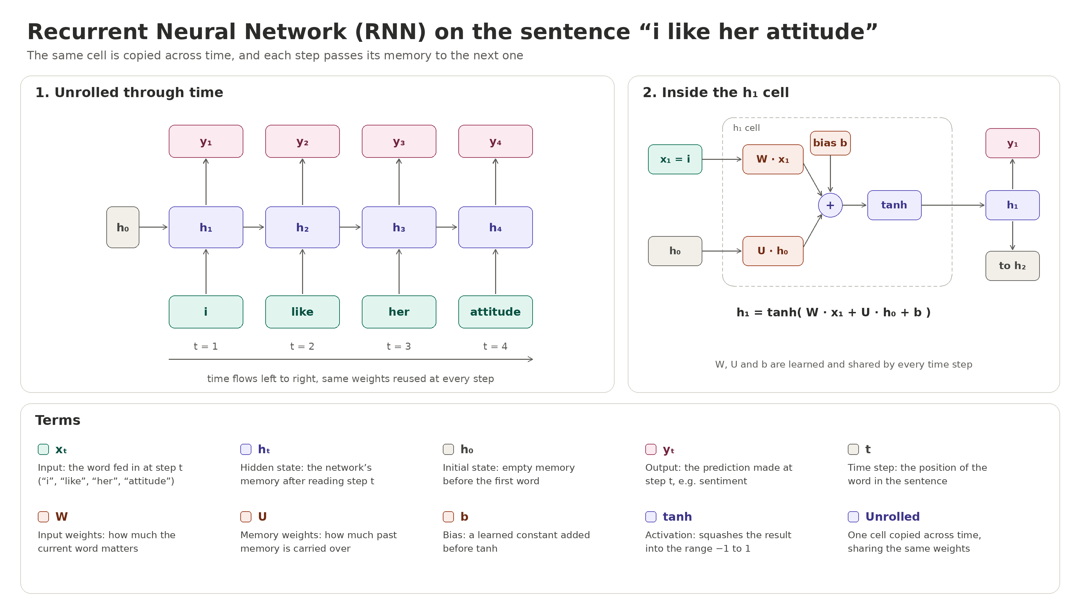

Slide 8
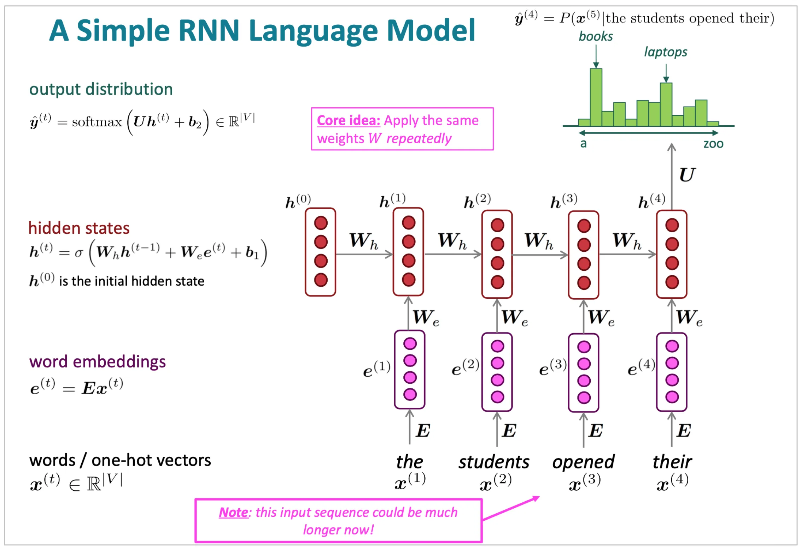

Slide 9
Inside one RNN cell
Output y = Wy·h
RNN cell
h = tanh(Wx·x + Wh·h₋₁ + b)
Previous memory h₋₁
New memory h
x = current input; h = hidden state (memory)
W = weights the network learns; b = bias
tanh squashes numbers between -1 and 1
The SAME weights are reused at every time step.
Input x (current word)

Slide 10
Unrolling the loop through time
y1
y2
y3
y4
RNN
h1
RNN
h2
RNN
h3
RNN
x1
x2
x3
x4
One cell, copied once per step. Each copy passes its memory h to the next. Same weights everywhere.

Slide 11
Step-by-step: reading "I love AI"
Step 1
Input "I". Memory is empty (zeros). Cell creates h₁ = "saw I".
Step 2
Input "love". Cell mixes "love" with h₁. h₂ = "I love…".
Step 3
Input "AI". Mixes with h₂. h₃ summarises the whole sentence → predict sentiment: Positive.
Rule at every step: new memory = f(current input + old memory)

Slide 12
Full example: sentiment analysis of a review
Goal: decide if a review is Positive or Negative. Review: "The movie was not good"
1. Raw text
2. Tokenize
3. Word → ID
4. Embedding
5. RNN reads
6. Prediction
1-3: turn words into numbers (computers only understand numbers).
4: give each word a vector that captures its meaning.
5: the RNN reads the words one by one and builds up memory.
6: an output layer converts the final memory into Positive/Negative.

Slide 13
Steps 1-4: turning text into numbers
1. Raw text
"The movie was not good!"
2. Tokens
the
movie
was
not
good
3. Word IDs
4
27
9
15
33
4. Embeddings
[0.1, -0.3]
[0.8, 0.2]
[0.0, 0.1]
[-0.9, 0.4]
[0.7, 0.9]
Tokenize: lowercase, remove punctuation, split into words.
ID: a dictionary gives every word a number (the=4, not=15).
Embedding: each ID becomes a small list of numbers (real ones use 50-300). Similar words get similar vectors; "not" and "good" get very different ones.

Slide 14
Step 5: the RNN reads word by word
Same cell each time: new memory h = tanh(W·embedding + U·old memory + b). Start: h₀ = all zeros.
h₀=0
RNN cell
h1
RNN cell
h2
RNN cell
h3
RNN cell
h4
RNN cell
h₅
"the"
"movie"
"was"
"not"
"good"
After the last word, h₅ is a summary of the WHOLE review.

Slide 15
What the memory holds after each word
h₁
the
Just a start. Neutral, no feeling yet.
h₂
movie
Topic is a movie. Still neutral.
h₃
was
An opinion is coming next.
h₄
not
Remembers a NEGATION: the next word must be flipped!
h₅
good
"good" is positive, but memory of "not" flips it: NEGATIVE.
This is why order matters: a plain word-counter sees "good" and says positive. The RNN remembers "not".

Slide 16
Step 6: prediction, error and learning
h₅
(summary)
Output layer
score = w·h₅ + b
Sigmoid
score → 0 to 1
0.08
→ Negative
Rule: probability above 0.5 = Positive, below 0.5 = Negative.
During training
After thousands of reviews
The true label is Negative (0).
Early on, the untrained RNN might output 0.70: wrong!
Loss measures the gap (big gap = big loss).
BPTT sends the error back through all 5 steps and adjusts weights.
The network learns that "not" followed by a positive word means negative.
Predictions like 0.08 appear for such reviews.
Now it works on new reviews it has never seen.

Slide 17
How does an RNN learn? (Training)
1. Feed a sequence and get predictions (forward pass).
2. Compare with the correct answer using a loss function (the error).
3. Backpropagation Through Time (BPTT): send the error backwards through every time step.
4. Adjust the shared weights slightly with gradient descent.
5. Repeat on many examples until the error is small.
Forward →
← Error flows back
Weights updated

Slide 18
The big problem: short memory
During BPTT the error is multiplied again and again across steps.
If numbers are < 1, the signal shrinks to almost 0: the vanishing gradient problem.
Result: RNN forgets things from long ago (e.g. word 1 in a 50-word sentence).
If numbers are > 1 it blows up: the exploding gradient (fixed by gradient clipping).
Signal strength fades over steps →

Slide 19
The fix: LSTM and GRU
LSTM (Long Short-Term Memory)
GRU (Gated Recurrent Unit)
Adds a separate memory lane (cell state)
Forget gate: what to throw away
Input gate: what new info to store
Output gate: what to reveal
Simpler, fewer parameters, faster
Update gate: keep old vs take new
Reset gate: how much past to ignore
Often performs as well as LSTM
Gates = small learned switches (values 0 to 1) that control what the memory keeps. Today most "RNNs" in practice are LSTMs or GRUs.

Slide 20
Types of RNN by input/output shape
One → Many
Many → One
Many → Many
out
out
out
out
out
out
out
RNN
RNN
RNN
RNN
RNN
RNN
RNN
RNN
RNN
in
in
in
in
in
in
in
Image → caption
Review → sentiment
Translation
Also: One → One is a plain network (no sequence).

Slide 21
Where do we use RNNs?
Language
Speech
Time series
Translation, chatbots, autocomplete, text generation
Voice assistants, speech-to-text
Stock, weather, sales and energy forecasting
Music & video
Health & sensors
Sentiment
Compose melodies, video captioning
ECG signals, anomaly detection
Reviews, tweets: positive or negative?
Use RNNs when: data is a sequence, order matters, and length varies.

Slide 22
Strengths and limitations
Strengths
Limitations
Handles variable-length sequences
Shares weights: fewer parameters
Remembers past context
Simple, well-understood idea
Vanishing gradients: forgets long past
Slow: steps must run one by one
Hard to train on very long sequences
Largely replaced by Transformers for big language tasks
Still great for small/medium sequence tasks, streaming data and learning the basics.

Slide 23
Summary and key terms
RNN = neural network with a loop that gives it memory.
Hidden state h carries info from step to step; weights are shared.
Unrolling shows the same cell repeated over time.
Training uses BPTT; long sequences cause vanishing gradients.
LSTM and GRU use gates to remember longer.
Best for text, speech and time-series data.
Glossary
Sequence: ordered data
Time step: one position in the sequence
Hidden state: the memory
Gradient: direction to improve weights
Gate: learned on/off switch

Slide 24
Code (1/3): prepare the data
import numpy as np
from tensorflow.keras.preprocessing.text import Tokenizer
from tensorflow.keras.preprocessing.sequence import pad_sequences
# toy reviews: 1 = positive, 0 = negative
texts = ["the movie was good", "great film loved it",
"i loved it", "the movie was not good",
"terrible boring film", "not great at all"]
labels = np.array([1, 1, 1, 0, 0, 0])
# Steps 1-3: tokenize + word -> ID
tok = Tokenizer(num_words=1000)
tok.fit_on_texts(texts)
seqs = tok.texts_to_sequences(texts)
# make all reviews the same length (pad with 0)
X = pad_sequences(seqs, maxlen=6)
Tokenizer: lowercases, splits into words and builds the word-to-ID dictionary (steps 2-3).
texts_to_sequences: "the movie was not good" becomes a list of IDs.
pad_sequences: batches need equal length, so short reviews get zeros in front.
labels: the correct answers the RNN learns from.

Slide 25
Code (2/3): build, train, predict
from tensorflow.keras import layers, models
model = models.Sequential([
layers.Embedding(1000, 16), # step 4
layers.SimpleRNN(32), # step 5
layers.Dense(1, activation="sigmoid") # step 6
])
model.compile(optimizer="adam",
loss="binary_crossentropy",
metrics=["accuracy"])
# training = forward pass + loss + BPTT
model.fit(X, labels, epochs=100, verbose=0)
# predict a review
new = pad_sequences(
tok.texts_to_sequences(["the movie was not good"]),
maxlen=6)
p = model.predict(new)[0][0]
print("Positive" if p > 0.5 else "Negative", p)
# Output example: Negative 0.08
Embedding(1000, 16): each word ID becomes 16 numbers.
SimpleRNN(32): the RNN cell with a 32-number memory h; returns the final h₅.
Dense + sigmoid: gives a probability from 0 to 1.
binary_crossentropy: the loss for two-class problems.
fit: learns the weights (uses BPTT automatically).

Slide 26
Code (3/3): how code maps to our steps
Embedding
SimpleRNN
Dense + sigmoid
Step 4: word → vector
Step 5: read words, build memory
Step 6: memory → probability
This is a toy: 6 reviews are far too few for real use. Real projects use thousands (e.g. the IMDB dataset built into Keras).
Try it: pip install tensorflow, copy both code slides into one file and run.
Upgrade: replace SimpleRNN with layers.LSTM(32) or layers.GRU(32) to remember longer reviews.
Swap sigmoid/1 output for softmax/3 outputs to predict Positive, Neutral, Negative.

