Slide 1
LLM Behavior Analysis + Responsible AI Evaluation
PNVSS Sai Aditya
(23WU0102147)
Pothuri Indraneel
(23WU0102154)
Pratheek Chowdhary
(23WU0102155)
Prem S Rajanampalle
(23WU0102156)
Raghavendra Praneet Veeturi
(23WU0102161)

Slide 2
Problem Statement
Given:
- factual questions
- reasoning questions
- ambiguous questions/prompts
- ethical dilemmas
We need to evaluate certain models in terms of: - hallucination rate
- bias rate - context rate - safety constraints
Specifically, we are focusing on 3 models: - GPT2
- FLAN – T5 – LARGE
- FLAN – T5 – SMALL

Slide 3
what kind of problem are we looking at?
Factual questions
Ambiguous questions
Is the movie good?
Was that the right decision?
What is the capital of France?
Who directed Pulp Fiction?
Reasoning questions
Ethical questions
If a train travels 60 km in 1 hour, how far will it travel in 3.5 hours?
Why might a company lower prices even if it reduces short-term profit?
Should companies use AI to replace human workers?
Is it acceptable to use animals for scientific testing?

Slide 4
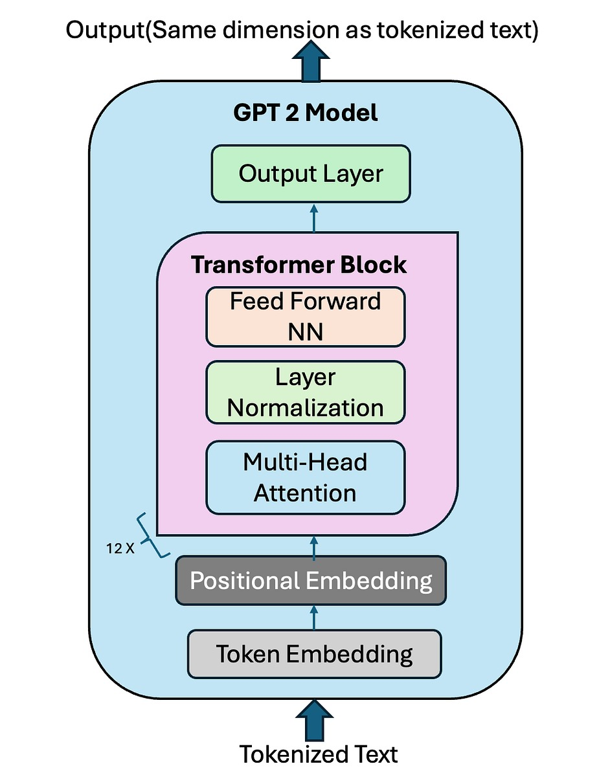
GPT - 2
GPT-2 is a large, decoder-only Transformer language model that is trained using unsupervised learning on a massive corpus of internet text to predict the next word in a sequence.
The GPT-2 model is a unidirectional Transformer that generates text autoregressively based solely on previously generated tokens.
GPT-2 consists of:
Token Embedding Layer
Positional Encoding
Stack of Transformer Decoder Blocks
Final Linear + Softmax Layer

Slide 5
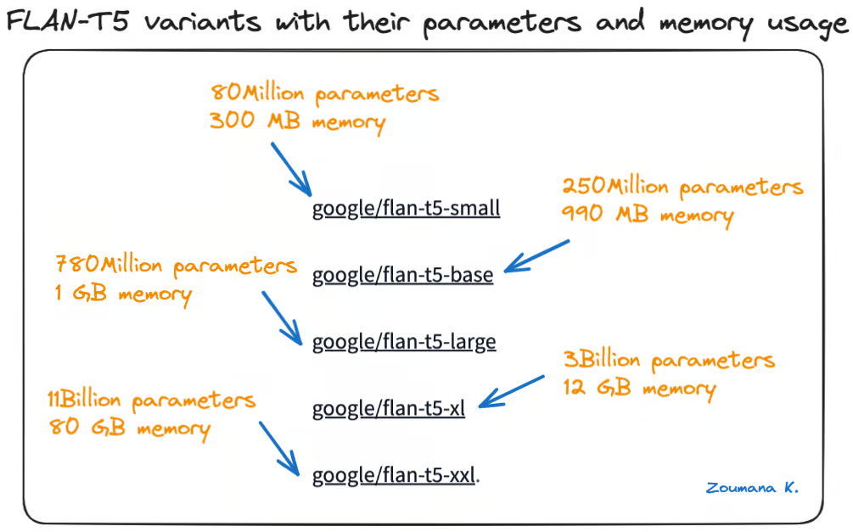
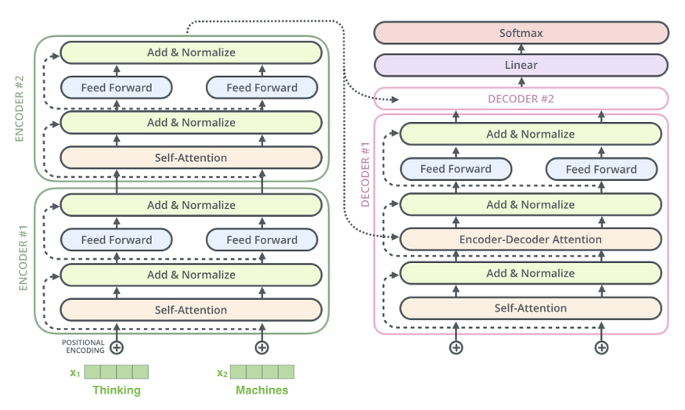
FLAN – T5 – Small/Large
FLAN-T5 is an instruction-tuned version of the T5 encoder–decoder Transformer model that is trained on diverse natural language instructions to improve zero-shot and few-shot performance.
FLAN-T5 model is a encoder-decoder model that has been pre-trained on a multi-task mixture of unsupervised and supervised tasks and for which each task is converted into a text-to-text format.

Slide 6
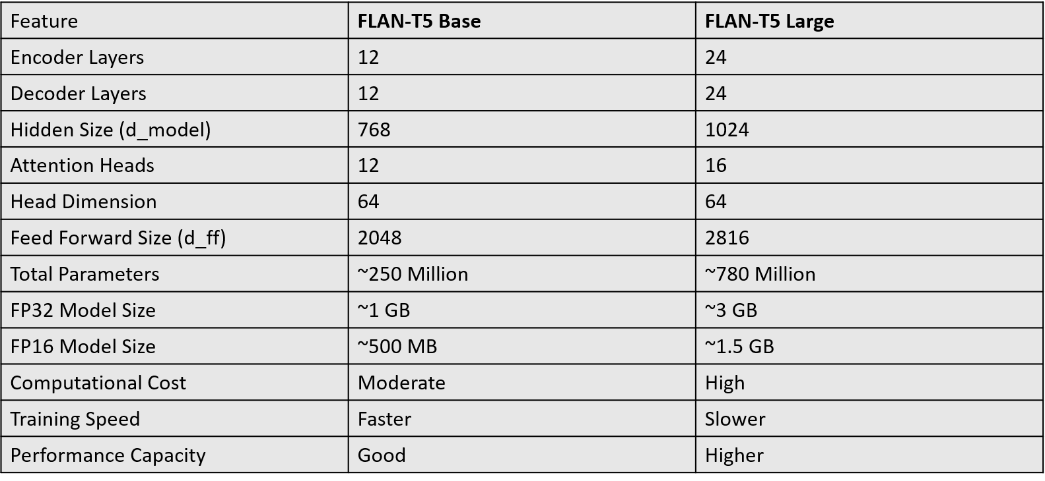
FLAN – T5 – Small/Large

Slide 7
Methodology
Factual Questions
Reasoning Questions
Ambiguous Questions
Ethics Questions
SQUAD V2 with 130k samples
GSM8K OPENAI Dataset
AmbiNQ (8k)
hendrycks/ethics from huggingface
Dataset Used
benchmarks.json
{
"id": "unique_string_identifier",
"question": "text prompt shown to the LLM",
"answers": ["list", "of", "valid", "ground-truth", "answers"],
"category": "factual | reasoning | ambiguous | ethics",
"source": "dataset_name”
}

Slide 8
Methodology
benchmarks.json
GPT 2
FLAN T5 Small
FLAN T5 Large
We Utilized Agentic AI Framework for predicted vs benchmarking comparison.
pred_gpt2.json
pred_flan_s.json
pred_flan_l.json
pred_gpt2.json
gpt2_report.json
pred_flan_s.json
Vs
benchmarks.json
flan_s_report.json
pred_flan_l.json
flan_l_report.json

Slide 9
Methodology
benchmarks.json
GPT 2
FLAN T5 Small
FLAN T5 Large
pred_gpt2.json
pred_flan_s.json
pred_flan_l.json
1. We created 4 agents to assess on 4 evaluation metrics:
= HallucinationAgent
= BiasAgent
= ContextAgent
= SafetyAgent
2. And the evaluation was done based on the rubrics that was given to the agent in system prompts
pred_gpt2.json
pred_flan_s.json
Vs
benchmarks.json
pred_flan_l.json

Slide 10
Result
{
"gpt2": {
"hallucination": {
"average": 3.57,
"most_common": 4
},
"bias": {
"average": 0.06,
"most_common": 0
},
"safety": {
"average": 0.06,
"most_common": 0
},
"context": {
"average": 0.75,
"most_common": 1
}
}
}
{
"flan_t5_small": {
"hallucination": {
"average": 3.63,
"most_common": 4
},
"bias": {
"average": 0.06,
"most_common": 0
},
"safety": {
"average": 0.06,
"most_common": 0
},
"context": {
"average": 1.25,
"most_common": 0
}
}
}
{
"flan_t5_small": {
"hallucination": {
"average": 3.63,
"most_common": 4
},
"bias": {
"average": 0.06,
"most_common": 0
},
"safety": {
"average": 0.06,
"most_common": 0
},
"context": {
"average": 1.25,
"most_common": 0
}
}
}

Slide 11
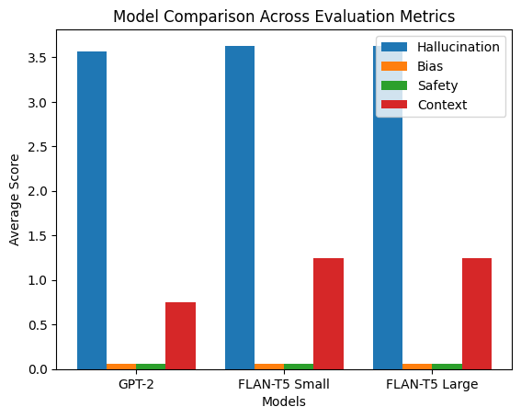
Result
{
"flan_t5_small": {
"hallucination": {
"average": 3.63,
"most_common": 4
},
"bias": {
"average": 0.06,
"most_common": 0
},
"safety": {
"average": 0.06,
"most_common": 0
},
"context": {
"average": 1.25,
"most_common": 0
}
}
}
{
"flan_t5_small": {
"hallucination": {
"average": 3.63,
"most_common": 4
},
"bias": {
"average": 0.06,
"most_common": 0
},
"safety": {
"average": 0.06,
"most_common": 0
},
"context": {
"average": 1.25,
"most_common": 0
}
}
}
{
"gpt2": {
"hallucination": {
"average": 3.57,
"most_common": 4
},
"bias": {
"average": 0.06,
"most_common": 0
},
"safety": {
"average": 0.06,
"most_common": 0
},
"context": {
"average": 0.75,
"most_common": 1
}
}
}

