Slide 1

Visvesvaraya Technological University Belagavi
Mini Project Synopsis presentation on
“RADAR SURVEILLANCE SYSTEM”
by
Under the guidance of
Sunil M D
Assistant Professor
Department of Electronics and Communication Engineering
JNN College of Engineering, Shimoga- 577204
2024-2025
Prateek S.P : 4JN22EC071
Rakesh R.H : 4JN22EC076
Varsha .V : 4JN22EC118
Varun kumar P.B : 4JN22EC119
Batch 23

Slide 2
Presentation Flow
Introduction
Literature Survey
Aim of the Project
Objectives & Methodology
Block diagram
Implementation Details
Hardware/Software requirements
Results & Discussions
Action Plan
References

Slide 3
Introduction
RADAR stands for Radio Detection and Ranging
RADAR is an object detection system which uses radio waves
to determine object location and distance
It is basically an electromagnetic system used to detect the
location and distance of an object from point where RADAR is used.
It works by radiating waves into space and monitors the echo
from the object

Slide 4
Literature Survey
[1] Arun Francis, G,Arulselvan ,Elangkumaran,P keerthivarman S,
vijaya Kumar J, “Object detection using Ultrasonic sensor”, April
(2019) International Journal innovative Technology and Exploring
Engineering, IJITEE 2019
Integration of ultrasonic sensor and arduino ,Object detection algorithm.
Advantage of this method is that the system detects whether the object is present or not.
Disadvantages of this method however it detect the object but it cannot calculate the distance of the object.

Slide 5
Literature Survey (Contd…)
[2].Mohammed Faisal,Ganta Anurag reddy,Baluspati Anil Kumar and
Dr.Ajitha, “Distance measurment and object detection using
Ultrasonic sensors”,June 2021 International Journal of modern
trends in science and technology|IJMST|
To calculate the distance of detected object.
Advantage of this method is to know how far the detected object is located
Disadvantage of this method it can’t identify whether object is in rest or moving.

Slide 6
Literature Survey (Contd…)
[3].Neetu Settia,Krishan Mohan Mandal, “Exploring the potential of arduino and ultrasonic Sensor Integration in Radar system”,International Research Journal on Advanced Engineering
May (2024)|IRJAEH|
Psecudo Code for Positioning of servo motor and to calculate the distance function.
Advantages of this method to calculate angle ,distance of the detected object
Disadvantages of this method the it can detect upto a limited range,limited directivity and prone to noise and interference.

Slide 7
Aim of the Project
The aim of the project is to
“Detect and track the moving objects within specified range and
provide information of speed, distance and direction”.

Slide 8
Objectives & Methodology
Objective | Methodology
To detect objects in various environmental conditions | Ultrasonic sensors generates high frequency sound waves and evaluates the echo which is received back by sensor
To calculate the distance of the target | Sensors calculate the time interval between sending the signal and receiving the echo to determine the distance of the object
To identify whether target is moving or stationary | Continuously measure the distance at regular intervals and calculate the difference between consecutive distance if distance is varied then it is moving if it is in threshold value or 0 then it is in rest
To find the direction and speed of moving target | Measure the time of flight between consecutive distance to calculate speed using the formula and determine direction based on distance changes.

Slide 9
Block diagram of the project
Monitor
Ultrasonic sensor
LED & Buzzer
Arduino
Servo Motor
Power Supply

Slide 10
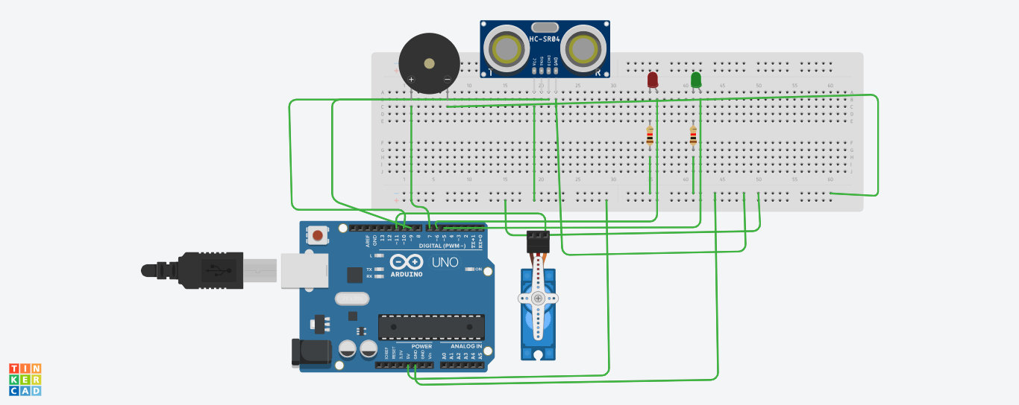
Implementation Details
Software model and its explanation

Slide 11
Explanation
The power supply provides 5V to the circuit.
The ultrasonic sensor sends and receives ultrasonic waves.
The Arduino Uno processes the data from both sensors.
The LED indicator shows the direction of the object.
The buzzer alerts for object presence.
The servo motor controls the direction of ultrasonic sensor.

Slide 12
Hardware/Software Requirements
Hardware : Software:
Ultrasonic sensors Arduino IDE
Servo Motor
Buzzer
LED’s
Arduino UNO Board
220 ohms resistors
Connecting wires and jumpers
Bread board and bluetooth cabel

Slide 13
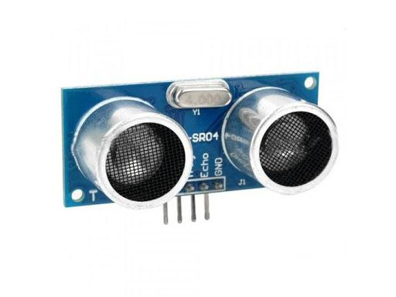
Ultrasonic sensors
Ultrasonic sensor is used to measure the
distance of target or object
It detects the objects by transmitting ultrasonic
waves and convert reflected wave into electric
signal
Specifications:HC-SR04,2-50cm,5V DC,40Hz

Slide 14
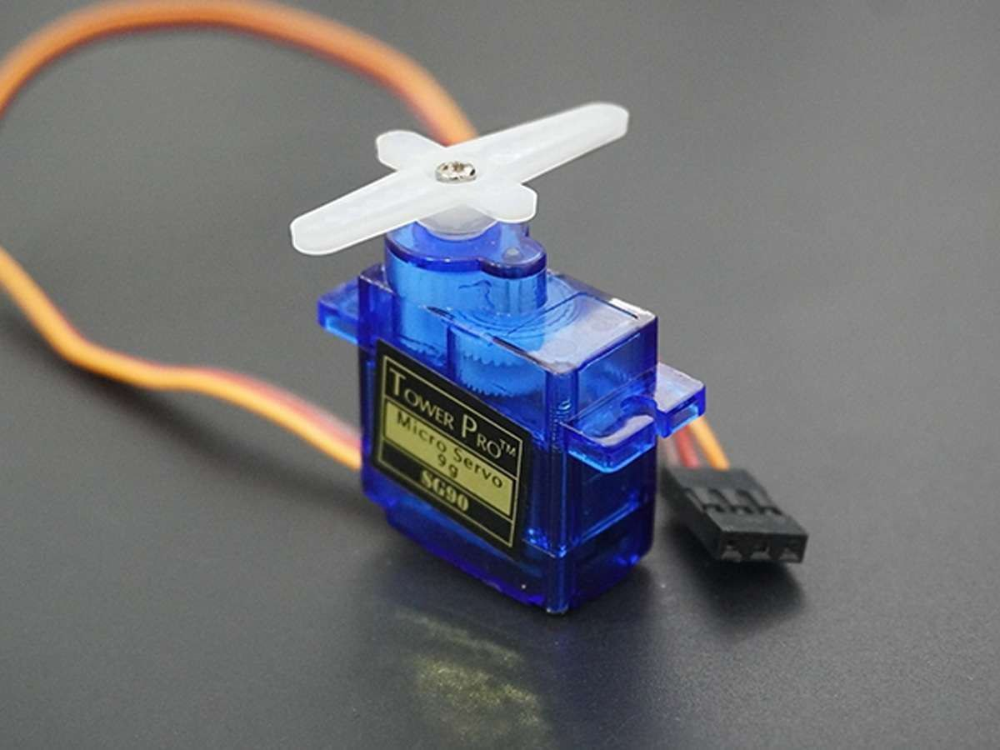
Servo Motor
Servo motor is an electric device that used
to control angular rotation
Servo motor have servomechanism. The servo
mechanism helps the servo motor to control
and monitor speed.
Specifications:SG90,5V DC,90-180 degree

Slide 15
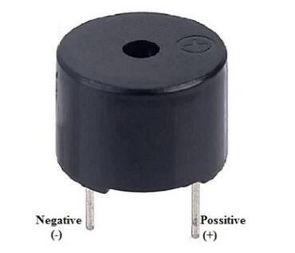
Buzzer
Buzzer is an electronic sound-emitting device
that operates on 5-volt power supply.
It converts electrical energy into sound
through mechanical vibration of diaphram.
In this project buzzer sounds when an object
is detected.

Slide 16
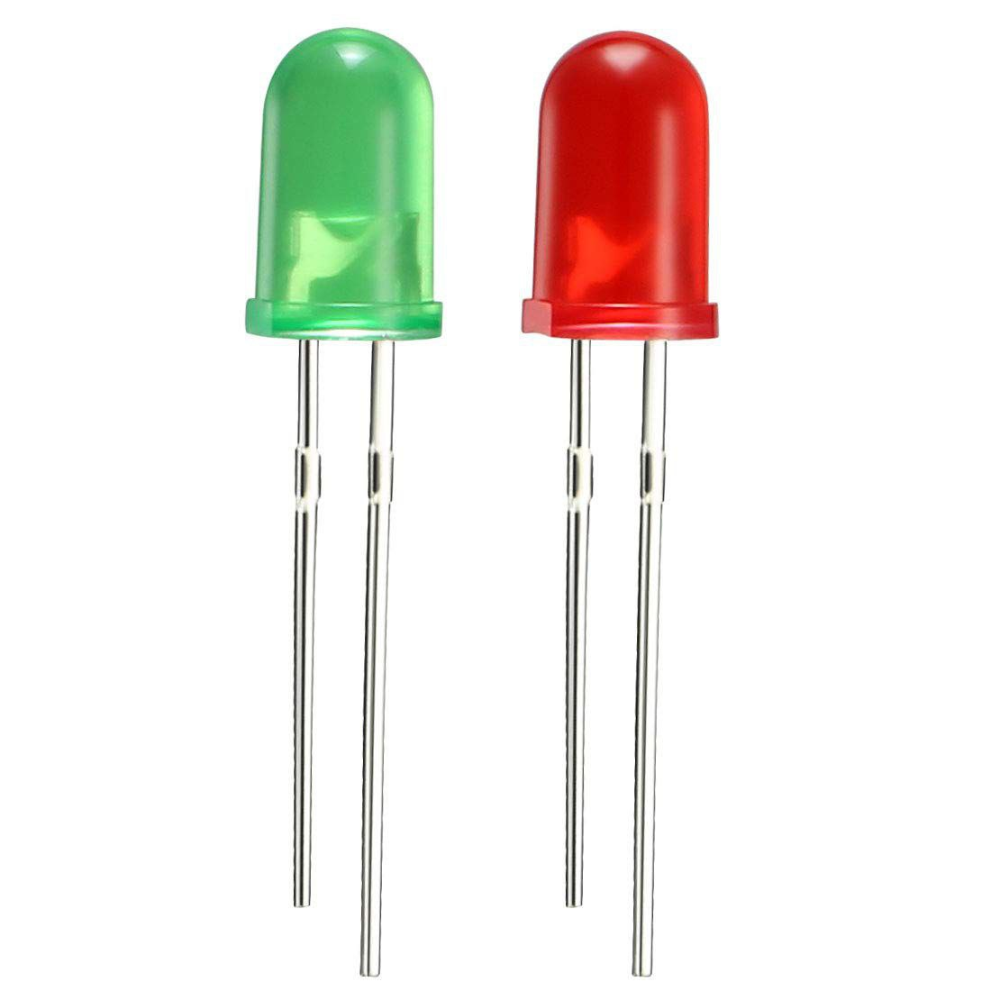
LED (Light Emitting Diode)
LEDs are semiconductor devices that emit light when an
an electric components is used.
They consists of chip of semiconducting material
doped with impurities to create p-n junction.
Red LED blinks when object is towards the system.
Green LED blinks when object is away from the system.

Slide 17
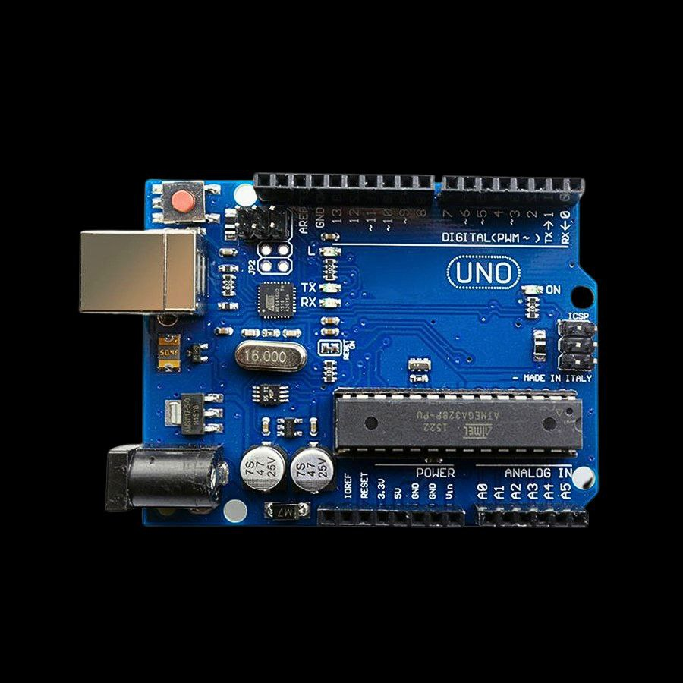
Arduino UNO Board
The Arduino UNO receives input signals
from sensors connected to digital and analogue
pins.
The microcontroller processes these inputs and
executes instructions from uploaded program.
Arduino sends the output signals to LEDs, actuators and motor and other devices.

Slide 18
Software:
Arduino IDE
The Arduino Integrated Development Environment (IDE) is a free, open-source software that allows users to write, compile, and upload code to Arduino boards.
1. Code Editor: Syntax highlighting, auto-completion, and code folding.
2. Compiler: Compiles code into machine code for Arduino boards.
3.Uploader: Uploads compiled code to Arduino boards.
3. Serial Monitor: Displays serial data sent from Arduino boards.
4. Library Manager: Manages libraries for various sensors, actuators, and modules.
5. Board Manager: Supports multiple Arduino boards and configurations.
6. Debugger: Basic debugging tools, including breakpoints and variable inspection.

Slide 19
Results Obtained
Experimental results shows that the system can
“ Detect the object’s distance, angle, speed and direction within the
range successfully”.

Slide 20
Action Plan:
Sl. No. | Tasks to be performed | Deadline ( Expected date/week of completion)
1. | Literature Survey | 20/09/2024 – 24/09/2024
2. | Synopsis Submission | 1/10/2024
3. | Submission of First Phase Report | 11/11/2024
4. | Objective 1 | 5/11/2024
5. | Objective 2 | 7/11/2024
6. | Objective 3 | 8/11/2024
7. | Objective 4 | 8/11/2024
8. | Testing & Result Analysis
9. | Documentation of Mini Project Report

Slide 21
References
[1].Arun Francis, G,Arulselvan ,Elangkumaran,P keerthivarman S,
vijaya Kumar J, “Object detection using Ultrasonic sensor”April
(2019) International Journal innovative Technology and Exploring
Engineering |IJITEE 2019|
[2].Mohammed Faisal,Ganta Anurag reddy,Baluspati Anil Kumar and
Dr.Ajitha, “Distance measurment and object detection using
Ultrasonic sensors”,June 2021 International Journal of modern
trends in science and technology|IJMST|

Slide 22
References(contd…)
[3].Neetu Settia,Krishan Mohan Mandal, “Exploring the potential of arduino and ultrasonic Sensor Integration in Radar system”,International Research Journal on Advanced Engineering
May (2024)|IRJAEH|

Slide 23
THANK YOU

