Slide 1

WIPRO NGA Program – 25SUB4530_CP_JAVA
Capstone Project Presentation – 9th Feb & 10th Feb 2026
Expense Tracker Application
Presented by :-
Prem Kumar R (58670)
Pratheep P (57168)
Team Number : 15
www.rpsconsulting.in

Slide 2

Problem Statement
Users struggle to track expenses across personal/organizational needs.
No easy way to categorize (Food, Travel, Utilities), filter by date, or visualize patterns.
Manual tracking leads to overspending and poor financial insights.
2024 - RPS Consulting all rights reserved
Notes:
This app solves real daily pain points.

Slide 3

Project Goals
Efficiently track and manage expense entries.
Provide clear visibility into spending habits via summaries and filters.
Support real-time updates, charts, and analysis for better decisions.
2024 - RPS Consulting all rights reserved
Notes:
Ties to core objectives from project description.

Slide 4
Core Functionalities
Add, edit, delete expenses along with their categories (Food, Travel, etc.).
Filter by date range and category.
Calculate totals and generate spending summaries.
Interactive dashboard with charts (Chart.js).
2024 - RPS Consulting all rights reserved
Notes:
Demo quick add/filter live if possible.

Slide 5



Technology Stack - Frontend
Frontend
Angular
Styling: Vanilla CSS
Data Viz: Chart.js
Backend
Spring Boot
ORM: Spring Data JPA
DB: MySQL.
Deployment
Docker: Containerized deployment for consistency.
Azure App Service: Cloud hosting for scalability.
Azure Static Webapp: Frontend hosting
2024 - RPS Consulting all rights reserved
Notes:
Independent frontend dev with mocks.

Slide 6
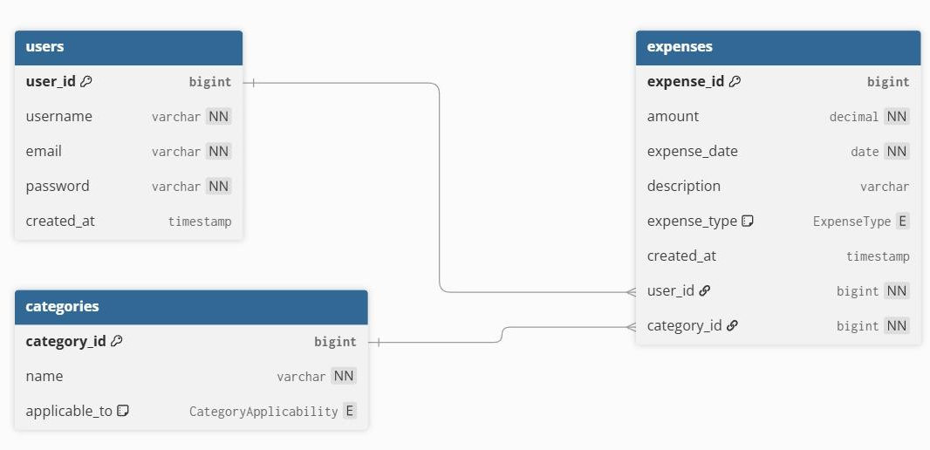
Entity Relationship Diagram
2024 - RPS Consulting all rights reserved
Notes:
Production-ready from day one.

Slide 7

Key Workflows
Authentication
User submits credentials on Login page.
Auth Service sends the POST request to http://<port>/auth/login.
On success, user data is stored in localStorage and BehaviorSubject.
User is redirected to Dashboard.
2024 - RPS Consulting all rights reserved
Notes:
Seamless user experience.

Slide 8
Key Workflows
2) Expense Management
View: DashboardComponent fetches expenses via ExpenseService.getAllExpenses().
Add: User clicks "Add Expense", navigates to expense/add.
Edit: User selects an expense, navigates to expense/edit/:id.
ExpenseService fetches the specific expense to pre-fill the form.
Delete: User deletes an expense, ExpenseService sends DELETE request and updates the local list/view.
2024 - RPS Consulting all rights reserved
Notes:
Seamless user experience.

Slide 9
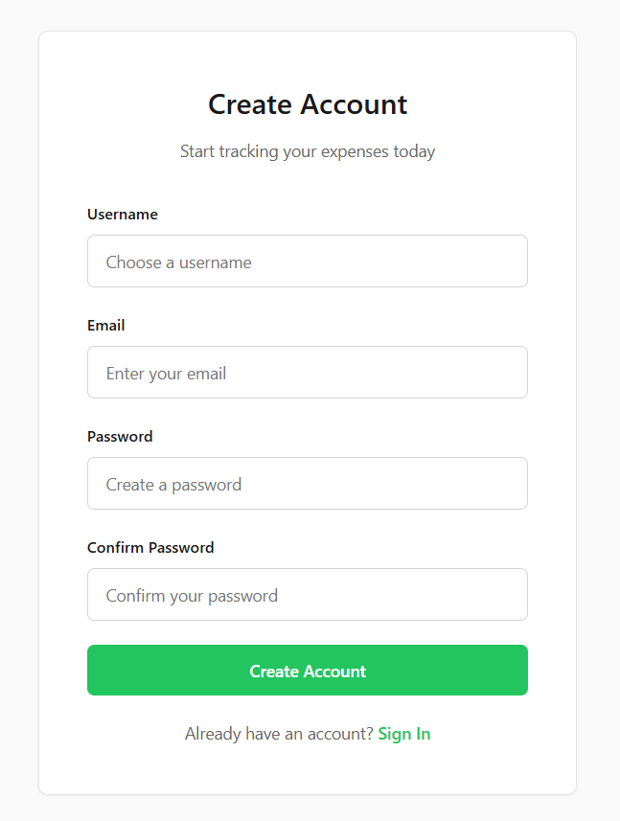
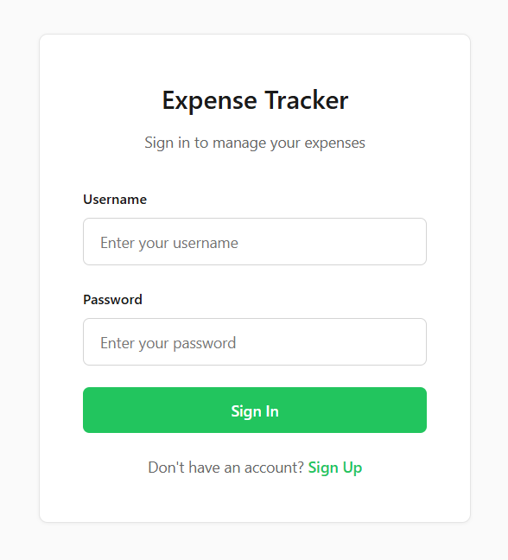
Demo Screenshots
Notes:
Pause for live demo if time allows.

Slide 10
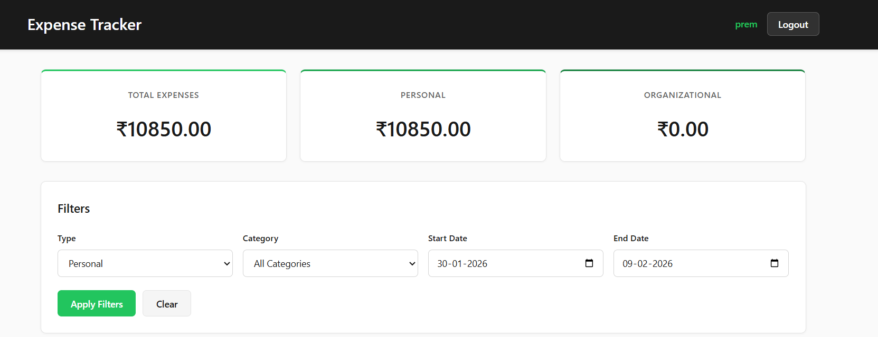
Demo Screenshots
Notes:
Pause for live demo if time allows.

Slide 11
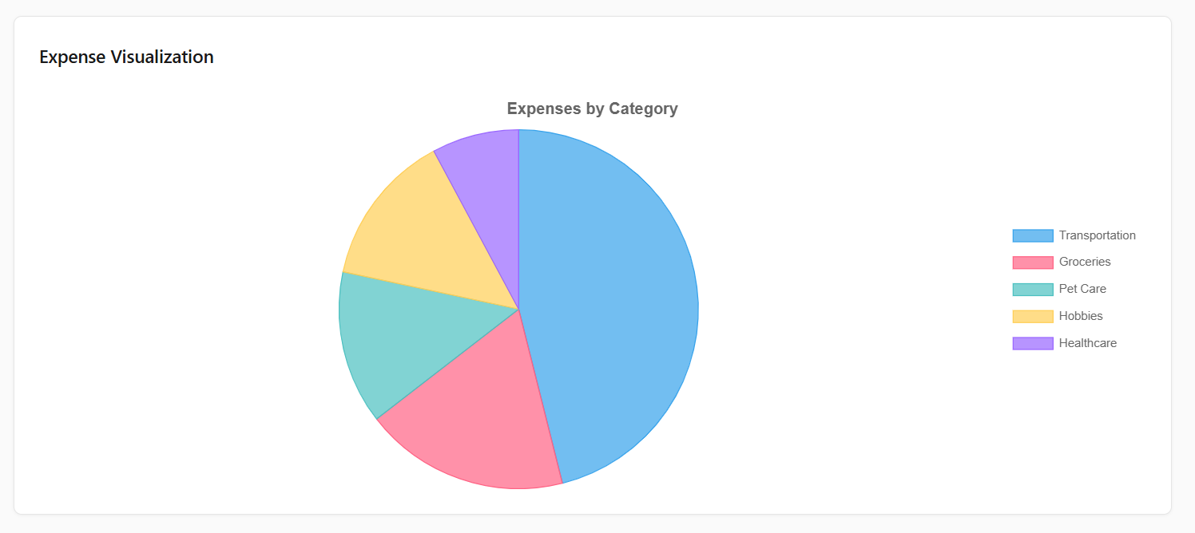
Demo Screenshots
Notes:
Pause for live demo if time allows.

Slide 12
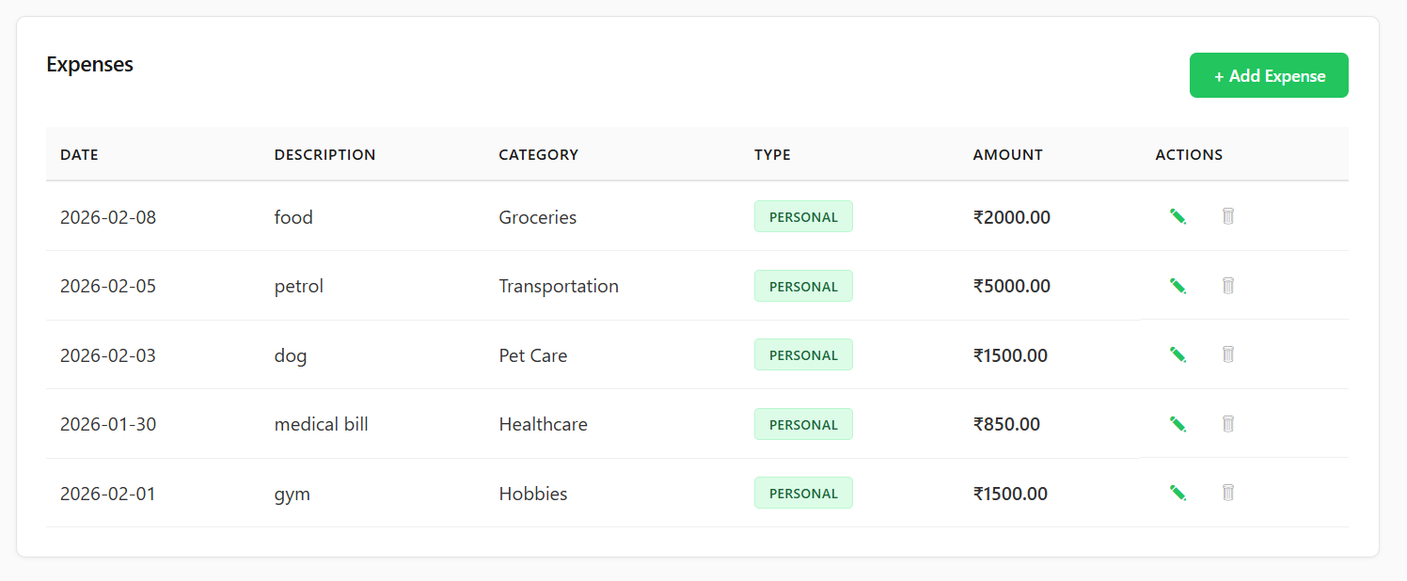
Demo Screenshots
Notes:
Pause for live demo if time allows.

Slide 13
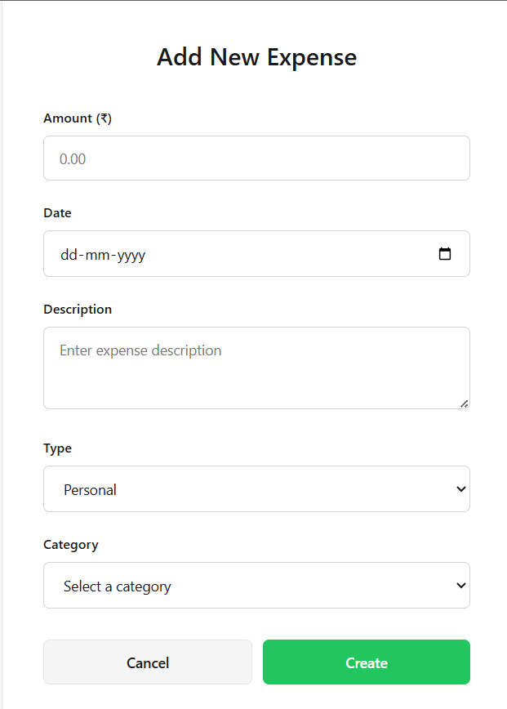
Demo Screenshots
Notes:
Pause for live demo if time allows.

Slide 14
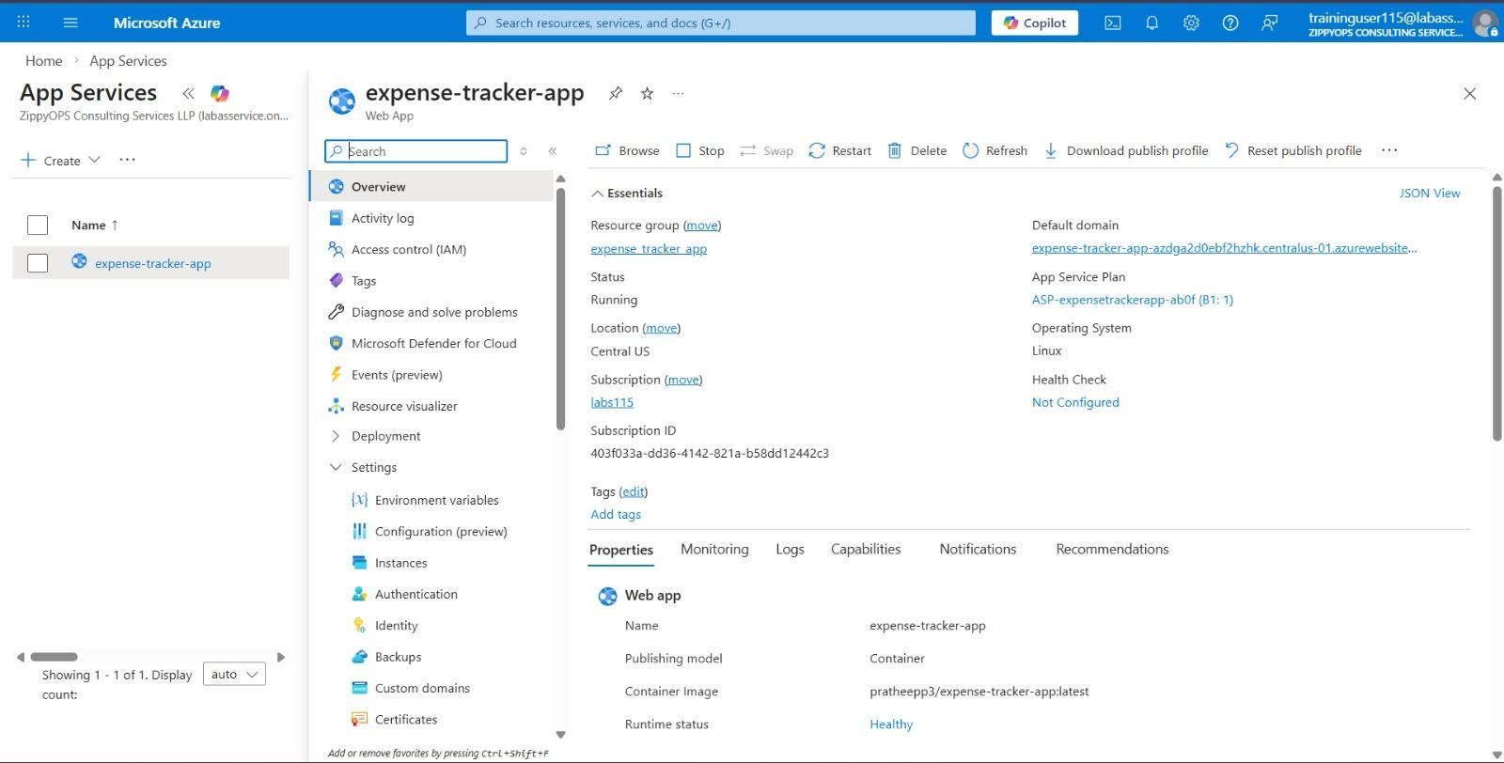
Backend Deployment
Notes:
Pause for live demo if time allows.

Slide 15
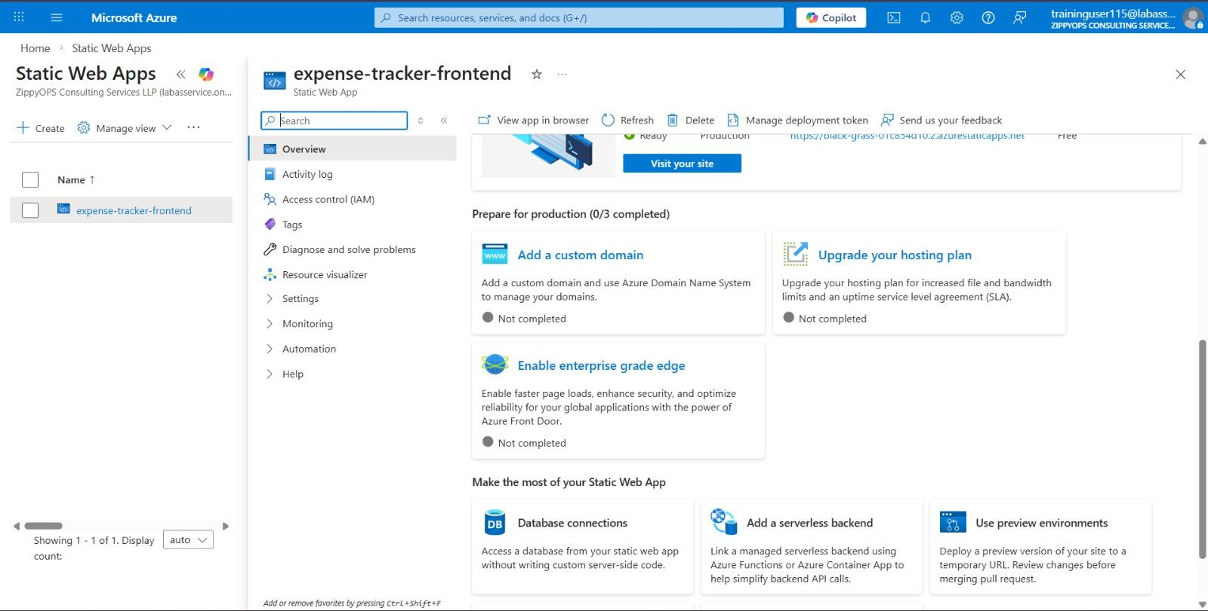
Frontend Deployment
Notes:
Pause for live demo if time allows.

Slide 16
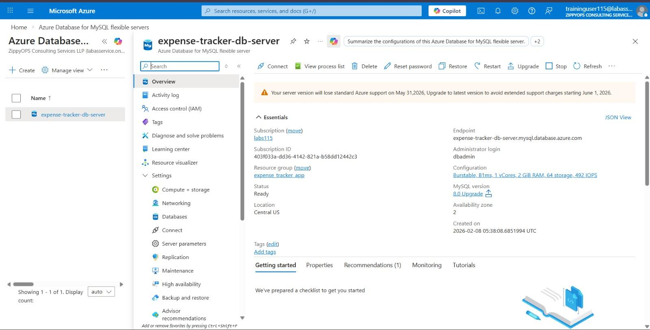
Database
Notes:
Pause for live demo if time allows.

Slide 17

Conclusion
Delivered: Full-stack expense tracking with modern stack and DevOps.
Impact: Empowers users with spending insights.
2024 - RPS Consulting all rights reserved
Notes:
Open floor.

Slide 18
THANK YOU
2024 - RPS Consulting all rights reserved
Notes:
Open floor.

