Slide 1

Customer Lifetime Value Prediction for the Auto Insurance

Slide 2
Synopsis
Insurance is a practice or arrangement by which company or government agency provides a guarantee of compensation for specified loss, damage, illness or death in return for the payment of a premium.
Motor insurance / auto insurance is insurance purchased for cars, trucks, and other road vehicles. Its primary objective is to provide protection against physical damage.
CLV shows which customers will offer the highest value in the future, which can identify the core attributes insurers should look for in current customers and prospects.

Slide 3
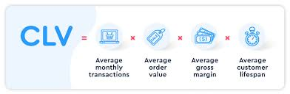
What is CLV?
Customer lifetime value (CLV) can be defined as the net present value of cash flow (past and future) attributed to a customer or household for a designated time period.
In simple words, CLV is the difference betIen the total premium revenue received and total expenses over the course of the relationship. In many cases, this may be greater than 20 years.

Slide 4
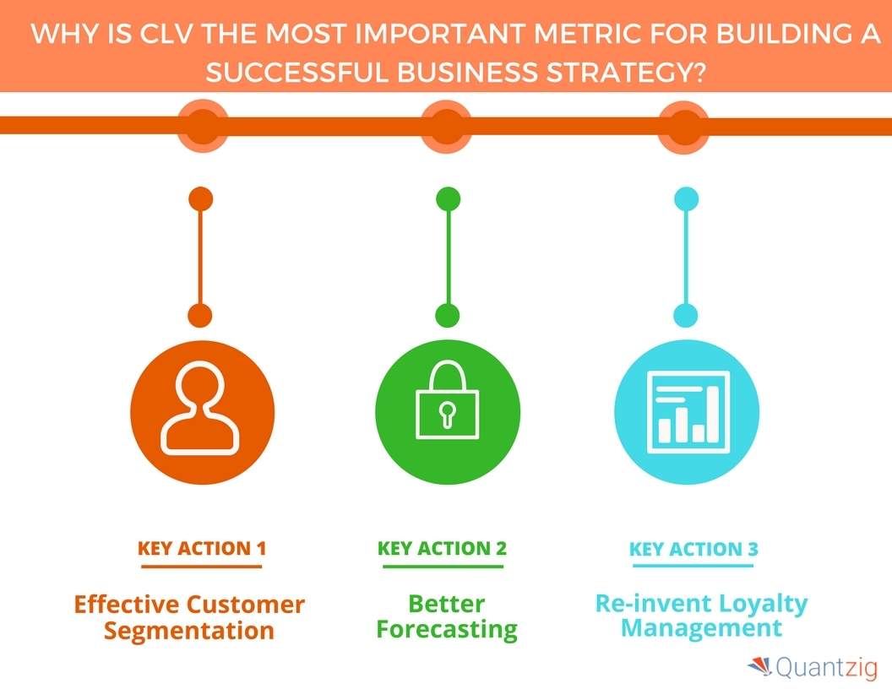
Why CLV is an important metric?

Slide 5
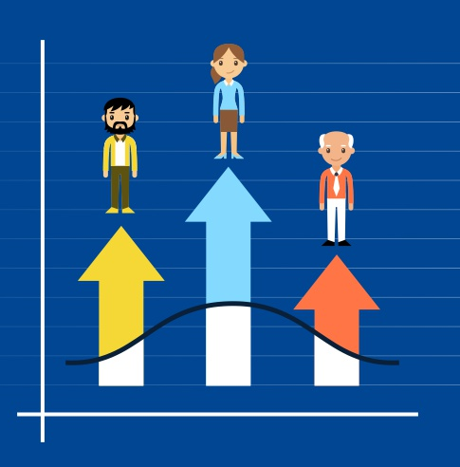
Problem Statement:
Business wants to identify the customers who will give the highest revenue for them by having a long term relationship with the company.
Business has provided one year data with multiple factors which provides information of the customers and the target feature as customer’s life time value (CLV) which in turns helps to calculate the overall revenue that a company generates through customers.

Slide 6

Information about dataset
This dataset is an IIT Kharaghpur hackathon dataset
This Dataset contains 9314 rows and 24 features.
Out of the 24 features ,there are 8 continuous variables and 16 categorical features.

Slide 7
Data Dictionary
Feature | Explanation | Data types
Customer | Unique customer ID | Object
State | US province to where the customer belongs to | Categorical
Response | Refers to whether customers have responded to marketing calls or not | Categorical
Coverage | Nature of insurance coverage | Categorical
Education | Education level of customer | Categorical
Effective To Date | Expiry date of policy | object
Gender | Gender of the customer | Categorical
Employment Status | Current Employment status of the customer | Categorical

Slide 8
Data Dictionary
Features | Explanation | Datatype
Income | Customer annual income in USD | Continuous
Location Code | Type of location where customer lives | Categorical
Marital Status | Marital status of the customer | Categorical
Vehicle Size | Size of vehicle | Categorical
Vehicle Class | Type of vehicle | Categorical
Sales Channel | Channel of sales | Categorical
Renew Offer Type | Offer given during renewal | Categorical
Total Claim Amount | Amount claimed till date | Continuous

Slide 9
Data Dictionary
Feature | Explanation | Datatype
Monthly Premium Auto | Monthly premium for auto insurance | Continuous
Months Since Last Claim | No. of months before which the last claim was made | Continuous
Months Since Policy Inception | No. of months before which the policy commenced | Continuous
Number of Open Complaints | No. of unresolved complaints from the customer | Continuous
Number of Policies | No. of policies with the current customer | Continuous
Policy Type | Type of policy | Categorical
Policy | Policy sub category | Categorical
Customer Life Time Value | CLV of the customer for the auto insurance company | Continuous

Slide 10
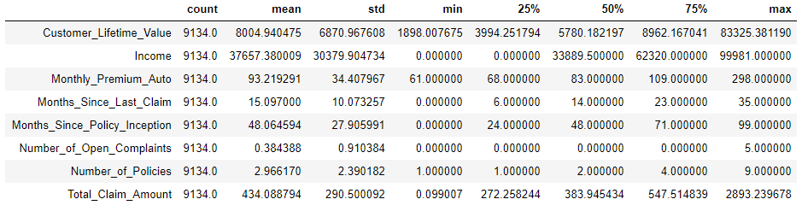
Descriptive Statistics

Slide 11
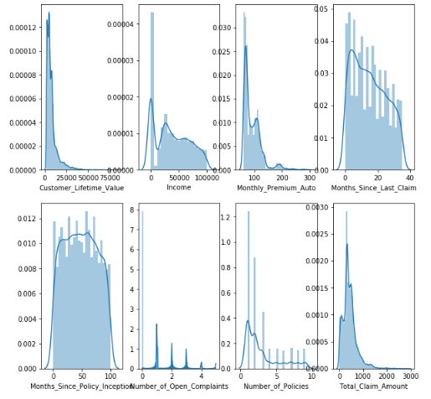
Skewness:
Most of the continuous Features are generally right or positively skeId.

Slide 12
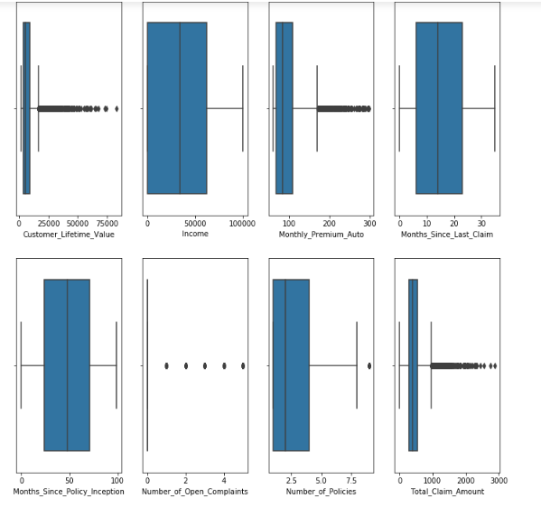
Outliers are also present in independent variables. these are important variables related to Auto – Insurance domain I are not treating them.
Outliers :

Slide 13
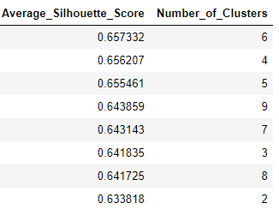
Converting CLV into bins
I have created bins for the CLV feature for better understanding of the data through visualization.
To find the number of clusters approximately, I have performed Average Silhouette analysis.
Since Average Silhouette score is high for 6 number of clusters. I have divided total data into 6 Bins.

Slide 14
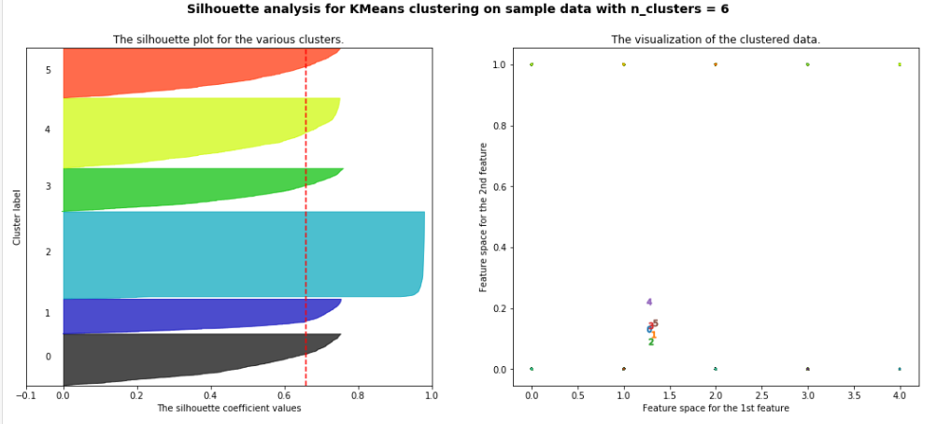
Silhouette Analysis

Slide 15
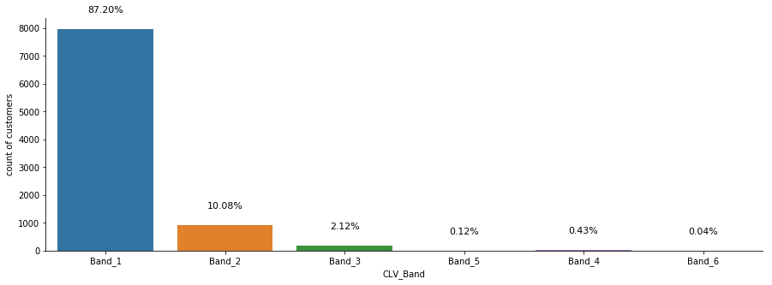
Converting CLV into bins:
The Bins can be fixed as 6 and I will divide the data to 6 bins.
The graph shows that around 87% of the customer's CLV comes under Band 1

Slide 16
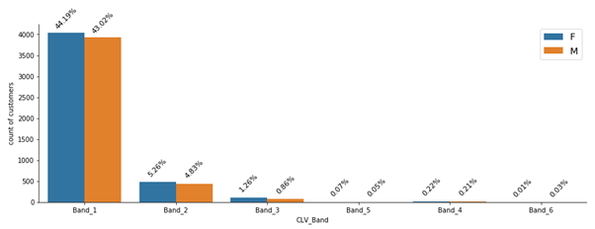
CLV Analysis on Gender

Slide 17
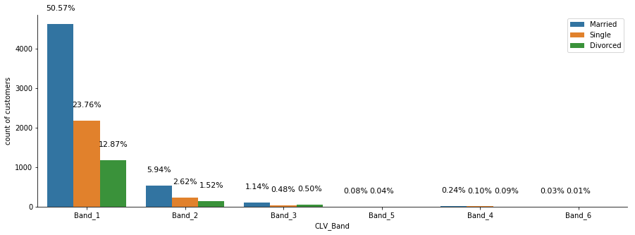
Univariate analysis on CLV
There are more than 50% of the customers who are married comes under Band 1

Slide 18
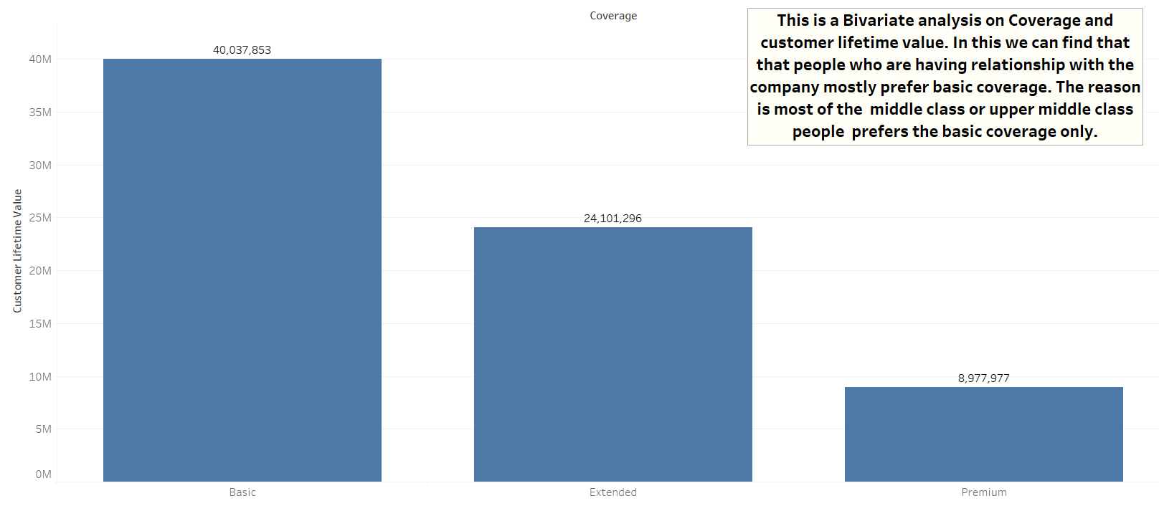
CLV vs Coverage :

Slide 19
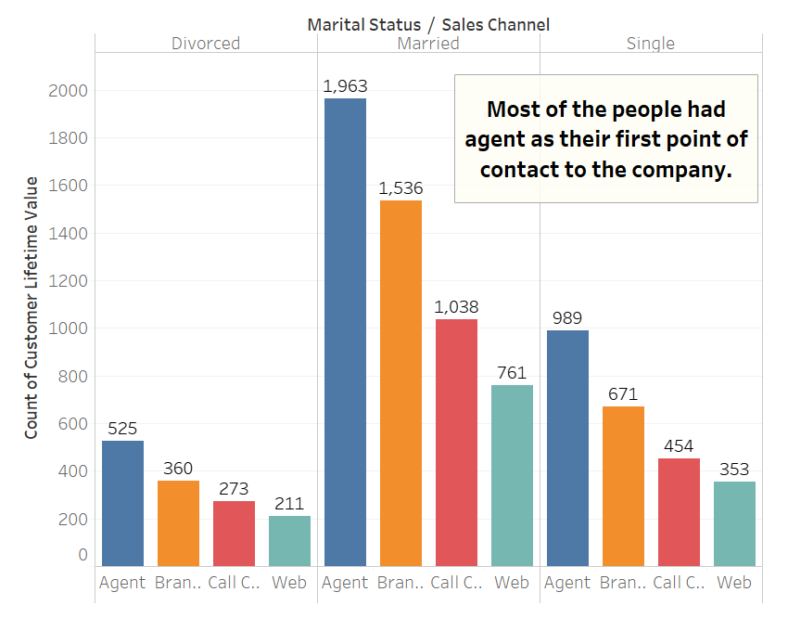
EDA-CLV vs Sales Channel

Slide 20
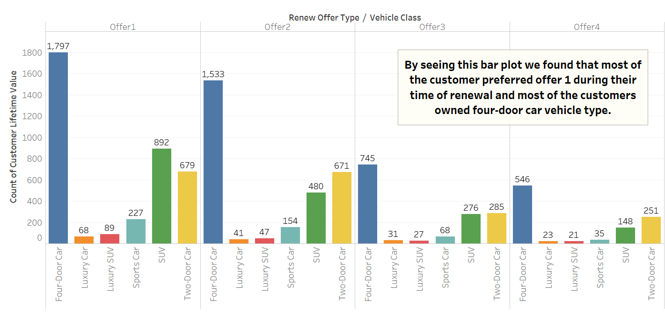
EDA – CLV vs Vehicle type & Offer type

Slide 21
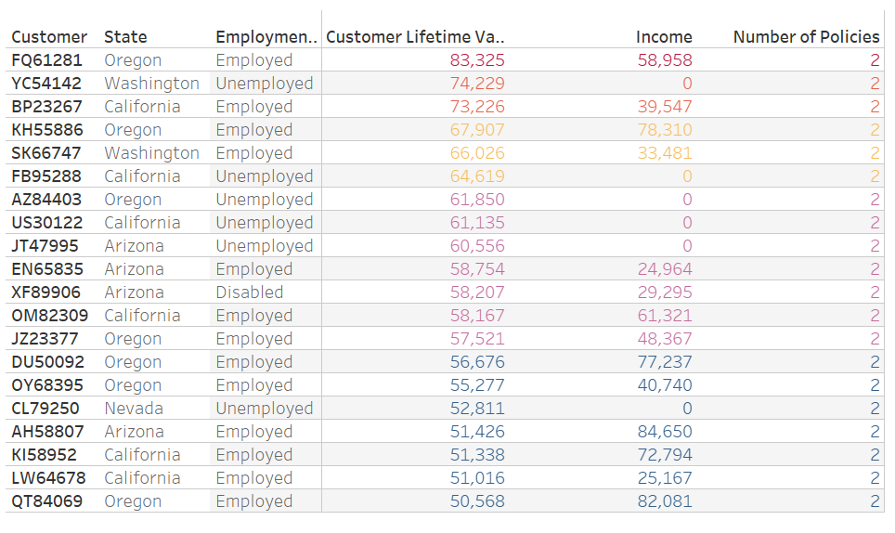
EDA – CLV vs Employment status
Since this dataset is having only 2011 data, the full details of people who are unemployed is unavailable.
Basically a longtime unemployed person will not have any source to pay the monthly premium but still there are some unemployed persons who are providing higher CLV.

Slide 22
Significant Inferences:
The inference obtained from the top 500 samples states that most of the top customers are married.
They own Luxury Cars.
They mostly prefer offer 1 or offer 2.
The coverage they usually possess are Extended or Premium types.
The service channel is usually agent.

Slide 23
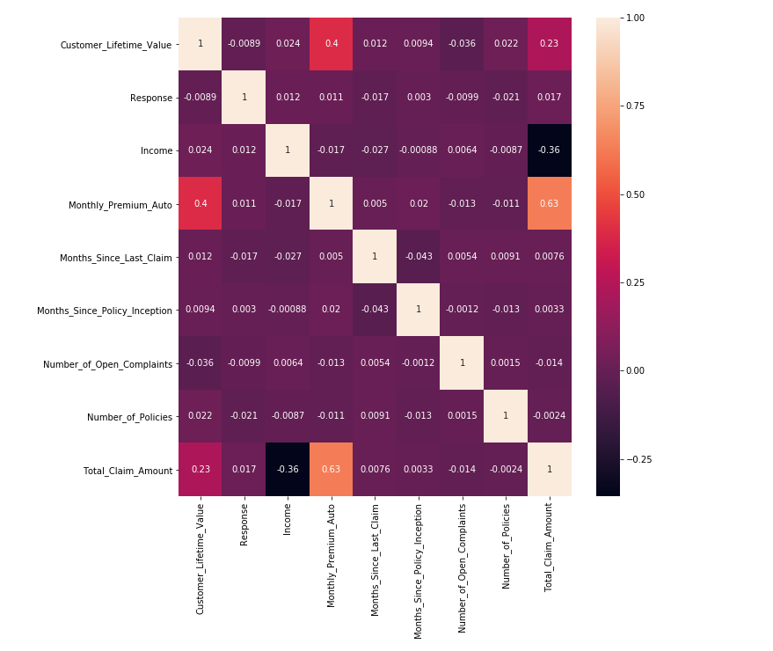
Correlation Matrix
The highly correlated variables with respect to Customer Lifetime Value are Monthly Premium Auto and Total Claim Amount

Slide 24
Inferences from Base Model
OLS Statistics | Observations
Durbin – Watson Score | 2.028
Jarque-Bera (JB) | 48362.362
Condition Number | 18.3
R-Squared | 0.176
Adjusted R-Squared | 0.173
No Auto-Correlation
Not normal
No homoscedasticity
Linear
No Multicollinearity

Slide 25
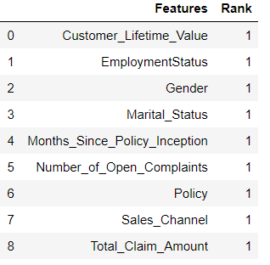
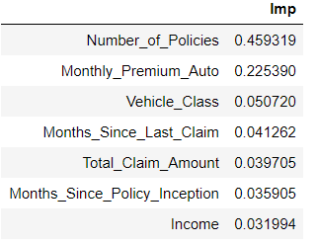
Feature Selection
Recursive Feature Elimination Results
Feature Importance Results
Feature Selection was done with the help of RFE, VIF and Feature Importance Scores.
The models built with the selected features also resulted in very low adjusted R-squared value, than the base model
Therefore, it was decided to use all the independent variables for model building

Slide 26
Variance inflation factor
FEATURES
VIF VALUE
Vehicle_Class | 5.074270
Monthly_Premium_Auto | 5.297231
Customer_Lifetime_Value | 6.309151
CLV_Band | 6.556110
Policy_Type | 7.105100
Policy | 9.356116
Monthly Premium Auto, Vehicle Class, CLV, CLV_Band, Policy Type and Policy have VIF values greater than 5. But I are not dropping them as of now, since they hold significant p – value.

Slide 27
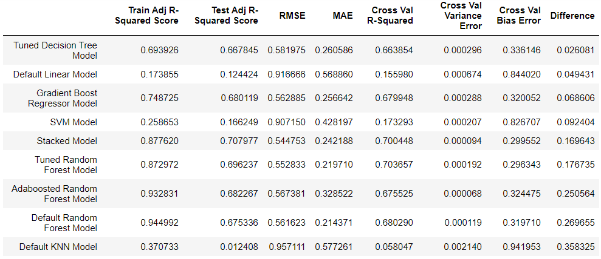
Evaluation metrics

Slide 28
Evaluation metrics
All the regression models Ire built, and their Training Adjusted R-Squared, Test Adjusted R-Squared values, RMSE, MAE, Cross Validated R2-Score, Bias errors and Variance errors are calculated and displayed in the data frame format as shown above.
I have also tried polynomial linear regression model with varying degrees. There is no significant change in the R2-score.
The stacked model was built based on the five models (Tuned Decision Tree, Gradient Boost Model, Tuned Random Forest Model, Adaboosted Random Forest Model and Default Random Forest) which gave the best adjusted R2-Score as Ill as low bias errors and variance errors.
Upon comparing all the values from the data frame, I can conclude that Tuned Decision Tree Model is the best model in this case since it provides high test adjusted r-squared score and very less MAE value along with very low difference betIen training metric and test metric.

Slide 29
Conclusion In order to predict the Customer Lifetime Value of the given client (auto-insurance company), I can choose Tuned Decision Tree Model since it predicts the CLV better than the other Regression models upon comparing all the required metrics

Slide 30
Thank you

