Slide 1

Composition
It's time now to talk about composition.
Composition is another component of object-oriented programming.
COMPLETE JAVA MASTERCLASS
Composition Part 1

Slide 2
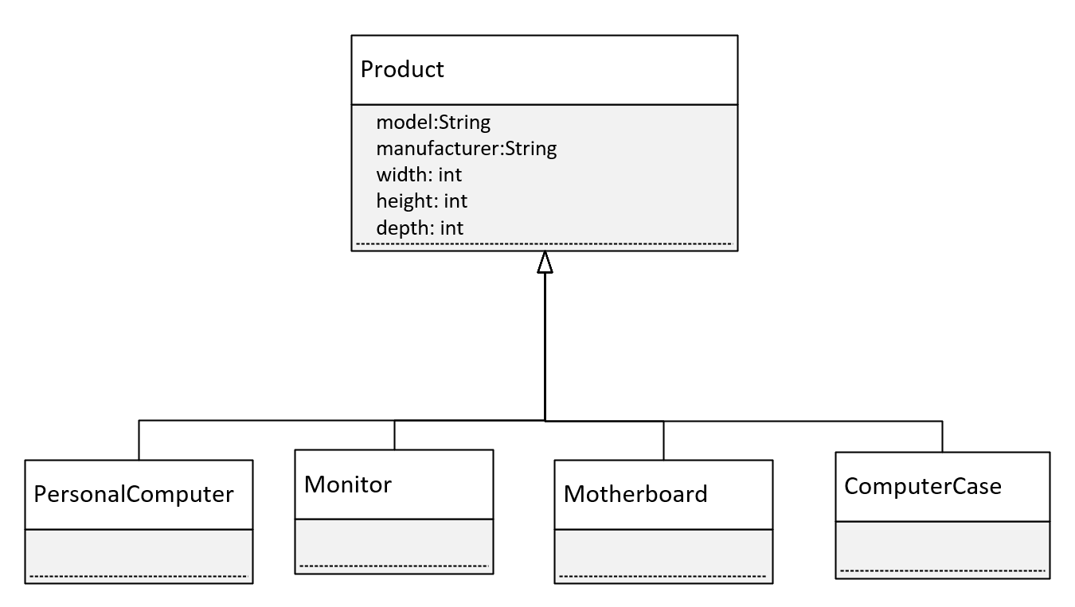
Inheritance
In this instance, I have a base class called Product.
All of my computer parts are going to inherit from Product.
All my parts will then have the same base set of attributes: manufacturer, model, and dimensions. The width, height, and depth, in other words.
All of these items are products, a particular type of Product.
COMPLETE JAVA MASTERCLASS
Composition Part 1

Slide 3
Inheritance vs. Composition
Inheritance defines an IS A relationship.
Composition defines a HAS A relationship.
COMPLETE JAVA MASTERCLASS
Composition Part 1

Slide 4
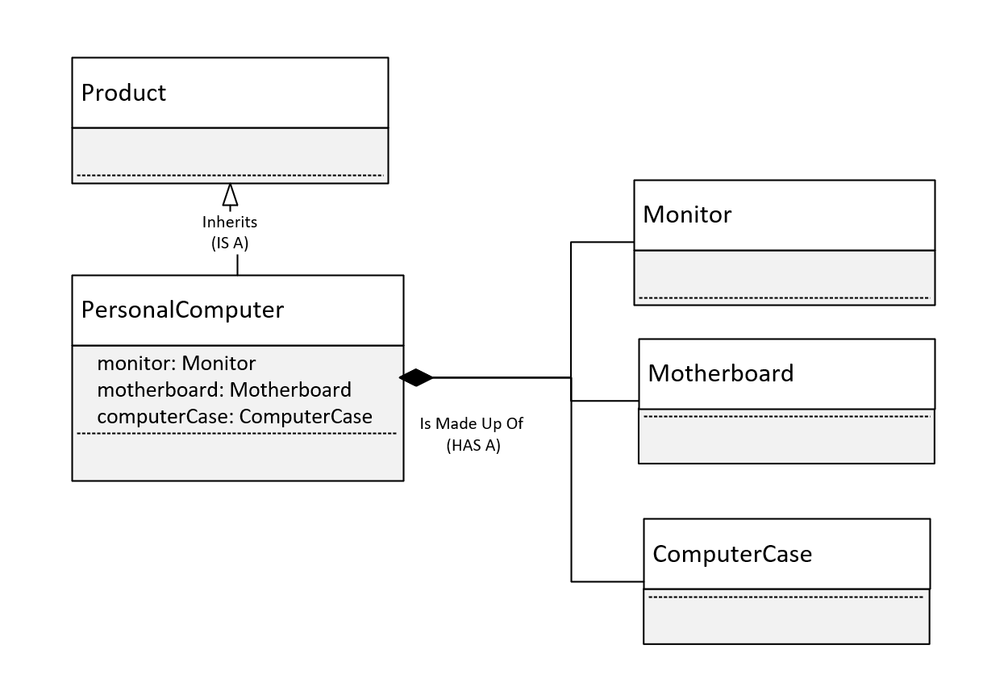
Inheritance vs Composition
To keep this diagram simple, PersonalComputer inherits from Product.
But a Personal Computer, in addition to being a product, is actually made up of other parts.
Composition is actually modeling parts, and those parts make up a greater whole.
In this case, I'm going to model the personal computer.
And I'm modeling the has a relationship with the motherboard, the case, and the monitor.
COMPLETE JAVA MASTERCLASS
Composition Part 1

Slide 5
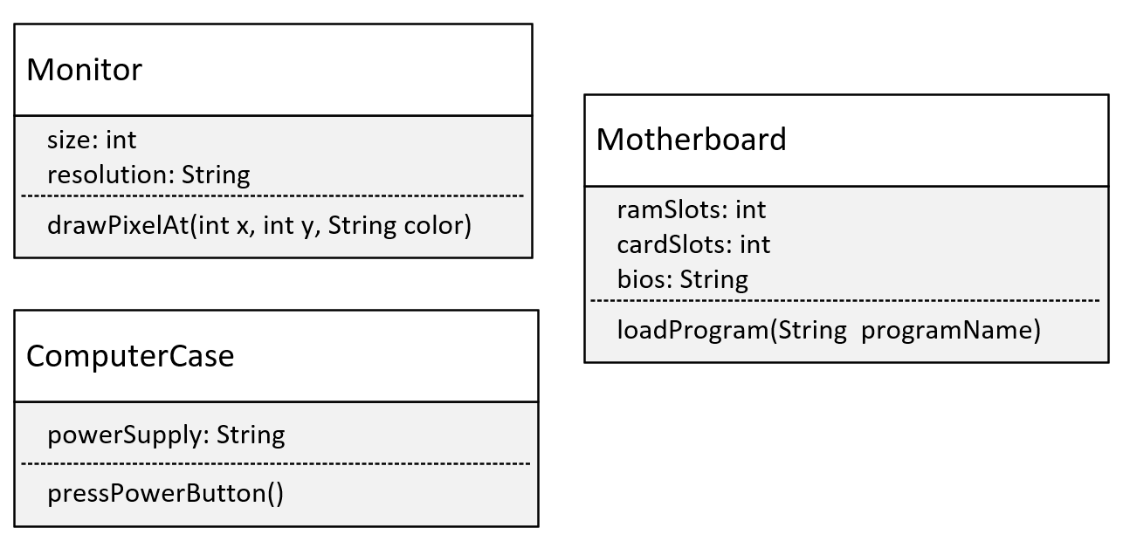
The Parts
This diagram shows the 3 classes that will make up the personal computer.
COMPLETE JAVA MASTERCLASS
Composition Part 1

Slide 6
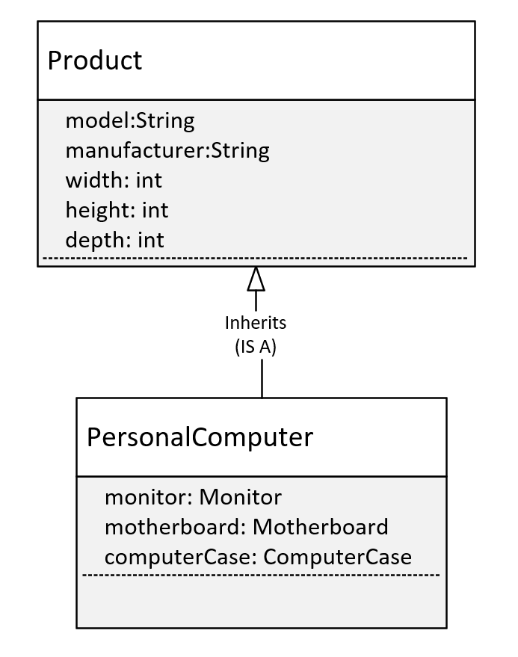
PersonalComputer
This will be my personal computer, and I've said it inherits from Product.
But it also has 3 fields, which are classes: these are Monitor, Motherboard, and ComputerCase.
COMPLETE JAVA MASTERCLASS
Composition Part 1

