Slide 1

Welcome to the Object-Oriented Programming Master Challenge!
Congratulations, you've made it to the object-oriented programming master challenge.
In this challenge, you're going to build a complete application using all the principles of object-oriented programming that we have covered in the last two sections of this course.
The challenge is to write an application for a food restaurant. Let's start by finding out some details about the restaurant and what is required.
COMPLETE JAVA MASTERCLASS
OOP Master Challenge Exercise, Part 1

Slide 2
Bill's Burger Challenge
Bill runs a fast-food hamburger restaurant and sells hamburger meals.
His meal orders are composed of three items, the hamburger, the drink, and the side item.
Your challenge is to write an application to let Bill select the type of burgers and some of the additional items or extras that can be added to the burgers, as well as the actual pricing.
COMPLETE JAVA MASTERCLASS
OOP Master Challenge Exercise, Part 1

Slide 3
Bill's Burger Challenge - The objects
You need a meal order.
This should be composed of exactly one burger, one drink, and one side item.
The most common meal order should be created without any arguments, like a regular burger, a small coke, and fries, for example.
You should be able to create other meal orders by specifying different burgers, drinks, and side items.
You need a drink and side item.
The drink should have at least a type, size, and price, and the price of the drink should change for each size.
The side item needs at least a type and price.
COMPLETE JAVA MASTERCLASS
OOP Master Challenge Exercise, Part 1

Slide 4
Bill's Burger Challenge - The objects
You need burgers.
Every hamburger should have a burger type, a base price, and up to a maximum of three extra toppings.
The constructor should include only the burger type and price.
Extra Toppings on a burger need to be added somehow and priced according to their type.
The deluxe burger bonus.
Create a deluxe burger meal with a deluxe burger that has a set price, so that any additional toppings do not change the price.
The deluxe burger should have room for an additional two toppings.
COMPLETE JAVA MASTERCLASS
OOP Master Challenge Exercise, Part 1

Slide 5
Bill's Burger Challenge - The functionality
Your main method should have code to do the following:
Create a default meal that uses the no arguments constructor.
Create a meal with a burger and the drink and side item of your choice, with up to 3 extra toppings.
Create a meal with a deluxe burger where all items, drink, side item, and up to 5 extra toppings are included in the burger price.
COMPLETE JAVA MASTERCLASS
OOP Master Challenge Exercise, Part 1

Slide 6
Bill's Burger Challenge - The functionality
For each meal order, you'll want to perform these functions:
Add some additional toppings to the burger.
Change the size of the drink.
Print the itemized list. This should include the price of the burger, any extra toppings, the drink price based on size, and the side item price.
Print the total due amount for the meal.
COMPLETE JAVA MASTERCLASS
OOP Master Challenge Exercise, Part 1

Slide 7
Bill's Burger Challenge - The objects
You need a meal order.
This should be composed of exactly one burger, one drink, and one side item.
The most common meal order should be created without any arguments, like a regular burger, a small coke, and fries, for example.
You should be able to create other meal orders by specifying different burgers, drinks, and side items.
You need a drink and side item.
The drink should have at least a type, size, and price, and the price of the drink should change for each size.
The side item needs at least a type and price.
COMPLETE JAVA MASTERCLASS
OOP Master Challenge Exercise, Part 1

Slide 8
Bill's Burger Challenge - The objects
You need burgers.
Every hamburger should have a burger type, a base price, and up to a maximum of three extra toppings.
The constructor should include only the burger type and price.
Extra Toppings on a burger need to be added somehow and priced according to their type.
The deluxe burger bonus.
Create a deluxe burger meal with a deluxe burger that has a set price, so that any additional toppings do not change the price.
The deluxe burger should have room for an additional two toppings.
COMPLETE JAVA MASTERCLASS
OOP Master Challenge Exercise, Part 1

Slide 9
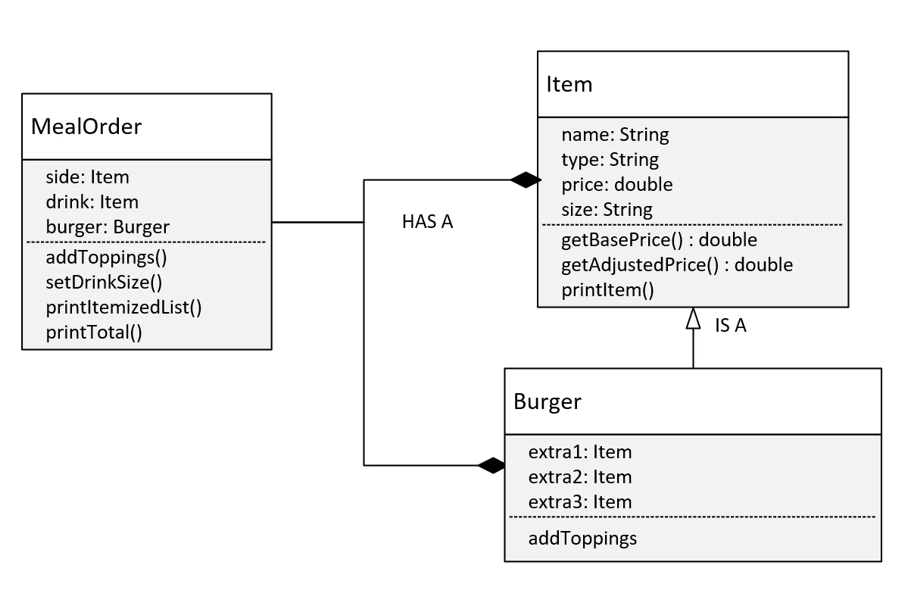
Initial Design Considerations
Let's start with the diagram of my design.
This diagram doesn't include the DeluxeBurger class. We'll look at that a bit later.
In my solution, the MealOrder class uses composition in the design. It's composed of a burger as well as a drink and a side, which will just be Items.
I've used inheritance for the Item and Burger relationships, which means Burger is an Item.
Every Item has a name, type, price or base price, and a size.
COMPLETE JAVA MASTERCLASS
OOP Master Challenge Exercise, Part 1

Slide 10
Initial Design Considerations
Item has the method, getBasePrice, which is really just a getter method for the price, but the name is more descriptive.
Item also has getAdjustedPrice and the printItem method.
These methods will exhibit different behavior based on the runtime type, and we know that's polymorphism.
COMPLETE JAVA MASTERCLASS
OOP Master Challenge Exercise, Part 1

Slide 11
Initial Design Considerations
For the burger, the toppings or extras are individual attributes and also have the type Item.
I'm going to use the MealOrder class to hide some of the implementation details from the calling code.
This means I'm going to use encapsulation techniques on MealOrder and Item.
COMPLETE JAVA MASTERCLASS
OOP Master Challenge Exercise, Part 1

