Slide 1
Hybrid model for sarcasm detection
Nimisha Katyayani PES1201700083
Prathiba P PES1201700112
UE17CS333 project submission

Slide 2
About the project
Project idea:
Using one of the aspects of the sentimental analysis, the project is about building a hybrid model for sarcasm detection using the dataset for the same.
The dataset used is a news headline dataset, stored in JSON format.
At the end , we have a hybrid model which gives us the most accurate way of analysing the dataset in the most accurate measure.

Slide 3
Uniqueness and analysis
Building hybrid model from scratch.
Dataset Ratio: The output of a machine learning classifier is well analyzed and the proportion of the predicted target values of test set and original train set is being input to the next ML classifier in the 80:20 on each pass.
More accurate with final accuracy being more than 80%.

Slide 4
Dataset source and preprocessing done
Dataset source :
https://www.kaggle.com/rmisra/news-headlines-dataset-for-sarcasm-detection#Sarcasm_Headlines_Dataset.json
Any pre-processing steps performed:
Lemmatization of text in the dataset
Removal of stopwords

Slide 5
Literature review
Few Important References:
S No | Reference Papers
1. | Aditya Joshi, Pushpak Bhattacharyya, and Mark J Carman. 2017. Automatic sarcasm detection: A survey. ACM Computing Surveys (CSUR) 50(5):73.
2. | Wenpeng Yin, Katharina Kann, Mo Yu, and Hinrich Schütze. 2017. Comparative study of cnn and rnn ¨ for natural language processing. arXiv preprint arXiv:1702.01923 .
3. | Ashwin Rajadesingan, Reza Zafarani, and Huan Liu. 2015. Sarcasm detection on twitter: A behavioral modeling approach. In Proceedings of the Eighth ACM International Conference on Web Search and Data Mining, pages 97–106. ACM.

Slide 6
Literature Review
Previous studies on sarcasm detection mostly make use of twitter datasets collected using hash tag based supervision but such datasets are noisy in terms of labels and languages.
However a proposal to use a CNN to automatically extract relevant features from tweets and augment them with user embedding to provide more contextual features during sarcasm detection.
Therefore to obtain a better accuracy, we have taken the machine learning classifiers approach rather than neural networks approach.

Slide 7
Quantity of work - High level block diagram of our implementation
Original dataset in JSON format
Clean the dataset
(Lemmatization + removal of stop words)
Logistic Regression Classifier
(Split into Train + Test >> Train the model >> Obtain a prediction for the test set)
BLOCK DIAGRAM
Filtered text
New data frame which has previous training data as well as newly predicted target labels for test data.
KNN classifier
(Split into Train + Test >> Train the model >> Obtain prediction for test dataset)
New data frame which has previous training data as well as newly predicted target labels for test data.
Naïve Bayes classifier
(Split into Train + Test >> Train the model >> Obtain a prediction for test set)
New data frame which has previous training data as well as newly predicted target labels for test data.
SVM classifier
(Split into Train + Test >> Train the model >>> Obtain prediction for test set)

Slide 8
Quantity of work – the main code modules ( what they do)
Serial no | Code module description | Status (% complete) | What it does ?
1. | lemmatize_text, remove_stopwords | Done | Does preprocessing. Lemmatizes the text and removes stopwords.
2. | wordCloudGen | Done | Generates wordcloud charts based on the text category
3. | knn | Done | Implements KNN classifier
4. | svm | Done | Implements SVM classifier
5. | NaiveBayesClassifier | Done | Implements Naïve Bayes classifier
6. | logisticReg | Done | Implements Logistic regression
7. | visualization | Done | A graph with accuracies

Slide 9
Quality of work – Milestones that are done and working
Serial no | Milestone description | Status (% complete) | Comments
1. | Preprocessing | 10% | Text lemmatization and stop words removal
2. | Building the first classifier KNN | 30% | A machine learning classifier built with input as the original dataset and output as the original training set combined with trained test set.
3. | Building the next classifier SVM | 50% | Machine learning classifier with the same implementation as above
4. | Building the third classifier Naïve Bayes | 70% | Third ML classifier
5. | Building the final classifier Logistic regression | 90% | Final ML classifier
6. | Working hybrid model with implementation of all the above | 100% | A working hybrid model for sarcasm detection with an accuracy of 83%

Slide 10
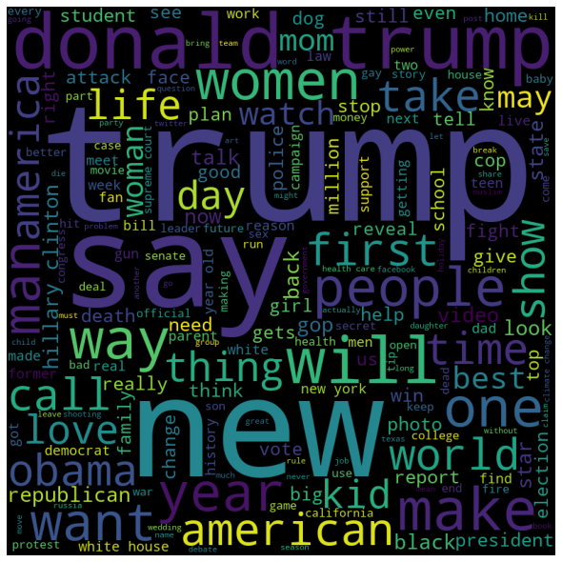
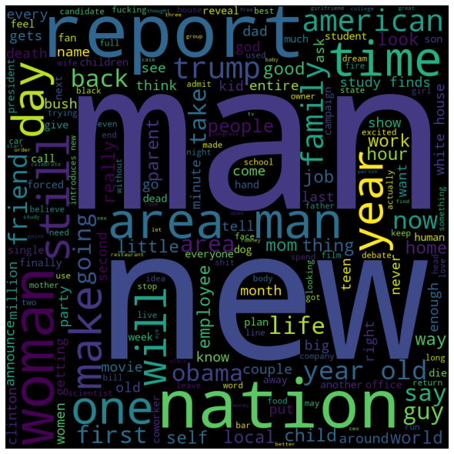
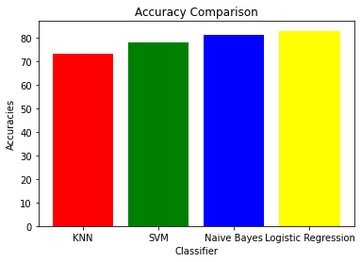
Results Obtained
CHARTS OBTAINED : WORDCLOUDS
GRAPH : BAR GRAPH
Sarcastic
Non Sarcastic

Slide 11
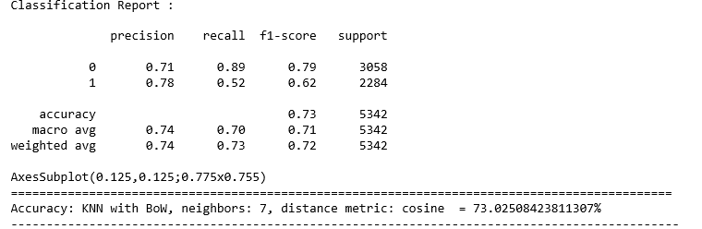
Results obtained
Tables: Classification Reports
KNN Classifier

Slide 12
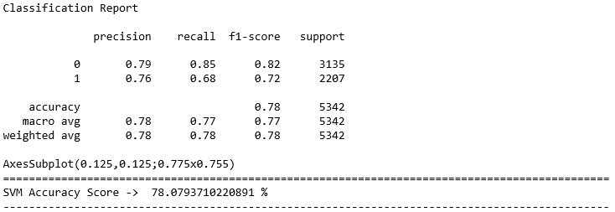
RESULTS OBTAINED
Tables : Classification Reports
SVM Classifier

Slide 13
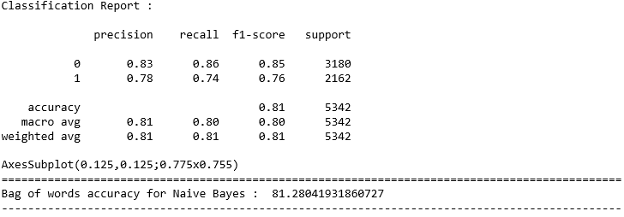
Results obtained
Tables : Classification Reports
Naïve Bayes Classifier

Slide 14
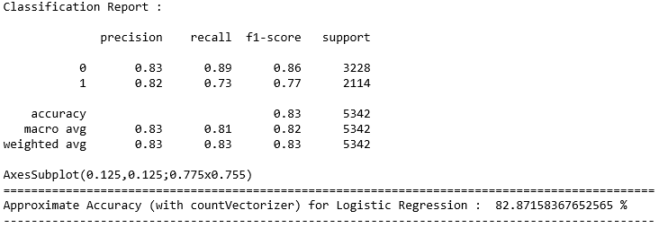
Results obtained
TABLES : Classification Reports
Logistic Regression

Slide 15
Our top three learning in this project
Any classifier that uses the probability at the base of it, works the best on any kind of dataset.
Hybrid model, no matter what the classifier is, improves upon the quality of predictions depending upon the dataset.
Using direct modules available in python, and implementing the same modules from scratch, gives us a huge difference, in the accuracy measures, as the former takes regularization into account to prevent overfitting and thus takes in a more normalized approach to the classification.

Slide 16
Top Challenges unresolved so far
Twitter datasets gave a very poor accuracy with this trained hybrid model as this model is trained on less noisy news headlines dataset unlike twitter datasets.
RNN classifier couldn’t be included in this hybrid model due to the non compatible values of delta and the number of arguments. Thus the implementation of neural network approach couldn’t be done.

