Slide 1
Machine Learning
Project
Prathiba P PES1201700112
Krithi D PES1201701789
Nimisha katyayani PES1201700083

Slide 2
Implementation of Naive Bayes Model from Scratch
Based on Bayes’ Theorem
Involves calculating probabilities for each class
Classifies according to the most probable class
Probability: P(A|B) = (P(B|A) * P(A))/P(B)
Given the dataset , the training and testing sets have been defined and the performance measures have been calculated after the execution.

Slide 3

About the project:
1. Dataset used : House-votes dataset
2.Preprocessing :
Used csv module , imported reader
Categorical data changed to numerical data
3.Classes: Total number of classes =2
4.Model implementation:
Used various functions to make the code general
Used cross validation method with k folds to avoid biasing and achieve high performance
5.Outputs:
Accuracies of all the 5 sets
Mean Accuracy
Confusion matrix
Performance measures:Recall,precision,F-measure

Slide 4

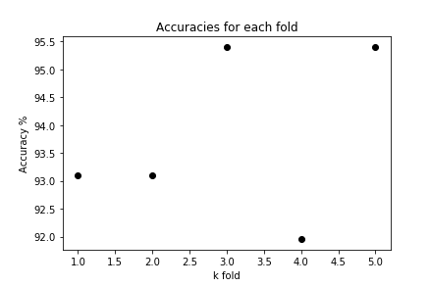
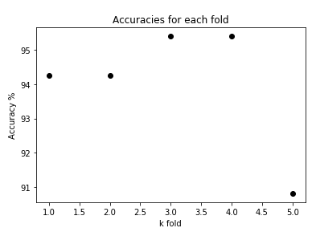
Performance of the model:
The accuracies have been calculated with 5 fold cross validation method
Accuracies for all the 5 folds have been listed
Mean Accuracy is considered
Graph have been plotted to show the variation of accuracy for each fold on each split.
Why?
The use of cross validation method in this model is to split the training and testing sets without any bias.
Thus the improves the accuracy and leads to better performance..

Slide 5
References:
Cite as: Saha, S. et. al, Introduction to Machine Learning and AstroInformatics, pp
THANK YOU !

