Slide 1


Smart Cities & AI-Driven Urban Technologies
Student Name K.Prathiba
Register Number 192421163
Course Name & Code Software Engineering (1003)
Faculty Supervisor Dr. T.M. Usha

Slide 2
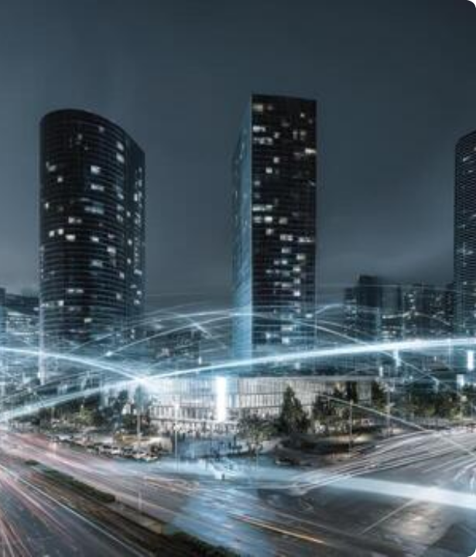
1. Introduction to Tech
Transforming Modern Urban Life
AI-driven Smart City technology integrates Artificial Intelligence, Internet of Things (IoT), and big data analytics into civic infrastructure to automate urban operations.
From self-optimizing traffic grids to intelligent waste collection and predictive public safety, AI turns static cities into adaptive, responsive environments.
In software engineering, this represents a paradigm shift toward distributed real-time systems, scalable cloud-edge architectures, and data privacy frameworks.

Slide 3






2. Need and Motivation
Rapid Urbanization
Sustainability & Energy
Operational Efficiency
By 2050, nearly 70% of the global population will live in urban areas, creating massive congestion and resource strains on traditional infrastructure.
Conventional municipal grids waste up to 30% of energy. AI algorithms optimize power grid distribution and reduce carbon footprints.
Manual civic monitoring is slow and costly. Automated AI systems enable proactive asset maintenance and rapid emergency responses.

Slide 4


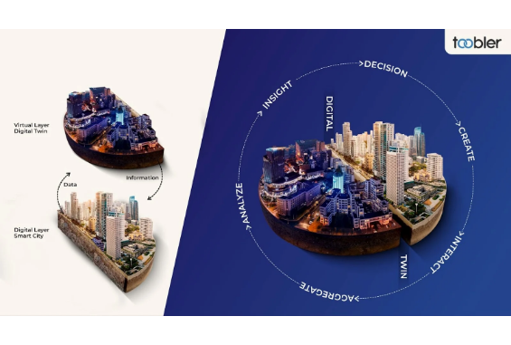


3. Working Principle & Architecture
1. Perception & Sensing Layer
IoT sensors, CCTV video feeds, environmental meters, and GPS units continuously capture physical city data.
2. Network & Edge Aggregation Layer
High-speed 5G networks and edge computing nodes process initial raw telemetric data with ultra-low latency.
3. AI Analytics Core & Actuation
Machine learning models generate actionable insights, sending commands back to physical actuators, signals, and municipal teams.

Slide 5
4. Key Components & Technologies
IoT Sensors & Actuators: Embedded hardware nodes deployed across roads, utilities, and buildings for continuous real-time telemetry.
Computer Vision & Deep Learning: Convolutional Neural Networks (CNNs) analyzing video streams for traffic control and surveillance.
Digital Twin Modeling: 3D virtual replicas of physical city assets simulating disaster scenarios and urban expansion plans.
5G Connectivity & Edge AI: High-bandwidth, low-latency communication enabling real-time autonomous vehicle routing.

Slide 6
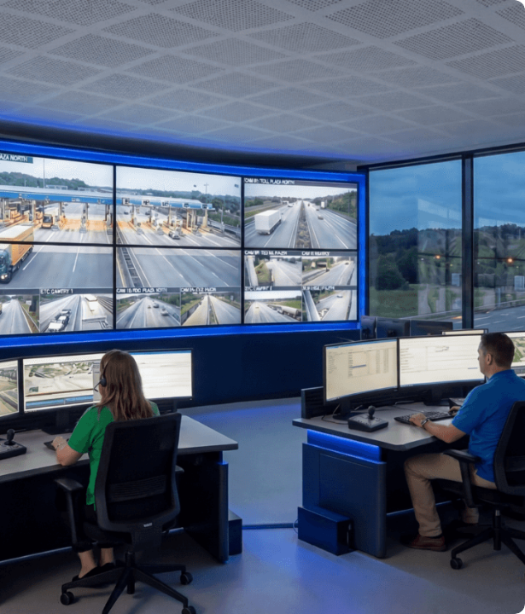



5. Applications & Use Cases
Intelligent Traffic Control Systems
Dynamic signal adjusting based on real-time vehicle density cuts traffic delays by up to 25%.
Smart Energy Grids & Street Lighting
Adaptive streetlights dim when streets are empty; smart microgrids reroute renewable power seamlessly.
Automated Waste Management
Sensors measure trash levels in bins, optimizing municipal garbage truck dispatch routes.

Slide 7

6. Advantages & Limitations
Key Advantages
Current Limitations
•
Enhanced Safety: AI surveillance reduces emergency response times significantly.
•
High Deployment Cost: Massive capital required for sensors, 5G networks, and compute.
•
Resource Optimization: Lowers municipal energy consumption and water wastage.
•
Cybersecurity Risks: Vulnerability to ransomware attacks targeting municipal utilities.
•
Data-Driven Policy: Enables city planners to make evidence-based zoning decisions.
•
Data Privacy Concerns: Continuous video surveillance risks infringing citizen rights.
•
Reduced Emissions: Smooth traffic flow lowers vehicular greenhouse gas emissions.
•
Legacy Interoperability: Difficulty integrating modern AI engines into older infrastructure.

Slide 8




7. Recent Developments & Trends
2024 - Generative AI Planning
Urban architects leverage GenAI models to design energy-efficient building layouts and transportation grids.
2026+ - Autonomous Grids
Fully self-healing urban energy grids driven by zero-human-touch predictive AI models.
2022 - Edge AI Deployment
2025 - Autonomous Fleets
Widespread shift from centralized cloud computing to processing data directly on roadside edge devices.
Integration of V2X (Vehicle-to-Everything) communication for self-driving public transport shuttles.

Slide 9






8. Challenges & Future Scope
Ethical AI & Privacy
Standardized Protocols
Future Scope
Developing strict software governance frameworks to anonymize biometric video data and eliminate algorithmic bias in law enforcement.
Establishing universal open-source IoT APIs so multi-vendor smart city systems can communicate seamlessly.
Integration of Quantum AI computing for instant city-wide traffic optimization and climate resilience forecasting models.

Slide 10

9. Case Study / Example
Singapore "Smart Nation"
Barcelona Smart Lighting & IoT
Implementation: Built a complete virtual "Virtual Singapore" digital twin platform fed by millions of IoT sensors.
Implementation: Deployed dynamic LED lighting equipped with environmental sensors and Wi-Fi routers across the city.
Results: Reduced emergency vehicle dispatch time by 20% and optimized wind flow modeling to naturally cool public housing estates.
Results: Achieved 30% reduction in municipal energy expenditure and generated over $50M in annual water management savings.

Slide 11

10. Conclusion & References
Key Takeaways
Key References
AI-driven smart city technologies are essential for creating resilient, sustainable, and efficient future urban environments.
•
IEEE Computer Society: Software Architectures for IoT-enabled Smart Cities.
•
ACM Digital Library: Artificial Intelligence in Urban Traffic Systems.
Success requires a balance between rapid technological adoption, robust software engineering design, and strong privacy protection for citizens.
•
ISO/IEC 30141: Internet of Things Reference Architecture for Municipalities.
•
UN-Habitat Report: Smart Cities for a Sustainable Future.

Slide 12



Image Sources
https://static.vecteezy.com/system/resources/thumbnails/070/681/698/small/cityscape-at-night-with-digital-network-connection-lines-futuristic-urban-technology-and-communication-infrastructure-photo.jpeg
Source: www.vecteezy.com
https://a.storyblok.com/f/122804/1600x896/8037002dad/the-technical-backbone-of-digital-twins.webp
Source: www.toobler.com
https://www.hanwhavision.com/_next/image?url=https%3A%2F%2Fupload.hanwhavision.com%2Fhanwha-global%2F%2Fmigrated%2Fcontent-images%2F2026%2F4%2FLPR-cameras-article-image-2000x848.png&w=3840&q=75
Source: www.hanwhavision.com

