Slide 1
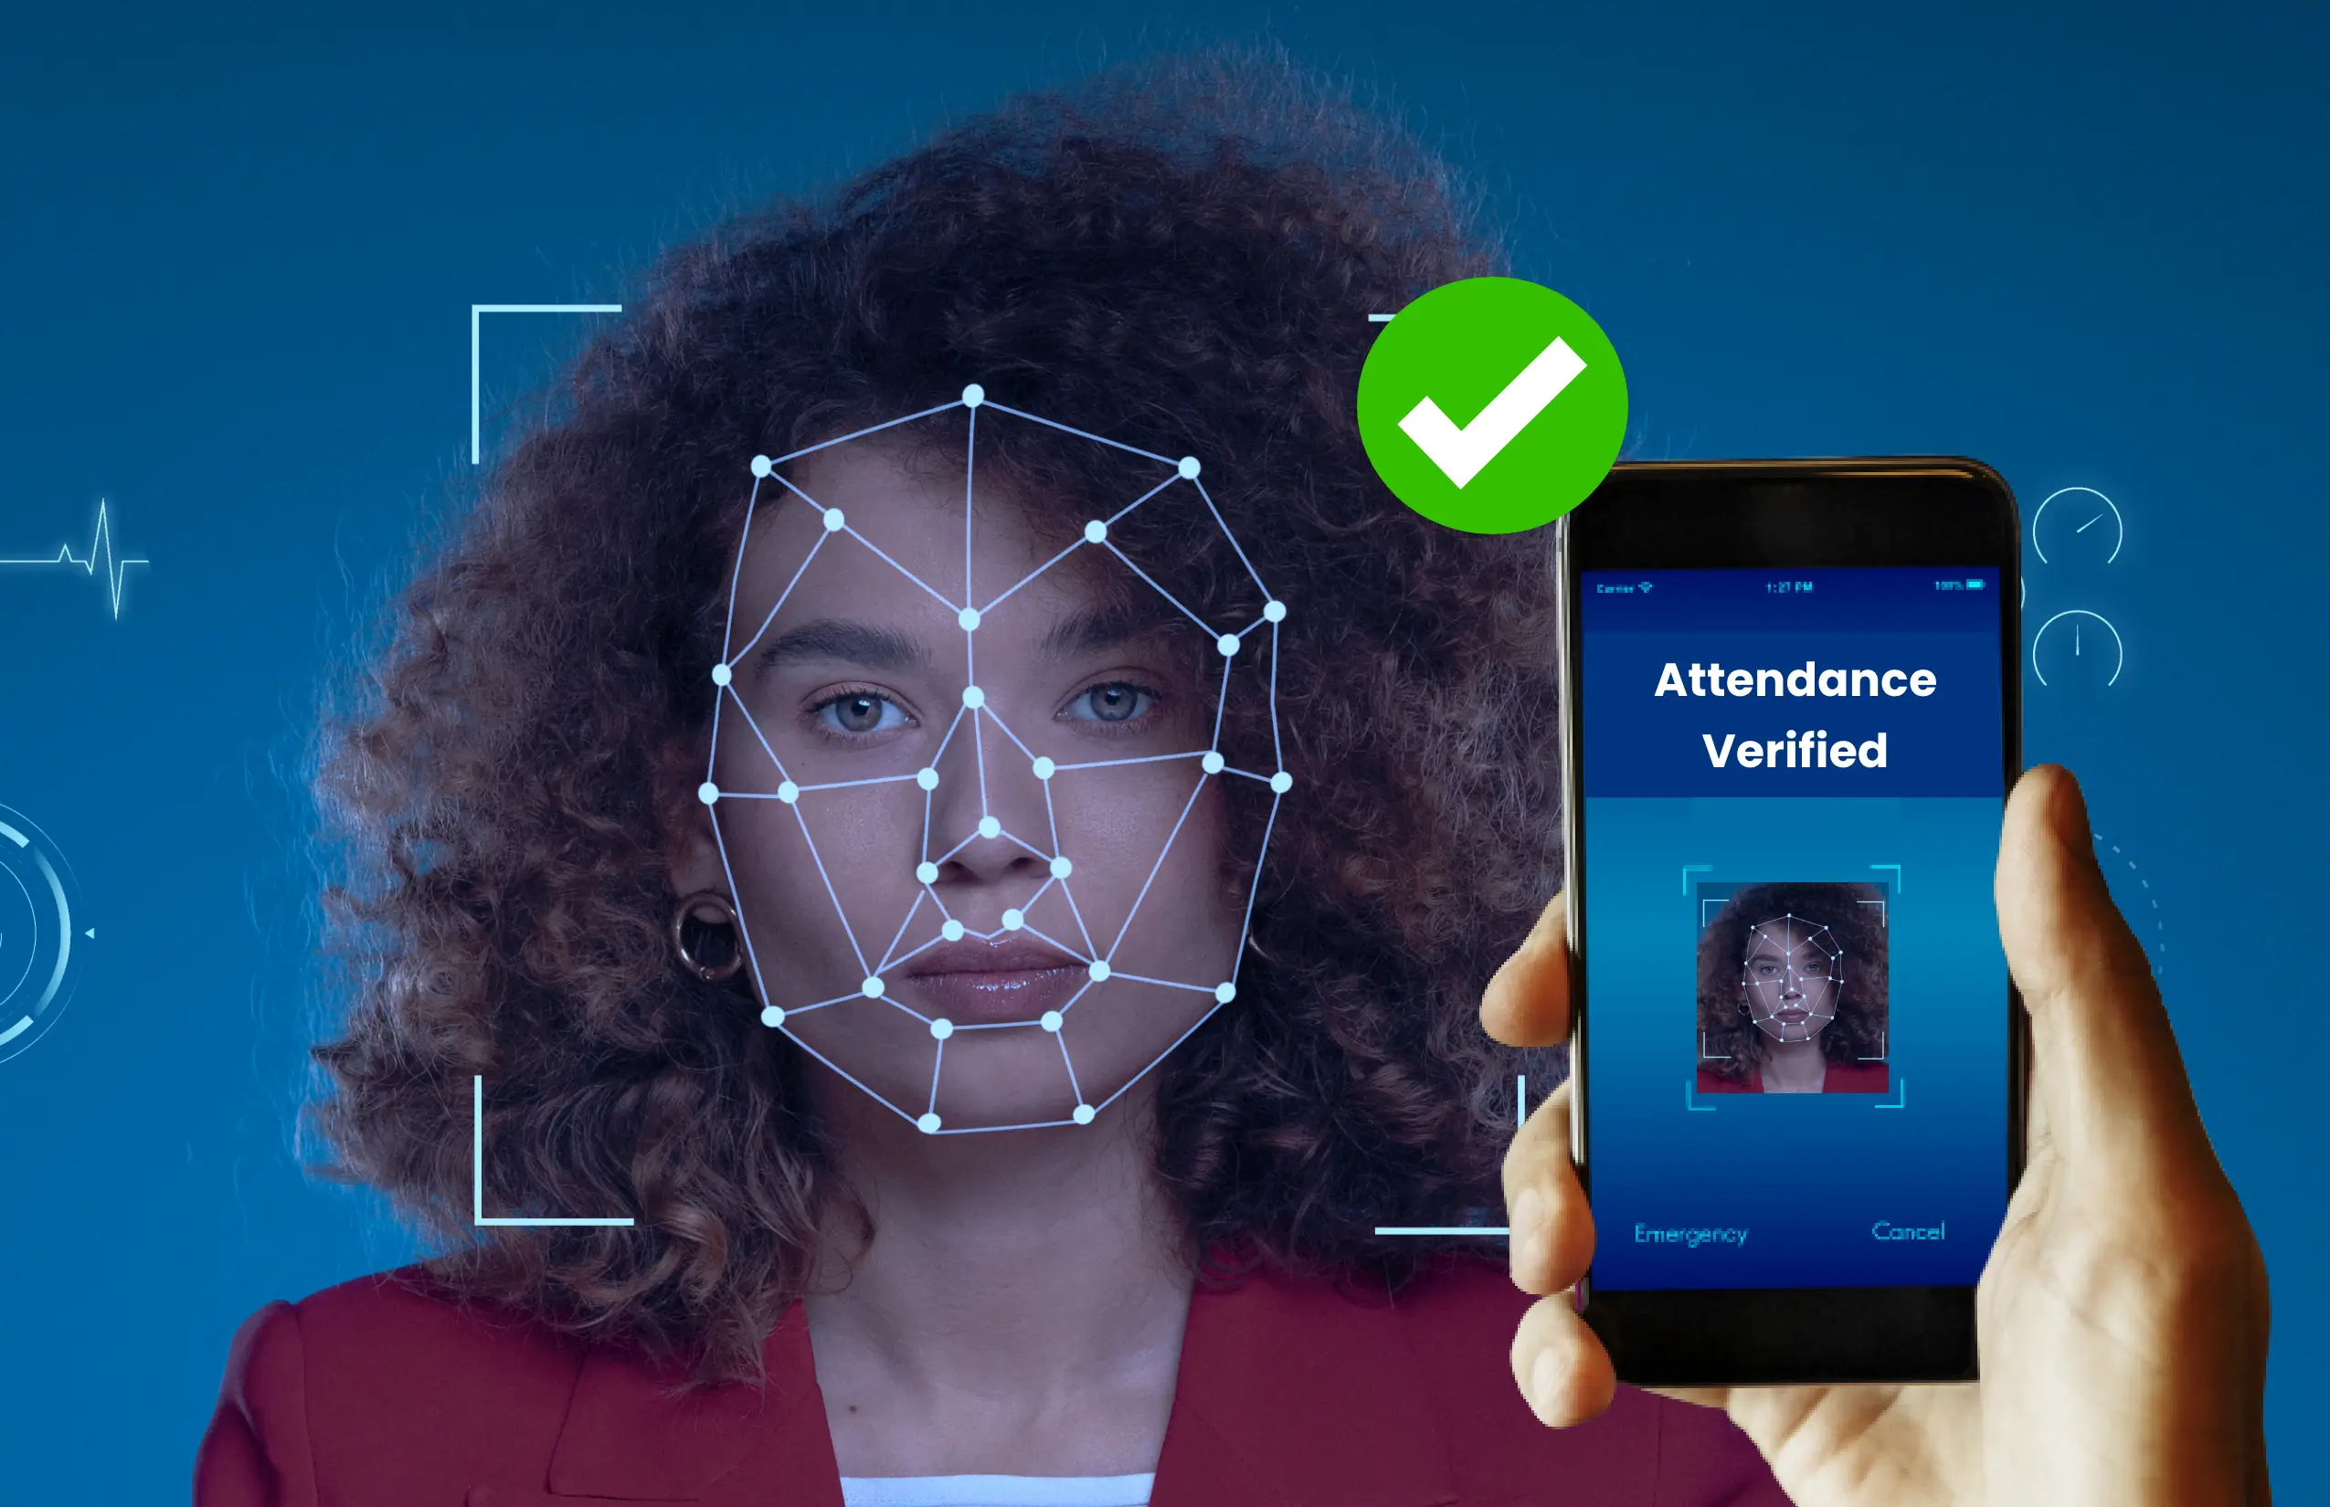

From Roll Call to Recognition
A Deep Learning-Based Face Recognition Attendance System
Presented by
Harshitha – 4SF23CS073
Prathibha – 4SF23CS154
Swathi – 4SF23CS227
Department of Computer Science and Engineering
Sahyadri College of Engineering and Management, Mangaluru

Slide 2
GETTING STARTED
Introduction & Objectives
Introduction
Manual attendance is time-consuming. Face recognition provides a contactless alternative. Deep Learning enables effective facial representations, and this project leverages FaceNet CNN for robust face recognition.
Our objectives:
Automate classroom attendance,
Capture and store student face images
Generate face embeddings using FaceNet
Recognize students via cosine similarity
Store attendance digitally.

Slide 3

ARCHITECTURE
Proposed System
The system integrates Python, OpenCV, FaceNet, DeepFace, Tkinter, and MySQL into a seamless pipeline.
Enrollment
Image Capture
Haar Detection
FaceNet CNN
128-D Embedding
Python & OpenCV
FaceNet & DeepFace
Tkinter & MySQL
Core programming language and computer vision library used for image capture, processing, and Haar Cascade-based face detection.
Deep learning frameworks that generate and process 128-dimensional facial embeddings for accurate identity recognition.
GUI toolkit and relational database used to provide an interactive interface and persistent attendance record storage.

Slide 4




DEEP LEARNING
FaceNet-Based Deep Learning
Haar Cascade Detection
FaceNet CNN
Face is detected in each frame using Haar Cascade, isolating the region of interest for further processing.
The detected face is processed by FaceNet CNN to extract a compact, discriminative 128-dimensional embedding.
Cosine Similarity
128-D Embedding
Live embeddings are compared against stored prototypes. A threshold of 0.65 determines a successful match.
A 128-dimensional vector uniquely represents each face. Student prototype embeddings are stored for comparison.

Slide 5
ATTENDANCE
Attendance Management
Faculty-Controlled Review
Recognized students are placed in a review queue. Faculty verify entries, prevent duplicates, and mark unrecognized students absent before final submission.
01
02
Recognition
Review Queue
FaceNet identifies students in the live camera feed using cosine similarity against stored embeddings.
Recognized entries are queued for faculty verification, ensuring accuracy before records are finalized.
03
04
Present / Absent
MySQL & CSV Export
Faculty confirm present students and mark unrecognized individuals absent, with duplicate prevention enforced.
Finalized attendance is stored in MySQL and can be exported as a CSV report for further use.

Slide 6
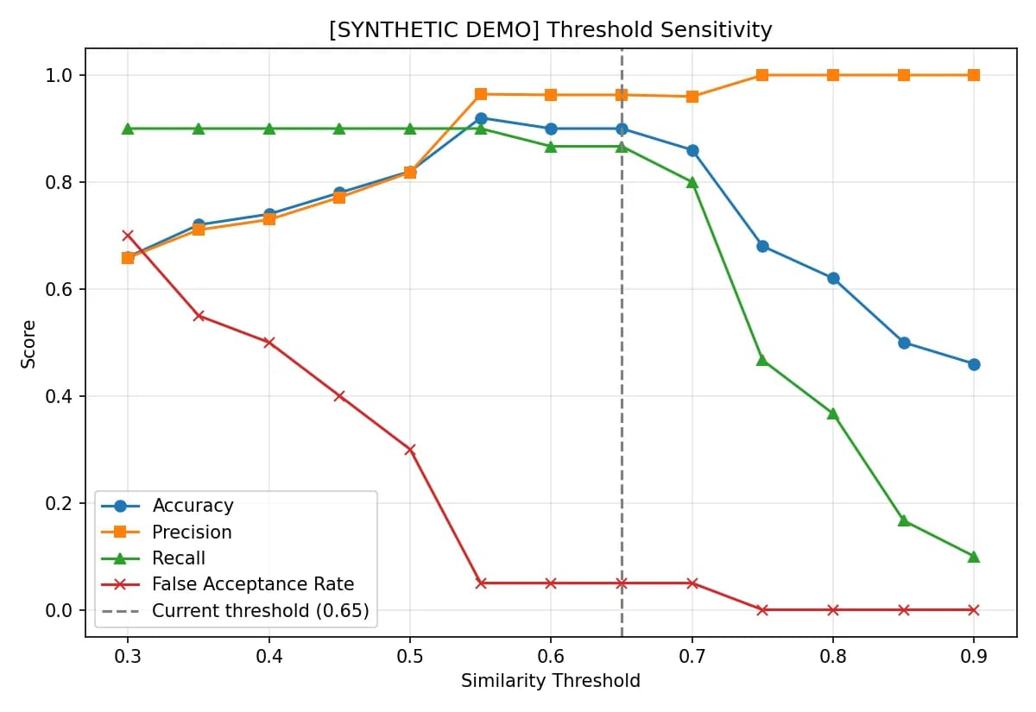
EVALUATION
Results & Observations
Correct Student: ~0.98
Every 5th Frame
Cosine similarity for a correctly matched student was approximately 0.98, well above the 0.65 threshold, confirming strong recognition.
Recognition runs every fifth frame to reduce CNN computation overhead and ensure smoother real-time operation.
Note: Similarity values are from a limited offline test, not overall classroom accuracy.

Slide 7
Conclusion & Future Scope
NEXT STEPS
Long-Term Vision
Immediate Improvements
Perform large-scale accuracy evaluation, strengthen privacy and secure storage, and extend the system to cloud-based deployment.
What We Built
Improve face detection accuracy, add face alignment preprocessing, and implement liveness detection to prevent spoofing.
A face-based automated attendance system integrating FaceNet CNN, cosine similarity, attendance review, MySQL storage, and CSV reporting.

