Slide 1
Book Recommendation System

Slide 2
SHRI VISHNU ENGINEERING COLLEGE FOR WOMEN
INFORMATION TECHNOLOGY
Mentor : Mr. V. Leela Prasad(Asst.Prof)
21B01A1220 – Bezawada Prathibha Sreeja
21B01A1221 – Bhudati Archana
21B01A1224 – Bobbara Swathi
21B01A1254 – Goguluri Vineela Reddy
22B05A1205 – Dulam Madhuri

Slide 3
Agenda
Objectives
Modularization
Modules & Design Methodology
Planning of Project Work
Summary

Slide 4
Objectives
Personalization
Accuracy
Diversity

Slide 5
Personalization
The central goal of a book recommendation system is to provide personalized suggestions to users based on their unique preferences, reading history, and behavior. By understanding each user's individual tastes, the system can offer recommendations that align closely with what the user is likely to enjoy.

Slide 6
Accuracy
Recommendations should be accurate and relevant. Users should feel that the system understands their preferences well and consistently suggests books that resonate with their interests. A high level of accuracy indicates that the recommended books align closely with what the user is likely to enjoy, leading to increased user satisfaction and engagement.

Slide 7
Diversity
While accuracy is crucial, the system should also aim to introduce users to a diverse range of books. This helps users discover titles they might not have encountered otherwise and enriches their reading experience.
A diverse set of recommendations introduces users to a broader selection of books, enriching their reading experience and encouraging exploration beyond their comfort zones.

Slide 8
Modularization

Slide 9
Data Collection and Preprocessing
User Profiling
Recommender Generation
Similarity Calculation

Slide 10
Modules
Top Rated Books Module
User Recommender Module

Slide 11
Top Rated Books Module
In this module we display the compendium of top-rated books and user can select n read the book that he is interested, he also can engage with latest releases.
This module effectively fulfills the "diversity" objective by providing an path for users to explore a wide range of books, enabling them to delve into previously unnoticed books and discover fresh narratives.
In this we meticulously present cover page, book title, author, published year, rating of each book, provide a comprehensive overview of the book.

Slide 12
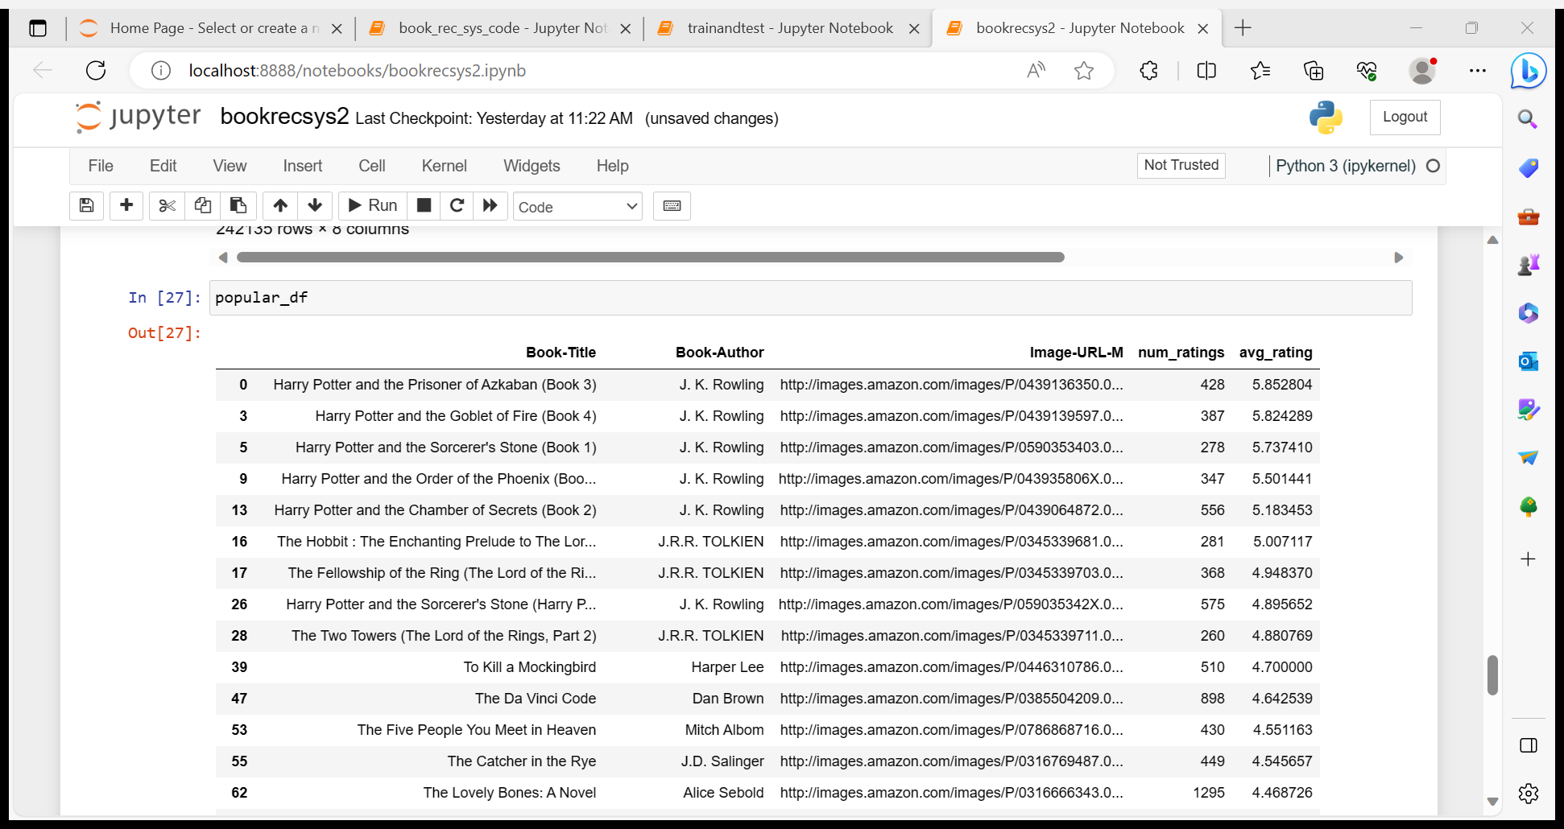

Slide 13
User Recommender Module
We've consolidated this module into a single page, where users can explore books of their interest through search and peruse them seamlessly.
In this module, the books matching the user's search are prominently showcased, accompanied by subtitles suggesting similar books. Additionally, we present closely related titles for a book.
This module covers the objective personalization and follows the technique content-based filtering.

Slide 14
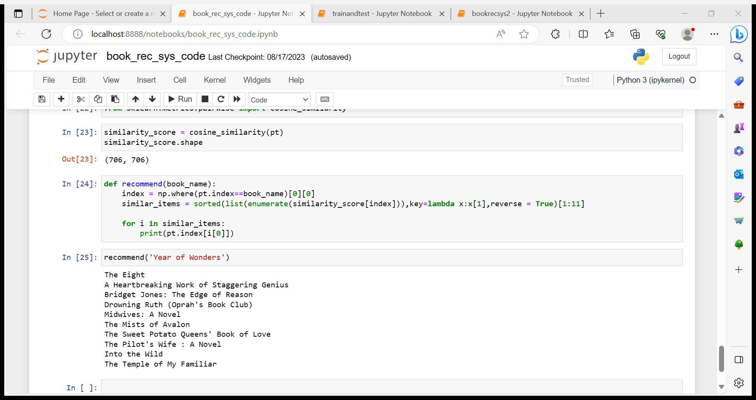

Slide 15
Planning of Project Work

Slide 16
Time Line
5 – 7 Days : User Recommended Module design
3 – 5 Days : Data base design
5 – 6 Days : Connecting Code with User Interface
2 – 3 Days : Testing the model
3 – 4 Days : Analysing the project and making reports.

Slide 17
Summary
This whole recommendation system goes on the Knn algo.
Here we are calculating the cosine-similarity values and considering the items the have more cosine-similarity value and recommending it as the similar books.
Top recommended books are taken based on the average ratings on that respective book greater than 3.5 for 5.
This is the overview of the techniques that are used to develop this project.

Slide 18
THANK YOU

