Slide 1

SAI VIDYA INSTITUTE OF TECHNOLOGY
Department of Information Science and Engineering
Rajanukunte, Bengaluru - 560064
INTERNET OF THINGS
InfiData Technologies
Internal Guide
Mary M D’souza
Assistant Professor
Dept of IS&E, SVIT
External Guide
Mr. Vinith Kumar GP
Design Engineer
InfiData Technologies
By
Prathibha.L 1VA16IS064

Slide 2
About Organization
Infidata Technologies is a dynamic start-up company.
The foundation to Infidata technologies is built on the key focus area of domain expertise in industry verticals, customer focus by quickly aligning to client needs and company’s unique delivery model is well executed through collaborative network of partners.
Dept. of ISE, SVIT Internship / Professional practice work Presentation 2

Slide 3
About Organization
Vision
To become a leading performer and grow as a major IT service provider, in providing quality Web application, Software Development solutions and corporate training in the competitive global marketplace.
Mission
To ensure strategic planning with quality products and Profitable growth through customer service, innovation, quality and commitment.
Dept. of ISE, SVIT Internship / Professional practice work Presentation 3

Slide 4
Organization
Services
Enterprise Application Services
Web designing and Development
Mobile Application Development
Internet of Things
Training Services
Company Clients
Streams Inc
Vishnu Enterprises
Deepthi Engineering
JB Transport India
BreakDQ
R.L Jalappa Institute of Technology
SJCPU
Rbits Technologies
Dept. of ISE, SVIT Internship / Professional practice work Presentation 4

Slide 5
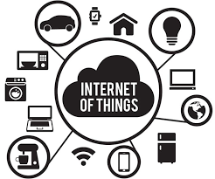
Domain
Dept. of ISE, SVIT Internship / Professional practice work Presentation 5

Slide 6
About Department
IOT Development department
Internet of things (IoT) is a computing concept that describes the idea of everyday physical objects being connected to the internet and being able to identify themselves to other devices.
Smart System and the Internet of the Things are driven by a combination for:
Sensors & Actuators
Connectivity
People & Process
Dept. of ISE, SVIT Internship / Professional practice work Presentation 6

Slide 7

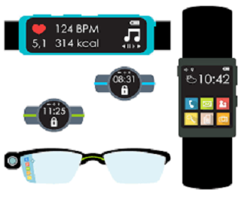
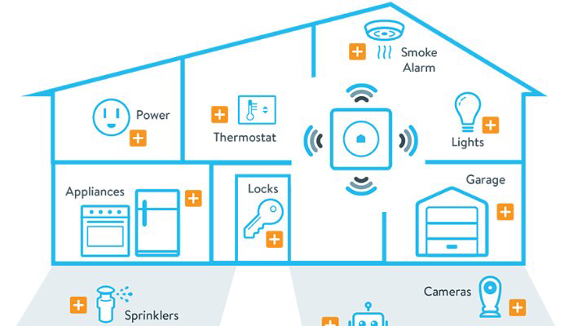
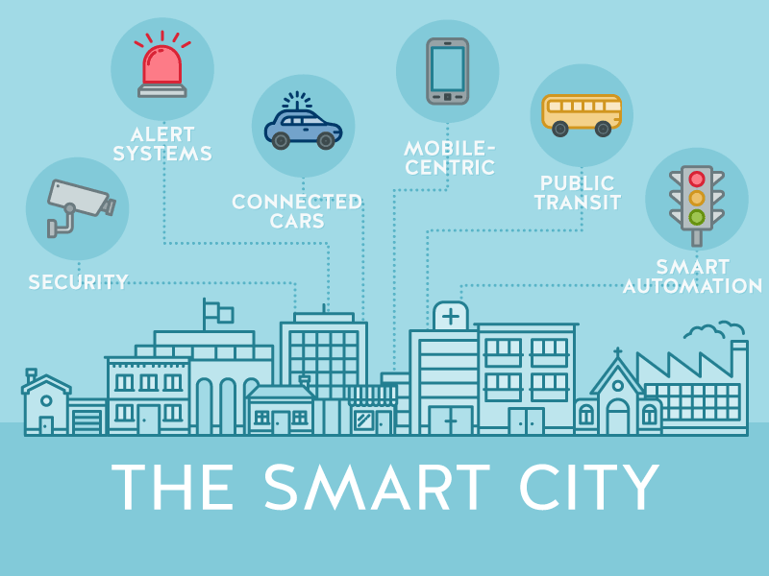
Internet of Things
Internet of things (IoT) is a computing concept that describes the idea of everyday physical objects being connected to the internet and being able to identify themselves to other devices.
Applications are:
Smart Home
Healthcare
Connected car
Smart cities..
Dept. of ISE, SVIT Internship / Professional practice work Presentation 7

Slide 8
Task Performed
Introduction to Arduino
Sensing moisture in soil
Fix of dc motors with relay driver for motors control.
Implementation and testing of ultrasonic sensors.
Python programming with GPIO
Project
Dept. of ISE, SVIT Internship / Professional practice work Presentation 8

Slide 9
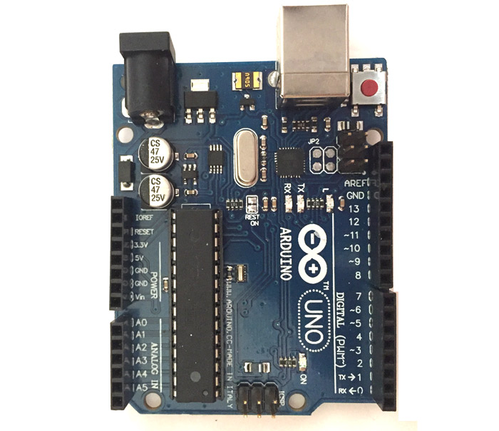
Task Performed
Arduino Uno is a microcontroller board based on 8-bit ATmega328P microcontroller
The 14 digital input/output pins can be used as input or output pins by using pinMode(), digitalRead() and digitalWrite() functions in Arduino programming.
Each pin operate at 5V and can provide or receive a maximum of 40mA current.
It has an internal pull-up resistor of 20-50 KOhms which are disconnected by default.
Dept. of ISE, SVIT Internship / Professional practice work Presentation 9

Slide 10
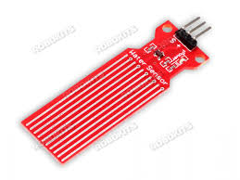
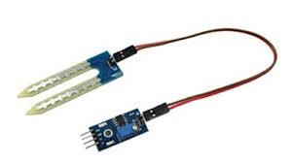
Task Performed
Sensing Moisture in Soil
These sensors senses the moisture presence in the soil.
Water sensor
Soil Moisture Sensor
Dept. of ISE, SVIT Internship / Professional practice work Presentation 10

Slide 11
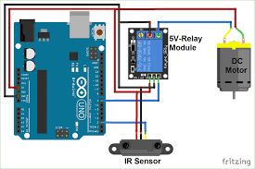
Task Performed
Fix of dc motors with relay driver for motors control.
Relay
DC Motor
IR Sensor
Dept. of ISE, SVIT Internship / Professional practice work Presentation 11

Slide 12
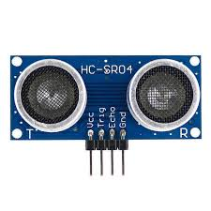
Task Performed
Implementation and testing of ultrasonic sensors.
Ultrasonic sensor is most suitable for obstacle detection and it is of low cost and has high ranging capability.
Dept. of ISE, SVIT Internship / Professional practice work Presentation 12

Slide 13
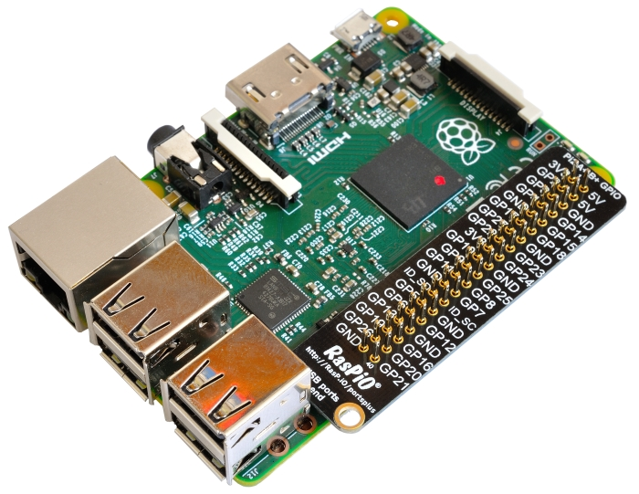
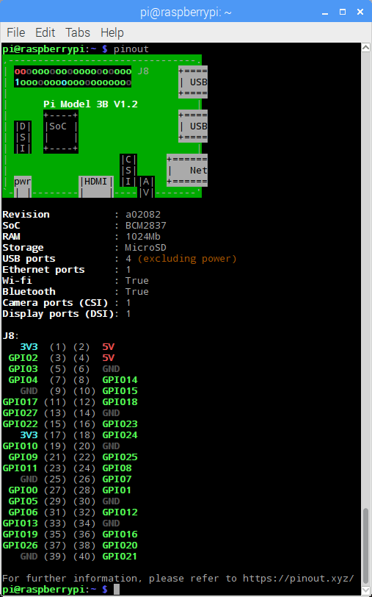
Task Performed
Python programming with GPIO
A powerful feature of the Raspberry Pi is the row of GPIO(general-purpose input/output)pins along the top edge of the board.
GPIO Board and Pin mode configuration
Dept. of ISE, SVIT Internship / Professional practice work Presentation 13

Slide 14
PROJECT
“Advanced Solar Panel Cleaning Bot using IoT”
This project deals with the cleaning of solar panel automatically without human efforts.
Software:
Python IDE 2.7
Hardware :
Raspberry pi 3.0
Power supply 5v/2A
IR sensors
Dept. of ISE, SVIT Internship / Professional practice work Presentation 14

Slide 15
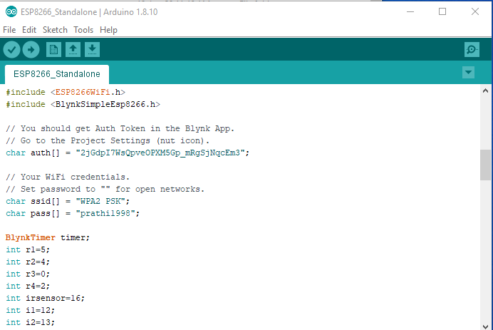
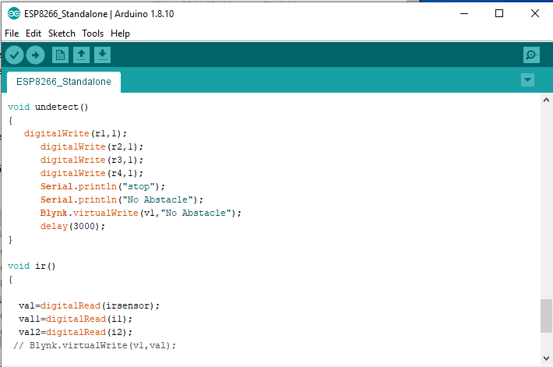
PROJECT
Snapshots of code
Dept. of ISE, SVIT Internship / Professional practice work Presentation 15

Slide 16
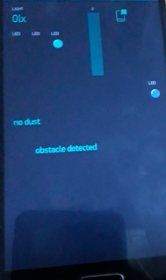
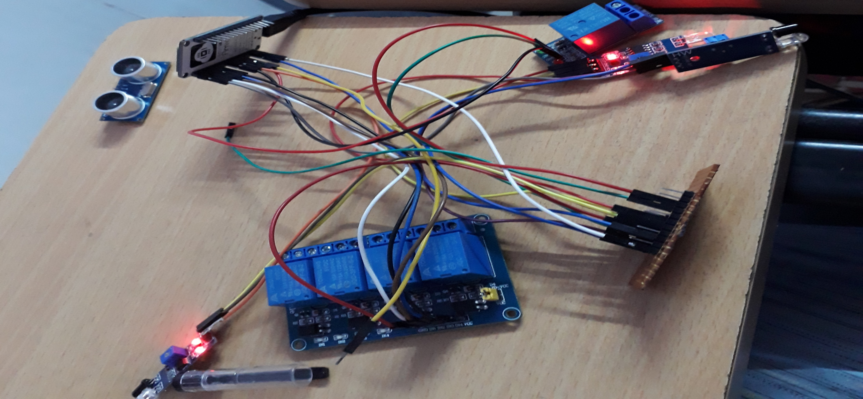
PROJECT
“Advanced Solar Panel Cleaning Bot using IoT”
Dept. of ISE, SVIT Internship / Professional practice work Presentation 16

Slide 17
REFLECTION NOTES
I thoroughly enjoyed my internship this summer and now have very valuable experience.
I know this will help when looking for jobs and needing references. I was dreading it in the beginning, but now I am so happy it was required.
As much as the curriculum changes, I hope that class remains constant.
Skills Utilized
Software Engineering Skills
Development of hardware Operation skills
Administrative and collaboration tools
Dept. of ISE, SVIT Internship / Professional practice work Presentation 17

Slide 18
REFERENCES
[1]. R. Howells, "The Business Case for IoT", June 2015, [online] Available: http://scn.sap.com/community/business-trends/blog/2015/06/18/the-business-case-for iot.
[2] D. Evans, "The Internet of Things: How the Next Evolution of the Internet Is Changing Everything",Apr.2011,[online]Available:www.cisco.com/web/about/ac79/docs/innov/IoT_IBSG_0411FINAL.pdf.
[3] Internet of Things: Architectures, Protocols, and Applications Journal of Electrical and Computer EngineeringVolume 2017, Article ID 9324035, 25 pages https://doi.org/10.1155/2017/9324035
Dept. of ISE, SVIT Internship / Professional practice work Presentation 18

Slide 19
THANK YOU
Dept. of ISE, SVIT Internship / Professional practice work Presentation 19

