Slide 1

SAI VIDYA INSTITUTE OF TECHNOLOGY
Department of Information Science and Engineering
Rajanukunte, Bengaluru - 560064
AN AGRI-PRODUCT TRACEABILITY SYSTEM BASED ON IOT AND BLOCKCHAIN TECHNOLOGY
By
Prathibha L 1VA16IS064
Under the guidance of
Prof. Mary M D’souza
Assistant Professor
Dept., of IS&E

Slide 2
Introduction
The quality, transportability of agricultural product has always been a social issue of concern to government.
Realizing the traceability of agricultural product can reduce the existence of fake and inferior commodities.
A simple scheme is,
Manually Record the product information.
Save them in a certain database.
Dept. of ISE, SVIT 2

Slide 3
Introduction
There are two problems in the above scheme,
Authenticity and credibility is low.
Easy to tamper and difficult to monitor.
By combining the Internet of Things (IoT) and blockchain technology, the above problems can be solved to some extent.
Dept. of ISE, SVIT 3

Slide 4
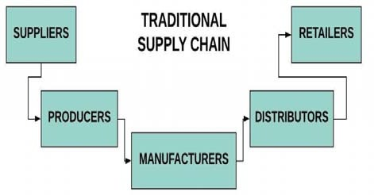
Related Work
Traditional Supply Chain
The Traditional supply chain process involves taking raw materials and making a physical product, then transferred to a consumer.
The traditional Supply Chain’s traceability is based on centralized systems IoT that provides no transparency and leads to security threats, tampering, data loss, etc.,
Also it consists of large amount of paper documents which may result in less efficiency during tracking and theft.
Dept. of ISE, SVIT 4

Slide 5
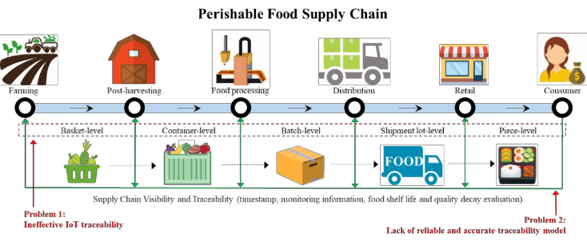
Related Work
Perishable food supply chain(PFSC)
PFSC involve a complex mixture of shippers and TRUs, such that a traceability tree is created to visualize the whole traceability process.
These were applicable tools for tracing, tracking, identifying, and monitoring the food to maintain its quality and safety through the supply chain.
To overcome the challenges, a blockchain–IoT-based food traceability system is proposed.
Dept. of ISE, SVIT 5

Slide 6
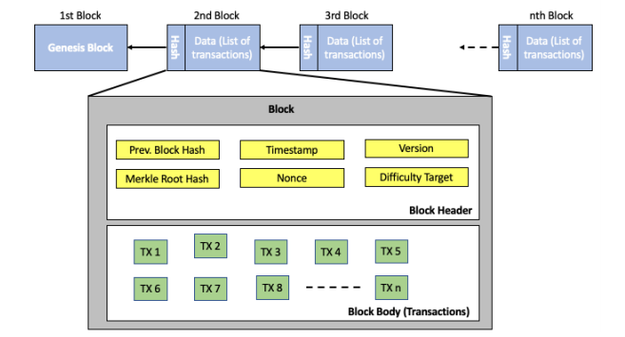
Blockchain
A blockchain is a digital encryption and recording of the history of transactions leading to the current asset state or value.
Blockchain technology which serves as a public ledger over a distributed network or all information maintenance including verification, validation etc.,
It mainly reduces transaction cost and also improves quality of the product.
The cryptographic method used here brings out trust among users which helps in demand for the product.
Dept. of ISE, SVIT 6

Slide 7
System Architecture
A hybrid approach is used to integrate IoT technologies, cloud computing, and blockchain.
A mobile app and a website serves as a platform for communication.
Now at each process involved in production, the organization present in the network scans the RFID and update the details using mobile app to the blocks which are stored in cloud.
So cloud also plays a major role in storing blocks. The verification, validation, transactions etc., all are done through the app or website.
Theoretically, identifying the source of a defective batch of asset is handled in seconds and a push notification can be sent to customers about the hazards.
Dept. of ISE, SVIT 7

Slide 8
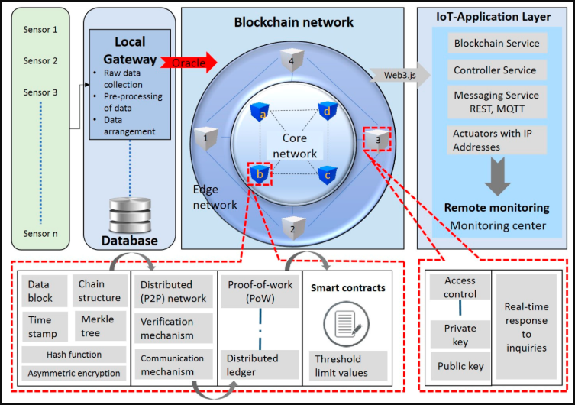
System Architecture
The Ethereum ecosystem follows Ethereum Request for Comments (ERC) feedback system among users.
The Provider-Consumer software assign private keys to execute the whole transaction process. To operate on different phones ERC-721 contracts are used. It also provide level of abstraction for IoT device and users.
Dept. of ISE, SVIT 8

Slide 9
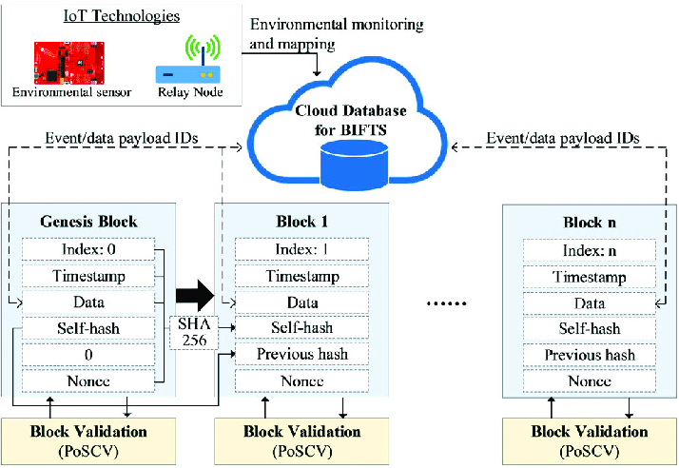
Blockchain Module
function [i, t] = forge(index, p_hash, timestamp, data)
Set value of difficulty Nzero;
Set process delay time tdelay;
Set number of iterations i ← 1;
Start of the stopwatch timer, tic;
for (idx from 0 to 232) do
nonce = uint32(idx);
[hash, uint8_sha256] = ft.Blockchain.calculate_hash(index, p_hash, timestamp, nonce, data);
if first Nzero bits of hash string, uint8_sha256, are equal to 0 then
break;
end if
Pause the process with tdelay;
i ← i+1;
end for
t ← end of the stopwatch timer, toc;
end function
Dept. of ISE, SVIT 9

Slide 10
Advantages
With the help of blockchain we can,
Increase Transparency
Reduce Error
Prevents product delays
Eliminate unethical and illegal activities
Better management
Increase the trust between consumer and supplier
Confidentiality, integrity and availability can be increased.
Dept. of ISE, SVIT 10

Slide 11
Disadvantages
Human factors cannot be neglected in implementation. Because blockchain has a feature that its data cannot be manipulated or tampered with, workers in the supply chain may create fake or incorrect data for food traceability.
The development of blockchain applications can only be successful if the collected data are accurate.
Honesty, integrity, and an open-mindedness to adopt the proposed system for all supply chain stakeholders may be a concern.
Moreover, because food traceability requires the capture of data from the whole supply chain process.
Dept. of ISE, SVIT 11

Slide 12
Applications
E-commerce platforms
Food Supply chain
Smart Agriculture
Agriculture Insurance
Tracking commodities
Dept. of ISE, SVIT 12

Slide 13
Conclusion
Food traceability has always been an important and critical function, which provides information covering the entire food life cycle.
Further, customers and supply chain stakeholders rely heavily on this information to make their decisions.
Due to the rapid development of e-commerce businesses, the perishable food e-commerce sector is one of the branches that promotes and sells perishable food in the online e-commerce platforms.
Dept. of ISE, SVIT 13

Slide 14
References
Y. P. Tsang, K. L. Choy, C. H. Wu, G. T. S. Ho and H. Y. Lam, "Blockchain-Driven IoT for Food Traceability With an Integrated Consensus Mechanism," in IEEE Access, vol. 7, pp. 129000-129017, 2019.
W. Hong, Y. Cai, Z. Yu and X. Yu, "An Agri-product Traceability System Based on IoT and Blockchain Technology," 2018 1st IEEE International Conference on Hot Information-Centric Networking (HotICN), Shenzhen, 2018, pp. 254-255.
“A supply chain traceability system for food safety based on HACCP, blockchain and Internet of Things,” in Proc. of the ICSSSM, 2017.
P. Olsen, and M. Borit, “The components of a food traceability system,” Trends Food Sci. Technol., vol. 77, pp. 143-149, Jul. 2018.
Dept. of ISE, SVIT 14

Slide 15

Dept. of ISE, SVIT 15

