Slide 1

EXPERIENTIAL LEARNING
TOPIC: SACHIN BANSAL
NAME | USN | EMAIL ID
PRATHICA SHETTY M | 1RV22CY046 | prathicasm.cy22@rvce.edu.in
SANTHOSH KUMAR L | 1RV22CY050 | santhoshkumarl.cy22@rvce.edu.in

Slide 2

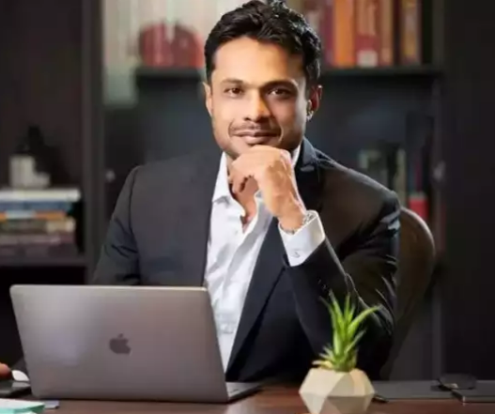

QUICK INTRODUCTION
Sachin Bansal is an Indian entrepreneur and software engineer, best known as the co-founder of Flipkart, India’s largest e-commerce platform.
He played a major role in revolutionizing online shopping in India and is often compared to global tech giants like Jeff Bezos.
Currently, he is the founder and CEO of Navi Technologies, a fintech company focused on providing affordable and accessible digital financial services to millions of Indians.

Slide 3
EDUCATION
Born on August 5, 1981, in Chandigarh, India.
His father was a businessman in a local sector, and his mother was a homemaker.
Known to be studious and curious, Sachin had a deep interest in computers and programming from a young age.
He cleared the IIT-JEE with an AIR of 49 and got into IIT Delhi, where he pursued Computer Science Engineering.

Slide 4
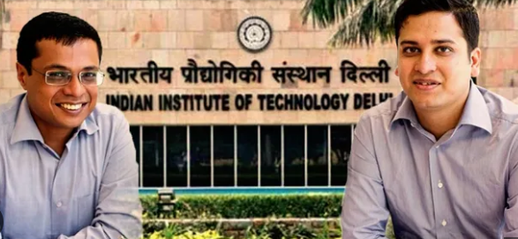
EARLY CAREER
After graduation, he worked briefly at Techspan, and later joined Amazon India as a software engineer.
At Amazon, he realized the gap in India’s online retail sector—poor logistics, limited reach, and lack of trust in online payments.
He often discussed startup ideas with his college junior and Amazon colleague, Binny Bansal.
In 2007, they quit their high-paying jobs to start Flipkart, focused initially on selling books online.

Slide 5
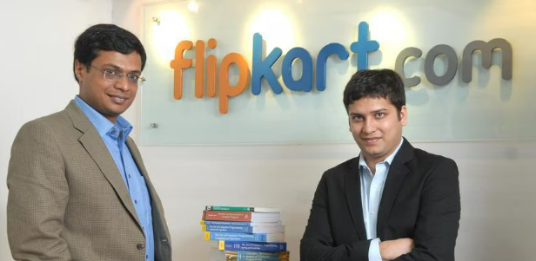
RISE OF FLIPKART
In October 2007, Bansal and his co-founder, Binny Bansal, started an online bookstore, Flipkart, with an initial capital of ₹4,00,000
They first started operating out of an 2BHK apartment in Koramangala, in Bangalore, India.
Their first customer was acquired through a blog post, and they personally delivered the order!
From inception until 2016, Bansal held the position of Chief Executive Officer and from 2016 until 2018, he held the position of Executive Chairman.

Slide 6

RISE OF FLIPKART
They realized the importance of logistics early on and built an in-house delivery network “Ekart” — for a faster, more reliable and controlled deliveries which was a big reason for their success.
They also pioneered the concept of building an in-house logistics network (Ekart), inspiring future Indian startups like Swiggy, Myntra, Zomato, and other e-commerce and quick commerce companies to develop their own delivery infrastructure.
Introduced Cash-on-Delivery (COD) — which solved trust issues and transformed Indian e-commerce.
Between 2009-2016, Flipkart expanded into electronics, fashion (via Myntra), home products, etc. At its peak, Flipkart had over 100 million registered users.

Slide 7
BUSINESS MODEL
Flipkart followed a marketplace model — connecting millions of customers with third-party sellers.
1. Online Marketplace: Acts as a platform for sellers to list products and connect with millions of Indian consumers.
2. Commission-Based Revenue: Earns a percentage commission on each product sold, varying by category and seller performance.
3. Logistics & Fulfilment (Ekart): Provides end-to-end logistics, including packaging, warehousing, and last-mile delivery, for a service fee.
4. Advertising Revenue: Generates income from sponsored listings, banner ads, and promotional placements by sellers and brands.
5. Subscription-Based Services (Flipkart Plus): Loyalty program offering perks like free delivery and early sale access; revenue from subscriptions and exclusive partnerships.
6. Financial Services: Offers loans, insurance, and invoice financing to sellers via Flipkart Financial Services; earns through interest and service charges.

Slide 8
BEYOND FLIPKART
In 2018, Sachin Bansal sold his share in Flipkart to Walmart for about $1 billion, marking one of the biggest startup exits in India.
After that, he started a new company called Navi Technologies to make financial services like loans, insurance, and mutual funds easier and more affordable.
Just like Flipkart made online shopping simple, Navi uses technology to make money-related services simple for everyday people.
Navi has already given out loans worth thousands of crores and is now getting ready to launch an IPO (Initial Public Offering).
Along with running Navi, Sachin also invests in other startups and supports India’s fast-growing fintech industry.
His current net worth is over $1.2 billion, making him one of the richest and most influential entrepreneurs in the country.

Slide 9

BUSINESS MODEL AND REVENUE
Digital-First Fintech Platform
Navi offers personal loans, home loans, health insurance, and mutual funds via a seamless mobile app experience.
Business Model
Lending: Earns interest from personal and home loans.
Insurance: Revenue from premiums and renewals via Navi General Insurance.
Investments: Asset management fees from mutual funds (Navi AMC).
Cross-Selling: Promotes bundled financial products in-app.
Revenue Snapshot (FY23)
Total Revenue: ₹1,189 crore
Net Profit: ₹173 crore – Navi’s first profitable year
Major Revenue Source: Lending vertical (Chaitanya/Navi FinServ)

Slide 10



SACHIN BANSAL’S NOTABLE INVESTMENTS
After exiting Flipkart, Sachin Bansal invested over $100 million+ of his own capital into various sectors through Navi and other ventures:
1. Navi Technologies (Founder & Investor)
Invested ₹4,000 crore of his own capital to build a full-stack fintech company.
2. Ather Energy (Electric Vehicles)
Invested $32 million in the EV startup building smart electric scooters.
3. Vogo (Bike Rental Startup)
Invested in this mobility startup offering two-wheeler rentals.
4. boAt (Consumer Electronics – Headphones, Wearables)
Indirect investment via venture funds he backs.
5. Other Sectors
Focused on tech-first startups in EVs, fintech, logistics, and education.

Slide 11
REASON BEHIND HIS SUCCESS
Technical Brilliance: Deep knowledge of coding and system architecture helped build a scalable platform.
Visionary Thinking: Saw e-commerce potential in India when no one else believed in it.
Risk-Taking Ability: Left a safe job at Amazon to build something from scratch.
Resilience: Faced funding challenges, competition, and criticism — but stayed focused.
Customer First Mindset: Everything Flipkart did was to make shopping easier for users.

Slide 12
CHALLENGES FACED
Flipkart faced intense competition from Amazon, which re-entered India in 2013.
Rapid scaling led to huge operational losses.
Internal challenges and investor pressure led Sachin to step down as CEO in 2016.
In 2018, Walmart acquired 77% of Flipkart for $16 billion, but Sachin had to exit the company entirely — a move that shocked many.
Even after this, Sachin didn’t stop — he quietly began his next venture.

Slide 13
LESSONS FROM SACHIN BANSAL
Start small, dream big: Flipkart started in a small room and became a unicorn.
Solve real problems: His focus was always on customer pain points — trust, delivery, ease.
Be willing to pivot: From books to electronics to fashion — always adapted to the market.
Don’t stop at success: Left Flipkart, but didn’t stop innovating — Navi proves that.
Invest back into the ecosystem: He is now helping others succeed.

Slide 14
Thank You!!

